Slide 1
Recent Advances in Scalable Retrieval of Personalized Recommendations
A Tutorial
Dung D. Le
Singapore Management University
ddle.2015@smu.edu.sg
Hady W. Lauw
Singapore Management University
hadywlauw@smu.edu.sg
Slides available at
https://code.preferred.ai/recommendation-retrieval
Notes:
Cover Slide with Image

Slide 2












Motivation: Success of MF RecSys

Slide 3
Outline
Part I: MF Recommendation Retrieval as Similarity Search Problem
Part II: Approaches for Scalable Recommendation Retrieval
Part III: Hands-on Session

Slide 4
Outline
MF Recommendation Retrieval as Similarity Search Problem (Duration: 45 mins)
Two phases of a MF Recommender System
Linear Scanning is not Scalable for Real-time Applications
Approaches for Scalable Recommendation Retrieval (Duration: 105 mins)
Approximate Maximum Inner Product Search
Indexable Representations
Discrete Representations
Hands-on Session (Duration: 60 mins)
Scalable Retrieval via Indexing Structures
Indexable Representation Learning

Slide 5
Part I:
MF Recommendation Retrieval as Similarity Search Problem

Slide 6















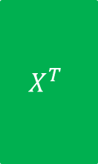










Two Phases of a MF Recommender System
$$n$$
$$d$$
$$n$$
$$R$$
$$X^{T}$$
$$Y$$
Learning
phase
$$m$$
$$≈$$
$$m$$
$$×$$
$$d$$
$$n$$
$$pref_{u}\left(i\right)=x_{u}^{T}{.y}_{i}$$
$$d$$
$$Y$$
$$n$$
$$×$$
$$d$$
$$=$$
$$pref_{u}$$
$$1$$
$$x_{u}$$
$$1$$
Retrieval
phase
$$n$$
Top-K items
$$1$$
Sorted $pref_{u}$

Slide 7






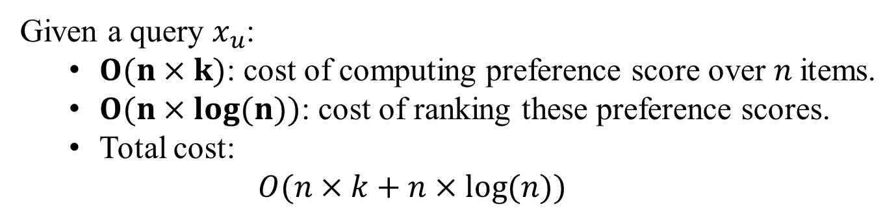









Linear Scanning is Not Scalable
$$n$$
$$pref_{u}\left(i\right)=x_{u}^{T}{.y}_{i}$$
$$d$$
$$Y$$
$$n$$
$$×$$
$$d$$
$$=$$
$$pref_{u}$$
$$1$$
$$x_{u}$$
$$1$$
Retrieval
phase
$$n$$
Top-K items
$$1$$
Sorted $pref_{u}$
Given a query $x_{u}$:
$O(n×k)$: cost of computing preference score over $n$items.
$O(n×\log{(n)})$: cost of ranking these preference scores.
Total cost:
$O(n×k+n×\log{(n)})$

Slide 8
Part II:
Approaches for Scalable Recommendation Retrieval

Slide 9
A Categorization of Approaches
Approximate Maximum Inner Product Search
Indexable Representations
Discrete Representations

Slide 10
1. Approximate Maximum Inner Product Search

Slide 11
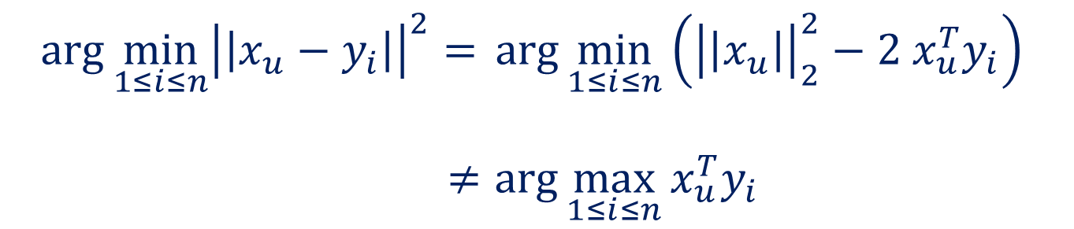
Maximum Inner Product Search?
(MIPS) Given a query $x_{u}$, determine the index $i$:
$$i=\arg{\max_{1≤i≤n}{x_{u}^{T}y_{i}}}$$
MIPS is not the same as classical NNS
$$\arg{\min_{1≤i≤n}{{\left|\left|x_{u}−y_{i}\right|\right|}^{2}}= }\arg{\min_{1≤i≤n}\left({\left|\left|x_{u}\right|\right|}_{2}^{2}−2 x_{u}^{T}y_{i}\right) }$$
$≠\arg{\max_{1≤i≤n}{x_{u}^{T}y_{i}}}$

Slide 12


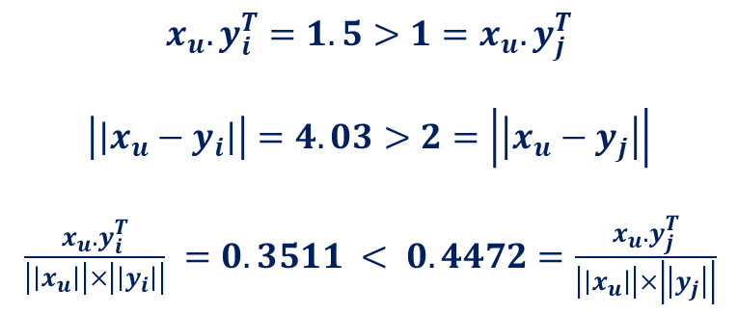

Maximum Inner Product Search
$$y_{i}=(4, 1.5)$$
$$x_{u}.y_{i}^{T}=1.5>1=x_{u}.y_{j}^{T}$$
$$\left|\left|x_{u}−y_{i}\right|\right|=4.03>2=\left|\left|x_{u}−y_{j}\right|\right|$$
$\frac{x_{u}.y_{i}^{T}}{\left|\left|x_{u}\right|\right|×\left|\left|y_{i}\right|\right|} =0.3511 < 0.4472=\frac{x_{u}.y_{j}^{T}}{\left|\left|x_{u}\right|\right|×\left|\left|y_{j}\right|\right|}$
$$x_{u}=(0, 1)$$
$$y_{j}=(2, 1)$$
This picture is taken from (*)
MIPS is not the same as classical NNS
(*) Le, D. D., & Lauw, H. W. (2017, November). Indexable Bayesian personalized ranking for efficient top-k recommendation. In Proceedings of the 2017 ACM on Conference on Information and Knowledge Management (pp. 1389-1398). ACM.

Slide 13
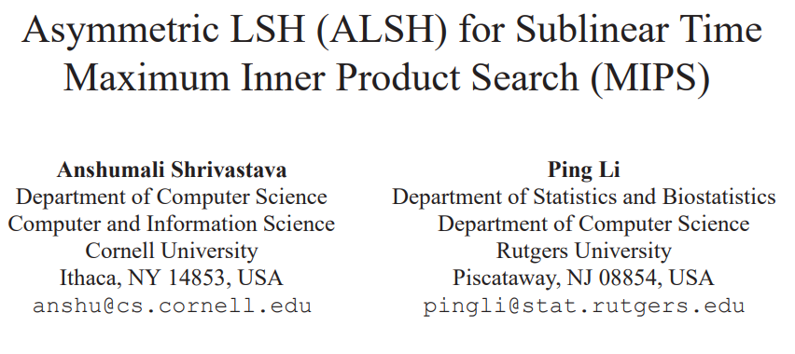
Idea 1: Asymmetric LSH for MIPS

Slide 14
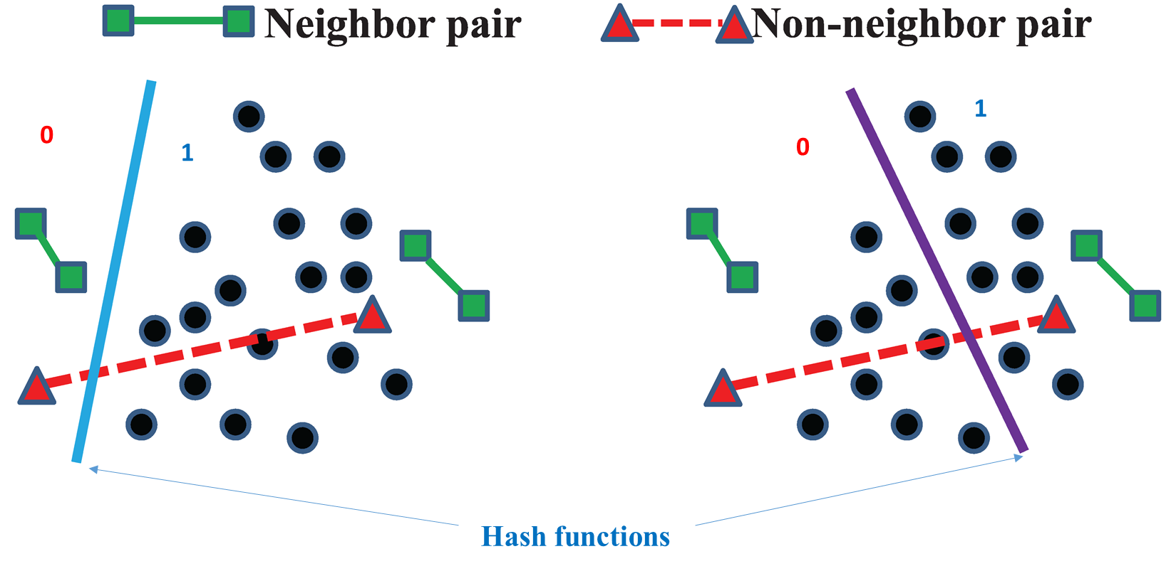
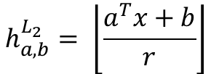

Inspired from LSH for NNS
$$h_{a,b}^{L_{2}}= \left\lfloor \frac{a^{T}x+b}{r}\right\rfloor$$
$$a_{i}∼N\left(0, 1\right)$$
$$b∼U\left(0, r\right)$$

Slide 15
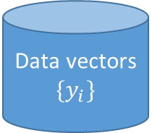



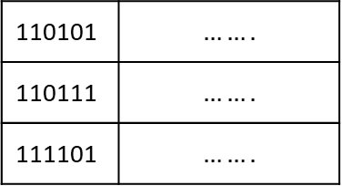

LSH for NNS
Data vectors
$$\{y_{i}\}$$
$$x_{u}$$
Hash Functions
$b−$ code size
$$C_{u}$$
$$x_{u}$$
110101 | $$…….$$
110111 | $$…….$$
111101 | $$…….$$
…
Top-K
Hash Table

Slide 16
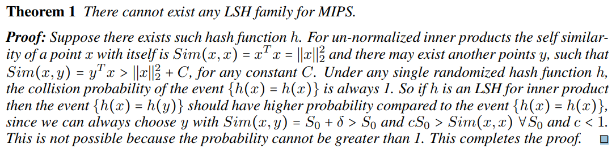
LSH for MIPS?

Slide 17













Idea: Vector Augmentation
$$n$$
$$d$$
$$n$$
$$R$$
$$X^{T}$$
$$Y$$
Learning
phase
$$m$$
$$≈$$
$$m$$
$$×$$
$$d$$
Pre-Processing
$$\left|\left|y_{i}\right|\right|<1, ∀y_{i}∈Y$$
$$Q\left(x_{u}\right)=\left[x_{u},\frac{1}{2},\frac{1}{2}, ….,\frac{1}{2}\right]$$
$$P\left(y_{i}\right)=\left[y_{i},{\left|\left|y_{i}\right|\right|}^{2},{\left|\left|y_{i}\right|\right|}^{4}, ….,{\left|\left|y_{i}\right|\right|}^{2^{m}}\right]$$
Reducing MIPS to NNS
$${\left|\left|Q\left(x_{u}\right)−P\left(y_{i}\right)\right|\right|}^{2} =\left({\left|\left|x_{u}\right|\right|}^{2}+\frac{m}{4}\right)−2x_{u}^{T}y_{i}+{\left|\left|y_{i}\right|\right|}^{2^{m}}$$
$$\arg{\min_{1≤i≤n }{x_{u}^{T}y_{i}∼\arg{\min_{1≤i≤n }\left|\left|Q\left(x_{u}\right)−P\left(y_{i}\right)\right|\right|}}}$$
Shrivastava, A., & Li, P. (2014). Asymmetric LSH (ALSH) for sublinear time maximum inner product search (MIPS). In Advances in Neural Information Processing Systems (pp. 2321-2329).

Slide 18


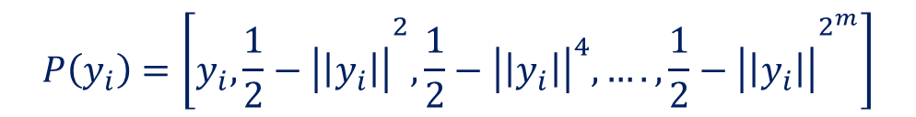









Idea: Vector Augmentation
$$d$$
$$n$$
$$R$$
$$X^{T}$$
$$Y$$
Learning
phase
$$m$$
$$≈$$
$$m$$
$$×$$
$$d$$
Pre-Processing
$$\left|\left|y_{i}\right|\right|<1, ∀y_{i}∈Y$$
$$Q\left(x_{u}\right)=\left[x_{u},0, 0, ….,0\right]$$
$$P\left(y_{i}\right)=\left[y_{i},{\frac{1}{2}−\left|\left|y_{i}\right|\right|}^{2},\frac{1}{2}−{\left|\left|y_{i}\right|\right|}^{4}, ….,{\frac{1}{2}−\left|\left|y_{i}\right|\right|}^{2^{m}}\right]$$
Reducing MIPS to MCSS
$$\arg{\min_{1≤i≤n }{x_{u}^{T}y_{i}∼\arg{\max_{1≤i≤n }{\frac{Q{\left(x_{u}\right)}^{T}P\left(y_{i}\right)}{\left|\left|Q\left(x_{u}\right)\right|\right|.\left|\left|P\left(y_{i}\right)\right|\right|}}}}}$$
Shrivastava, A., & Li, P. (2015). Improved Asymmetric Locality Sensitive Hashing (ALSH) for Maximum Inner Product Search (MIPS). UAI.

Slide 19


Idea: Vector Augmentation
$$d$$
$$n$$
$$R$$
$$X^{T}$$
$$Y$$
Learning
phase
$$m$$
$$≈$$
$$m$$
$$×$$
$$d$$
Pre-Processing
$$\left|\left|y_{i}\right|\right|≤M, ∀y_{i}∈Y$$
$$Q\left(x_{u}\right)=\left[x_{u},0\right]$$
$$P\left(y_{i}\right)=\left[y_{i},\sqrt{M^{2}−{\left|\left|y_{i}\right|\right|}^{2}}\right]$$
Reducing MIPS to NNS/MCSS
$$\arg{\max_{1≤i≤n }{x_{u}^{T}y_{i}=\arg{\min_{1≤i≤n }\left|\left|Q\left(x_{u}\right)−P\left(y_{i}\right)\right|\right|= \arg{\max_{1≤i≤n }{\frac{Q{\left(x_{u}\right)}^{T}P\left(y_{i}\right)}{\left|\left|Q\left(x_{u}\right)\right|\right|.\left|\left|P\left(y_{i}\right)\right|\right|}}}}}}$$
[1] Neyshabur, B., & Srebro, N. (2015). On Symmetric and Asymmetric LSHs for Inner Product Search. ICML.
[2]. Bachrach, Y., Finkelstein, Y., Gilad-Bachrach, R., Katzir, L., Koenigstein, N., Nice, N., & Paquet, U. (2014).
Speeding up the Xbox recommender system using a euclidean transformation for inner-product spaces. RecSys.

Slide 20
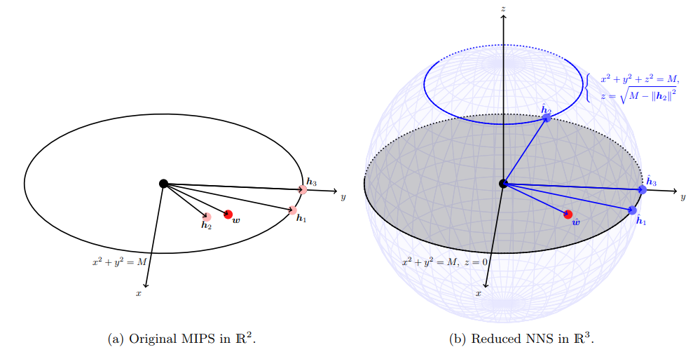











Idea: Vector Augmentation
$$M$$
$${Q(y}_{1})$$
$$M$$
$$y_{3}$$
$${Q(y}_{3})$$
$$x_{u}$$
$$y_{2}$$
$$P(x_{u})$$
$${Q(y}_{2})$$
$$y_{1}$$
$$M$$
$$M$$
An illustration of vector augmentation approach in $2$-d space
(This picture is taken from (*))
(*) Yu, H., Hsieh, C., Lei, Q., & Dhillon, I.S. (2017). A Greedy Approach for Budgeted Maximum Inner Product Search. NIPS.

Slide 21
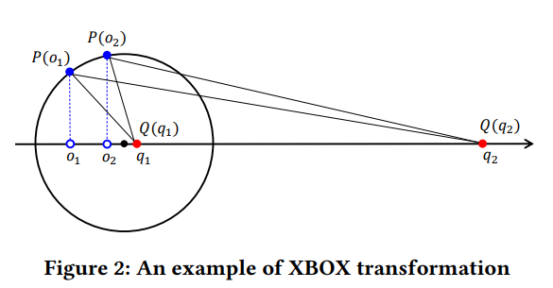
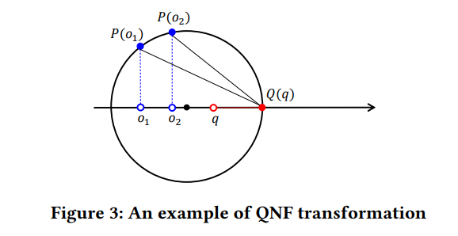



A Better Augmentation
$$P\left(y_{i}\right)=\left[y_{i},\sqrt{M^{2}−{\left|\left|y_{i}\right|\right|}^{2}}\right]$$
$$Q\left(x_{u}\right)=\left[x_{u},0\right]$$
X-box Transformation
$$P\left(y_{i}\right)=\left[y_{i},\sqrt{M^{2}−{\left|\left|y_{i}\right|\right|}^{2}}\right]$$
$$Q\left(x_{u}\right)=\left[{λx}_{u},0\right], λ=\frac{M}{\left|\left|x_{u}\right|\right|}$$
QNF Transformation
Huang, Q., Ma, G., Feng, J., Fang, Q., & Tung, A.K. (2018). Accurate and Fast Asymmetric Locality-Sensitive Hashing Scheme for Maximum Inner Product Search. KDD.

Slide 22
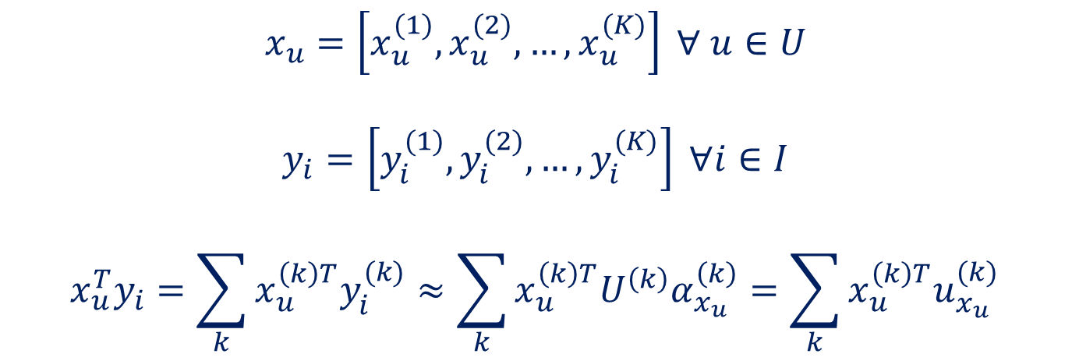
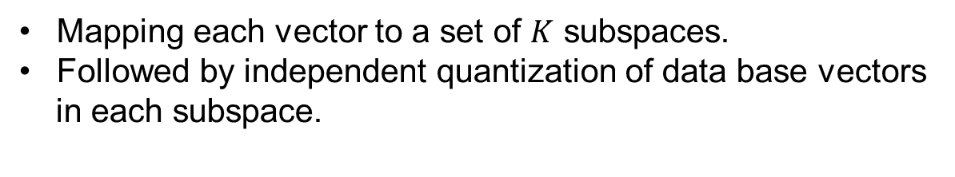
Idea: Quantization-based
Mapping each vector to a set of $K$ subspaces.
Followed by independent quantization of data base vectors
in each subspace.
$$x_{u}=\left[x_{u}^{(1)},x_{u}^{(2)}, …,x_{u}^{(K)}\right] ∀ u∈U$$
$$y_{i}=\left[y_{i}^{(1)},y_{i}^{(2)}, …,y_{i}^{(K)}\right] ∀i∈I$$
$$x_{u}^{T}y_{i}=\sum_{k}{x_{u}^{\left(k\right)T}y_{i}^{(k)}}≈\sum_{k}{x_{u}^{\left(k\right)T}U^{\left(k\right)}α_{x_{u}}^{\left(k\right)}}=\sum_{k}{x_{u}^{\left(k\right)T}u_{x_{u}}^{(k)}}$$
Guo, R., Kumar, S., Choromanski, K., & Simcha, D. (2016, May). Quantization based fast inner product search. In Artificial Intelligence and Statistics (pp. 482-490).

Slide 23
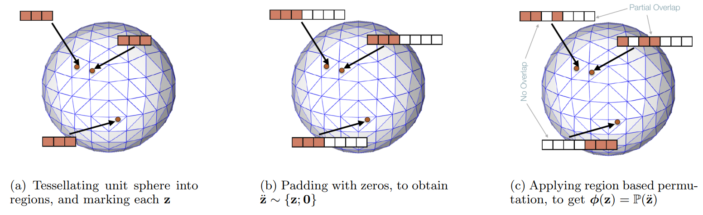
Idea: Sparsity Mapping
(This picture is taken from (*))
(*) Bhowmik, A., Liu, N., Zhong, E., Bhaskar, B.N., & Rajan, S. (2016). Geometry Aware Mappings for High Dimensional Sparse Factors. AISTATS.

Slide 24
Idea: Sparsity Mapping
(This picture is taken from (*))
(*) Bhowmik, A., Liu, N., Zhong, E., Bhaskar, B.N., & Rajan, S. (2016). Geometry Aware Mappings for High Dimensional Sparse Factors. AISTATS.

Slide 25
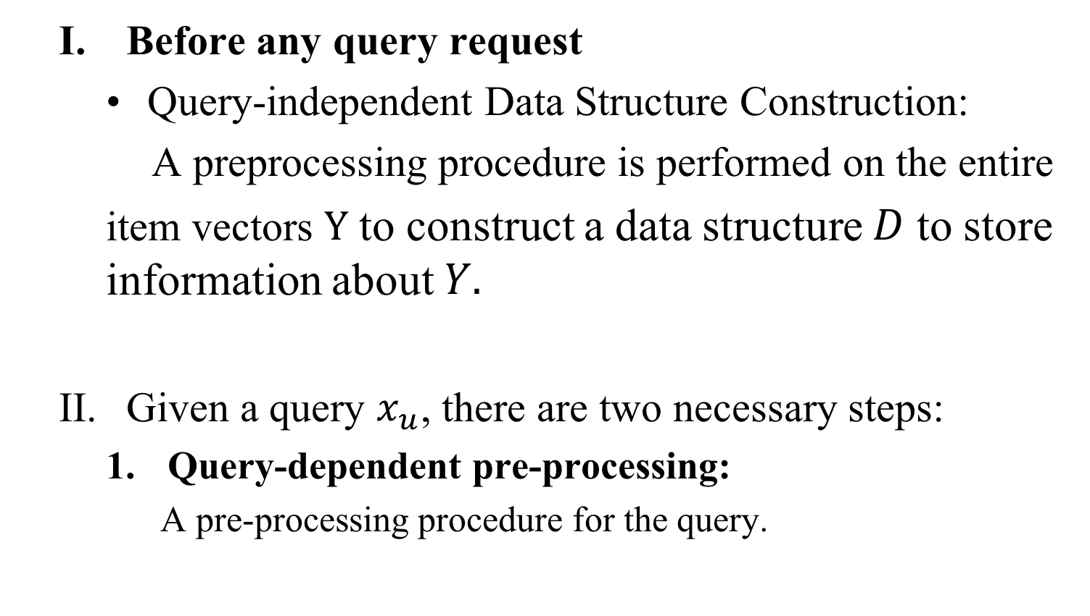
A Framework for an Efficient MIPS
Before any query request
Query-independent Data Structure Construction:
A preprocessing procedure is performed on the entire
item vectors $Y$ to construct a data structure $D$ to store information about $Y.$
Given a query $x_{u}$, there are two necessary steps:
Query-dependent pre-processing:
A pre-processing procedure for the query.

Slide 26
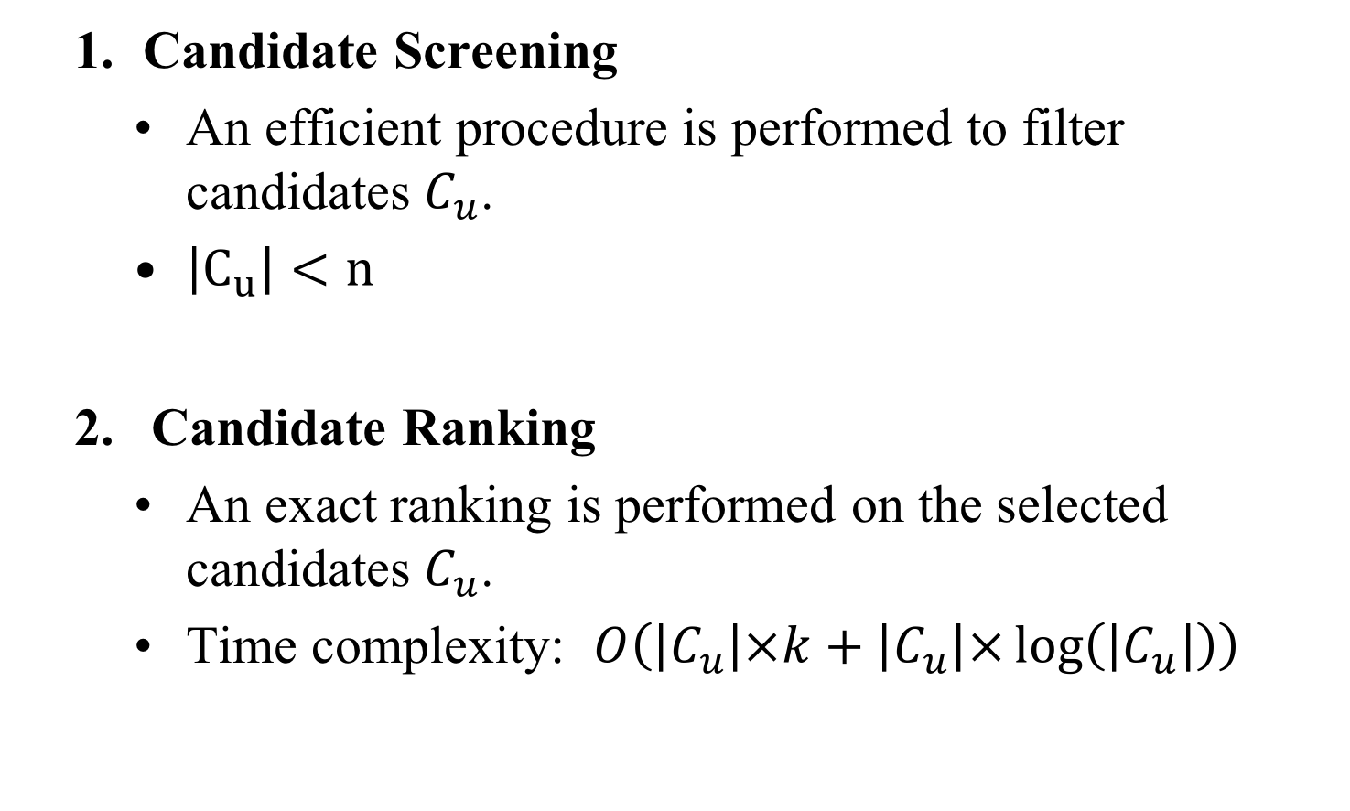
Essential Components for a Fast MIPS
Candidate Screening
An efficient procedure is performed to filter candidates $C_{u}$.
$\left|C_{u}\right|<n$
Candidate Ranking
An exact ranking is performed on the selected candidates $C_{u}$.
Time complexity: $O\left(\left|C_{u}\right|×k+\left|C_{u}\right|×\log\left(\left|C_{u}\right|\right)\right)$

Slide 27
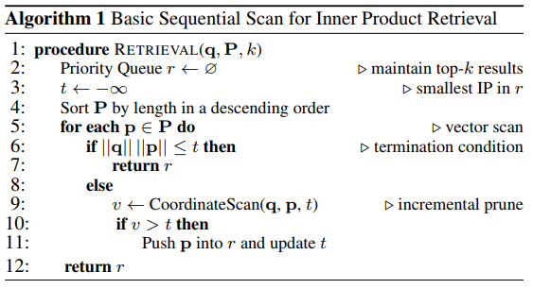
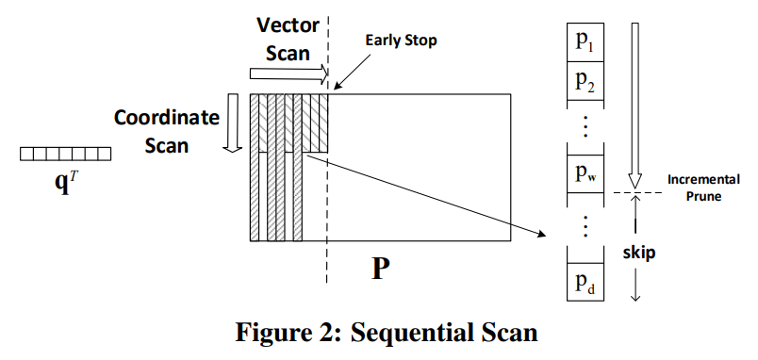
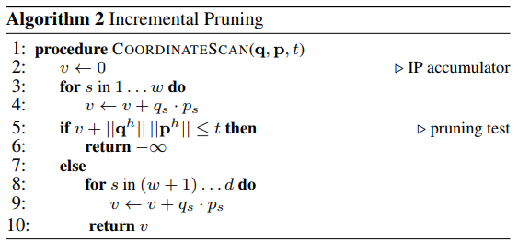

Idea: Sequential Scanning with Upper-Bound
$$q^{T}p≤\left|\left|q\right|\right|.\left|\left|p\right|\right|$$
Cauchy-Schwarz inequality
[1] Teflioudi, C., Gemulla, R., & Mykytiuk, O. (2015). LEMP: Fast Retrieval of Large Entries in a Matrix Product. SIGMOD Conference.
[2] Li, H., Chan, T.N., Yiu, M.L., & Mamoulis, N. (2017). FEXIPRO: Fast and Exact Inner Product Retrieval in Recommender Systems. SIGMOD Conference.

Slide 28
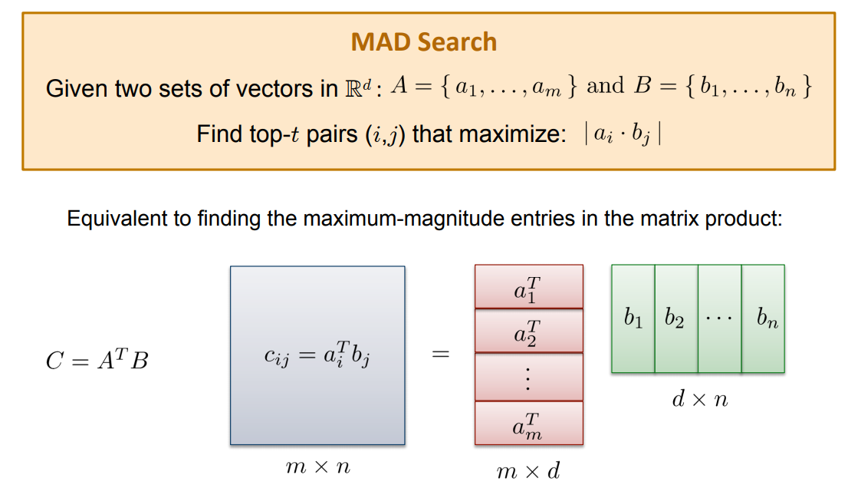
Idea: Sampling

Slide 29
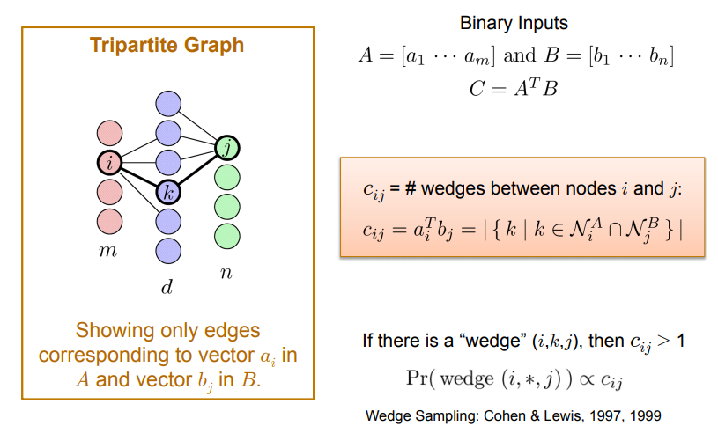
Idea: Sampling

Slide 30
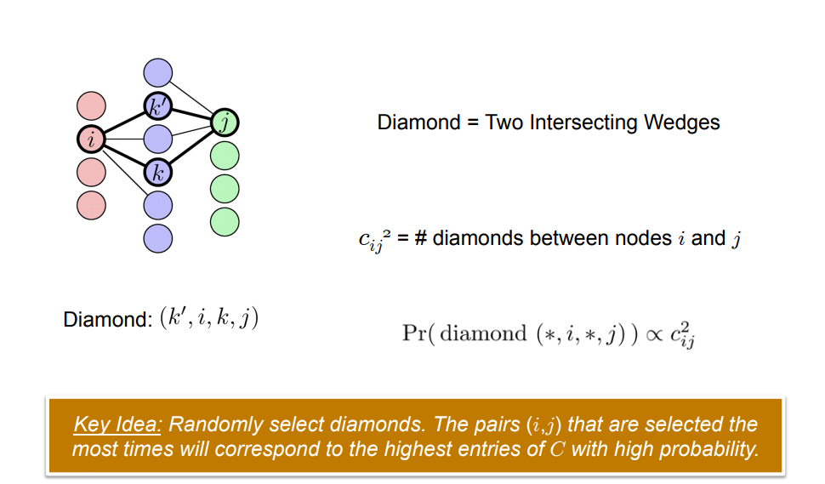
Idea: Sampling

Slide 31
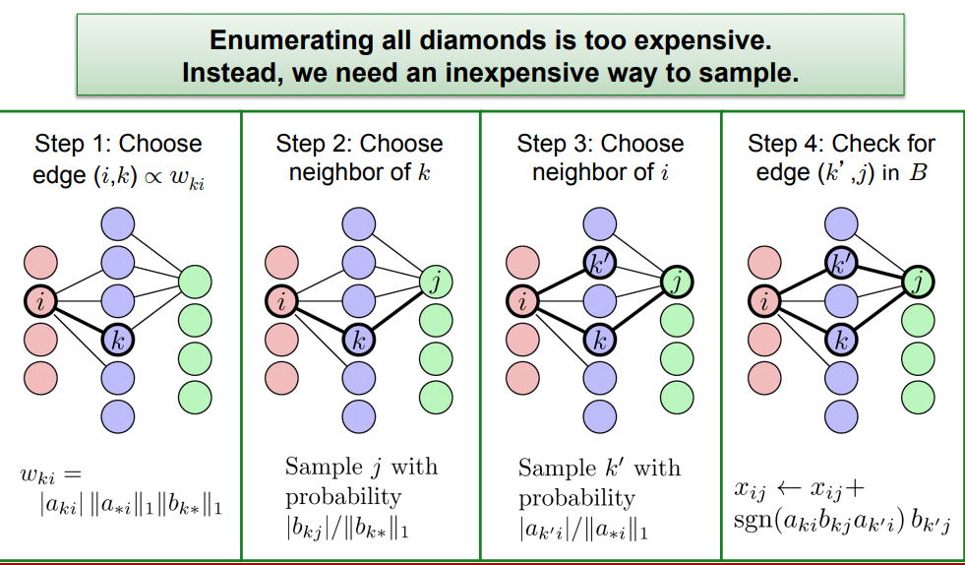
Idea: Sampling

Slide 32
2. Indexable Representation

Slide 33
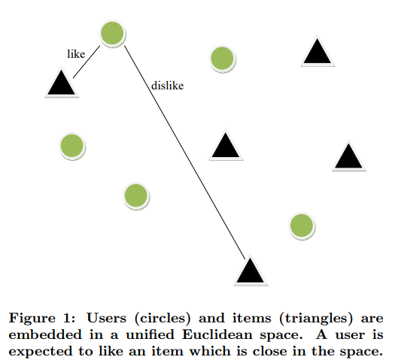
Euclidean Embedding
(This picture is taken from [2])
[1] Le, D. D., & Lauw, H. W. (2016, June). Euclidean co-embedding of ordinal data for multi-type visualization. In Proceedings of the 2016 SIAM International Conference on Data Mining (pp. 396-404). Society for Industrial and Applied Mathematics.
[2] Khoshneshin, M., & Street, W. N. (2010, September). Collaborative filtering via euclidean embedding. In Proceedings of the fourth ACM conference on Recommender systems (pp. 87-94). ACM.

Slide 34
Euclidean Embedding
Point-wise:
Pair-wise:
[1] Le, D. D., & Lauw, H. W. (2016, June). Euclidean co-embedding of ordinal data for multi-type visualization. In Proceedings of the 2016 SIAM International Conference on Data Mining (pp. 396-404). Society for Industrial and Applied Mathematics.
[2] Khoshneshin, M., & Street, W. N. (2010, September). Collaborative filtering via euclidean embedding. In Proceedings of the fourth ACM conference on Recommender systems (pp. 87-94). ACM.

Slide 35
Indexable Representation
[1] Fraccaro, M., Paquet, U., & Winther, O. (2016, February). Indexable Probabilistic Matrix Factorization for Maximum Inner Product Search. In AAAI (pp. 1554-1560).
[2] Le, D. D., & Lauw, H. W. (2017, November). Indexable Bayesian personalized ranking for efficient top-k recommendation. In Proceedings of the 2017 ACM on Conference on Information and Knowledge Management (pp. 1389-1398). ACM.

Slide 36
3. Discrete Representations

Slide 37
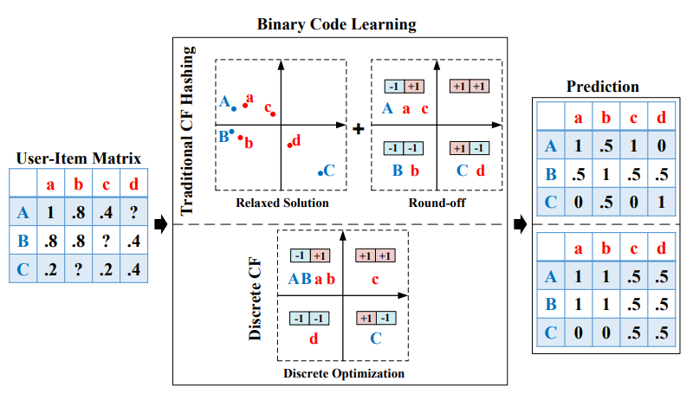
Discrete Collaborative Filtering
Zhang, H., Shen, F., Liu, W., He, X., Luan, H., & Chua, T. S. (2016, July). Discrete collaborative filtering. In Proceedings of the 39th International ACM SIGIR conference on Research and Development in Information Retrieval (pp. 325-334). ACM.

Slide 38
Discrete Personalized Ranking
Zhang, H., Shen, F., Liu, W., He, X., Luan, H., & Chua, T. S. (2016, July). Discrete collaborative filtering. In Proceedings of the 39th International ACM SIGIR conference on Research and Development in Information Retrieval (pp. 325-334). ACM.

Slide 39
Part III:
Hands-on Session

Slide 40


THANK YOU
Notes:
Cover Slide with Image

