Slide 1
Tom Anderson
The Founder of Myspace.com
By: Elisa Fenkner

Slide 2
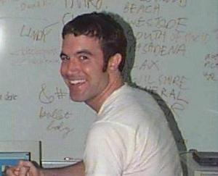
Biography
Tom Anderson: (born October 13, 1975) is the President of the social networking website MySpace.com. He founded the site along with CEO Chris DeWolfe. Since newly created MySpace accounts include Tom as a default "friend," he has become known as the face of MySpace. Anderson attended University of California, Berkeley from 1994 to 1998, and graduated in 1998 with a Bachelor of Arts in Rhetoric and English. From 1999 to 2000, he attended University of California, Los Angeles and graduated with a master's degree in film - critical studies. In 2003, he and a few computer programmers set up the first pages of MySpace, and the site grew from there. It is currently the most popular social networking website on the Internet.

Slide 3
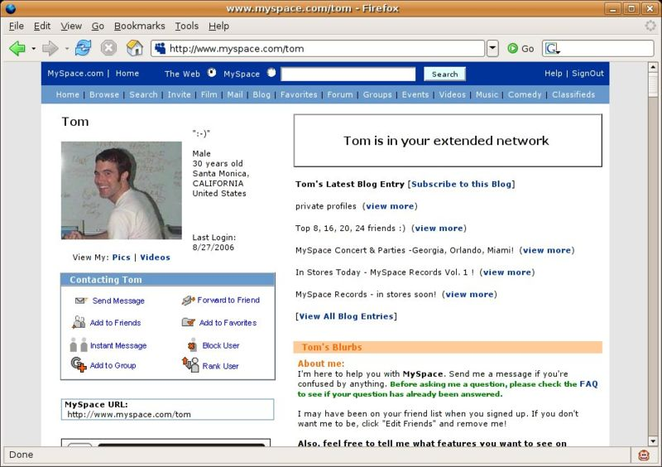
Myspace.com
Myspace.com is a networking website offering interaction with other people from different parts of the world.

Slide 4
Contents
Myspace.com includes such things as:
  A place to put information about yourself, such as your interests and details.
  A upload for pictures of yourself and friends.
  A list of your friends.
  A place to put bulletins of information out to your friends added onto your page.
  A page for groups of people who have the same interests.

Slide 5
Profile customization
Myspace.com allows their users to modify their page to their interests and standards. HTML/XHTML and CSS can be used to change the majority of the profile to the user's preference. Users also have the option to add embedded music into their profiles from MySpace Music, a service that allows bands to post songs onto their individual profiles. Videos, flash-based content, and almost anything else can be added, much like a standard HTML page.

Slide 6
Music & Movies
Myspace Music:
    Is where artists could display music onto their myspace page and show tour dates and new material. Gaining new fans and a wide range of audiences.
    Myspace Videos:
    Myspace.com was competing with many different websites, but Youtube.com was a ranking at number one. So Myspace.com decided to start their own viral video site, which blocks youtube from having the same videos.

Slide 7
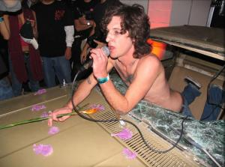
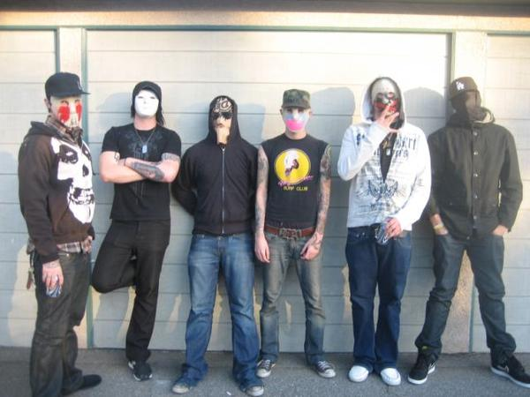
Myspace Records
In 2005, Myspace Music had such success that they started their own record company with Interscope records. They helped such bands as Mickey Avalon and Hollywood Undead to where they are now.

Slide 8
Why Tom Anderson was so successful…
I think the only reason Tom Anderson was successful is because he didn’t give up on his dreams. Myspace.com became so popular because it gave a chance for people to interact with each other.

