Slide 1
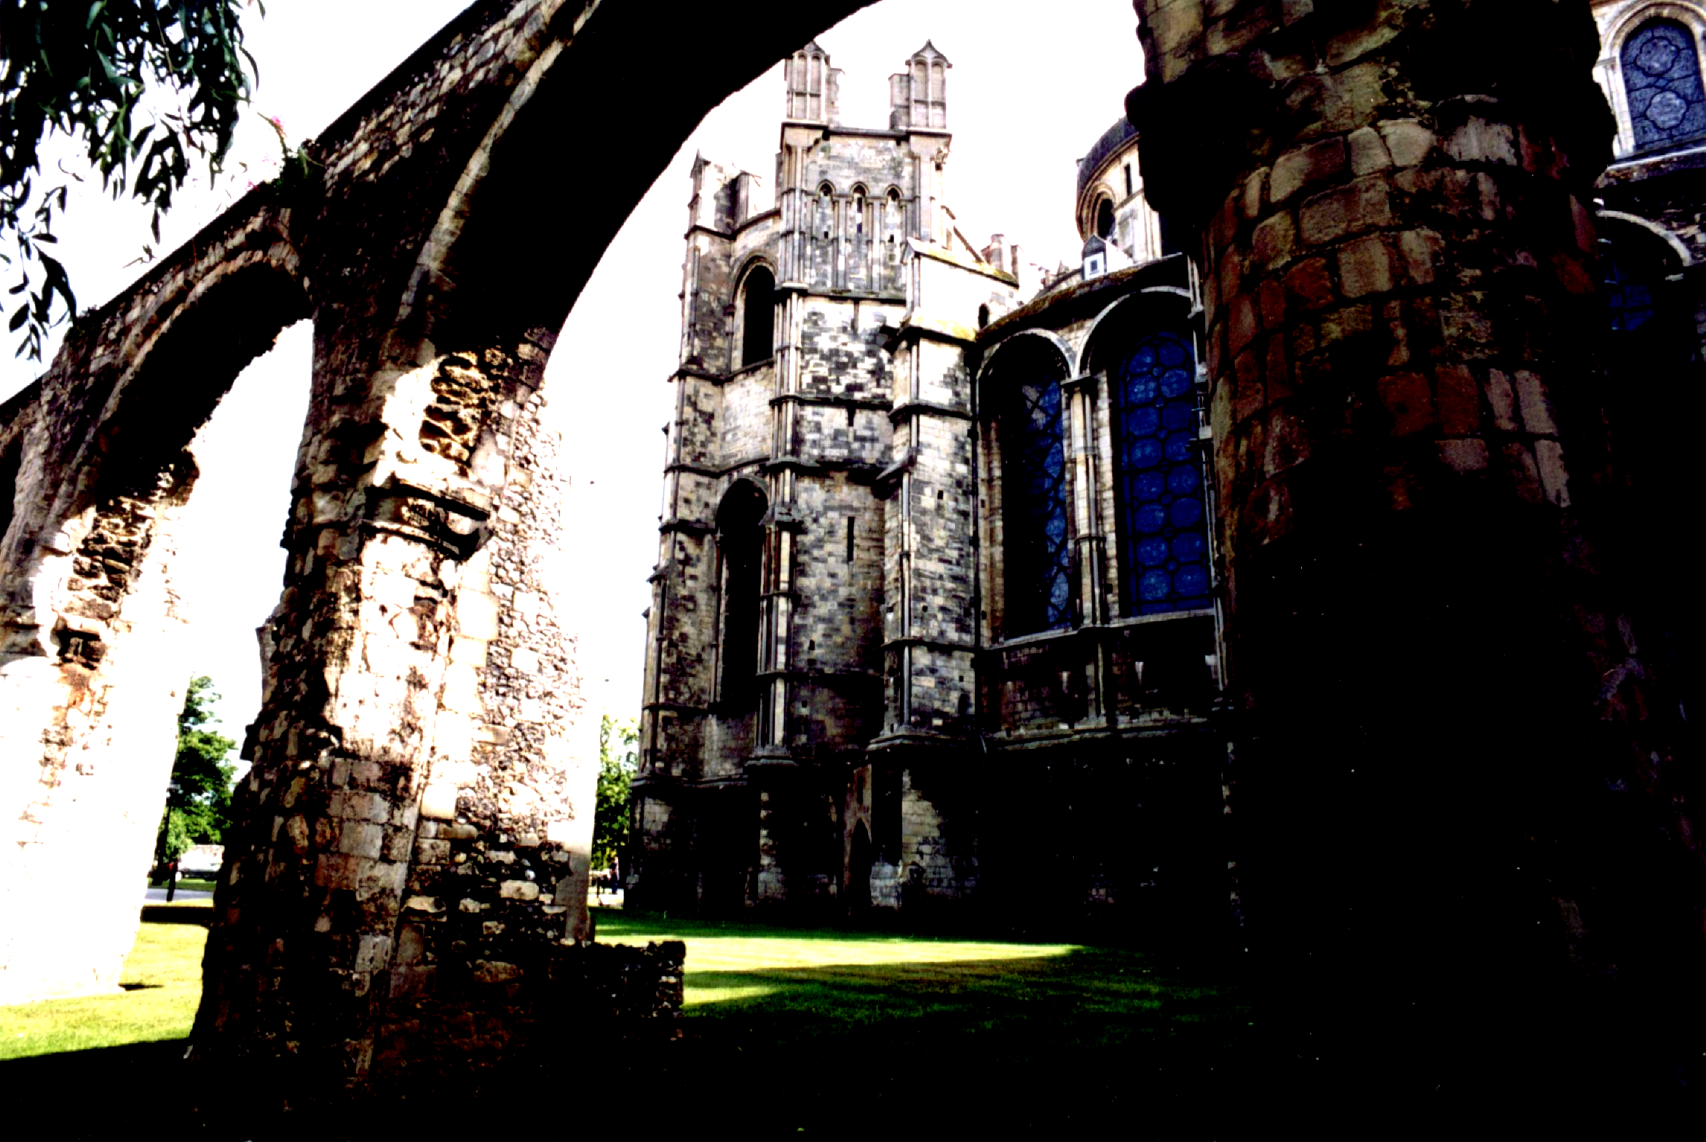
Thomas Becket
By Elisa Fenkner

Slide 2
Thomas Becket:
The Early Years
Becket was born in 1118, in Normandy the son of an English merchant.
His family was well off, his father a former Sheriff of London.
Becket benefited from his family's status first by being sent to Paris for his education and from there to England where he joined the household of Theobold, the then Archbishop of Canterbury.
Becket's directorial skills, his charm, intelligence and diplomacy sent him forward. The archbishop sent him to Paris to study law and upon his return to England made him Archdeacon of Canterbury.

Slide 3
Thomas Becket:
The Archbishop Of Canterbury
Once the Archdeacon of Canterbury, His status eventually sent him to King Henry II; the two bonded well.
Archbishop Theobold died in 1161, and Henry immediately saw the opportunity to increase his influence over the Church by naming Thomas Becket the Archbishop.
Thomas Becket was the Archbishop of
Canterbury from 1162 until 1170.
He was recognized as a saint and martyr in the Roman Catholic Church and Anglican Church.
King Henry II believed that having Becket as the head of church, he could easily diminish the independence of the Roman Catholic Church.

Slide 4
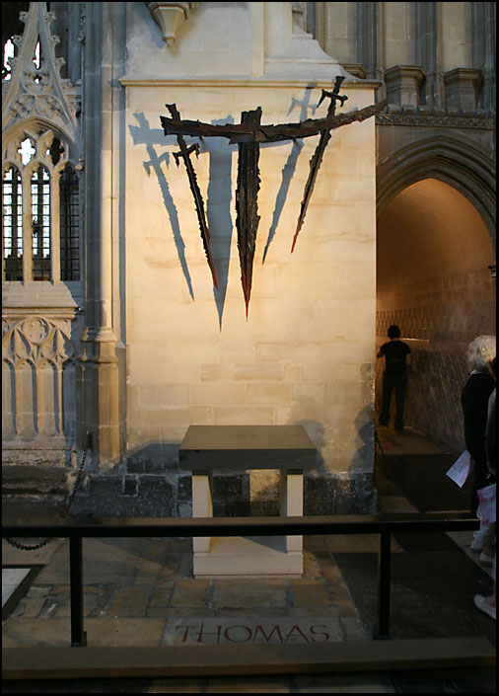
Thomas Becket:
The Victim
Becket stood against the king’s demands and eventually fled to France for 6 years.
In 1170, Becket met King Henry II in Normandy to resolve their issues.
King Henry appointed 4 knights to assassinate Thomas Becket.
On December 29, 1170, Thomas Becket was murdered on his way to the crypt of Canterbury Cathedral.
Edward Grim hid under the alter and witnessed Becket’s murder.

