Slide 1
Hospital ACQUISITION MANAGEMENT
Uniqname: prekshah
Name: Preksha Kamleshkumar Shah
Data Source: Hospital Admissions Data from my Health Informatics coursework
Fun Fact: The most interesting part about the data is that it is used to determine whether an organization should invest its resources and time in the acquisition of this Hospital. The demographics offer insight into relevant fields that determine Profitability, Public Health Status as well as Hospital Efficiency.
Notes:
Missing values, deidentify, LOS had negative values which was invalid,

Slide 2
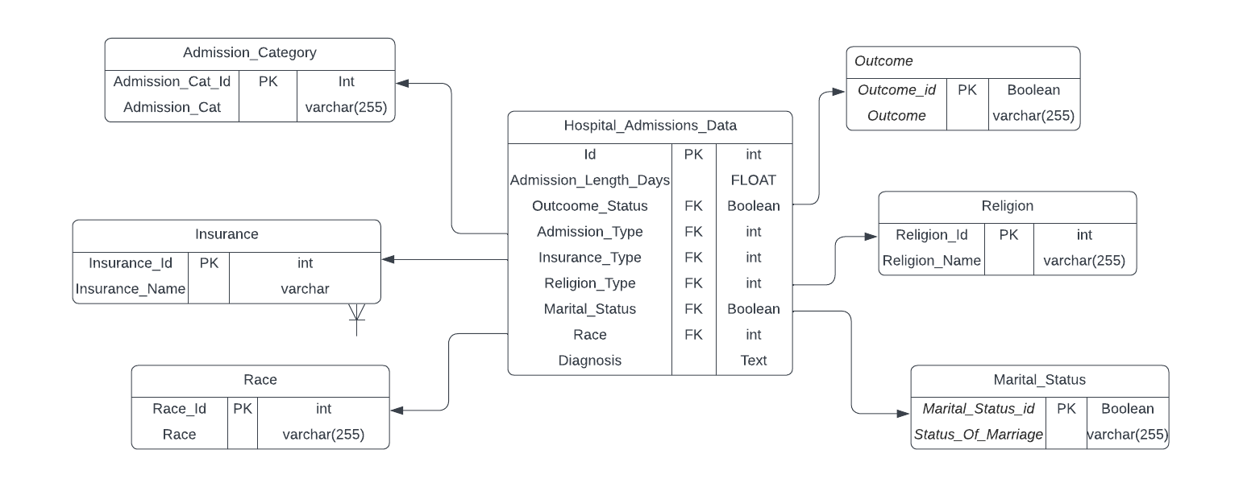
ERD and Documentation
Complex thing about getting Data into the dataset: Data cleaning was done using DataGrip.
It contained sensitive patient information and had to be de-identified. It also had negative values, which were errors and irrelevant fields that were dropped.
Notes:
Database design choices: My questions, My data selection, Why this subtables??

Slide 3
My FAVORITE PICK:
Questions:
The profitability of a hospital depends on the kind of insurance they have in its Payer mix. I would like to see the proportion of deaths among each insurance type, to determine whether the hospital is biased in their treatment and care, considering Private insurance pays more compared to Medicare/Medicaid.
Output:
Medicare/Medicaid: 0.14/0.07 versus Government/Private: 0.05/0.06
Result:
There seems to be a bias in the treatment of those who pay via Medicare and Medicaid, compared to those who pay via Govt/private insurance. This is an area to look at because such a scenario can bring in legal issues and cause loss to us.
Also, to note, the reimbursement rate is more for Govt/private insurance compared to those of Medicare/Medicaid. As commercial/ private insurance payers pay more/ generate more revenue when compared to payments from Medicare/Medicaid (Lopez et al., 2020)
Notes:
Explain other important questions??
Query:
select Insurance_Name, count(Outcome_Id)/count(Insurance_Type) AS "Total Death Rate" from Hospital_Admissions_Data had join Insurance I on I.Insurance_Id = had.Insurance_Type left join (SELECT Outcome_Id from Outcome O where Outcome like "%Dead%") OT on OT.Outcome_Id = had.Outcome_Status group by Insurance_Name order by count(Outcome_Id)/count(Insurance_Type)

Slide 4

THANK YOU!

