Slide 1
HEALTHCARE INDUSTRY AND DATA Analysis
Uniqname: prekshah
Name: Preksha Kamleshkumar Shah
Data Source: Hospital Admissions Data available on open-source Canvas.
Fun Fact: The most interesting part about the data is that it is used to determine whether Borromean Digital should invest its resources and time in the acquisition of this Hospital. The demographics offer insight into relevant fields that will help us determine Profitability, Public Health Status as well as Hospital Efficiency.
Notes:
Borromean Digital wants to try its luck in the healthcare industry and start with the acquisition of a Hospital. They have assigned me with this project, Healthcare Industry and Data Analysis. But before doing so, they would like to know the current scenarios of various demographics and its relation to Profitability, Public Health Status as well as Hospital Efficiency.

Slide 2
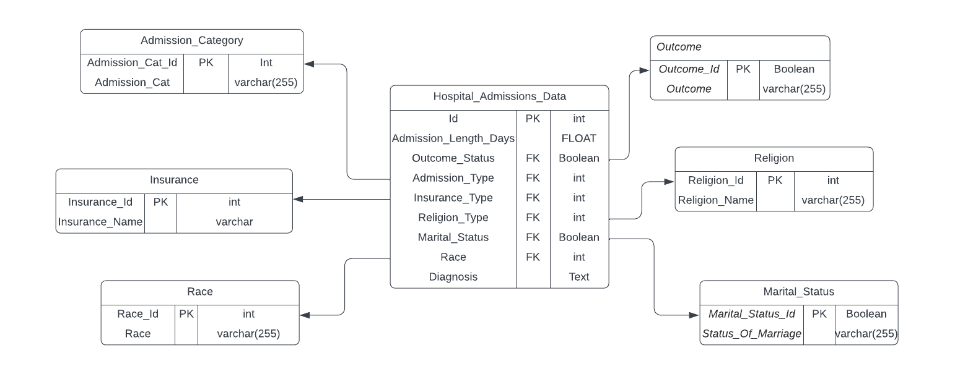
ERD and Documentation
Complex thing about the data: It contained sensitive patient information and according to standard HIPAA rule, had to be de-identified. It also had negative values, which were errors and irrelevant fields that were dropped.
If I had more time, I would have tried cleaning the diagnosis as some row values have special characters and ambiguity which I could have tweaked using my knowledge on clinical terminologies.
Notes:
Over here is an ERD diagram describing the relational database that I created. The main table is Hospital admissions data which is linked to various other subtables. Outcome of treatment and Marital Status, have Boolean fields, whereby for Marital Status, it is either married or not married, whereas For Outcome it is Dead or Alive. Moreover, the Diagnosis had a length description, so I chose it as a text field. Also, the number of days admitted is a float field type. Other values were incorporated as varchar.

Slide 3
My FAVORITE PICK:
Question:
The profitability of a hospital depends on the kind of insurance they have in its Payer mix. I would like to see the proportion of deaths among each insurance type, to determine whether the hospital is biased in their treatment and care, considering Private insurance pays more compared to Medicare/Medicaid.
Output:
Medicare/Medicaid: 0.14/0.07 versus Government/Private: 0.05/0.06
Result:
There seems to be a bias in the treatment of those who pay via Medicare and Medicaid, compared to those who pay via Govt/private insurance. This is an area to look at because such a scenario can bring in legal issues and cause loss to us.
Also, to note, the reimbursement rate is more for Govt/private insurance compared to those of Medicare/Medicaid. As commercial/ private insurance payers pay more/ generate more revenue when compared to payments from Medicare/Medicaid (Lopez et al., 2020)
Notes:
Query:
select Insurance_Name, count(Outcome_Id)/count(Insurance_Type) AS "Total Death Rate" from Hospital_Admissions_Data had join Insurance I on I.Insurance_Id = had.Insurance_Type left join (SELECT Outcome_Id from Outcome O where Outcome like "%Dead%") OT on OT.Outcome_Id = had.Outcome_Status group by Insurance_Name order by count(Outcome_Id)/count(Insurance_Type)

Slide 4

THANK YOU!
What would I do differently?
I would have tried finding the connecting data source which provides information about the procedures, the bills and how the payments were divided among insurance and deductibles.
This would help me gain a better insight on whether to invest in the project or not.

