Slide 1
Costs and
Coverage of
Diabetes
Medications
Medicare Part D Drug Spending
Preksha Shah

Slide 2
A walkthrough
01
02
Overview
Data Acquisition
And Pre-Processing
03
04
ANALYSIS
Key INSights
Notes:
Overview: Clear overview of the project's purpose and objectives. Explanation of the relevance of the healthcare data analysis to real-world healthcare issues.
Data Acquisition and Preprocessing
Description of data sources, collection methods, and any challenges faced.
Quick overview of data cleaning and preprocessing techniques applied, along with any decisions/assumptions made.
Data Analysis Techniques
Explanation of the analytical methods and tools used.
Justification for the chosen techniques based on the research question and/or literature review.
Results and Interpretation
Presentation of key findings and insights from the analysis.
Effective visualisation and clear interpretation of results.
Discussion of any limitations or uncertainties in the findings.

Slide 3
Understanding Medicare
Medicare is the federal health insurance program for people who are 65 or older, certain younger people with disabilities, and people with End-Stage Renal Disease.
Medicare
Original / Traditional
Additional Coverage
Part A
Part B
Part C
Part D
Hospital Insurance
Medical
Insurance
Plans via Private Insurance
Prescription
Drugs
Notes:
It covers insulin, diabetes drugs, and certain supplies.

Slide 4
Why Diabetes?
30%
7th
1 of 4
$412.9B
61%
People aged 65 and above have diabetes (ADA, 2023)
Leading cause of death in US
Healthcare dollar spent is towards diabetes
Cost of diabetes in 2022 (Parker et al., 2023)
Diabetes costs paid by Medicare (CDC 2020)
Notes:
As we see, patients who are 65 and above will need a lot of diabetes medications to maintain their chronic condition and for the same, they will need to opt for a Part D plan that helps them pay the costs.

Slide 5


Project Purpose
Explore the financial dimensions of diabetes medications
Medicare
Pharmaceuticals
Policymakers
Plan Beneficiary
Overarching Objective
Improve the program's effectiveness
Increase its financial sustainability
Raise beneficiary care standards
Notes:
This project aims to explore the financial dimensions of medications related to diabetes within the context of Medicare Part D drug spending. This exploration holds significant importance for stakeholders such as Medicare, plan beneficiaries, policymakers, and pharmaceutical companies. The objectives of our analyses include:
The proportion of diabetic medication to the remainder of the medication and how it affects the spending
To identify diabetic medications with outlier spending patterns, which may have a significant impact on the program's budget.
To assess the relationship between the number of drug manufacturers for diabetic medications and drug spending within this specific category.
To examine the annual trends in Medicare Part D drug spending for diabetic medications from 2017 to 2021, including changes in average spending
Our overall aim is to offer actionable insights and suggestions that will improve the program's effectiveness, increase its financial sustainability, and raise beneficiary care standards.

Slide 6

Objectives
Proportion of diabetes medication in Part D drugs dataset.
Identify outlier spending patterns that may affect program budget
Number of drug manufacturers and spending within that category
Annual trends in spending for diabetes medication from 2017-21

Slide 7
Data Acquisition
Data
Centers for Medicare & Medicaid Services
Publicly available dataset.
It has 13,751 rows and 46 columns
Collection Methods
Group by: Brand and Generic Name
Aggregation: across strengths, dosage and routes of administration
PDE Data
NDC
Commercial Data
PDE: Prescription Drug Event
NDC: National Drug Codes
Notes:
As we see, patients who are 65 and above will need a lot of diabetes medications to maintain their chronic condition and for the same, they will need to opt for a Part D plan that helps them pay the costs.

Slide 8
Cleaning and Pre-processing
Based on official resource within the CMS website. Drugs that did not make it to this list are likewise not filtered in our diabetes specific medication.
Duplication of data due to additional rows that represented overall metrics for each drug brand.
Decided to split the original and diabetes specific dataset into two. So a total of four datasets.
Redacted data cleaned on case by case basis. It did not make sense to drop entire rows just because some column values have NaN.
Filtered Diabetes Medication
Misrepresentation and Duplicate Data Entries
Handling Missing Values

Slide 9
Data Analysis Techniques
Data Segmentation and Grouping
Outlier Detection
Comparative Analysis
Splitting the dataset based on the manufacturer name to analyze data more specifically
Grouping data by ‘Generic Name’ and calculating aggregated values, such as total manufactures and spending to help identify trends and patterns
Implementing the Interquartile Range method to identify outliers in spending data. This helps in understanding spending patterns and identifying unusual or large values that indicate issues such as overpricing or monopolistic practices
Comparing total spending on diabetic drugs against overall spending to understand the proportion and significance of diabetic medication spending throughout the years.

Slide 10
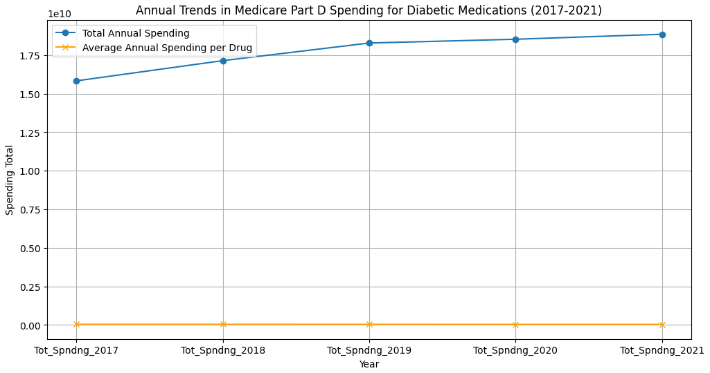
Objective one
1/29 of Generic Medications are related to Diabetes.
Total Annual Spending is consistently increasing on diabetic medications.
Average spending per drug shows a slight decrease
Notes:
Slight decrease on spending per drug can be indicative of a shift towards more cost-effective medications or changes in prescription patterns

Slide 11
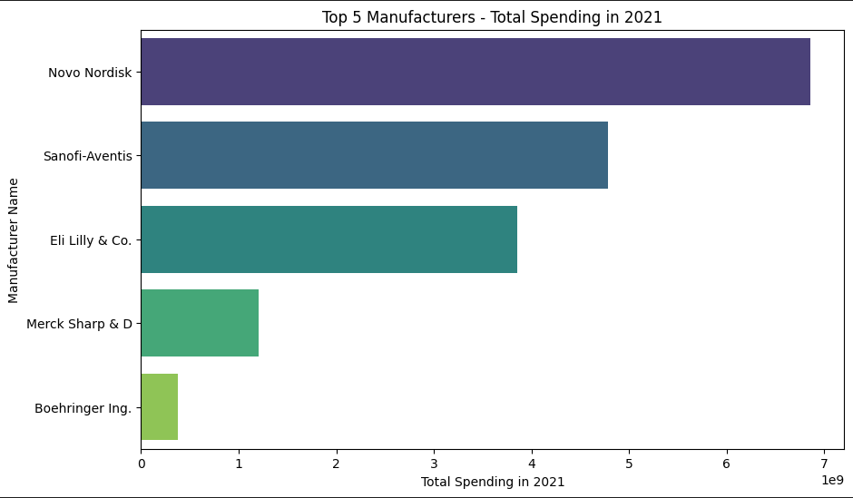
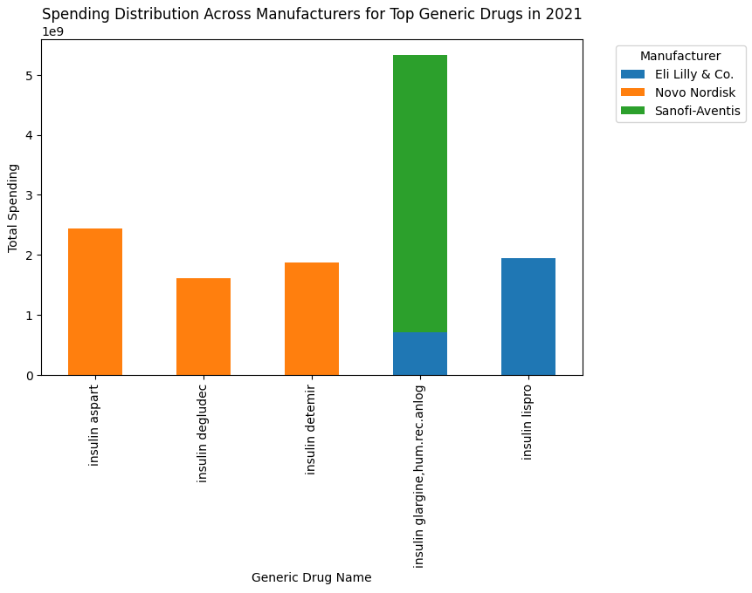
Objective two
97% of the total spending is due to the outliers
These are the top 5 manufacturers that are responsible for outlier spending patterns
Notes:
Insulin

Slide 12
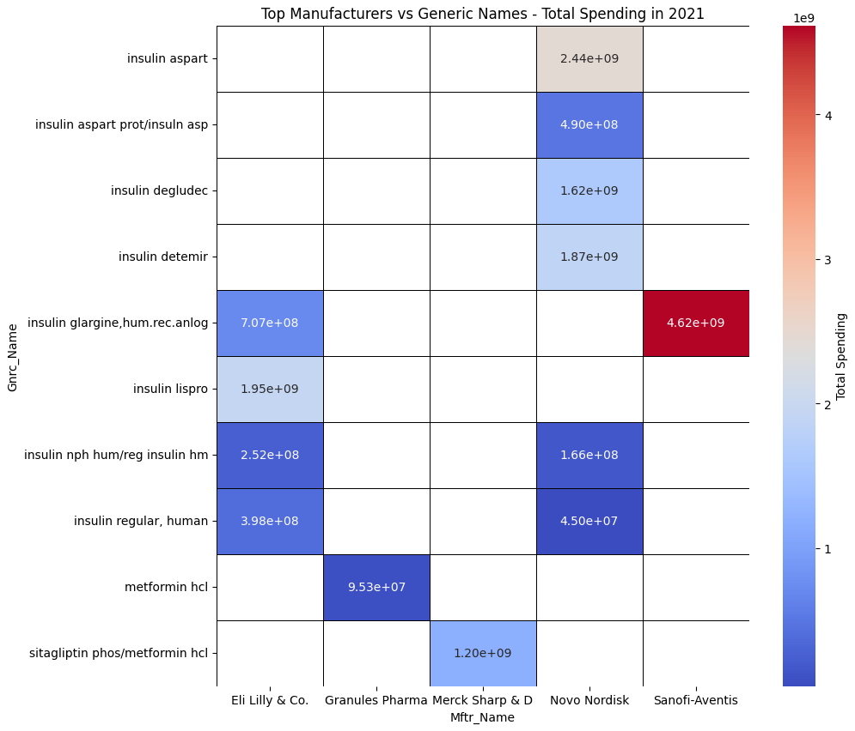
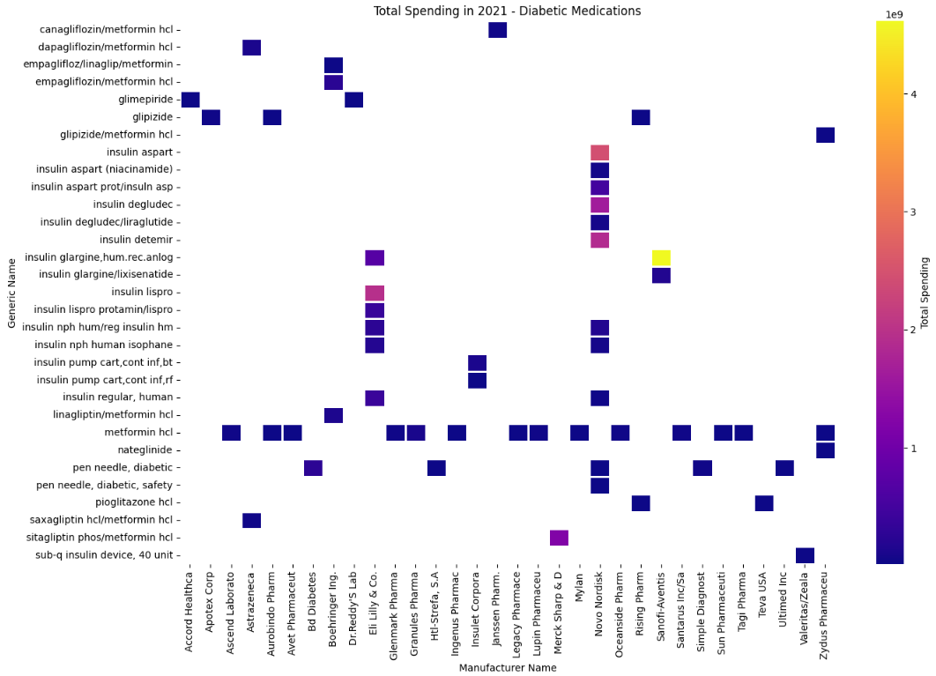
Objective two
The top 5 manufacturers also have a monopoly in the certain drugs they create hence charge exceptionally high amounts.
Notes:
This gives a opportunity for pharmaceutical companies to look into. Medicare also can negotiate terms with these manufacturers using policy reform and negotiating prices and leveraging the customer base they have.

Slide 13
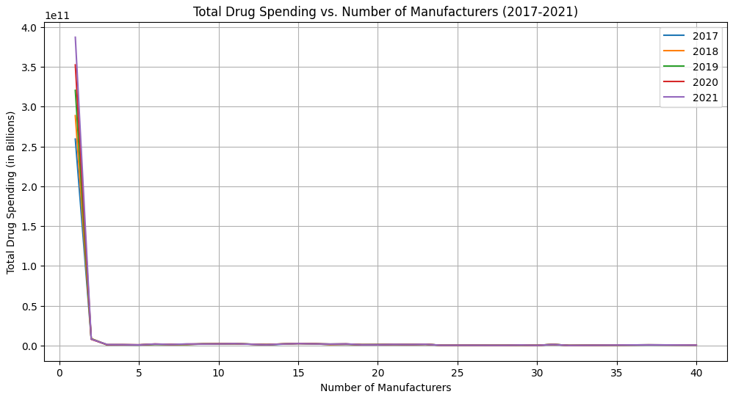
Objective three
- Majority of the drug spending is associated with drugs that have only one manufacturer.
- The total drug spending tends to decrease as the number of manufacturers increase.
- Overall, there appears to be a significant correlation between the number of drug manufacturers and total drug spending, with single manufacturer scenarios dominating the total spending.
Notes:
Potential limitations: Decrease in spending with more manufacturers might be due to other factors not captured in the dataset, such as rate of prescription or broader market forces

Slide 14
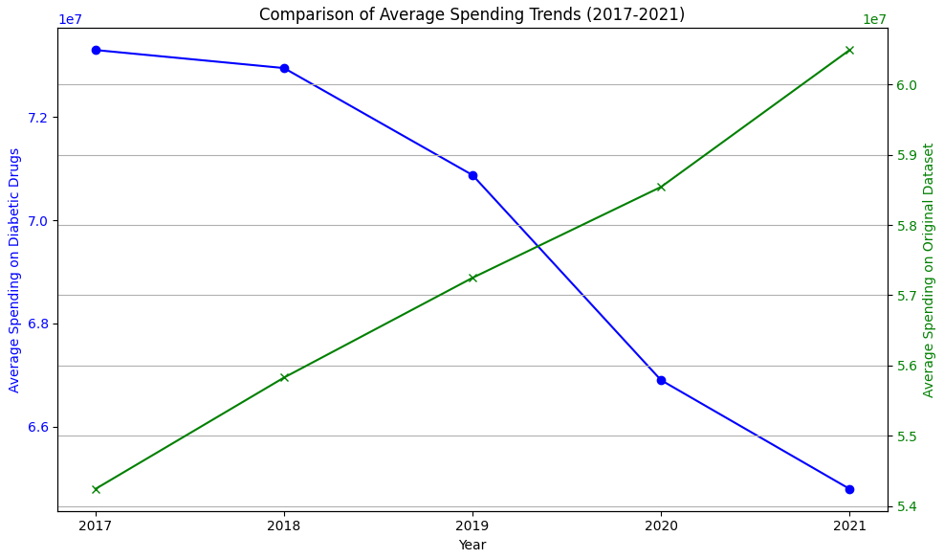
Objective four
The average spending for the overall Medicare Part D has increased while the average spending for diabetic medication has decreased overtime.
Considering that they form only 3.45% of the overall prescription drugs the average spending is still 135% more in 2017 and 107% more in 2021 than the overall average spending.
Notes:
average spending on diabetic medications could be influenced by changes in prescribing practices, such as a shift towards more cost-effective generic medications, or changes in treatment guidelines that affect drug choice
for example the guideline to diagnosis diabetes was changed in 2018 to include prediabetic and diabetic ranges

Slide 15
Future prospects
Medicare :
Use Case - Reproducible, future scope to use updated data to make real-time decision.
CMS has a dashboard, this can be integrated into it.
Improve real time decisions made regarding coverage, price negotiation.
Pharmaceuticals :
Key-Partnerships for companies who provide drugs at lower costs in comparison to the market.
An opportunity to research and innovate in the drug space with limited manufacturers and higher spending.

Slide 16
Future prospects
PolicyMakers:
Policy reforms to cap the costs for diabetes based medications.
Monitor and manage provider prescription practices to foster transition to Value-Based Care.
Reforms on current regulatory barriers that limit generic and biosimilar development
Overall improvement of healthcare access and reduce burden on US healthcare system.
Patients:
Low values, as they have no power over costs, are not the payer.
They can use the interpretation to make informed decisions on pushing policy reforms and bills, election choices as well as selecting insurance plans.

Slide 17
Thank you
Questions?

