Slide 1
“Customer Churn Analysis in Telecom Industry”
“Analyzing customer data to identify why customers leave and providing actionable insights to reduce churn and improve retention.”

Slide 2

Title: Customer Churn Analysis Using SQL, Python, and Power BIr title
Subtitle:
👉 Understanding Customer Behavior & Reducing Churn in Telecom Industry
Presented By:
👉 Preksha
Tools Used:
👉 SQL | Python | Power BI
Date:
👉 (10-APRIL-2026)

Slide 3

“Customer Churn Analysis in Telecom Industry”
Dataset Overview
“The dataset contains 7,043 telecom customers with 21 features covering demographics, services, account details, and billing information, used to analyze customer churn behavior.”
Points
Source: Telecom Customer Data
Includes categorical & numerical data
Target variable: Churn
This dataset provides comprehensive customer information to uncover patterns and key drivers behind customer churn in the telecom business.

Slide 4

“Customer Churn Analysis in Telecom Industry”
Objectives :-
To analyze customer data and understand churn behavior
To identify key factors influencing customer churn
To segment customers based on risk of churn
To discover patterns using SQL and Python analysis
To visualize insights using Power BI dashboard
To provide actionable recommendations to reduce churn
To help business improve customer retention and revenue

Slide 5



“Customer Churn Analysis in Telecom Industry”
Business Problem
Customer churn leads to significant revenue loss
Acquiring new customers is more costly than retaining existing ones
Difficulty in identifying customers who are likely to churn
Lack of clear insights into reasons behind customer churn
High churn impacts overall business growth and profitability
Ineffective customer retention strategies due to limited data analysis
Need for data-driven decision making to improve retention

Slide 6
Data Cleaning (SQL)
Missing & Blank Values
Duplicate Records
Checked for missing (NULL) values across all columns
Verified absence of blank and empty values in key fields
Validated consistency of categorical values (Yes/No, etc.)
Ensured no data gaps that could affect analysis
Confirmed dataset completeness and reliability
Performed duplicate check using customerID
Ensured each record represents a unique customer
No duplicate entries found in the dataset
Maintained data integrity for accurate analysis
Verified uniqueness of primary identifier
Data Type Correction
Reviewed data types for all columns
Converted TotalCharges from text to numeric format
Ensured numerical fields are ready for calculations
Standardized data for analysis and visualization
Prepared dataset for efficient querying and reporting

Slide 7

SQL Analysis Overview
SQL-Based Data Analysis
Calculated overall customer churn rate
Analyzed churn based on contract type
Examined churn patterns across customer tenure
Studied impact of monthly charges on churn
Evaluated churn based on services (Internet, Tech Support, etc.)
Analyzed customer behavior using payment methods
Segmented customers into new and loyal groups
“SQL analysis helped identify key patterns and factors influencing customer churn.”

Slide 8
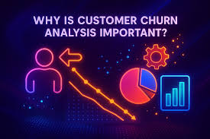
SQL Analysis Overview
Key Insights from Analysis
Customers with month-to-month contracts show the highest churn
New customers (low tenure) are more likely to churn
Higher monthly charges are associated with increased churn
Customers without tech support tend to leave more
Certain payment methods (like electronic check) show higher churn
Fiber optic users have relatively higher churn compared to others
Customer churn is mainly influenced by contract type, tenure, service usage, and pricing.”

Slide 9
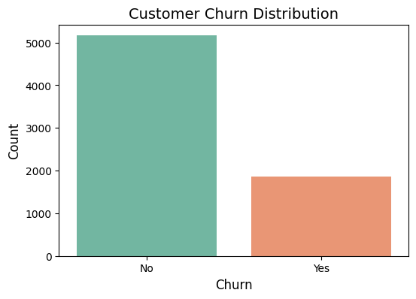
Exploratory Data Analysis (EDA) Using Python
Majority of customers have not churned, indicating a relatively stable customer base.
A significant portion of customers have churned, showing a notable retention issue.
The company needs to focus on reducing churn rate to improve profitability.
Churned customers represent a potential loss of revenue and growth opportunities.
Churn Distribution

Slide 10
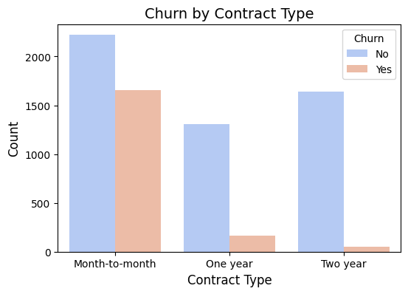
Exploratory Data Analysis (EDA) Using Python
Customers with month-to-month contracts have the highest churn rate.
Long-term contracts (one-year and two-year) show significantly lower churn.
Customers with longer commitments are more loyal and stable.
Encouraging long-term contracts can help reduce churn effectively.
Churn by Contract

Slide 11
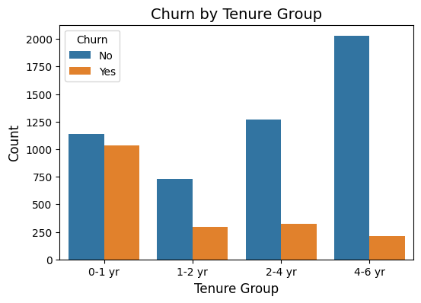
Exploratory Data Analysis (EDA) Using Python
Customers with low tenure (new customers) show higher churn.
Long-term customers are more likely to stay with the company.
Initial months are critical for customer retention.
Improving early customer experience can significantly reduce churn.
Churn by Tenure

Slide 12
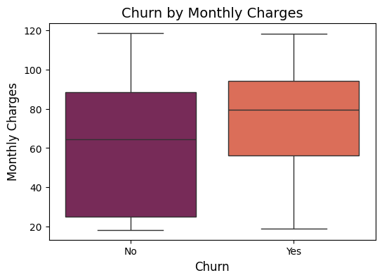
Exploratory Data Analysis (EDA) Using Python
Customers with higher monthly charges tend to churn more.
Lower charges are associated with better customer retention.
Pricing plays an important role in customer satisfaction.
Offering competitive pricing may help reduce churn rate
Churn by Monthly Charges

Slide 13
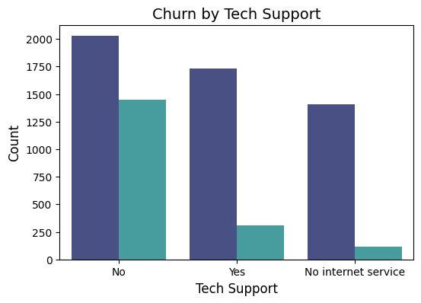
Exploratory Data Analysis (EDA) Using Python
Customers without tech support have higher churn.
Customers with support services are more satisfied and retained.
Lack of support may lead to customer dissatisfaction.
Improving support services can help reduce churn
Churn by Tech Support

Slide 14
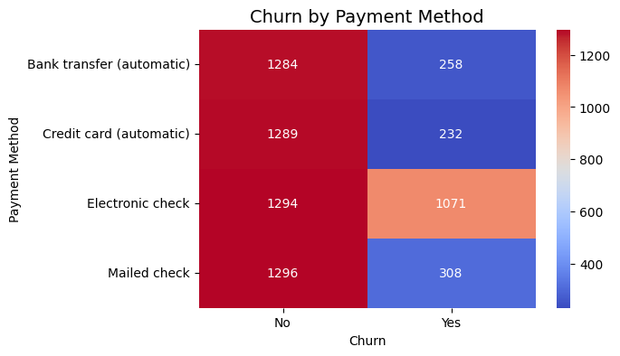
Exploratory Data Analysis (EDA) Using Python
Certain payment methods show higher churn rates.
Customers using electronic payment methods may churn more.
Payment experience impacts customer behavior.
Improving payment flexibility can help increase retention.
Churn by Payment Method

Slide 15
Customer Churn Insights
High churn observed in month-to-month contracts, indicating lack of long-term commitment.
Customers with shorter tenure (0–1 year) are more likely to churn, showing early-stage risk.
Higher monthly charges are associated with increased churn, suggesting pricing sensitivity.
Customers without tech support show significantly higher churn, highlighting service gaps.
Fiber optic users show higher churn compared to other services, indicating possible dissatisfaction.
Electronic check users tend to churn more, suggesting payment behavior impact
26.5%
customers
churned
50%
F
50%
M
40%+
electronic payment
👉 “Churn is primarily driven by contract type, tenure, pricing, and service quality.”

Slide 16
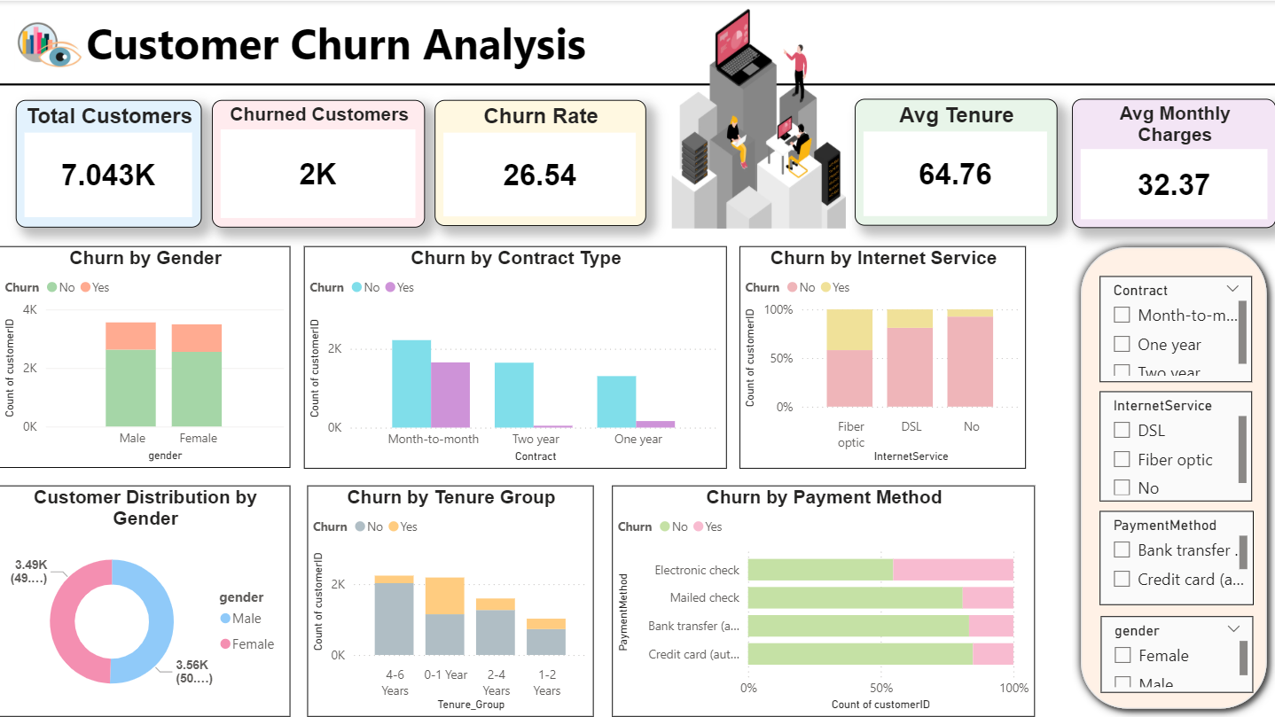
Power BI Dashboard
“The dashboard enables quick identification of churn drivers and supports data-driven decision making.”

Slide 17
Interactive Dashboard Overview :-
Developed an interactive Power BI dashboard to analyze customer churn
Included key KPIs such as:
Total Customers
Churned Customers
Churn Rate (%)
Avg Monthly Charges
Avg Tenure
Used pastel color theme for clean and professional visualization
Implemented slicers (filters) for:
Contract
Gender
Internet Service
Payment Method
Visualized churn patterns using:
Contract Type
Tenure Group
Payment Method
Tech Support
Internet Service

Slide 18






Business Recommendations
Promote Long-Term Contracts:
Offer discounts or incentives for yearly and multi-year plans to reduce churn from month-to-month customers.
Strengthen Early Customer Engagement :
Focus on customers in the first year with onboarding support, personalized communication, and offers.
Optimize Pricing Strategy :
Review high monthly charges and provide flexible pricing or bundled offers to reduce price-sensitive churn.
Enhance Tech Support Services :
Provide faster and more accessible support to improve customer satisfaction and retention.
Improve Payment Experience :
Encourage customers to switch from electronic check to auto-pay methods for better retention .
Improve Service Quality (Fiber Users) :
Investigate issues and enhance service quality for high-churn segments.
“By implementing these strategies, the company can significantly reduce churn and improve long-term customer retention and revenue.”

Slide 19
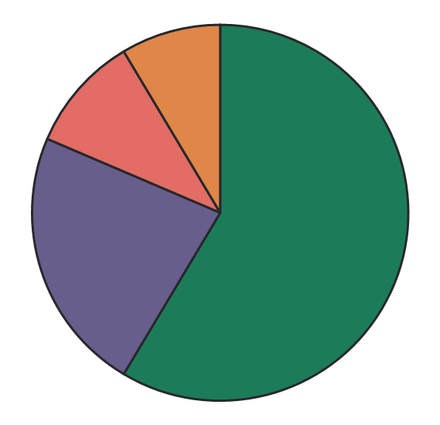
Conclusion
Project Summary :-
Successfully analyzed customer data to identify key drivers of churn.
Discovered that contract type, tenure, pricing, and support services heavily influence churn behavior.
Built an interactive Power BI dashboard for clear and dynamic visualization.
👉 Identified actionable insights that can help the business:
Reduce customer churn
Improve customer satisfaction
My Learning :-
Strengthened skills in SQL, Python (EDA), and Power BI.
Gained hands-on experience in data cleaning, analysis, and visualization.
Improved ability to convert data into business insights.
Key Outcome
Increase long-term revenue

Slide 20
Thank You
“This project demonstrates how data-driven insights can help businesses make smarter decisions and improve customer retention.”

