Slide 1
Logistic Regression
On Parole Violation

Slide 2
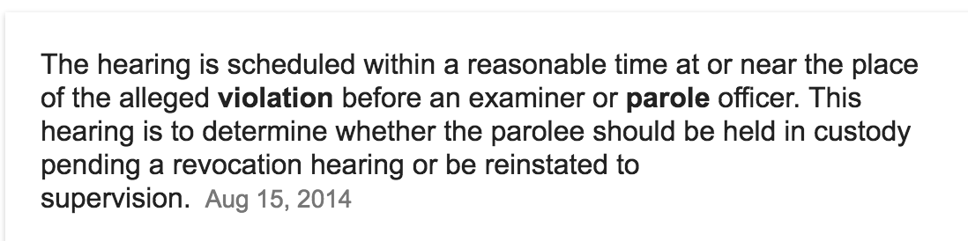
What is parole violation
Taken from Google Search

Slide 3
Dataset Taken FROM
https://github.com/chicheongweng/MITx-15.071x-The-Analytics-Edge/blob/master/data/parole.csv
Used 409 instaces out of 675 available

Slide 4
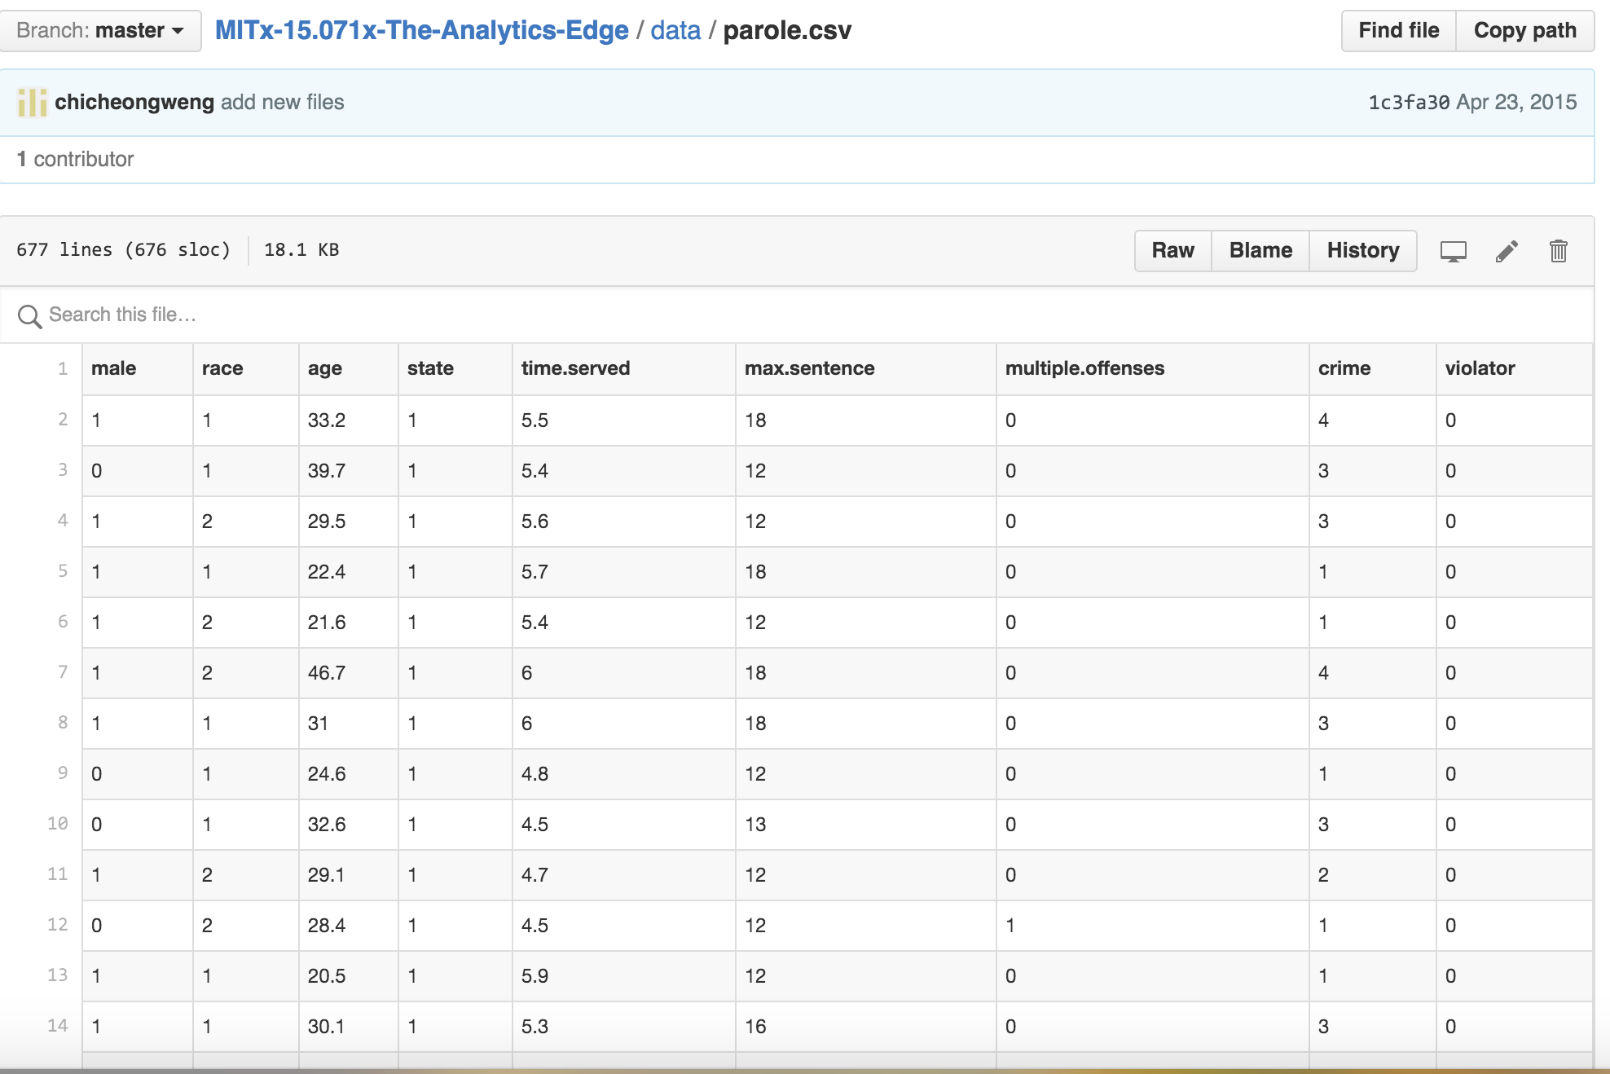
Parole violation dataset

Slide 5
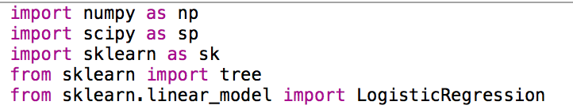
Libraries Used
NUMPy
SCIPY
Sklearn

Slide 6
Variables taken into consideration
Sex
Multipleoffenses (Boolean value)
Violator
Data Ignored:
Race, age, state, timeserved, crimes, maxsenteces

Slide 7
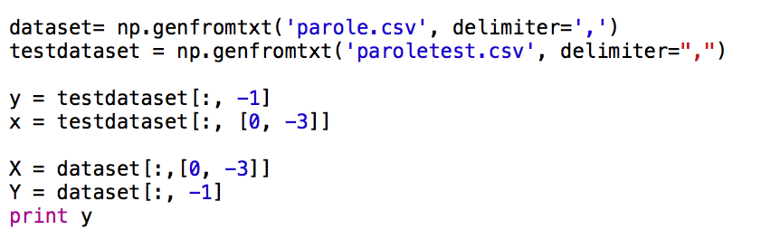
Process
Taken 409 instances out of 675 sample and used logistic regression on these instances
Taken another 409 samples randomly from 675 samples and used them as test sample
No missing values were found

Slide 8
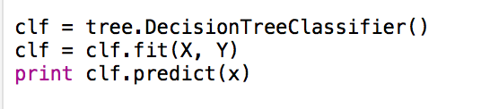
Decision tree
Also used decision tree from sklearn library
Got same result

Slide 9
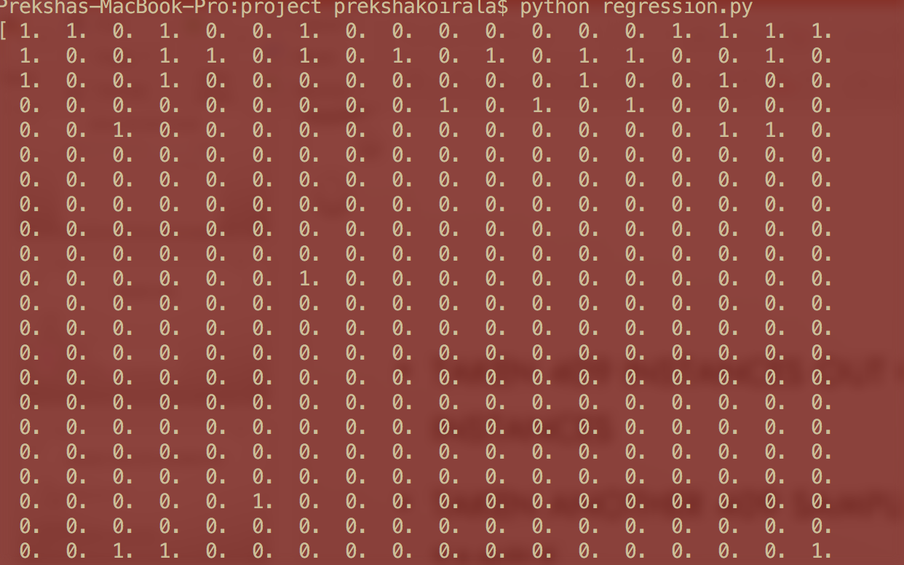
Predicted data from both logistic regression and decision tree

Slide 10
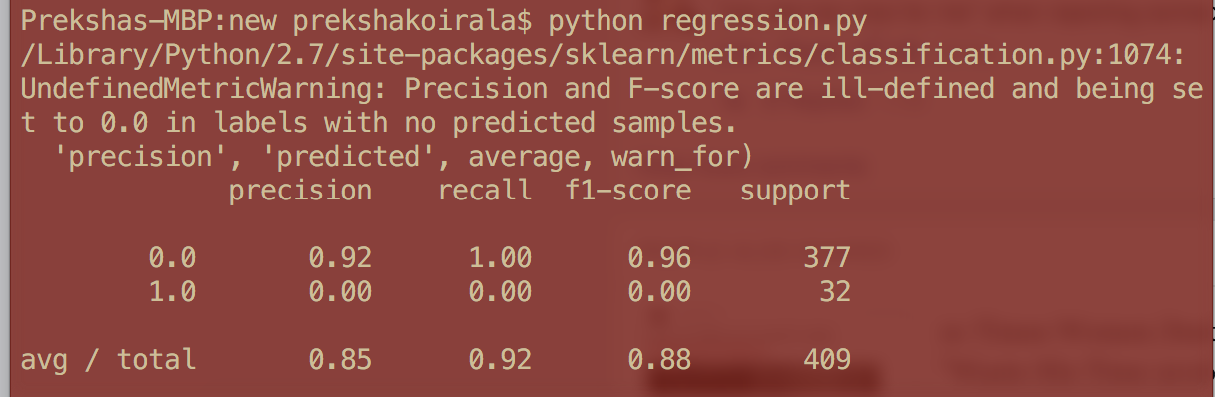
Result
Using both logistic regression and decision tree, I got 88% accuracy.

Slide 11

Thank you

