Slide 1
Logistic Regression
On Parole Violation

Slide 2
Dataset Taken FROM
https://github.com/chicheongweng/MITx-15.071x-The-Analytics-Edge/blob/master/data/parole.csv
Used 409 instaces out of 675 available

Slide 3
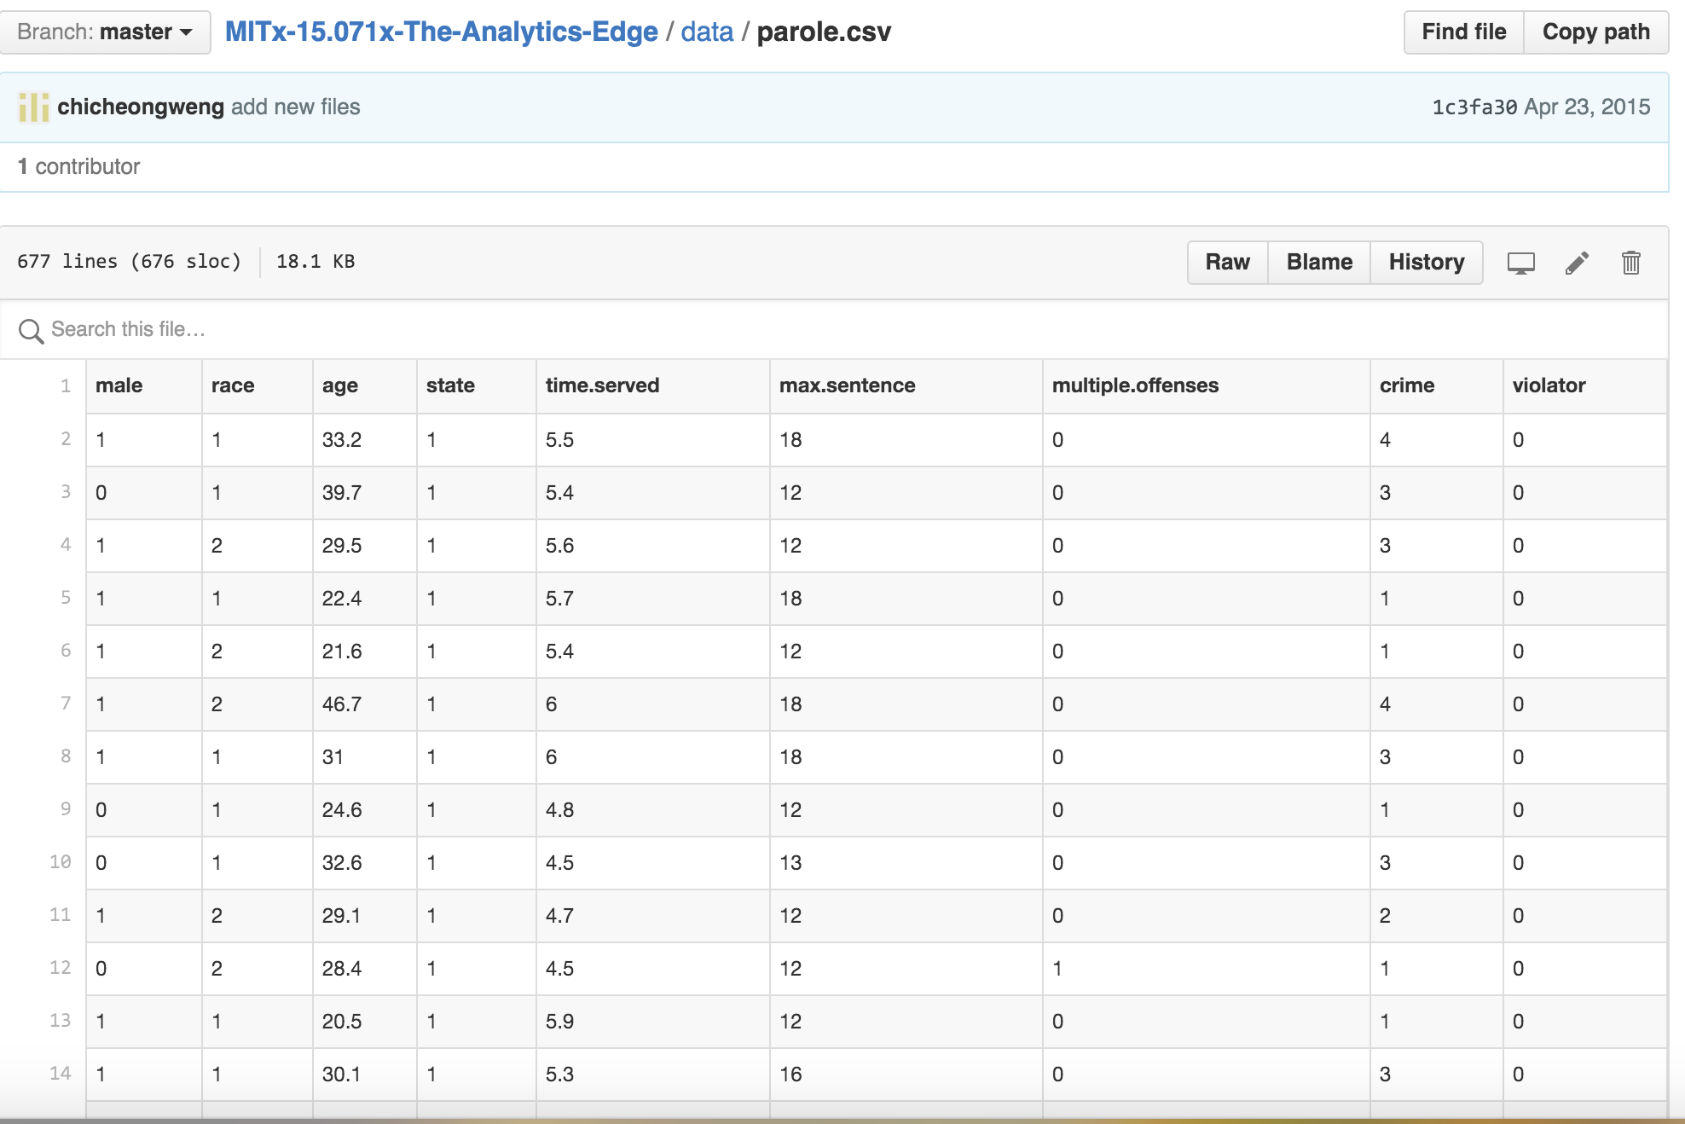
Parole violation dataset

Slide 4
Libraries Used
NUMPy
SCIPY
Sklearn

Slide 5
Variables taken into consideration
Sex
Multipleoffenses (Boolean value)
Violator
Data Ignored:
Race, age, state, timeserved, crimes, maxsenteces

Slide 6
Process
Taken 409 instances out of 675 sample and used logistic regression on these instances
Taken another 409 samples randomly from 675 samples and used them as test sample

Slide 7
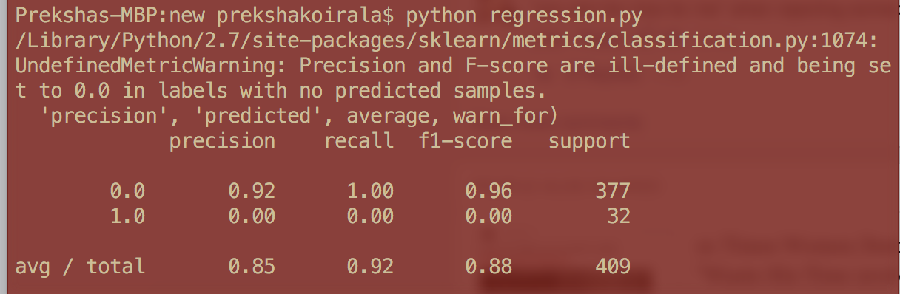
Result
88% accuracy.

