Slide 1
Logistic Regression
On Parole Violation

Slide 2
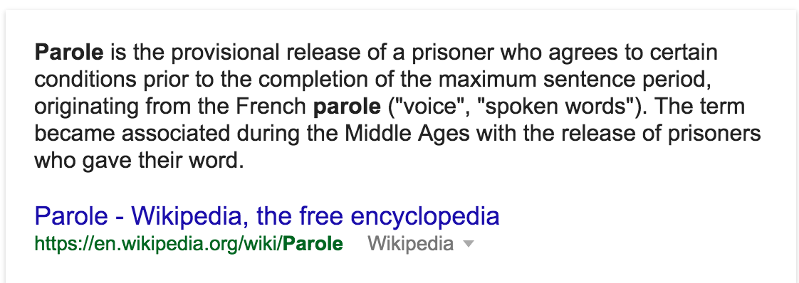
What is parole violation
Wikipedia defination

Slide 3
Dataset Taken FROM
https://github.com/chicheongweng/MITx-15.071x-The-Analytics-Edge/blob/master/data/parole.csv
Used 409 instaces out of 675 available

Slide 4
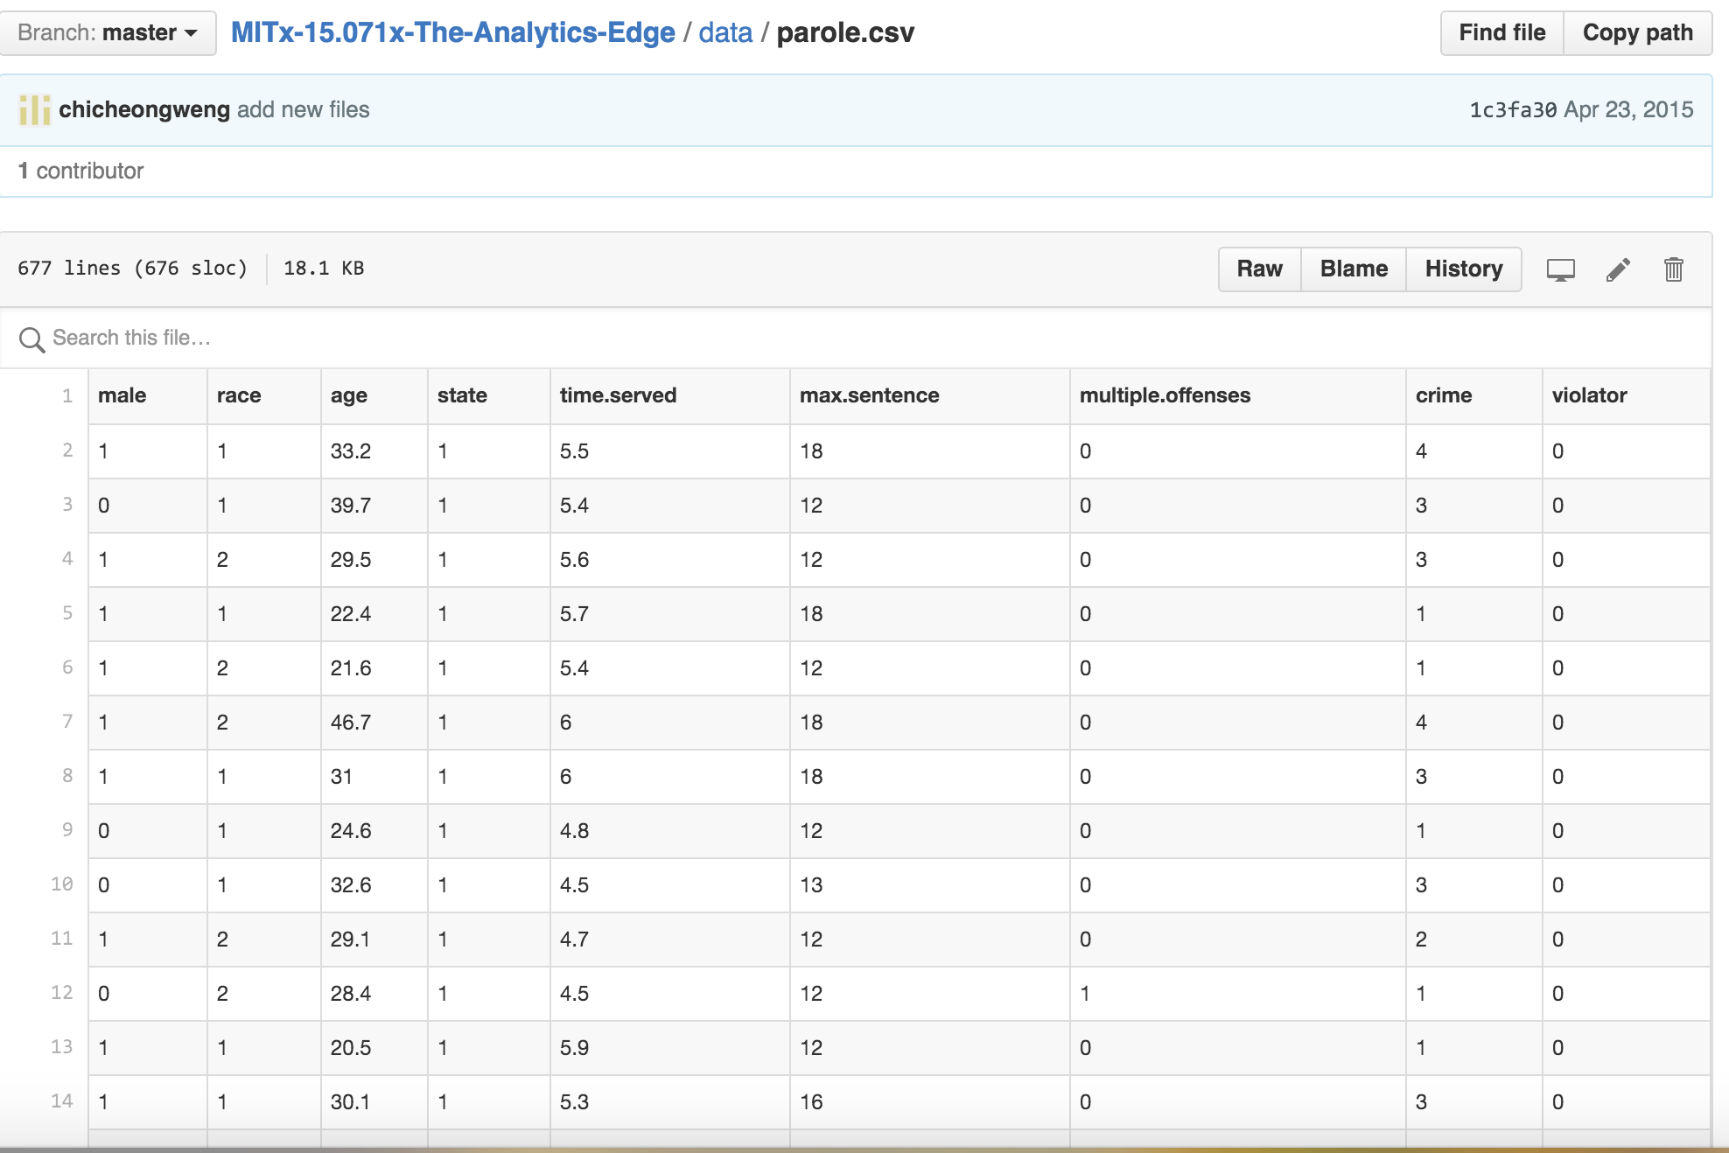
Parole violation dataset

Slide 5
Description of variables
sex: Male 1, Female 0
Race: (1,2,3) Not necessary for our prediction
Age: Integer
State: (1,2,3)Not necessary for our prediction
Max.sentence: integer
Multiple.offenses: binary
Crime: integer
Violator: True(1), False(0)

Slide 6
Variables taken into consideration
Sex, Multipleoffenses (Boolean value), Violator
Why These?? Sex: Because of difference in prison experience between men and women (Source: http://www.americanjail.org/10-facts-about-women-in-jails/)
Multiple offenses: the more offenses you have, the more likely you are desperate to violate parole

Slide 7
Variables ignored and reasons
Race (Race not defined properly in dataset given)
Age (Difficult to convert to binary values)
State (difficult to convert to binary values)
Time served (difficult to convert to binary values)
Max sentence: ( very similar to time served and multiple offenses)
Crimes (similar to multiple offenses)

Slide 8
Problem statement
Let’s treat this as a classification problem by focusing on three variables sex, multiple.offenses and violater. Since they are in binary form, it will be easier to use logistic regression function and decision tree on those variables.

Slide 9
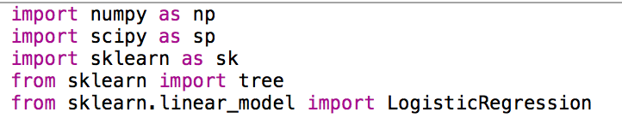
Libraries Used
NUMPy
SCIPY
Sklearn

Slide 10
Testing and training dataset
Taken 409 instances out of 675 sample and used logistic regression on these instances
Taken another 409 samples randomly from 675 samples and used them as test sample
No missing values were found

Slide 11
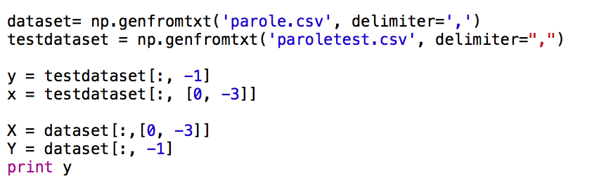
Process/Reading data
1) Read file using numpy
2) Categorized X and y with the variables that were chosen to be used

Slide 12
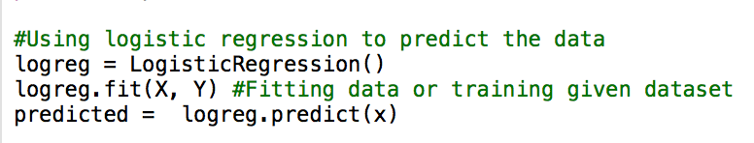
Process/Logistic regression
3) Instantiated LogisticRegression class available in Sklearn.linear_model
4) Called predict function from LogisticRegression on X

Slide 13
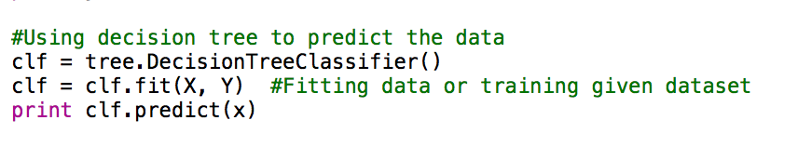
Process/Decision tree
Also used decision Tree for predicting data

Slide 14
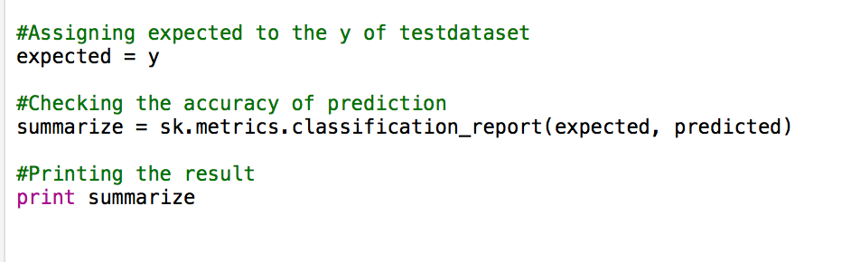
Process/accuracy calculation
Calculated the accuracy of the prediction using metrics.classifictionreport from sklearn

Slide 15
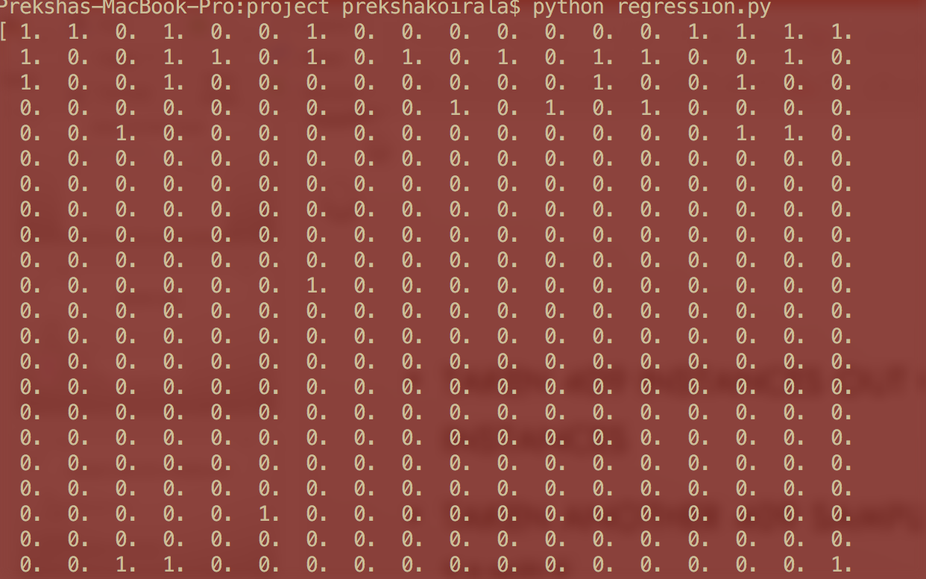
Predicted data from both logistic regression and decision tree

Slide 16
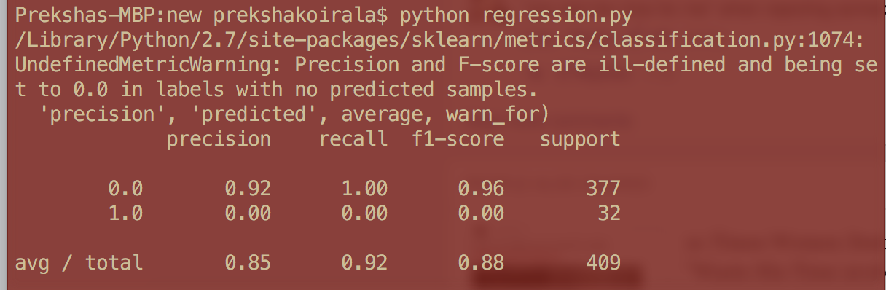
Result
Using both logistic regression and decision tree, I got 88% accuracy.

Slide 17
What’s next?
Can use cross validation

Slide 18

Thank you

