Slide 1

Computer Engineering Department A.P. Shah Institute of Technology G.B.Road,Kasarvadavali, Thane(W), Mumbai-400615 UNIVERSITY OF MUMBAI Academic Year 2021-2022

Slide 2
A Project Report on Predicting Instagram Influencer Engagement Rate Submitted in partial fulfilment of the degree of Bachelor of Engineering(Sem-8) in Computer Engineering By Aishwarya More(18102008) Shweta Patil(19202002) Preksha Vora(19202004)
Moksha Shah(18102057) Under the Guidance of Prof. Shafaque syed

Slide 3
1.Project Conception and Initiation

Slide 4
1.1 Abstract
Social media networks like Facebook, Twitter, and Instagram have provided a marketing platform for marketers(Brands) to interact with their customers. Through Instagram, Brands can share photos and videos about their products by collaborating with influencers. An influencer is a person who can influence potential buyers of the product or service by promoting it on social media. They make regular posts about that topic on social media and generate massive followings of enthusiastic, engaged people who pay in interest to their views. There are 1 billion active Instagram influencers and brands that need to find the best Influencer for marketing their products will require a tool that will talk about Engagement rates (Engagement rates refer to the number of likes, comments, and shares an influencer gets when posting content online) of the influencers. In this project, a discussion on how Brands on Instagram can find an Influencer for marketing their product will be done. We will be using machine learning algorithms like Linear Regression, Random Forest and whichever algorithm will give the best result we will use that algorithm for the final prediction.

Slide 5
1.2 Objectives
1.Study Influencer Marketing and its process as one of the emerging field of marketing in digital space.
2. Overview of Prediction Engagement Rate and its effects and consequence.
3. Exploring the practice for the parameters of influence within the application of Prediction to evaluate the effectiveness of Influencer.
4. Explore the opportunities and challenges of using Prediction of engagement rate to evaluate Influencer Marketing.

Slide 6
1.3 Literature Review
In [1], Sentiment Analysis and classification of Restaurant Reviews using Machine learning. This model is to analyze the customer reviews about various restaurants across Karachi. The contribution of this research is twofold. First, it performs sentiment analysis and classifies each comment as positive, negative.
In [2], Measurement of Engagement Rate in Instagram. The author took an explorative engagement approach dealing with government data processing. Social networking(online); Internet; learning (artificial intelligence); mobile computing; computer- aided instruction; smart cities; Big Data; educational institutions; Internet of Things.
In [3], Measuring Instagram activity and Engagement Rate of Hospital A comparison Before and During COVID-19 pandemic. This model identifies the hospitals’ frequency of posts in their Instagram account and the engagement rate before and during the COVID-19 pandemic.
In [4], Sentiment/opinion Review analysis Detecting spams from the good ones! We go through this in a step by step for- mat of different papers and summarize for other readers how we can identify the correct emotions and differentiate between the real and fake reviews.
In [5], An Effective machine learning Approach for Sentiment Analysis on Popular Restaurant Reviews in Bangladesh. We built a model using natural language processing techniques and machine learning algorithms to automate the approach of classifying reviews on around 200 popular restaurants of Bangladesh as Satisfactory or Poor.
In [6], Exploring practices and engagement of Instagram by Indonesia Government Ministries. The results of analysis of ministry Instagram data.
In [7], Social Network Influencers Engagement Rate Algorithm Using Instagram Data. Research has been done about related case studies and existing algorithms to get a better understanding of how to use available metrics such as likes, comments, and followers, to calculate the engagement rate of Influencers in the most accurate way.

Slide 7
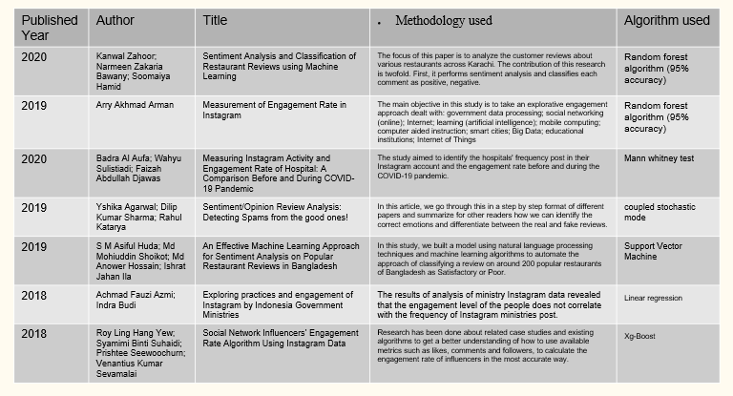
1.3 Literature Review

Slide 8
1.4 Problem Definition
The challenge is to recommend influencer(s) for a particular marketing campaign. Companies might be interested in micro influencers for a certain industry/region and they would also like to understand which content works for the audience of a particular influencer. After finding the right influencers they might want to start a marketing campaign with them and monitor the efficiency of such a campaign.

Slide 9
1.5 Scope
The proposed system will predict the engagement rates correctly on the basis of data input like likes, comments, posts, etc.
This application will be used to calculate engagement rates of Instagram Influencers. In this project, we have to help brands find the best Instagram user for branding its products. This platform makes brands work easier by calculating engagement rates.
The reason for developing such a system is, there are millions of users on Instagram but out of them, which user is constantly active, which user has more shares, and more response by audience, that's the question. So to help brands find the users having the highest engagement rate will help them for better sales of their product. Here, on the basis of engagement rate we define whether the user will be in the growing/ declining phase.
If a user in a growing phase means that the audience interaction with that user will continue like this. If in a declining phase means that the audience interaction with that user will decrease.

Slide 10
1.6 Technology stack
Front- End:
HTML - HTML (Hypertext Markup Language) is the code that is used to structure a web page and its content. HTML is the standard markup language for documents designed to be displayed in a web browser
CSS - ”Cascading Style Sheets” is a code that is used to layout and structure a web page . It is used for describing the presentation of a document written in a markup language such as HTML.
JavaScript - JavaScript is the world’s most popular programming language. JavaScript is the programming language of the Web. JavaScript is easy to learn .
Python Libraries:
Python is a general purpose interpreted, interactive, object oriented, and high level programming language. Python is designed to be highly readable. Python has become one of the most popular programming languages in the world in recent years. It’s used in everything from machine learning to building websites and software testing.
Scikit-learn is a free software machine learning library for the Python programming language. Scikit-learn provides a range of supervised and unsupervised learning algorithms via a consistent interface in Python.

Slide 11
1.6 Technology stack
NumPy stands for Numerical Python. NumPy is a Python library used for working with arrays. It also has functions for working in domain of linear algebra, fourier transform, and matrices. Using NumPy, a developer can perform the following operations
Mathematical and logical operations on arrays.
Matplotlib is a low level graph plotting library. Matplotlib is a cross-platform, data visualization and graphical plotting library for Python and its numerical extension NumPy.
Back-End :
PhpMyAdmin - phpMyAdmin is a free and open source administration tool for MySQL and MariaDB. As a portable web application written primarily in PHP, it has become one of the most popular MySQL administration tools, especially for web hosting services.

Slide 12
1.7 Benefits for environment & Society
You can develop a more insightful, data-based marketing strategy.
Nothing beats data-based strategy.
Understand your customers.
Measure your marketing campaign.
Take a look at brand perception.
Find industry leaders and influencers.
Give extra boost to your customer service.

Slide 13
2. Project Design

Slide 14
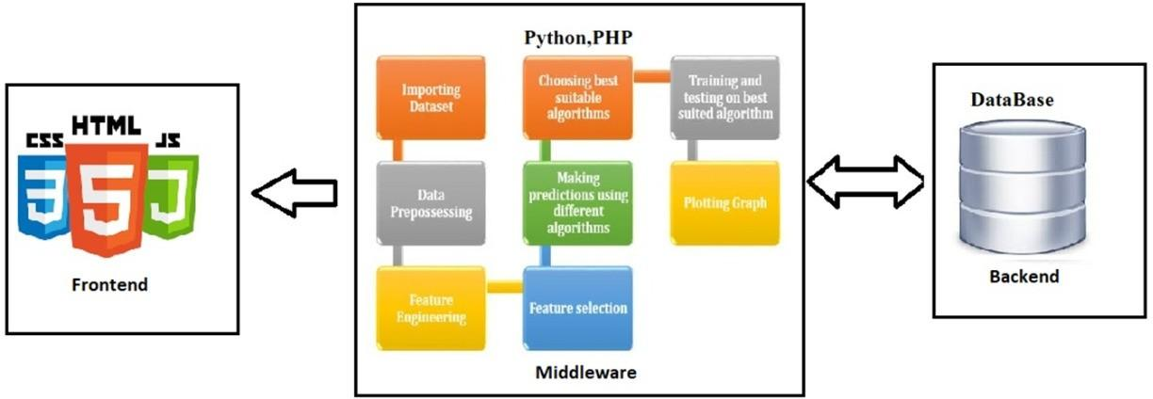
2.1 Proposed System
The presentation layer which is concerned with delivering the data to the user. So, those area units typically the UI connected issues that area unit addressed at the presentation layer. Here we tend to typically have hypertext markup language, CSS, and JavaScript.
The business logic layer on the opposite hand is bothered a lot about the information, the information validation, the dynamic content process, and generating the content to be delivered to the user. Here we tend to typically have Node, Python , PHP.
This is insured behind the scenes with the information persistence layer or the information access layer. So, this is often involved with however we tend to store and move with the information, generally within the type of information, and access this information through an API. Therefore, the business logic layer interacts with the information like MongoDB or PostgreSQL.

Slide 15
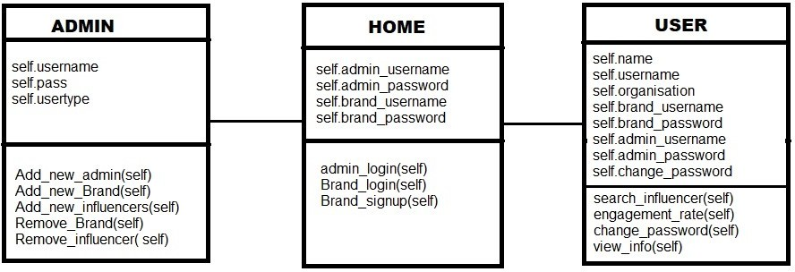
2.2 Class Diagram
Admin can add new Brands, Influencer and also remove Brand, Influencer. Admin can also add new admin.
In Home admin can login, brand can login and signup.
User can search the influencer, engagement rate, change password, and view information.

Slide 16
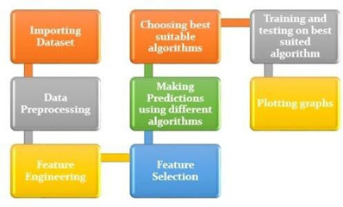
2.3 Design(Flow Of Modules)
Importing Dataset
Data Preprocessing
Feature Engineering
Feature Selection
Making prediction using different algorithms
Choosing best suitable algorithm
Training and testing on best suited algorithm
Plotting graph
Above steps are explain in Module 1-4

Slide 17
2.3.1 Module 1
Importing Dataset
We have taken the dataset from GitHub. It has 11 columns and 52687.
Data Preprocessing
Data Preprocessing is that step in which the data gets transformed, or Encoded, to bring it to such a state that now the machine can easily parse it. Preprocessing data starts from data cleansing, feature engineering, feature selection and etc until the data is ready to be consumed by the Machine Learning model. Four stages: data cleaning, data integration, data reduction, and data transformation.

Slide 18
2.3.2 Module 2
Feature Engineering
Feature engineering is the process of selecting, manipulating, and transforming raw data into features that can be used in supervised learning.
Feature selection
The next step is Feature Selection. There are in total 63 features, but all of the features are not highly correlated with our target variable, so we need to find the top features which are correlated with our target variable for this we are constructing a correlation heatmap.
Correlation Coefficient
Correlation is a measure of the linear relationship of two or more variables. If two variables are correlated, we can predict one from the other. Correlation can be positive (increase in one value of feature increases the value of the target variable) or negative (increase in one value of feature decreases the value of the target variable)

Slide 19
2.3.3 Module 3
Making predictions using different algorithms
Modeling uses Machine Learning Algorithm (Linear Regression, Random Forest) and also does some Tuning Hyper-parameters.
Hyperparameters Tuning
A Machine Learning model is defined as a mathematical model with a number of parameters that need to be learned from the data. By training a model with existing data, we are able to fit the model parameters.
GridSearchCV
In GridSearchCV approach, machine learning model is evaluated for a range of hyperparameter values. This approach is called GridSearchCV, because it searches for best set of hyperparameters from a grid of hyperparameters values.

Slide 20
2.3.3 Module 3
In our project we will be considering 4 cases:
Modelling without Feature Selection and without Tuning Hyperparameters.
Modelling without Feature Selection and with Tuning Hyperparameters.
Modelling with Feature Selection and without Tuning Hyperparameters.
Modelling with Feature Selection and wit Tuning Hyperparameters.
Metrics evaluation that we will be using is Root Mean Squared Error (RMSE)
Root mean square error or root mean square deviation is one of the most commonly used measures .
It shows how far predictions fall from measured true values using Euclidean distance .RMSE is commonly used in supervised learning applications, Lower values of RMSE indicate better fit.
Choosing best suitable algorithms
The algorithm which will give lowest rmse value will be chosen for final prediction and results will be evaluated.

Slide 21
2.3.4 Module 4
Training and testing on best suited algorithm
Whichever RMSE value is least that will be better fitted so we will choose that algorithm to make our final predictions. Our main target is to predict the engagement rates of different users and based on that the user will be categorized in to ”Growing” or ”Declining” phase. Brand will be able to select Influencers basis on which phase they are.
Plotting Graph
A heatmap contains values representing various shades of the same color for each value to be plotted. Usually the darker shades of the chart represent higher values than the lighter shade.

Slide 22
3.Implementation

Slide 23
3.1 proposed system
First brand can login to the website ,then user dashboard appear in that brand details is shown After the user dashboard there is an search influencer In search influencer we can search any influencer with their category We can also bookmark the influencers that will be stored in the list tab. In the settings tab we can change a password for the brand. After that we logout from the brand dashboard. After that admin dashboard there is a Brand. Where each Brand is shown After brand there is an Influencer tab. In influencer tab we can see the list of influencer In the settings tab we can change a password for the Admin. After that we logout from the br Admin dashboard.

Slide 24
3.1.1 policies
The First task in our project was to search the topic. We need to search for a project which is practical oriented and theoretically aligned. After reading all the descriptions and discussing it with others a project topic is finalized. After finalizing with others, our next task is to identify the problem. Problem identification involves a lot of background work in the general area of the problem. Normally it calls for the use of prior experience, typically experience we may not yet have. For identifying the task, we need to read as much base paper as we can. After identifying the problem we are now able to design our system. After the Designing is finalized we now start with the actual coding part. We will split the coding into small modules. When each module is fully qualified, we will integrate into one system. After the implementation of our idea, we must test for the bugs by using all possible test scenarios and test cases. After the testing phase is done, we are now ready to deploy our project.

Slide 25
3.1.2 Algorithms
Linear Regression:
Linear regression analysis is used to predict the value of one variable based on the value of another variable. based on the value of another variable. In Linear Regression, we accept that there is a connection between an autonomous variable vector and the needy target variable. By utilizing the free parameters, we can anticipate the objective variable.
Random Forest :
Random forest is a supervised learning algorithm. Random forest algorithms can be used for both classifications and regression tasks. It provides higher accuracy through cross-validation. Random Forest [1] forms several decision trees and integrates them so that they can predict more accurately. When the tree starts spreading it creates more randomness in the model. Due to the wide diversity of Random Forest provides better results and prevents over-fitting.

Slide 26
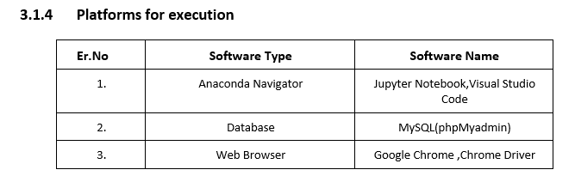
3.1.4 platforms for execution

Slide 27
4. Results
In Modelling without feature selection and without tuning: RMSE value of Linear regression is greater than Random forest In Modelling without feature selection with tuning: RMSE value of Linear regression is greater than Random forest In Modelling with feature selection without tuning: RMSE value of Linear regression is almost equal to Random forest In Modelling with feature selection with tuning: RMSE value of Linear regression is greater than Random forest among all the above RMSE value Random forest give the least value that’s why we select that algorithm for final prediction.

Slide 28
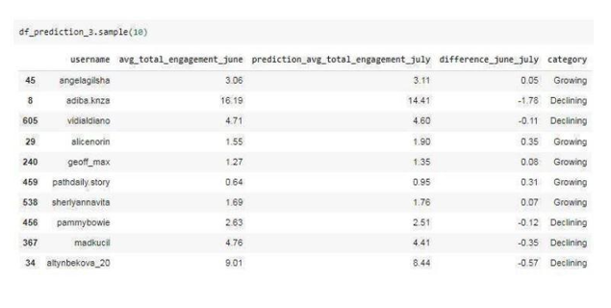
4. Results

Slide 29
4. Results
 | Modeling without feature selection and without tuning | Modeling without feature selection and with tuning | Modeling with feature selection and without tuning | Modeling with feature selection and with tuning
Linear Regression | 2.02 | — | 1.99 | —-
Random Forest | 1.90 | 1.68 | 1.95 | 1.50

Slide 30
5.Conclusion
We have looked at a dataset containing information of Instagram Influencers. Social media networks like Facebook, Twitter, and Instagram have provided a marketing platform for marketers (Brands) to interact with their customers. To help brands in finding the best influencer suitable for their product is the major goal of our project. And this goal has been achieved with better results using various Machine Learning Algorithms. This will help the Brands to find influencers with maximum engagement rates and they can decide whether to collaborate with them or not. Among all the above algorithms used, random forest is the best suitable algorithm for predicting

Slide 31
6. References
Zahoor Kanwal, Narmeen Zakaria Bawany and Soomaiya Hamid. ”Sentiment Analysis and Classification of Restaurant Reviews using Machine Learning.,2020 21st International Arab Conference on Information Technology(ACIT).IEEE 10.1109/ACIT50332.2020.9300098.
Arry Akhmad Arman; Agus Pahrul Sidik, “Measurement of Engagement Rate in Instagram” (Case Study: Instagram Indonesian Government Ministry and Institutions), 2019 International Conference on ICT for Smart Society (ICISS), DOI: 10.1109/ICISS48059.2019.8969826.
Badra Al Aufa; Wahyu Sulistiadi; Faizah Abdullah Djawas, “Measuring Instagram Activity and Engagement Rate of Hospital: A Comparison Before and During COVID- 19 Pandemic”, 2020 3rd International Seminar on Research of Information Technology and Intelligent Systems (ISRITI),DOI: 10.1109/ISRITI51436.2020.9315490.
Yashika Agarwal; Dilip Kumar Sharma; Rahul Katarya, “Sentiment/Opinion Review Analysis: Detecting Spams from the good ones!”, 2019 4th International Conference on Information Systems and Computer Networks (ISCON),DOI: 10.1109/IS- CON47742.2019.9036249.
S M Asiful Huda; Md Mohiuddin Shoikot; Md Anower Hossain; Ishrat Jahan Ila, “An Effective Machine Learning Approach for Sentiment Analysis on Popular Restaurant Reviews in Bangladesh”, 2019 1st International Conference on Artificial Intelligence and Data Sciences (AiDAS).
Achmad Fauzi Azmi; Indra Budi, “”Exploring practices and engagement of Instagram 10 by Indonesia Government Ministries”, 2018 10th International Conference on Information Technology and Electrical Engineering (ICITEE).
Roy Ling Hang Yew; Syamimi Binti Suhaidi; Prishtee Seewoochurn; Venantius Kumar Sivamalai, “Social Network Influencers Engagement Rate Algorithm Using Instagram Data” ,2018 Fourth International Conference on Advances in Computing Communication Automation(ICACCA).
https://fbohz.com/posts/2020-08-10-threetierfullstack
Xiao Yang, Seungbae Kim, Yizhou Sun,How Do Influencers Mention Brands in Social Media? Sponsorship Prediction of Instagram Posts,2019 IEEE/ACM International Conference on Advances in Social Networks Analysis and Mining (ASONAM) DOI:10.1145/3341161.33429.

Slide 32
Thank You

