Slide 1
Argument Mining in Spanish Clinical Trials
A 27-Run Transformer Benchmark + Ensemble for Evidence Component Detection
GRACE @ IberLEF 2026 · Track 1 · Subtask 1
Best single: mDeBERTa-v3 0.705 All-9 ensemble: 0.743 Blind: 11,752 components
GRACE @ IberLEF 2026 · Track 1: Evidence Component Detection (ES)
1 / 28

Slide 2
Agenda
From a small, imbalanced corpus to a validated submission
01
Problem & Data
The task, an annotated example, the corpus and its class imbalance
02
Method
Sentence-level 4-class framing, two-stage runner, the 9 backbones
03
Infrastructure
The GPU journey (Kaggle → Azure → Modal) and the parallel sweep
04
Results
Leaderboard, per-class behaviour, seed stability, training dynamics
05
Ensemble & Submission
Probability averaging, honest selection, the blind-test output
06
Lessons & Outlook
What we explored, engineering lessons, limitations, next steps
GRACE @ IberLEF 2026 · Track 1: Evidence Component Detection (ES)
2 / 28

Slide 3
Why Argument Mining in Clinical Trials?
Turning prose evidence into structured, machine-readable argumentation
Evidence-based medicine runs on RCTs
Randomised controlled trials are the gold standard of clinical evidence, but their conclusions are locked in free-text abstracts — hard to search, compare, or synthesise at scale.
Arguments have structure
Each abstract builds an argument: Premises (results) support Claims (interpretations) that roll up into a MajorClaim (the take-home conclusion). Recovering that structure powers automated evidence synthesis and systematic reviews.
Spanish clinical NLP is under-resourced
Most argument-mining work targets English. GRACE provides a Spanish RCT benchmark — exactly where domain-specific models and careful methodology can make a difference.
Our goal
A rigorous, reproducible benchmark of Spanish/clinical encoders for evidence component detection, plus an ensemble strong enough to submit.
GRACE @ IberLEF 2026 · Track 1: Evidence Component Detection (ES)
3 / 28

Slide 4
The Task — Evidence Component Detection
Classify each segment of a Spanish RCT abstract by argumentative role
Premise
Reported evidence, statistical results
Claim
Interpretation of the findings
MajorClaim
The overall conclusion
None
Background / methods text
Our framing: sentence-level 4-class classification.
• Segment each abstract into sentences with spaCy (es_core_news_sm).
• Classify each sentence in the context of its previous sentence: prev_sentence [SEP] sentence (≤192 tokens).
• A 0.50 probability override promotes a segment to the rare MajorClaim class.
• Official ranking metric: strict macro-F1 — predicted spans must match gold character offsets exactly.
GRACE @ IberLEF 2026 · Track 1: Evidence Component Detection (ES)
4 / 28

Slide 5
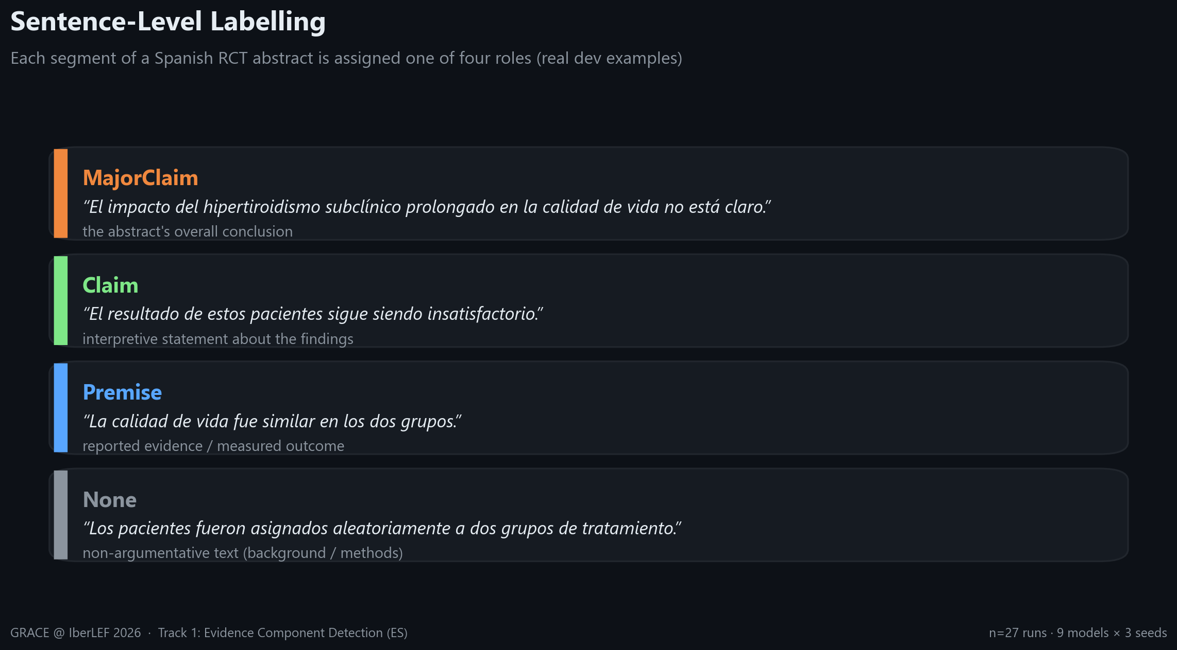
What the Model Labels
Real dev examples of each argumentative role
Premise → Claim → MajorClaim form the argumentative chain; everything else is None.
GRACE @ IberLEF 2026 · Track 1: Evidence Component Detection (ES)
5 / 28

Slide 6
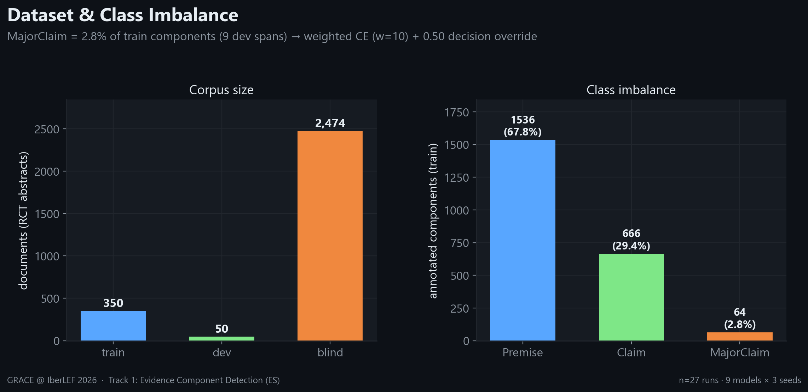
Dataset & the Core Challenge
Small, severely imbalanced — MajorClaim is the bottleneck
350 train / 50 dev / 2,474 blind abstracts · MajorClaim = 2.8% of train, only 9 dev spans.
GRACE @ IberLEF 2026 · Track 1: Evidence Component Detection (ES)
6 / 28

Slide 7
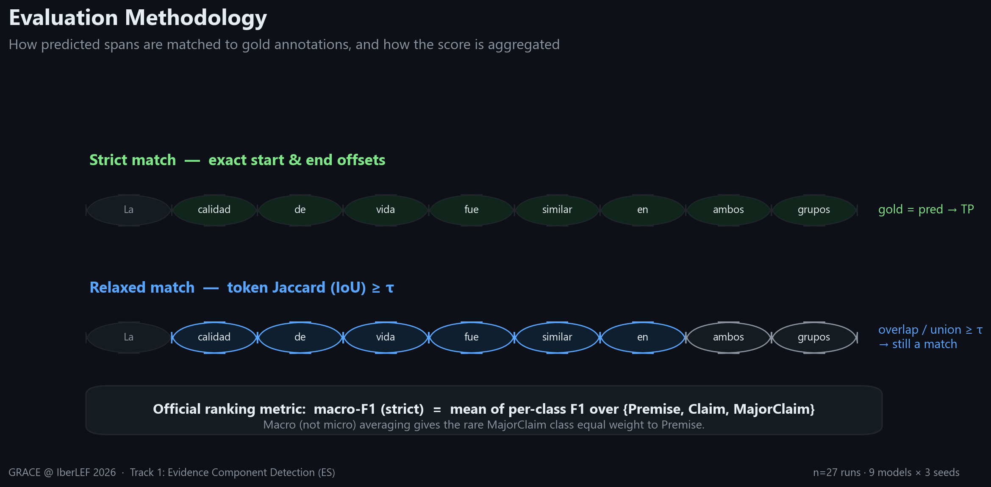
Evaluation Methodology
Strict vs relaxed span matching, and macro-F1 aggregation
We optimise and report the official strict macro-F1 throughout.
GRACE @ IberLEF 2026 · Track 1: Evidence Component Detection (ES)
7 / 28

Slide 8
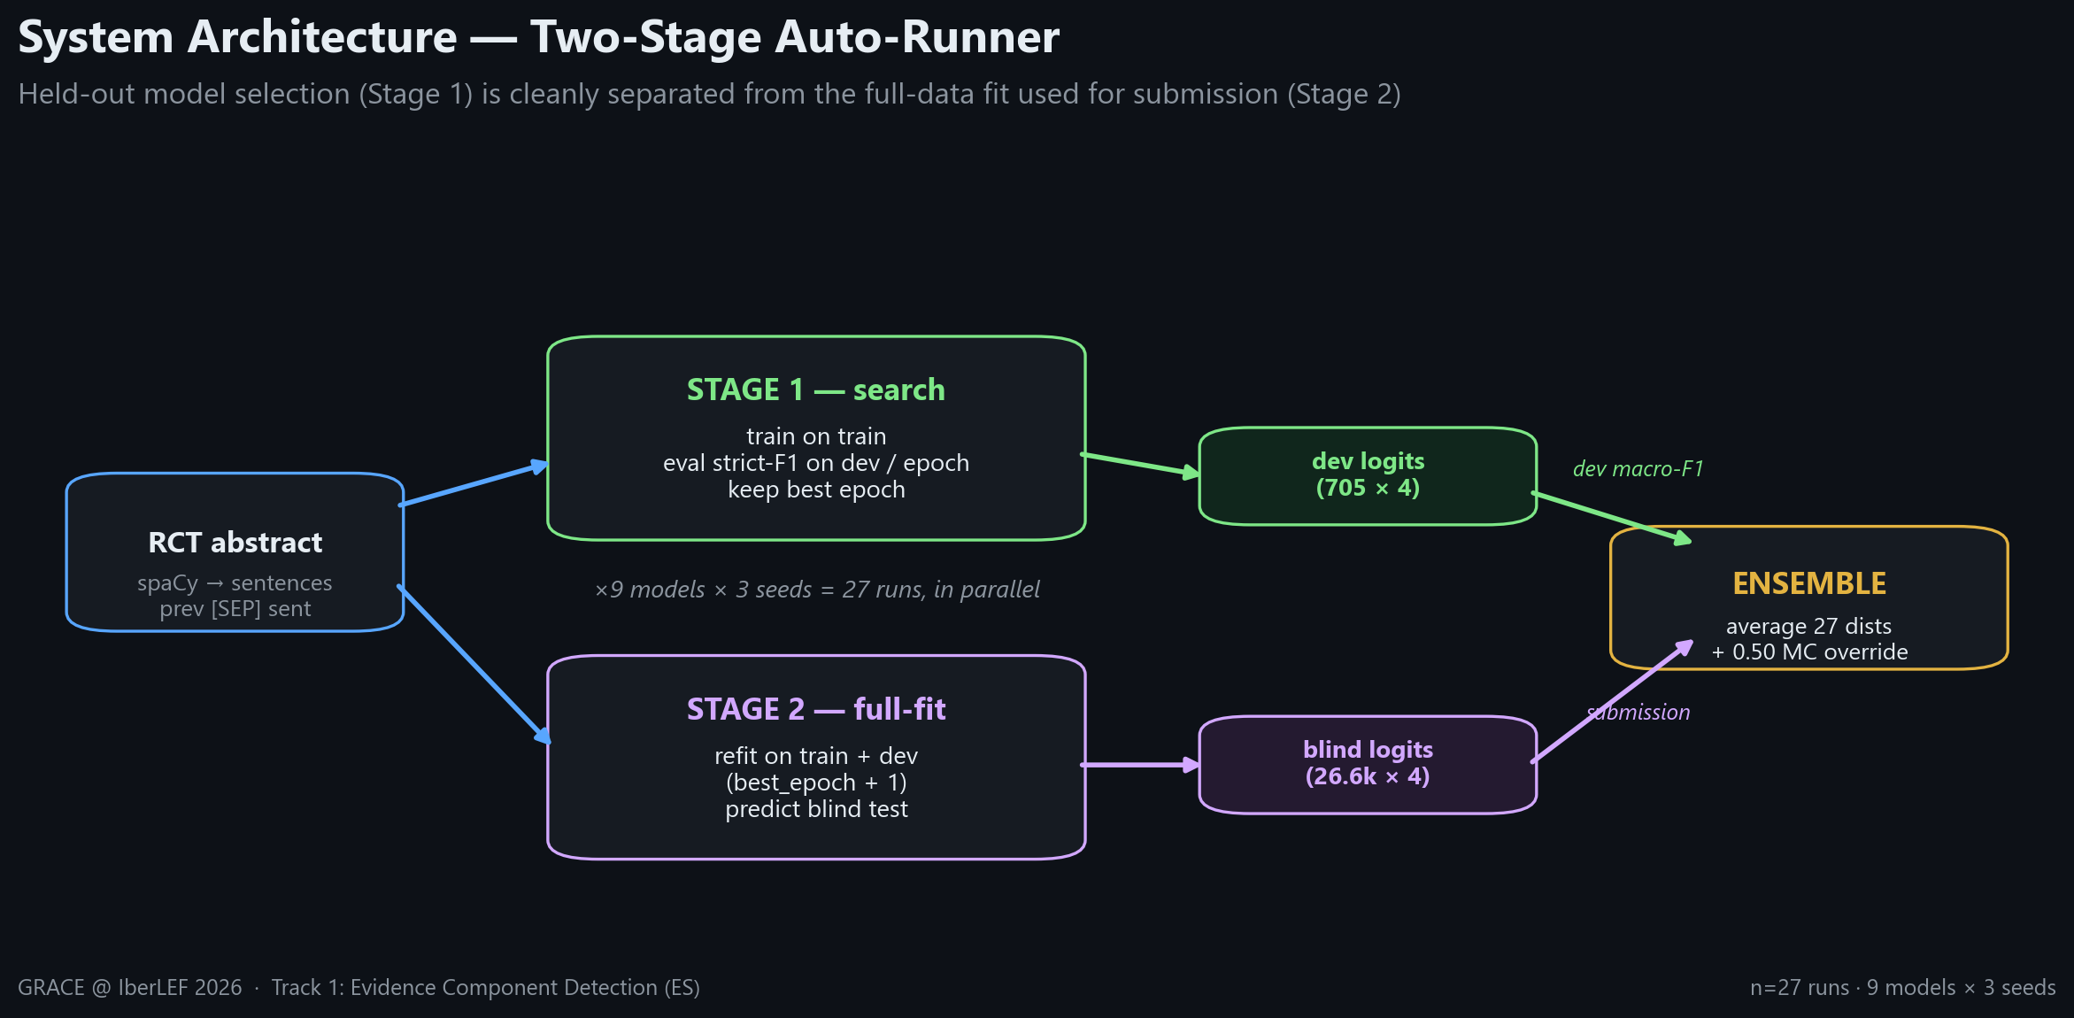
System Architecture
One pipeline, two stages, 27 runs in parallel
Stage 1 selects the best epoch on held-out dev; Stage 2 refits on all data for the submission.
GRACE @ IberLEF 2026 · Track 1: Evidence Component Detection (ES)
8 / 28

Slide 9
Input Representation
Context-aware sentence classification
Each sentence is classified together with the one before it:
[CLS] La calidad de vida fue similar en los dos grupos. [SEP] ← previous sentence (context)
El resultado de estos pacientes sigue siendo insatisfactorio. [SEP] ← target sentence (the one we label)
Why previous-sentence context?
Argument role is relational — a Claim often follows the Premises that support it. The preceding sentence gives the encoder that discourse cue.
Segmentation
spaCy es_core_news_sm splits abstracts into sentences; segments shorter than 10 characters are dropped as noise.
Length budget
max_len 192 tokens comfortably covers a sentence pair in clinical Spanish without truncation in the vast majority of cases.
GRACE @ IberLEF 2026 · Track 1: Evidence Component Detection (ES)
9 / 28

Slide 10
The 9 Backbones
General, biomedical, and clinical encoders — Spanish and multilingual
Model | Pretraining domain | Language | Size | Dev macro-F1
mDeBERTa-v3-base | General web | Multilingual | base | 0.705
bsc-bio-ehr-es | Biomedical + clinical EHR | Spanish | base | 0.702
MrBERT-es | General (ModernBERT) | Spanish + English | base | 0.696
RigoBERTa-Clinical | Clinical | Spanish | large | 0.692
MrBERT-biomed | Biomedical | Spanish + English | base | 0.691
roberta-clinical-es | Biomedical + clinical | Spanish | base | 0.685
XLM-RoBERTa-large | General web (100 langs) | Multilingual | large | 0.677
BETO | General web | Spanish | base | 0.675
BETO-Galén | Clinical (Galén) | Spanish | base | 0.568
Selected to span the pretraining spectrum — does clinical pretraining beat a strong multilingual general model? (It doesn't, quite.)
GRACE @ IberLEF 2026 · Track 1: Evidence Component Detection (ES)
10 / 28

Slide 11
Training Setup
Identical recipe across all 9 backbones for a fair comparison
Handling class imbalance
Optimisation
Weighted cross-entropy
Per-class weights with MajorClaim set to 10× to counter its 2.8% frequency.
Differential LR
Body 1e-5, classifier head 1e-4 (AdamW, weight decay 0.05).
Label smoothing 0.15
Reduces over-confidence on the dominant Premise class and improves calibration.
Cosine schedule
100 warmup steps, batch size 16, up to 15 epochs.
0.50 MajorClaim override
Promote a segment to MajorClaim when its probability clears 0.50 — recovers recall on the rare class.
Early stopping
Patience 4 on dev strict macro-F1; best epoch restored (load-best-at-end).
GRACE @ IberLEF 2026 · Track 1: Evidence Component Detection (ES)
11 / 28

Slide 12
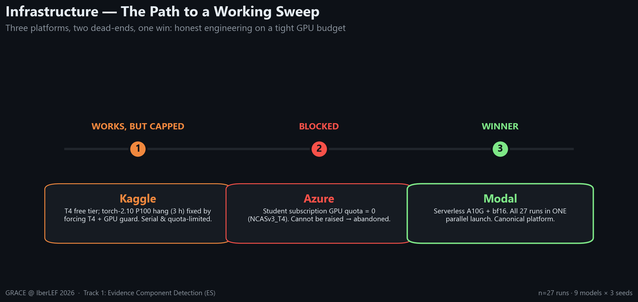
Infrastructure — The Path to a Working Sweep
Three platforms, two dead-ends, one win on a tight GPU budget
Live monitoring was essential — it exposed the silent P100 hang that looked like normal training.
GRACE @ IberLEF 2026 · Track 1: Evidence Component Detection (ES)
12 / 28

Slide 13
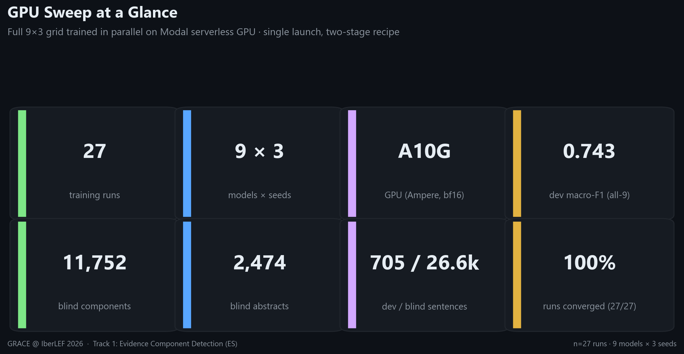
Infrastructure — One Parallel Sweep
The full 9×3 grid trained in a single Modal launch
GRACE @ IberLEF 2026 · Track 1: Evidence Component Detection (ES)
13 / 28

Slide 14
Deep-Dive — The bf16 Fix
How a precision setting turned the worst model into the best
Symptom
Under fp32, mDeBERTa-v3 produced grad_norm = NaN within the first epoch and collapsed to 0.0 macro-F1 — effectively unusable.
Diagnosis
mDeBERTa-v3's disentangled attention is numerically sensitive; fp32 mixed with the training dynamics overflowed. A common Kaggle workaround was pinning an older transformers version.
Fix
Train in bf16 on Ampere (A10G). bf16's wider dynamic range stabilises the gradients without loss scaling — no version pinning needed.
Result
mDeBERTa-v3 became the #1 single backbone at 0.705 ± 0.028 dev macro-F1. The right precision mattered more than the architecture.
GRACE @ IberLEF 2026 · Track 1: Evidence Component Detection (ES)
14 / 28

Slide 15
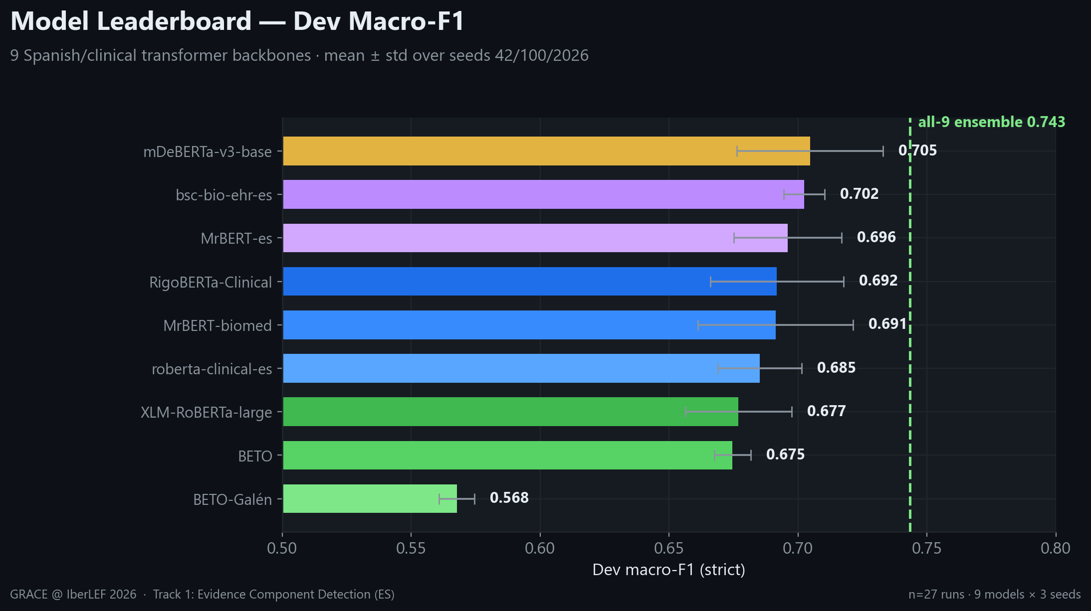
Results — Model Leaderboard
Dev strict macro-F1, mean ± std over 3 seeds
Clinical pretraining helps, but multilingual mDeBERTa-v3 wins; the ensemble line (0.743) clears every single model.
GRACE @ IberLEF 2026 · Track 1: Evidence Component Detection (ES)
15 / 28

Slide 16
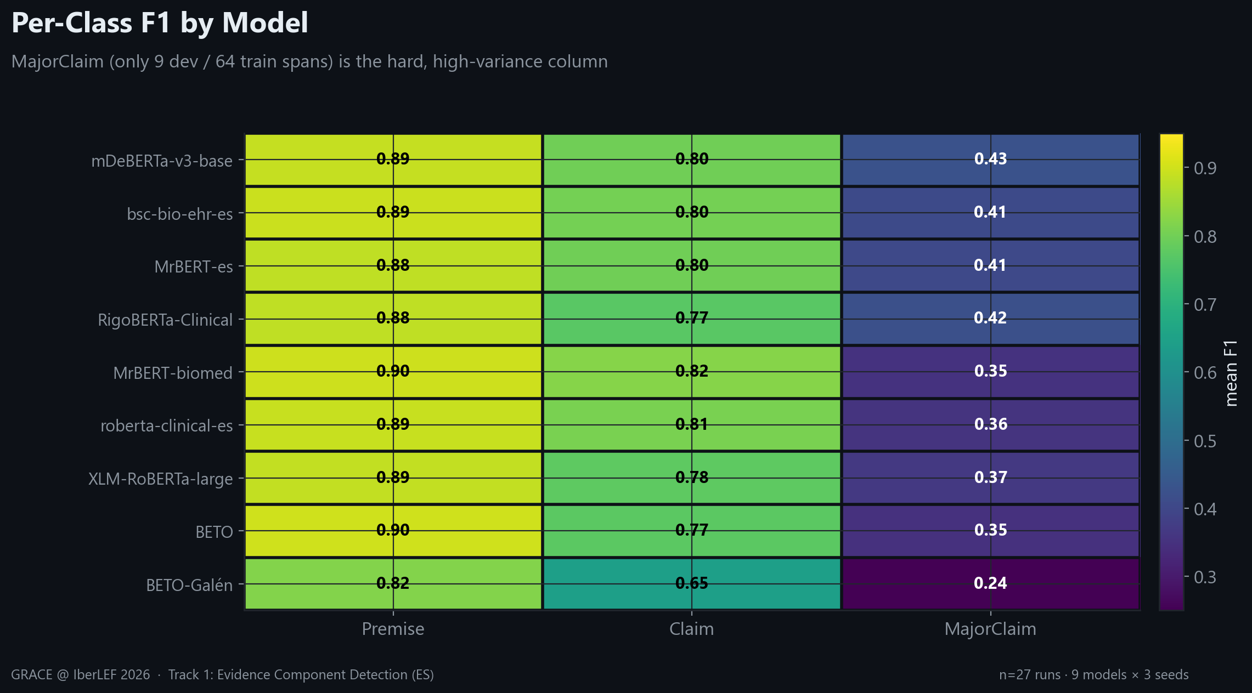
Results — Per-Class Breakdown
Premise is easy; MajorClaim is the universal weak spot
0.82–0.90 on Premise vs 0.24–0.43 on MajorClaim — a data-scarcity ceiling, not a model defect.
GRACE @ IberLEF 2026 · Track 1: Evidence Component Detection (ES)
16 / 28

Slide 17
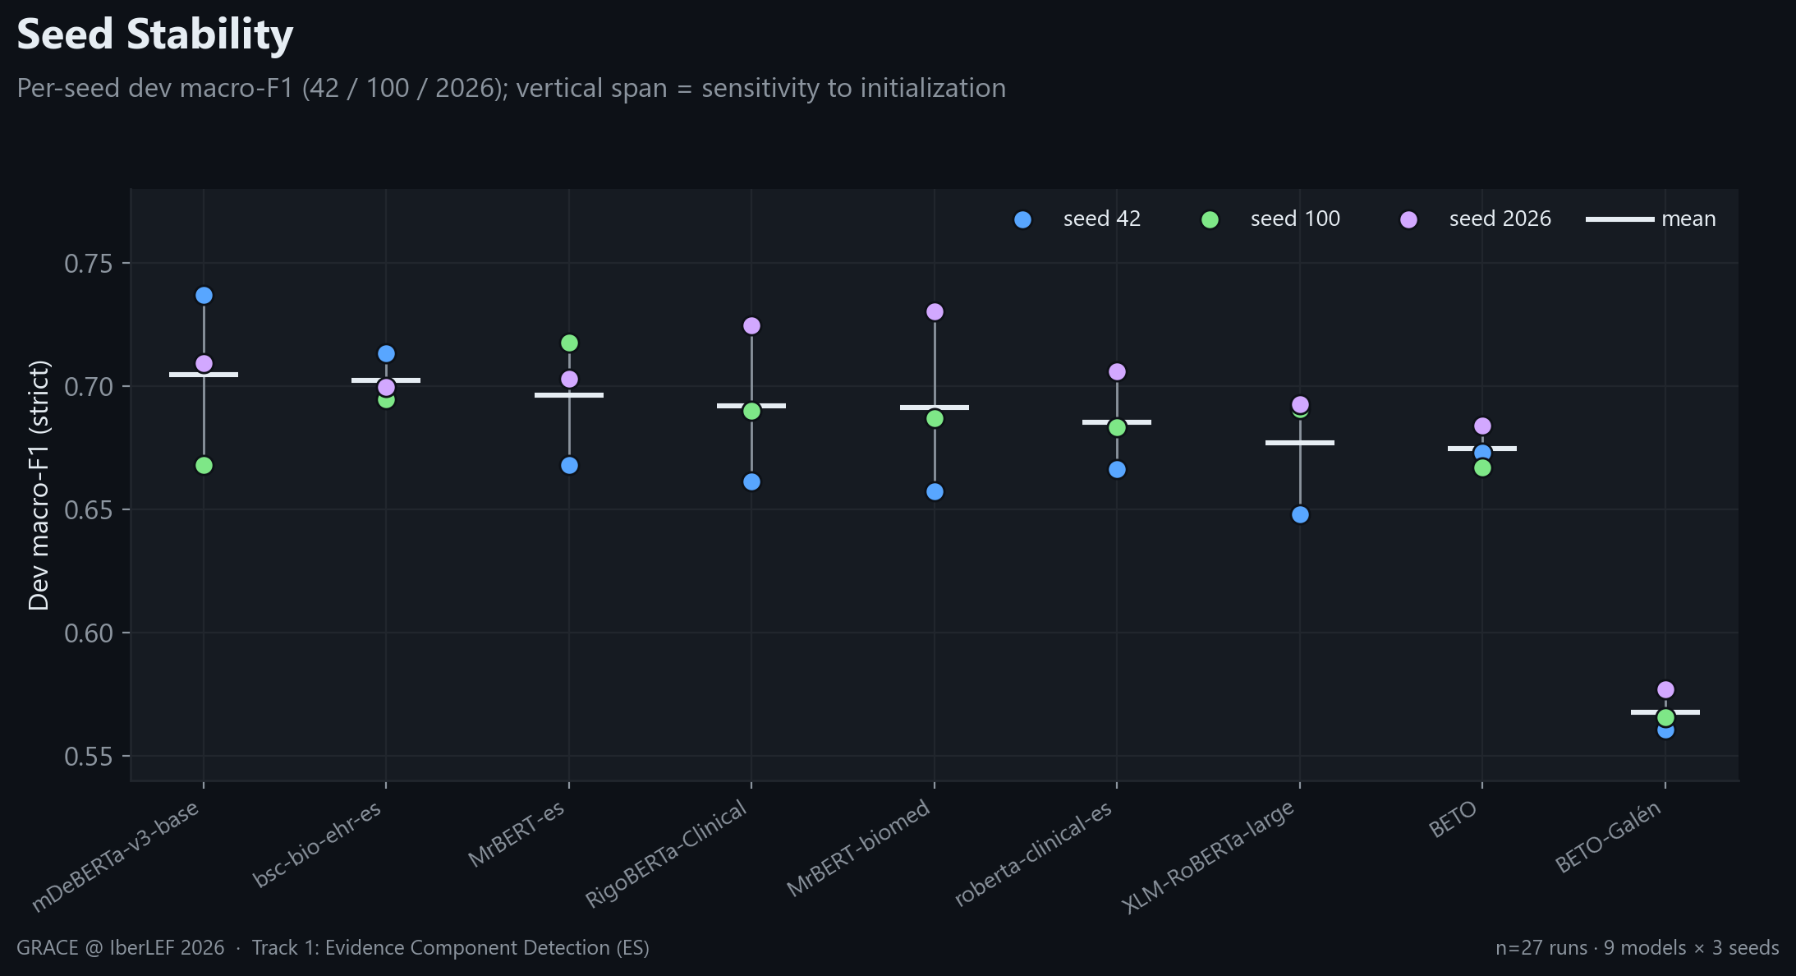
Results — Seed Stability
Why we report mean ± std, not a single lucky run
Seed spread reaches ~0.07 macro-F1 — single-seed leaderboards are unreliable on data this small.
GRACE @ IberLEF 2026 · Track 1: Evidence Component Detection (ES)
17 / 28

Slide 18
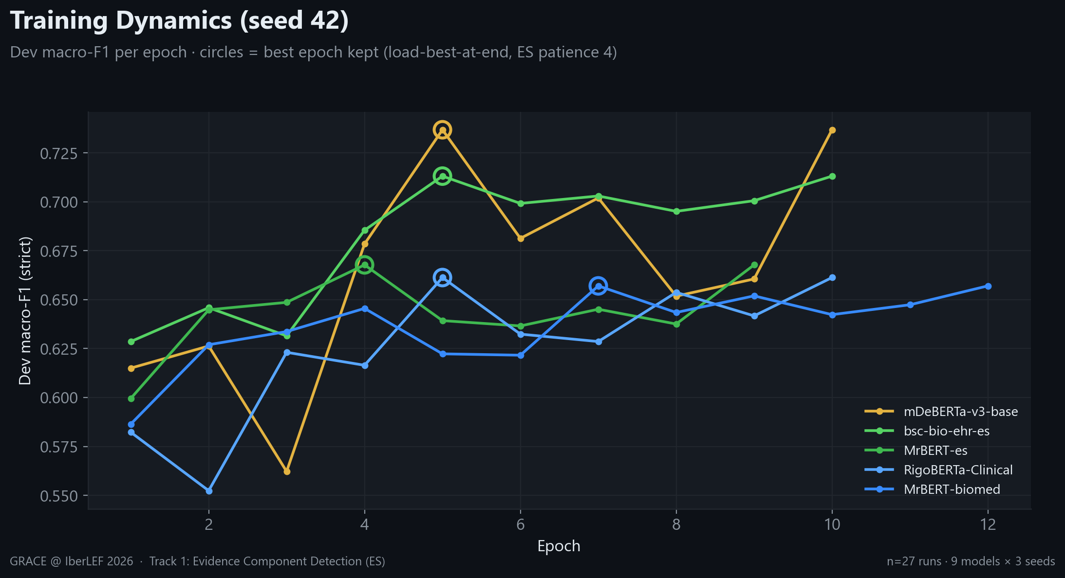
Results — Training Dynamics
Fast convergence; best epoch kept via load-best-at-end
The five strongest models peak within 4–7 epochs (seed 42); early stopping (patience 4) prevents overfitting on 350 docs.
GRACE @ IberLEF 2026 · Track 1: Evidence Component Detection (ES)
18 / 28

Slide 19
Error Analysis — Where Models Struggle
Three recurring failure modes, all concentrated in the harder classes
MajorClaim ↔ Claim confusion
The two are linguistically similar (both interpretive); with only 9 dev / 64 train MajorClaim spans, models under-recall it and frequently label it Claim instead.
Strict boundaries penalise near-misses
Sentence-level spans sometimes differ from gold clause-level annotations by a few tokens — correct in spirit, but counted wrong under exact-offset strict matching.
Premise is near-saturated
At 0.82–0.90 F1 across all models, Premise offers little headroom — gains must come from the rare classes, where data is scarcest.
GRACE @ IberLEF 2026 · Track 1: Evidence Component Detection (ES)
19 / 28

Slide 20
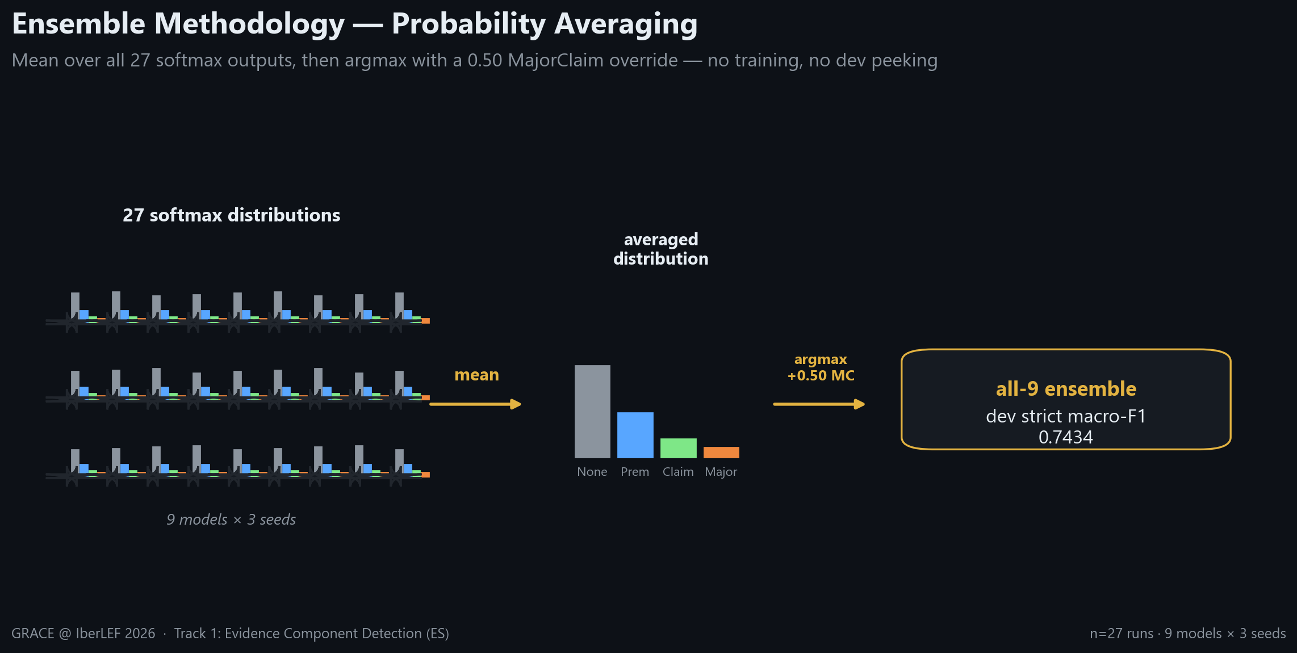
Ensemble — Methodology
Probability averaging over all 27 runs
Average softmax outputs (mean over seeds, then over models), then argmax with the 0.50 MajorClaim override.
GRACE @ IberLEF 2026 · Track 1: Evidence Component Detection (ES)
20 / 28

Slide 21
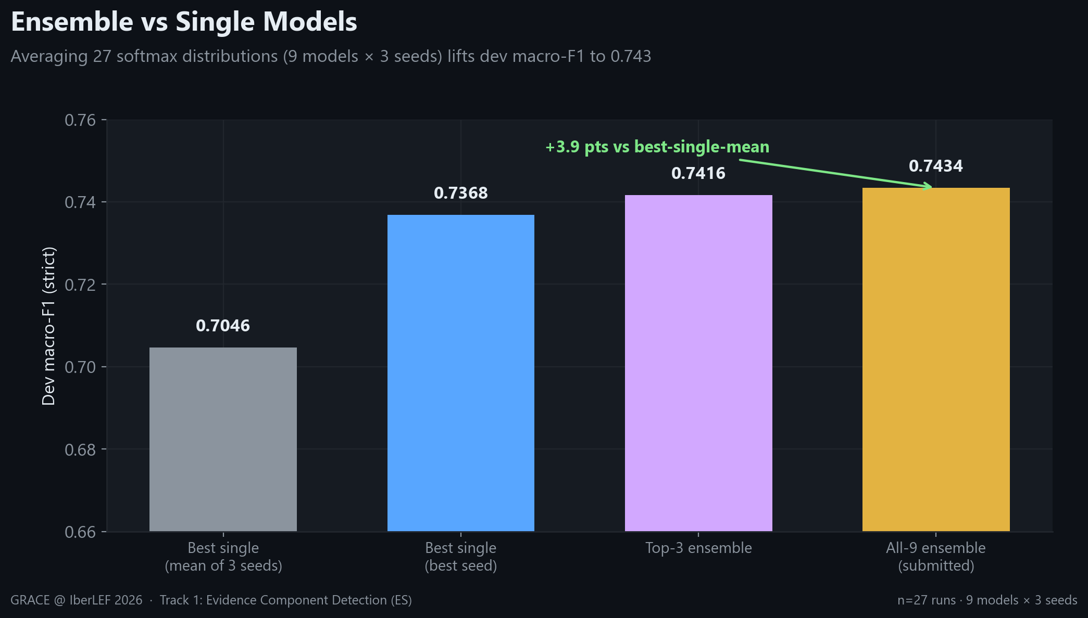
Ensemble — Honest Model Selection
All-9 averaging beats every single model AND dev-selected top-3
All-9 (0.7434) > top-3 (0.7416): the zero-peek choice is also the best → submit all-9, no selection bias.
GRACE @ IberLEF 2026 · Track 1: Evidence Component Detection (ES)
21 / 28

Slide 22
Blind-Test Submission — Generation & Validation
Applying the all-9 ensemble to 2,474 unseen abstracts
2,474
abstracts
26,640
sentences
11,752
components
0
offset mismatches
Stage-2 logits
Predictions come from models refit on train+dev — the full-data fit, not the dev-selection fit.
Offset validation
Every predicted span satisfies raw_text[start:end] == text after trimming spaCy's trailing whitespace (135 → 0).
Sanity check
Premise/Claim proportions match the training prior; MajorClaim is predicted conservatively (1.4% vs 2.8%) — no degenerate single-class collapse.
GRACE @ IberLEF 2026 · Track 1: Evidence Component Detection (ES)
22 / 28

Slide 23
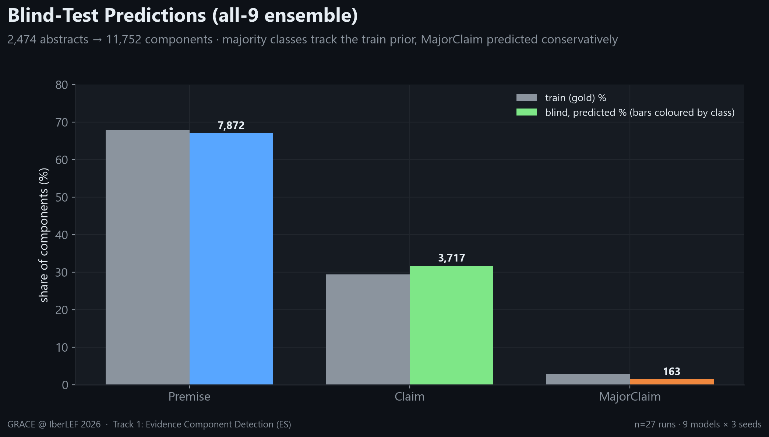
Blind-Test Submission — Predicted Distribution
All-9 ensemble output across the unseen abstracts
Premise/Claim mirror the training prior; MajorClaim is predicted more conservatively — the ensemble generalises without collapsing to one class.
GRACE @ IberLEF 2026 · Track 1: Evidence Component Detection (ES)
23 / 28

Slide 24
Beyond the Core Benchmark — What We Explored
The sentence-level recipe was selected after a broader search
Architecture variants
Focal loss, a CRF decoding layer, and a BiLSTM head were trialled on the encoder baseline before settling on the simpler, more reliable sentence-level classifier.
Relation classification (Track 2)
An NLI-style relation classifier for Support / Attack / Partial-Attack between components — the natural next step on top of detected evidence.
Data strategies
Rare-class oversampling, external clinical corpora, and LLM-based synthetic augmentation to attack the MajorClaim scarcity directly.
Why the sentence-level recipe won
It was the most robust and reproducible across backbones and seeds — the right foundation for a fair 27-run benchmark and a trustworthy ensemble.
GRACE @ IberLEF 2026 · Track 1: Evidence Component Detection (ES)
24 / 28

Slide 25
Engineering Lessons
Four takeaways that generalise beyond this task
Precision can unlock a model
Ampere bf16 turned mDeBERTa-v3 from a NaN collapse into the #1 backbone — the numerical setup mattered more than the architecture choice.
Ensembling is the cheap, honest win
Averaging 27 distributions adds +3.9 pts over the best single model with zero extra training, and — chosen as all-9 — carries no selection bias.
Report distributions, not lucky seeds
Up to ~0.07 seed spread on 350 docs makes single-seed rankings unreliable; mean ± std over 3 seeds is the defensible comparison.
Monitor training live
The silent P100 hang looked like normal training — only live log monitoring revealed it. Trust, but verify your GPU is actually working.
GRACE @ IberLEF 2026 · Track 1: Evidence Component Detection (ES)
25 / 28

Slide 26
Limitations & Future Work
Honest scope and the road ahead
Limitations
Future work
Sentence-level granularity
Cannot recover sub-sentence clause spans that strict matching rewards.
Clause-level segmentation
Predict intrasentence spans to align with gold boundaries.
Tiny dev set
50 docs / 9 MajorClaim spans → wide confidence intervals on the rare class.
MajorClaim augmentation
Targeted synthetic / contrastive data for the weakest class.
Dev-only estimate
Blind labels are unreleased; 0.743 is our dev estimate, not a leaderboard score.
Track 2 relations
Support / Attack / Partial-Attack detection on the detected components.
GRACE @ IberLEF 2026 · Track 1: Evidence Component Detection (ES)
26 / 28

Slide 27
Key Takeaways
0.743
dev strict macro-F1 from the bias-free all-9 ensemble
+3.9 pts
ensemble gain over the best single model — no extra training
27 / 27
runs converged in one parallel Modal launch
In one sentence:
A disciplined 27-run benchmark plus a zero-peek ensemble delivers a strong, reproducible Spanish clinical argument-mining system — and the remaining headroom is a data problem (MajorClaim), not a modelling one.
Methodology that travels:
• Get the numerics right before blaming the architecture. • Prefer bias-free ensembling to dev-tuned selection. • Rank on mean ± std, never a lucky seed.
GRACE @ IberLEF 2026 · Track 1: Evidence Component Detection (ES)
27 / 28

Slide 28
Thank you
Questions & discussion welcome
GRACE @ IberLEF 2026 · Track 1 — Evidence Component Detection (ES)
Reproducible pipeline: modal_sweep.py → modal_ensemble.py → report/ (figures · DOCX · PPTX)
GRACE @ IberLEF 2026 · Track 1: Evidence Component Detection (ES)
28 / 28

