Slide 1
COURSE TOPIC 4 · AUTOMATIC SEARCH-BASED TESTING OF AUTONOMOUS SYSTEMS
AmbieGen
Search-Based Test Case Generation for Autonomous Systems
test case = [[type, attr, attr], …] -> simplified model -> fitness + novelty -> NSGA-II
The paper
The tool
Our runs
Humeniuk, Khomh, Antoniol - “AmbieGen: A Search-based Framework for Autonomous Systems Testing”, Science of Computer Programming 230 (2023), art. 102990 · arXiv:2301.01234
github.com/swat-lab-optimization/AmbieGen-tool - MIT license, v0.1.0, built on Pymoo; winner of the SBST 2022 tool competition
Built-in robot study + our team case study “Mountain Pass”, executed and logged 2026-10-16 - artifacts in tss/course-ambiegen/evidence/
Presenter 1 - problem · framework · method | Presenter 2 - case studies · results · live demo
2 students × 10 minutes - the deck is split into two labeled parts

Slide 2
20-MINUTE TALK · TWO PRESENTERS
Today: from the testing problem to a live demo
01
Part 1 - Problem · Framework · Method
02
Part 2 - Case Studies · Results · Demo
Presenter 1 · ~10 minutes
Presenter 2 · ~10 minutes
Why testing autonomous systems is hard
Paper results: failures found vs random search
AmbieGen: model-in-the-loop idea + framework
Built-in case study run: robot mazes (live)
Test representation, algorithms, fitness, novelty
Team case study: “Mountain Pass” roads (live)
Operators, defaults and run outputs
Strengths, limits and conclusions
Every claim in this deck is backed by an artifact: the paper (arXiv:2301.01234), the AmbieGen-tool repo, or our own logged runs in evidence/.
2

Slide 3
01
PART 1 · PRESENTER 1 · ~10 MINUTES
Problem · Framework · Method
What makes testing autonomous systems hard, and how AmbieGen searches for the critical scenarios
The problem: huge parameter space, rare failures
The framework: model-in-the-loop + Pymoo core
The method: representation, algorithms, fitness, novelty
3

Slide 4
PART 1 · THE PROBLEM
Testing autonomous systems does not scale by hand
The parameter space is too large
Road geometry, obstacle layouts, sensor ranges - simulating every scenario is impossible; the paper's premise is a space too large for exhaustive simulation.
Two systems under test in the paper
Robot - Pioneer 3-AT
Critical failures are rare
SICK LMS200 laser (10 m range), nearness-diagram obstacle-avoidance navigation, simulated in Player/Stage.
A random scenario almost never pushes the system to its limits - the dangerous configurations cluster in small pockets of the space.
Hand-designed tests do not scale
Engineers write typical cases; the failures live in atypical ones. AmbieGen searches for them automatically instead of guessing.
Vehicle - Lane Keeping Assist
Tested in BeamNG.tech. Failure criterion: more than 85% of the car's area leaving the lane; speed capped at 70 km/h.
AmbieGen's answer: let an evolutionary algorithm search the scenario space, scoring each candidate on a fast simplified model of the system.
!
A test is “fault-revealing” when it breaks the system like this.
Source: Humeniuk et al., SCP 2023 (arXiv:2301.01234), §Introduction
4

Slide 5
PART 1 · THE IDEA
Evolve scenarios against a cheap model of the system
Test case
Simplified model
Fitness + novelty
Evolutionary search
Test suite
genotype: a list of environment elements
kinematic car / A* planner - cheap to evaluate
how fault-revealing and how different
NSGA-II: select · crossover · mutate
validate on the full simulator
one search loop - defaults: population 100 × 100 generations, crossover 0.9, mutation 0.4 (config.py)
Why a simplified model inside the loop?
The full simulator (BeamNG.tech, Player/Stage) is far too slow to evaluate thousands of candidate scenarios. AmbieGen evolves against a cheap model of the system under test, so every evaluation is fast, and only the final test suite goes to the real simulator - the paper completes a 2-hour budget per run.
Source: Humeniuk et al., SCP 2023 - model-in-the-loop testing
5

Slide 6
PART 1 · THE FRAMEWORK
AmbieGen: a modular tool built on the Pymoo core
Open source
AmbieGen-tool - MIT license · v0.1.0
github.com/swat-lab-optimization/AmbieGen-tool - MIT license; the exact tool behind the paper's experiments (cloned and executed by us).
Pymoo evolutionary core - GA · NSGA-II · Random search
Modular by design
extension points - implement 4 classes to add a system under test
A new system under test plugs in as Problem + Sampling + Operators + Solution classes - no changes to the core.
Problem
Sampling
Crossover / Mutation
Solution
Competition-proven
Winner of the SBST 2022 tool competition: the most diverse fault-revealing scenarios under a limited time budget.
shipped systems under test
Reproducible runs
robot - Player/Stage
vehicle LKAS - BeamNG.tech
random seeds, duplicate elimination, stats + convergence logs, and compare.py boxplots for algorithm face-offs.
search operators + samplers are pluggable the same way
Sources: repo README (Installation, Adding a new problem) · paper §framework · ambiegen/__init__.py:1-9
6

Slide 7
PART 1 · TEST REPRESENTATION
A test case is just an array of environment elements
Robot - maze elements
Vehicle - road segments
element = [type, size, x]
element = [type, length, angle]
type: 0 = horizontal wall · 1 = vertical wall
type: 0 = straight · 1 = turn right · 2 = turn left
[1, 15, 40] -> vertical wall, size 15, at x = 40
[1, 0, 75] -> turn right by 75°
Genomes are variable-length - crossover works across different lengths
A real genome from our team run - tc0, all 7 segments verbatim (opens with 75° and 76° turns):
[[1,0,75],[2,0,76],[0,10,0],[0,7,76],[2,0,63],[0,9,0],[0,6,0]]
evidence/team/16-10-2026_team_tcs_nsga2/16-10-2026-tcs.json
Source: repo README - “Representation of the test cases”
7

Slide 8
PART 1 · THE SEARCH
Three algorithms, one Pymoo core
Key | Algorithm (Pymoo class) | Objectives | Role
nsga2 | NSGA-II - multi-objective GA (default) | 2: fitness + novelty | best suites: critical AND diverse
ga | Genetic algorithm - single objective | 1: fault-revealing fitness | fast single-objective baseline
random | Random search (RandomSearch) | - | control baseline for comparison
Fitness values are negative and minimized by Pymoo - so “minimizing” fitness means maximizing how fault-revealing (or how novel) a scenario is. The algorithm is wired with problem-specific sampling, crossover and mutation, plus duplicate elimination.
The command line (what we will run in the demo)
python optimize.py --problem {robot | vehicle} --algorithm {nsga2 | ga | random} --runs 1 --seed 42
verified flags; the README's example uses --algo, which does not exist (the real flag is --algorithm, optimize.py:58)
Sources: ambiegen/__init__.py:1-9 (registry) · optimize.py:86-120 · CLI verified via --help
8

Slide 9
PART 1 · FITNESS FUNCTION
Fitness: make the system misbehave on the cheap model
Robot - maximize the A* path
Vehicle - maximize lane deviation
Obstacle map is built from the genotype's walls
Road points are spline-interpolated from the segments
A* plans a route from (1,1) to (map_size - 2, map_size - 2)
A kinematic bicycle model + waypoint-following controller drive the road
fitness = -(path length): a longer forced detour = a harder maze
fitness = -(max distance between car and road centreline)
Failure constraint: G = 150 - path -> fault-revealing when path > 150
Failure constraint: G = 5 - deviation -> failure when deviation > 5
Edge cases handled in code: invalid scenarios get fitness 0; self-intersecting roads cap the per-step distance at 3. Our team run raises the vehicle bar to 6.
Sources: robot_solution.py:34-58 · vehicle_evaluate.py:99-163 · kinematic_model.py · a_star.py
9

Slide 10
PART 1 · SECOND OBJECTIVE
Novelty: keep the test suite diverse
Pairwise novelty - a Jaccard-style distance between genotypes
Why a second objective?
novelty(a, b) = 1 - |a ∩ b| / ( |a| + |b| - |a ∩ b| )
NSGA-II balances fault-revealing against novel, so the suite contains different failures - not 10 near-copies of one. Diversity of failing scenarios is exactly the criterion AmbieGen won at SBST 2022.
Two elements “intersect” when they have the same type and near-equal attributes (tolerance: 5 for vehicle, 2 for robot).
A scenario's novelty = its average distance to the 5 most fault-revealing solutions in the current population.
Two objectives, one search
objective 1 = fault-revealing fitness (per system under test) · objective 2 = novelty vs the elite of the population - NSGA-II evolves a Pareto front of scenarios that are critical AND diverse.
Sources: vehicle_solution.py:64-101 · vehicle_problem.py:49-61 · robot_problem.py:24-39
10

Slide 11
PART 1 · OPERATORS & OUTPUTS
Operators, defaults, and what a run produces
Search operators
Shipped defaults (config.py)
pop_size 100 · n_gen 100 · mut_rate 0.4
cross_rate 0.9 · test_suite_size 10
Crossover - one-point, p = 0.9
a random cut in the element list; the tails are swapped (works across different lengths)
paper experiments used 150 × 200 - our demo runs use a bounded 20 × 15 budget
Mutation - p = 0.4, 1-3 repeats
exchange two random elements, or re-roll one element's type + attributes
Every run writes
stats JSON - suite fitness list + novelty · convergence JSON
Sampling - random valid scenarios
test cases JSON - the genomes of the suite
e.g. roads grown from random straight/right/left actions until the map border, then validity-checked
scenario PNGs - one rendered image per test case
duplicate elimination is built into every algorithm
16-10-2026_stats_nsga2/ · _tcs_nsga2/ · _tc_images_nsga2/
Sources: robot_crossover.py:31-50 · vehicle_mutation.py:23-77 · vehicle_sampling.py:22-56 · config.py:2
11

Slide 12
02
PART 2 · PRESENTER 2 · ~10 MINUTES
Case Studies · Results · Demo
What we ran on this machine - the paper's numbers, our built-in run, and our own team scenario
Paper results: failures found vs random search
Live demo A - built-in robot case study (~86 s)
Live demo B - team case study “Mountain Pass” (~6 s)
Strengths, limits, conclusions
12

Slide 13
PART 2 · PAPER RESULTS
More failures found than random search
Robot (Player/Stage) - avg failures in 2 h
LKAS (BeamNG.tech) - avg failures, SBST'22 pipeline
9 vs 2 failures on the robot, and 14 vs 9 on the LKAS vehicle - AmbieGen matches Frenetic on failures while also winning the diversity criterion (SBST 2022).
Source: Humeniuk et al., SCP 2023 - results sections (30 runs × 2-hour budget; NSGA-II 150 pop × 200 gens)
13

Slide 14
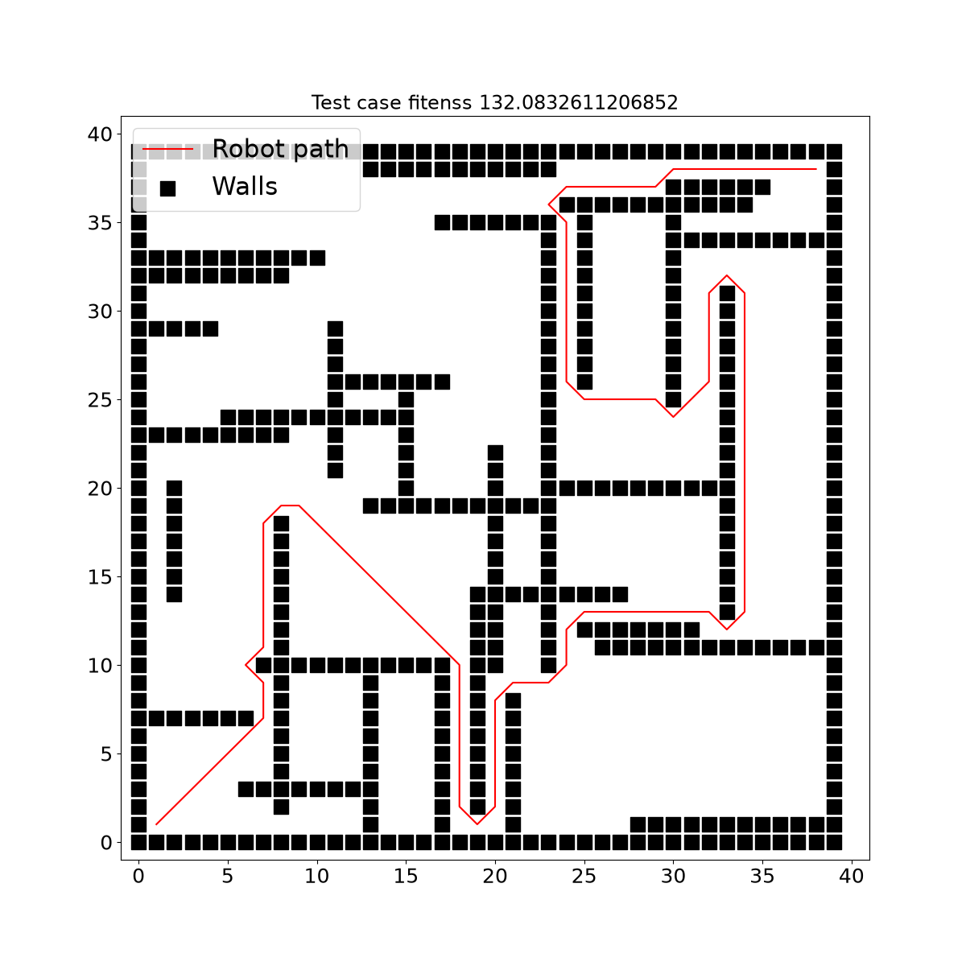
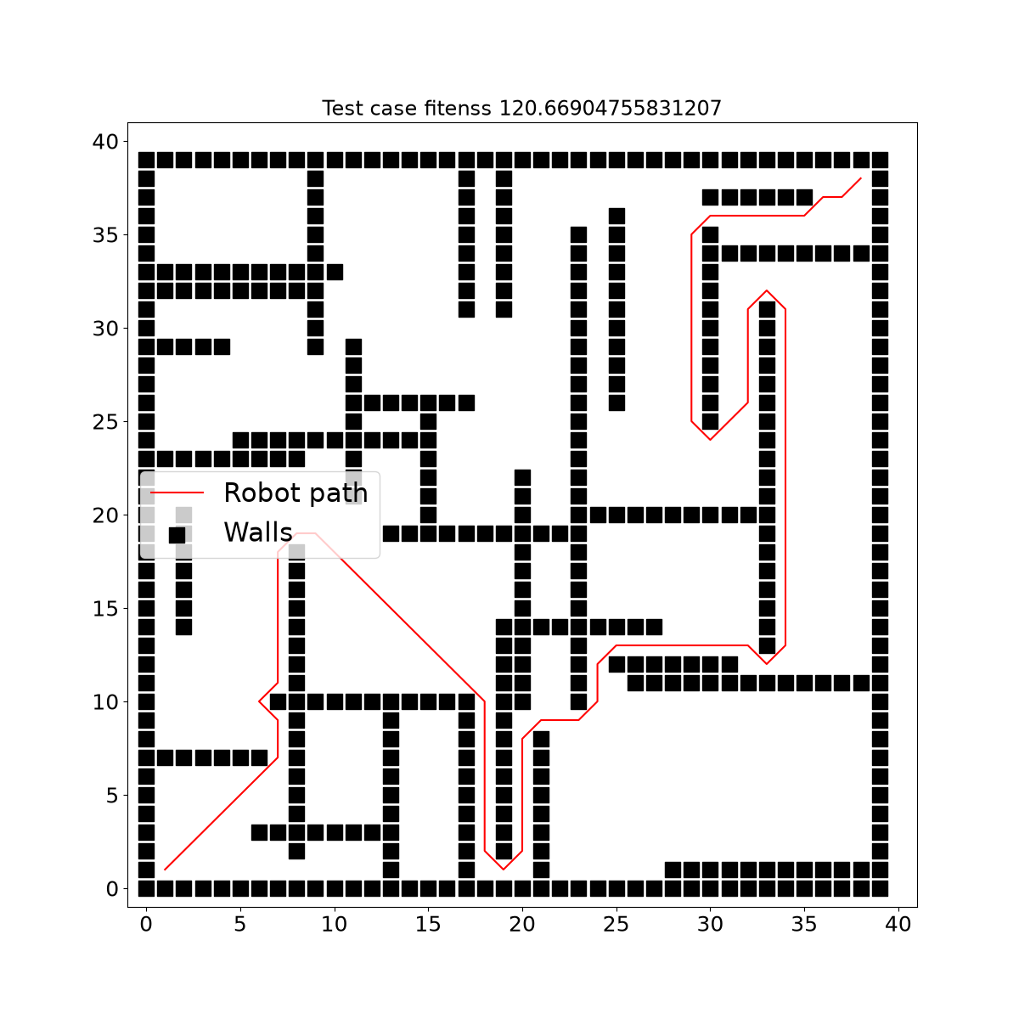
PART 2 · BUILT-IN CASE STUDY · OUR RUN
Robot mazes: the search at work in 86 seconds
85.5 s
Best-so-far fitness vs evaluations
wall clock · 300 evaluations · seed 42
132.1
best A* path length - a maze is fault-revealing above 150
tc0 - fitness 132.1
tc4 - fitness 120.7
0.437
Each image is one generated maze: the walls plus the A* path the robot is forced to take. A longer path means a harder maze (bar = 150).
suite novelty (average pairwise)
NSGA-II · pop 20 × 15 generations (bounded demo budget; shipped defaults are 100 × 100)
Live in the terminal: the pymoo table's cv_min column dropped 52.99 -> 17.92 - the search pushing path length toward the 150 bar.
Artifacts: evidence/builtin/run_log.txt · 16-10-2026_stats_nsga2/ · images 16-10-2026_tc_images_nsga2/run0/
14

Slide 15
PART 2 · TEAM CASE STUDY
“Mountain Pass”: our scenario for the LKAS vehicle
Setting | Shipped | Mountain Pass
map_size | 200 | 200
min_len | 5 | 5
max_len (straight cap) | 30 | 12 *
min_angle (turn) | 10° | 25° *
max_angle | 80° | 80°
failure threshold | 5 | 6 *
Why these changes
straights capped at 12 - the lane-keeper never gets a stable stretch to settle
every turn ≥ 25° - sustained, hairpin-like curvature
failure bar raised 5 -> 6 - harder to reveal a failure
How - zero repo files modified
scenario set through the native vehicle_env config, patched at runtime
* the three changes that define our scenario (config.py:5-11 defaults)
stricter constraint via subclass MountainVehicleProblem2Obj, registered as “vehicle_nsga2”
Scope, stated plainly: a team-designed scenario for the shipped LKAS SUT (runtime reconfiguration + one subclass) - not a brand-new SUT. The 4-class new-SUT recipe is mapped in research.md §6 and listed under “if we had more time” (slide 18).
runners/run_team_vehicle.py
Research question: can the search still push the simplified LKAS out of its lane on aggressive geometry and a higher failure bar?
Artifacts: runners/run_team_vehicle.py · evidence/team/team_scenario_config.json · evidence/team/README.md
15

Slide 16
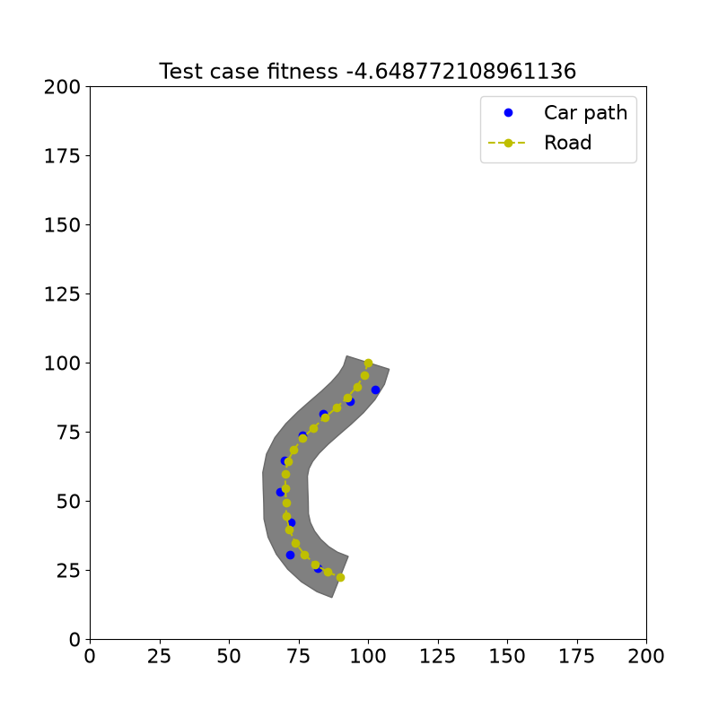
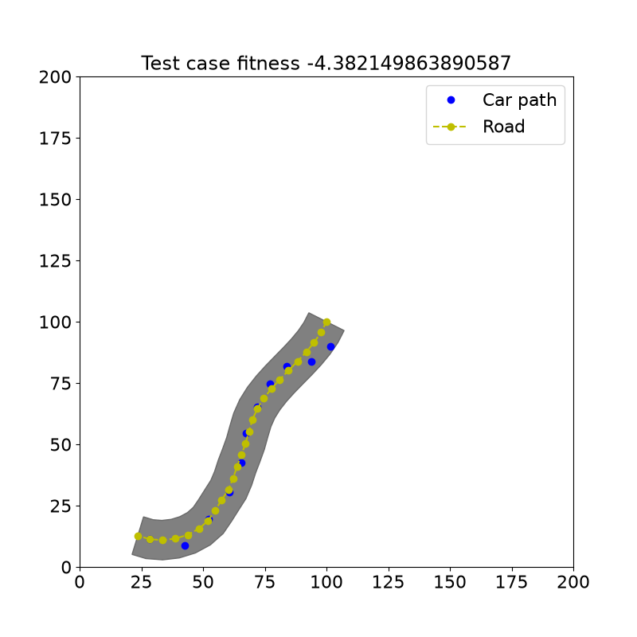
PART 2 · TEAM CASE STUDY · RESULTS
Mountain Pass: deviation pushed to 4.65 against a bar of 6
5.9 s
Best-so-far lane deviation vs evaluations
wall clock · 300 evaluations · seed 42
4.649
best max lane deviation - failure needs more than 6 (team bar)
tc0 - deviation 4.65
tc1 - deviation 4.38
2.36 -> 1.35
Gray band = the road polygon; blue dots = the car's path drifting away from the centreline through the hairpins.
constraint violation (cv_min) over 15 generations
0.583
suite novelty (average pairwise)
Read of the result: the best deviation rose 3.64 -> 4.65 and never regressed, but did not cross the stricter bar of 6 within this small budget - the expected effect of a higher threshold.
Artifacts: evidence/team/run_log.txt · 16-10-2026_team_stats_nsga2/ · images 16-10-2026_team_tc_images_nsga2/run0/
16

Slide 17
PART 2 · DISCUSSION
What we learned: strengths and limits
Strengths
Limits
Modularity is real
Surrogate, not reality
a new scenario needed only a runtime config patch + one subclass; the 4-class extension path is how the tool is actually built.
fitness uses simplified 2D models - no pedestrians, traffic or other cars in the representation (paper's future work).
Cheap fitness, big budget
Small problem zoo
simplified models keep evaluations fast - a 2-hour budget yields a 30-case suite in the paper.
two systems under test (robot, vehicle), three algorithms.
Dependency rough edges
Diversity as an objective
requirements.txt omits scipy/matplotlib/descartes; pymoo must stay pinned to 0.6.0 (0.6.1+ breaks _evaluate); descartes crashes with shapely >= 2.
novelty inside NSGA-II produced varied failing scenarios - the SBST 2022 winning criterion.
Reproducible tooling
Docs vs code
seeds, per-run stats, convergence logs, compare.py boxplots.
README example uses --algo; the real flag is --algorithm (optimize.py:58).
Limits verified in our session, 2026-10-16 (see research.md §5, §7)
17

Slide 18
PART 2 · CONCLUSIONS
Four takeaways
1
Search finds failures that random misses
9 vs 2 failures on the robot and 14 vs 9 on the LKAS vehicle, on the paper's 30-run × 2-hour budget.
2
The recipe: cheap model + novelty objective
surrogate fitness makes the loop fast; the second objective keeps the suite diverse - together they won SBST 2022.
3
Extensible in practice
we built the “Mountain Pass” scenario without modifying a single repo file - runtime config + one subclass.
4
Read the code, not just the README
pin pymoo==0.6.0, install the missing deps - and remember the fitness is a simplified model, not the real simulator.
If we had more time
full 100 × 100 run (~45-50 min, est. from our measured 85.5 s) · a brand-new SUT via the 4-class recipe · compare.py boxplots: NSGA-II vs random · quality-diversity search (paper's future work)
18

Slide 19
BOTH PARTS · BIBLIOGRAPHY
References
[1] The paper
Humeniuk, D., Khomh, F., Antoniol, G. “AmbieGen: A Search-based Framework for Autonomous Systems Testing.” Science of Computer Programming 230 (2023), art. 102990 · doi 10.1016/j.scico.2023.102990 · arXiv:2301.01234 (abstract + full HTML, fetched 2026-10-16).
[2] The tool
[3] Our artifacts
AmbieGen-tool - github.com/swat-lab-optimization/AmbieGen-tool, MIT license, v0.1.0, winner of the SBST 2022 tool competition; built on the Pymoo framework (pymoo.org). Cloned and executed by us, 2026-10-16.
research.md (verified knowledge base) · runners/run_builtin_robot.py, run_team_vehicle.py · evidence/builtin/, evidence/team/ (logs, stats, test cases, images) · demo-run.md, demo-script.md.
AI usage for this deliverable (tool, purpose, prompts, results, edits, validation) is documented in AI_USAGE.md.
Every slide also carries its own source line (paper section, repo file:line, or evidence/ artifact) - the full index is in research.md §8.
All sources below were fetched, cloned or executed in our session, 2026-10-16
19

Slide 20
PART 2 · LIVE DEMO
See it run - the exact commands
A
Built-in robot case study - ~86 s
B
Team “Mountain Pass” - ~6 s
cd tss\course-ambiegen
.venv\Scripts\python.exe runners\run_builtin_robot.py
.venv\Scripts\python.exe runners\run_team_vehicle.py
watch the pymoo table: cv_min 52.99 -> 17.92 · then the mazes in evidence\builtin\16-10-2026_tc_images_nsga2\run0\*.png
watch cv_min 2.36 -> 1.35 · then the roads in evidence\team\16-10-2026_team_tc_images_nsga2\run0\*.png
Where the numbers come from: every command, time and figure on these slides is reproduced in demo-run.md and demo-script.md, with logs under evidence/.
Thank you - questions?
Presenter 1 - problem · framework · method | Presenter 2 - case studies · results · demo | timings measured 2026-10-16

