Slide 1









GPCSSI-2025
Our Journey as a Cyber Warrior
Industrial Internship Details:-
Academic Information
Prem Singh -2315300018
Dushyant Nagal-2315300005
Mentor:- Soumya Shrivastava
University:-GLA University, Mathura
Platform:- Gurugram Cyber Cell Summer On-Site Internship
Department: Computer Science
Cyber Security
Technical Skills
Team Collaboration
Achievement

Slide 2
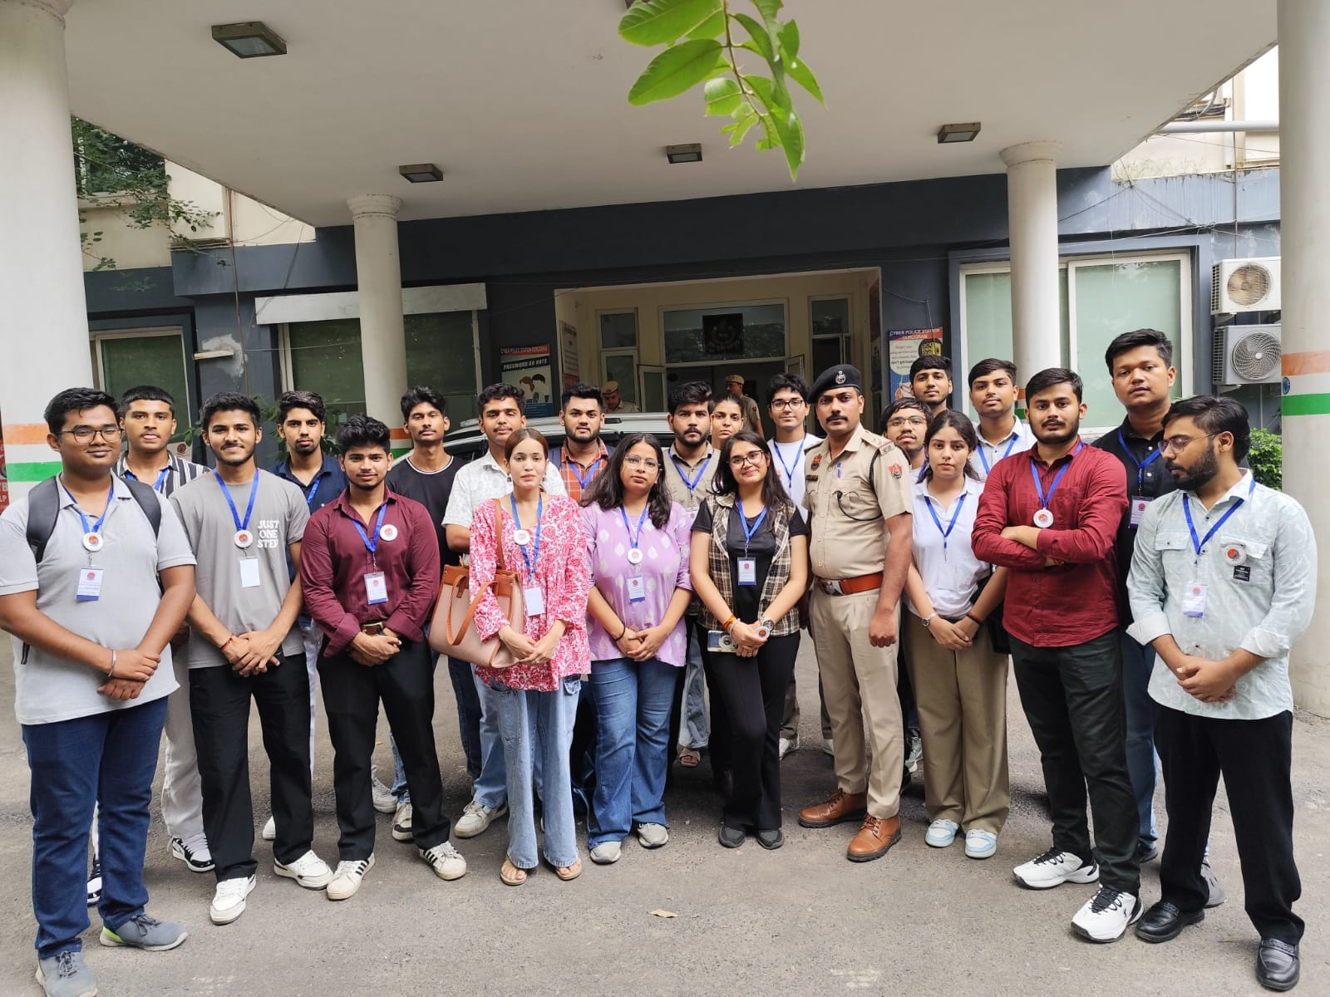







About GPCSSI 2025:-
Program Details
Organized by Gurugram Police Cyber Cell & DAV Public School, Sector 49
12th Edition of National Cyber Security Summer Internship
Duration: 48 days (on-site) + project during off-days
Selection Statistics
Mission
Build cyber-aware and technically skilled youth to combat evolving cyber threats
12,000+
Applicants
1,100
Selected
550
Warriors
550
Ambassadors

Slide 3
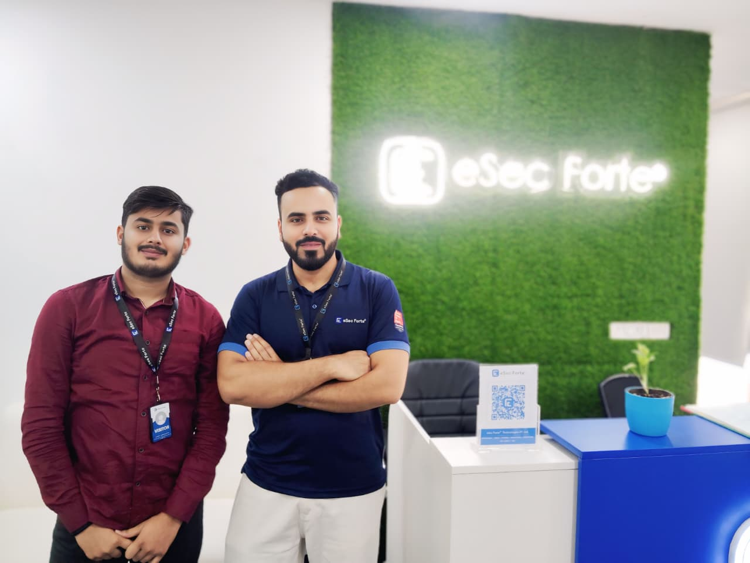
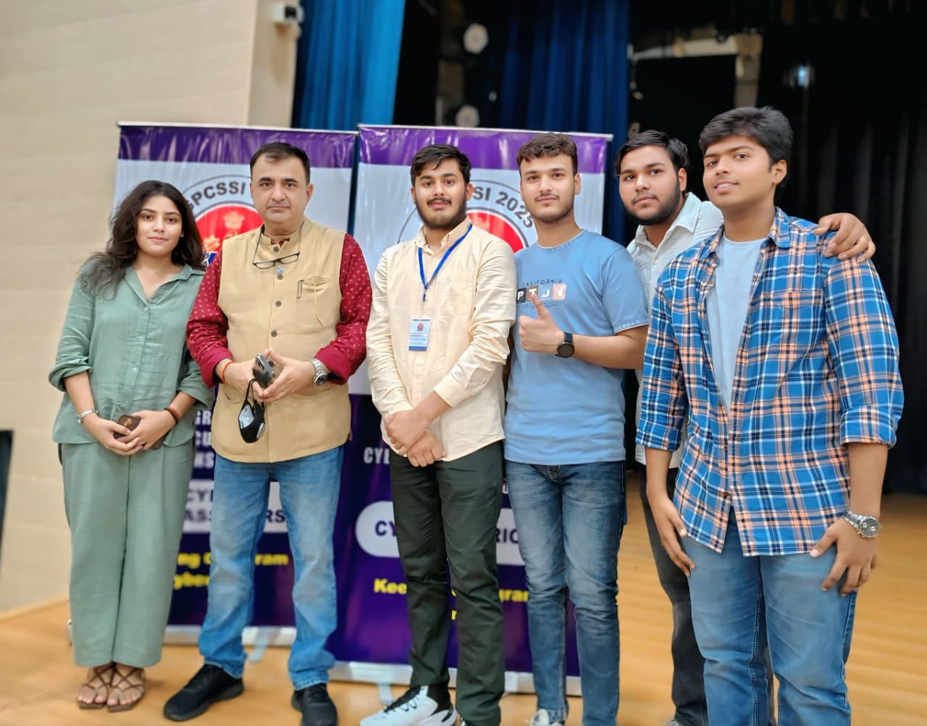











Internship Workflow Timeline:-
48-Day Journey at Gurugram Cyber Cell
Step 1
Orientation & Awareness
Step 2
Technical Labs
Step 3
Case Studies & Field Exposure
Step 4
Project Work (SKIDScan)
Step 5
Final Evaluation & CTF
All sessions conducted on-site at Gurugram Cyber Cell Project built during breaks and off-days

Slide 4












Awareness & Knowledge Sessions:-
Cyber Laws & IT Act 2000
Legal framework and regulatory compliance in cybersecurity
Cyber Awareness & Online Safety
Best practices for secure digital behavior and threat prevention
Drugs & Cyber Helpline Case Study
Real-world analysis of drug-related cybercrime investigations
Real Case Study: Mule Accounts
Investigation techniques for financial fraud and money laundering

Slide 5






Awareness & Knowledge Sessions:-
Cyber Harassment & Social Media Crimes
Digital forensics for online harassment and social platform abuse
AI vs Cyber Security
Artificial intelligence applications in threat detection and defense
Data Recovery & Advanced Collection Techniques
Forensic methods for evidence preservation and data extraction

Slide 6
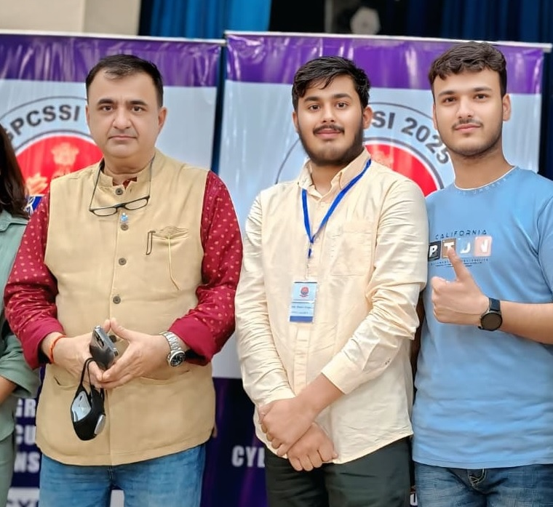





Expert Mentorship:-
Cyber Forensic Officers
Direct mentorship from experienced Cyber Forensic Officers providing real-world insights into digital investigation techniques and evidence handling procedures.
Dr. Rakshit Tandon
Expert guidance from renowned cybersecurity professional Dr. Rakshit Tandon, gaining insights into advanced cyber threat landscape and defense strategies.
Evidence Collection
Practical sessions on digital evidence gathering and preservation techniques
Malware Investigation
Hands-on analysis of malicious software and attack vectors
SOC Environment
Hands-on exposure to Security Operations Center environment, learning real-time threat monitoring and incident response protocols.

Slide 7












Mini Project SkidScan
Dark Web Monitor & Web Forensics
Objective
Detect and analyze leaked credentials & stolen data from dark web sources for cybersecurity intelligence gathering.
Tech Stack
Key Features
Safe .onion Crawling
Securely crawls dark web sites for sensitive data detection
Smart Filtering
Filters false positives using keyword scoring algorithms
Report Generation
Generates structured reports for comprehensive analysis
Python
Tor API
Outcome
Received Appreciation Letter from Gurugram Cyber Cell for innovation and technical excellence in cybersecurity research.
BeautifulSoup
SQLite

Slide 8
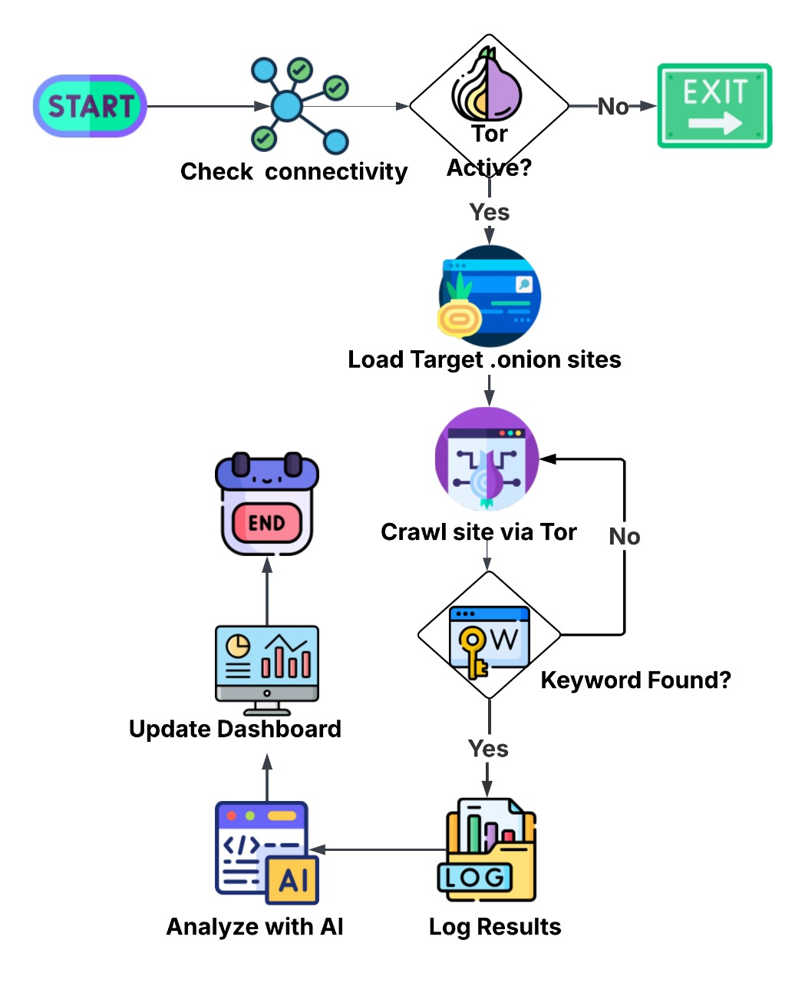

SkidScan Workflow:-
Crawler
Scans .onion sites safely through Tor network
Filter Engine
Keyword scoring to eliminate false positives
Report Generator
Comprehensive analysis reports for investigation
Security Architecture
Sandboxed VM
Isolated virtual environment for safe operation
Tor Bridge
Anonymous, secure crawling through encrypted network

Slide 9
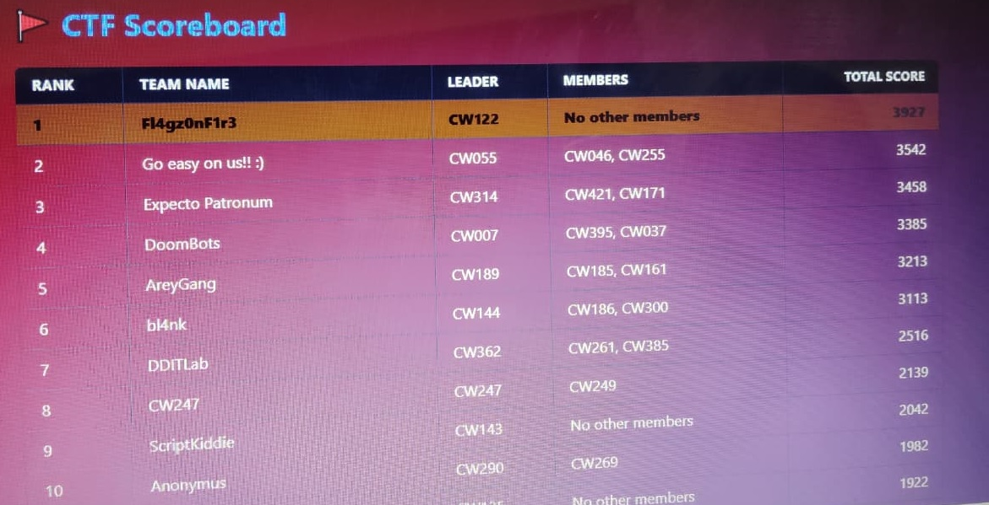











CTF Competition:-
Competition Overview
Web Security Challenges
Network Analysis Tasks
Digital Forensics Investigations
Skills Enhanced
Teamwork
Collaborative problem-solving and coordination
Analytical Skills
Critical thinking and pattern recognition
Investigation
Evidence analysis and threat detection
Achievement
TOP-10
Rank Among Nationwide Interns

Slide 10

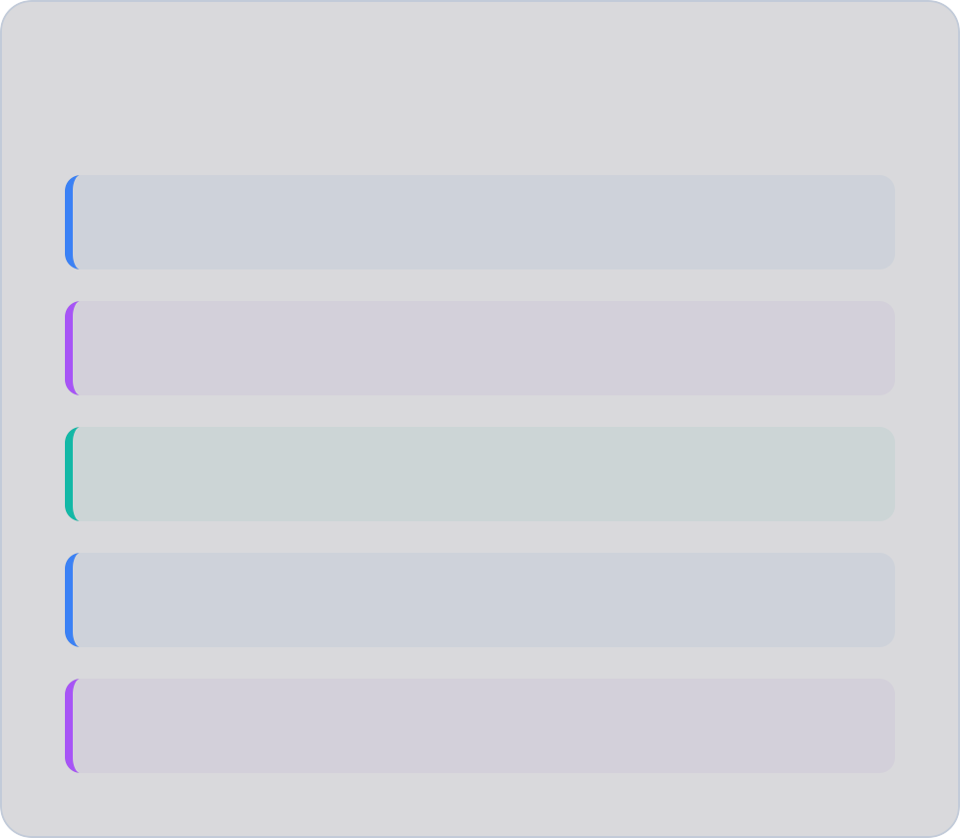










Technical Skills & Tools Learned
Core Skills
Forensics Analysis
Threat Detection SOC Log Correlation
Cybersecurity Tools
Wireshark
Burp Suite
Autopsy
Legal & Compliance
Nmap
FTK Imager
Digital Evidence Handling
Proper collection and preservation
Chain of Custody
Legal documentation standards

Slide 11
Challenges & Solutions:-
Challenge
Solution
Safe Dark Web Access
Ensuring secure navigation through potentially dangerous networks
Sandboxed VM + Tor Bridge
Isolated environment with secure routing protocols
False Positive Filtering
Reducing noise in threat detection systems
Keyword Scoring Algorithm
Intelligent filtering based on weighted scoring
Time Management
Balancing project work with other commitments
Off-Days Project Work
Strategic scheduling during available time slots

Slide 12








Key Acheivements:-
48-Day Internship
SKIDScan Development
Dark Web Crawler
On-Site Completion
Appreciation Letter
For Innovation
Top-10 Rank
Cyber Warrior CTF
8 Expert Sessions
Law, AI, Awareness & Forensics

Slide 13


Conclusion & Acknowledgment:-
Gurugram Police Cyber Cell .
GPCSSI 2025 Team .
Grateful to all mentors and officers for their invaluable guidance, expertise sharing, and unwavering support throughout this transformative internship experience.
Special thanks to the GPCSSI 2025 Team and college faculty for their continuous support, encouragement, and creating this incredible learning opportunity.
From the Surface Web to the Dark Web
every click is a responsibility.

Slide 14


