Slide 1


Adarsh Institute of Technology & Research Centre, Vita Department of Computer Science & Engg Class-TY(B.Tech)
Mini- Project Presentation on
“Voting System Using Blockchain ”
Presented by :
Premkumar Arjun Pawar CS3067
Pranav Gurling Ligade. CS3073
Pratik samadhan masake. Cs3074
Gaurav Suresh mali. Cs3075
Umesh mohan jadhav. Cs2068
Academic Year
2023-2024
Under Guidance of
Mr.S.S.Lad

Slide 2
INDEX :
Introduction
Relevance of the Work
Proposed Work
Proposed Methodology
Literature Review
HW/SW Requirement
Flowchart
References

Slide 3
INTRODUCTION:
What is Blockchain?
Blockchain is a system of recording information in a way that it makes difficult or impossible to change ,hack or cheat the system.
consist of several blocks associated with each other and in sequence.
Current voting systems like ballot box voting or electronic voting suffer from various security threats.
Also require huge amount of paperwork.

Slide 4
Relevance of the Work :
Comprehensive Overview :
Valuable Insights : Up-to-Date Information : Relevance : Starting Point for Research :

Slide 5
Proposed Work :
Project Overview:
Develop and implement an "Online Voting System Using Blockchain" over 2 to 3 months.
Project starts with defining objectives and assembling a dedicated team.
Phases:
Requirements analysis, blockchain technology selection, and system design.
Extensive backend and frontend development.
Key Objectives:
Create a reliable, secure, and transparent online voting system.
Foster knowledge dissemination and long-term sustainability.
Milestones:
Project initiation, requirements analysis, and design.
Development and testing, including usability and security assessments.

Slide 6
PROPOSED METHODOLOGY:
You can fill-up details.
User can update information.
Secures the data of each user.
In a Blockchain you can just insert data but cannot update or delete. hence when you insert something , it stays there forever and no one can manipulate it.

Slide 7
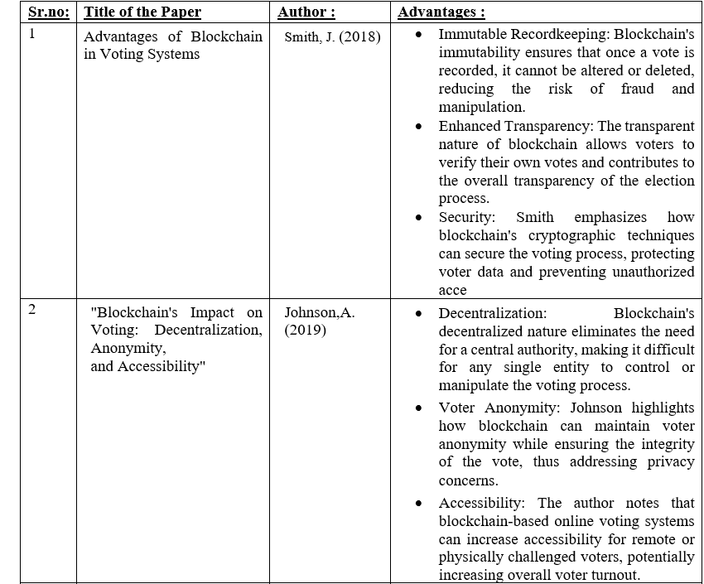
literature Review :

Slide 8
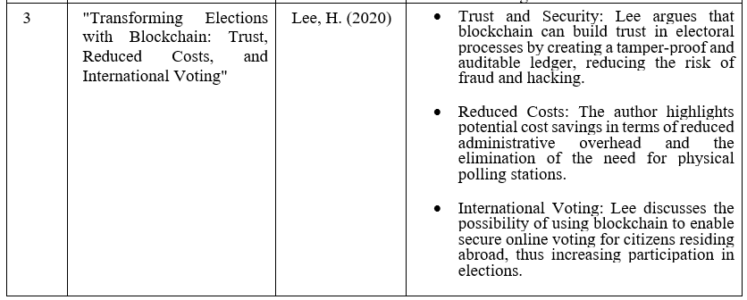

Slide 9
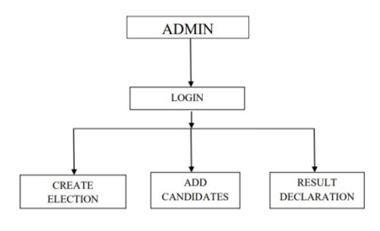
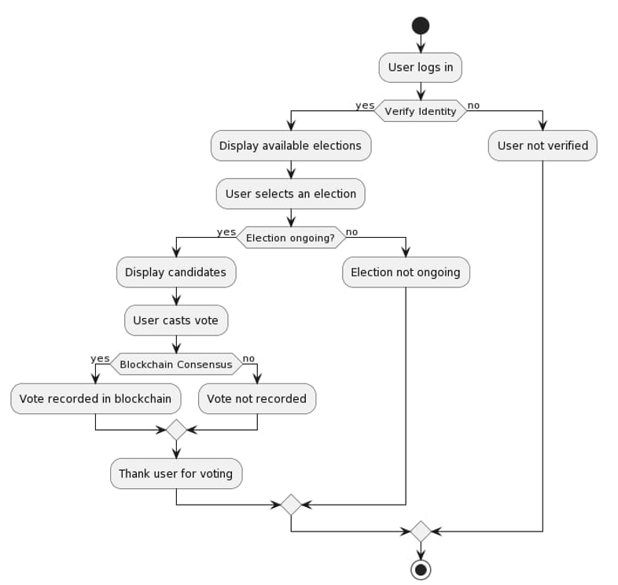
BLOCK DIAGRAM:

Slide 10
CONCLUSION:
Our future system is designed to provide a secure data and dependable voting amongst the people of equality. This Project aims to voting effect using Blockchain procedure from every place of election.

Slide 11
REFERENCE :
Blockchain in e-voting. [Online].
Available: https://youtu.be/mzPoUjQC4WU
Mega_Project_Report-5[1].pdf :https://www.irjmets.com/uploadedfiles/paper/issue_7_july_2022/28260/final/fin_irjmets1657916481.pdf
Youtube :- : https://youtu.be/f22rJ1m7JBs?si=6zrqugxYNnXzoPRG
: https://youtu.be/GuVbR4qtQlE?si=aCUIq_S1R5mOyaXq
: https://youtu.be/_8COCdzJot8?si=WeH7Vt5SnFfsdQpX
Google :- voting system using blockchain project with code
:https://github.com/Vatshayan/Final-Year-Blockchain-Voting-System
https://chat.openai.com/auth/login

Slide 12
THANK YOU

