Slide 1
Customer Feedback System
Java | JDBC | MySQL | Maven | JUnit

Slide 2
Introduction
The Customer Feedback System is a Java-based application designed to collect and manage feedback from customers regarding various products.
It allows CRUD operations for Customers, Products, and Feedbacks, ensuring efficient data management and insights into customer satisfaction.

Slide 3
Abstract
The Customer Feedback System is developed using Java and MySQL to collect and manage feedback from customers about products. It performs all CRUD operations like adding, viewing, updating, and deleting data. The system includes exception handling, logging, and testing to ensure smooth and error-free performance. It helps businesses understand customer satisfaction and improve their product quality.

Slide 4
Objectives
To provide a simple feedback management solution.
To perform CRUD operations on Customer, Product, and Feedback tables.
To establish relational integrity using MySQL foreign keys.
To test the system using JUnit test cases.
To demonstrate modular and layered architecture (DAO, Service, Model).

Slide 5
Technologies Used
• Java (JDBC)
• MySQL Database
• Maven (Dependency Management)
• IntelliJ IDEA (IDE)
• JUnit 5 (Testing Framework)
• Logger Utility (for logging system operations)

Slide 6
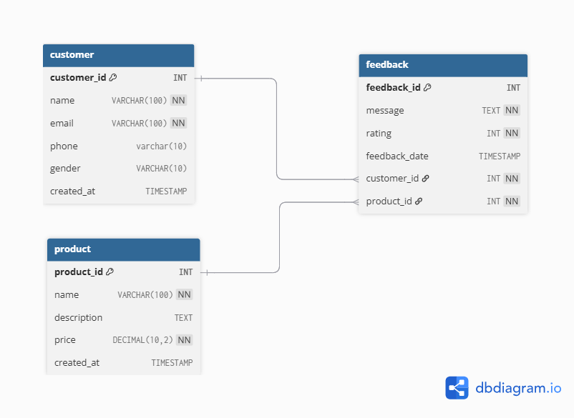
ER Diagram

Slide 7
CRUD Operations Overview
Customer Module:
• Add, View, Update, Delete Customers
Product Module:
• Add, View, Update, Delete Products
Feedback Module:
• Add, View, Update, Delete Feedbacks
• Each feedback is linked to a specific customer and product.

Slide 8
Output – Main Menu
=== Welcome to Customer Feedback System ===
----- Main Menu -----
1. Customer Operations
2. Product Operations
3. Feedback Operations
4. Exit
Enter your choice: 1
This menu allows the user to navigate different operations in the system.

Slide 9
--- Customer Menu ---
1. Add Customer
2. View Customer
3. Update Customer
4. Delete Customer
Enter Choice : 1
Enter Name: Prem
Enter Email: prem@gmail.com
Enter Phone Number: 7896541032
Enter Gender: Male
[2025-11-03 10:25:45][INFO] Database Connected Successfully!
[2025-11-03 10:25:46][INFO] Customer Inserted Successfully!
Enter Choice : 2
[2025-11-03 10:25:47][INFO] Customer{id=1, name='Prem', email='prem@gmail.com', phone=‘7896541032', gender='Male', createdAt=2025-11-03 10:25:46.000}

Slide 10
Output – Product Operations
----- Main Menu -----
1. Customer Operations
2. Product Operations
3. Feedback Operations
4. Exit
Enter your choice: 2

Slide 11
--- Product Menu ---
1. Add Product
2. View Product
3. Update Product
4. Delete Product
Enter Choice : 1
Enter Product Name: Mobile
Enter Description: High performance device
Enter Price: 60000
[2025-11-03 10:25:45][INFO] Database Connected Successfully!
[2025-11-03 10:26:01][INFO] Product Inserted Successfully!
Enter Choice : 2
[2025-11-03 10:26:03][INFO] Product{id=1, name='Laptop', description='Gaming Laptop', price=55000.00}
[2025-11-03 10:26:03][INFO] Product{id=2, name=‘Mobile', description=‘High performance device', price=55000.00}

Slide 12
Output – Feedback Operations
----- Main Menu -----
1. Customer Operations
2. Product Operations
3. Feedback Operations
4. Exit
Enter your choice: 3

Slide 13
---Feedback Menu---
1. Add Feedback
2. View Feedback
3. Update Feedback
4. Delete Feedback
Enter Choice : 1
Enter Customer ID: 1
Enter Product ID: 2
Enter Feedback Message: Excellent quality!
Enter Rating (1-5): 5
[2025-11-03 10:25:45][INFO] Database Connected Successfully!
[2025-11-03 10:26:20][INFO] Feedback Inserted Successfully!
Enter Choice : 2
[2025-11-03 10:26:21][INFO] Feedback{id=1, customerId=1, productId=1, message='Excellent service!', rating=5}

Slide 14
Output – View All Customers
Customer{id=1, name='Prem', email='prem@gmail.com', phone='9876543210', gender='Male', createdAt='2025-11-02 19:40:00'}
Customer{id=2, name='Priya', email='priya@gmail.com', phone='9123456789', gender='Female', createdAt='2025-11-02 19:42:00'}
Fetched all customers successfully!
Displays the list of all customers currently stored in the system database.

Slide 15
Test Case Summary
Test Case ID | Module | Description | Expected Result | Status
TC01 | Customer | Add new customer | Customer added successfully | ✅ Passed
TC02 | Product | Update product details | Product updated successfully | ✅ Passed
TC03 | Feedback | Insert valid feedback | Feedback added successfully | ✅ Passed
TC04 | Database | Establish Connection | Database Connected Successfully | ✅ Passed

Slide 16
Future Enhancements
Add a web interface using Spring Boot or React.
Implement sentiment analysis for feedback text using AI.
Generate PDF/Excel reports for management.
Enable user authentication and role management.
Add analytics dashboard for customer satisfaction trends.

Slide 17
Conclusion
The Customer Feedback System successfully demonstrates:
• Integration of Java, JDBC, and MySQL.
• Effective CRUD functionality.
• Proper database relationships and constraints.
• Testing with JUnit for reliability.
Thank you…!

