Slide 1
What are the advantages of Bootstrap?
Bootstrap is a popular front-end framework that offers numerous advantages for web development. Here are some of the key advantages of using Bootstrap:
Rapid Development: Bootstrap provides a set of pre-designed and responsive UI components (e.g., buttons, forms, navigation bars, modals) that you can readily use in your projects. This saves time and speeds up the development process.
Responsive Design: Bootstrap is built with a mobile-first approach, meaning it's designed to work on various screen sizes and devices. It offers a responsive grid system that automatically adjusts the layout to fit the screen size, making it easier to create mobile-friendly websites.
Consistency: Bootstrap ensures a consistent and cohesive look and feel throughout your project. It follows a style guide, which helps in maintaining a uniform design across the entire application.
Customization: While Bootstrap provides a default theme, it's highly customizable. You can use the customizer tool to select the specific components and styles you need for your project. Additionally, you can override Bootstrap's default CSS with your own styles, giving you full control over the design.
Cross-Browser Compatibility: Bootstrap is tested and compatible with various web browsers, including Chrome, Firefox, Safari, and Internet Explorer, ensuring that your website functions correctly on most platforms.
Open Source and Community Support: Bootstrap is open-source, which means it's free to use and has a large community of developers contributing to its development and providing support. You can find extensive documentation, tutorials, and third-party resources to assist you.
Accessibility: Bootstrap places a strong emphasis on creating accessible websites. It includes ARIA roles and attributes for screen readers and focuses on keyboard navigation for enhanced accessibility.
Modularity: Bootstrap is built using a modular approach. You can include only the components you need, reducing the size of your CSS and JavaScript files and improving page load times.
development.

Slide 2
Built-In JavaScript Plugins: Bootstrap comes with a variety of JavaScript plugins, such as carousels, modals, and tooltips, which can be easily integrated into your project. This saves time on writing custom JavaScript code for common functionality.
Large Community and Ecosystem: Bootstrap's popularity has led to a vast ecosystem of themes, templates, and third-party extensions. This makes it easier to find resources and tools that complement your development needs.
Support for Flexbox and Grid Layout: Bootstrap 5 introduced improved support for modern CSS layout features like Flexbox and CSS Grid, offering more layout options and flexibility.
Security: Bootstrap is regularly updated to address security issues and vulnerabilities, making it a safer choice for web development.
2. What is a Bootstrap Container, and how does it work?
Ans: Here's how a Bootstrap container works:
Responsive Layout: Bootstrap's grid system is based on a 12-column layout, which is divided into rows and columns. The container helps to organize and control the layout of these rows and columns. Containers come in different sizes:
fixed-Width Container: When you apply the container class to an HTML element, it creates a container with a fixed maximum width that adjusts its width based on the screen size. The maximum width varies depending on the screen size, ensuring that the content is not too wide or too narrow. This provides a clean and readable design on various devices.
Full-Width Container: If you want your content to span the entire width of the viewport, you can use the containerflulid
class. This makes the content expand to the edges of the screen, without any fixed maximum width. It is particularly useful for creating full-width hero sections or backgrounds.

Slide 3
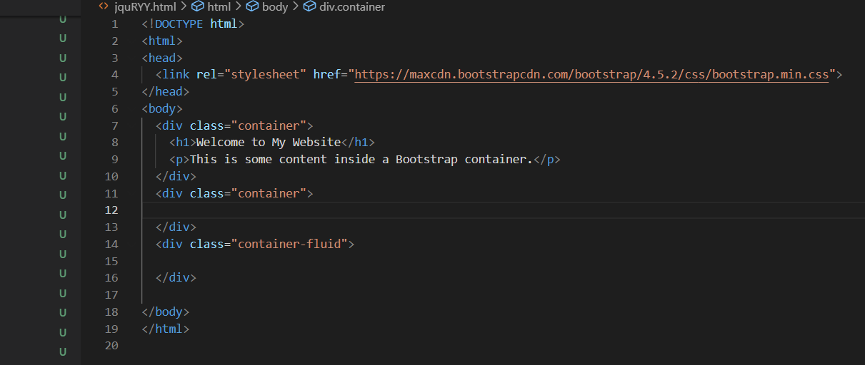
Centered Content: Regardless of whether you use a the content inside the container is automatically centered both horizontally and vertically. This is especially useful for ensuring a consistent design and readability.
Responsiveness: As the screen size changes (e.g., on different devices or when resizing the browser window), the Bootstrap container adjusts its width and the layout of its contents to maintain a visually appealing and readable design. This ensures that your website is responsive and adapts to various screen sizes.

Slide 4
3.What are the default Bootstrap text settings?
Ans:Bootstrap, as a CSS framework, provides default styling for text elements to help maintain a consistent and visually appealing design. Here are some of the default text settings in Bootstrap:
Font Family: Bootstrap sets a default font-family for the entire document. In Bootstrap 4, the default font is a system font stack, which means it uses the default system fonts of the user's operating system
Font Size: Bootstrap defines a default base font size of 16px (1rem) for the document. This base font size is used throughout the framework, and all other text sizes are typically defined relative to this base size.
Line Height: Bootstrap sets a default line height to ensure that text is properly spaced. The line height is usually 1.5, which means that there is 1.5 times the font size as the space between lines.
Text Color: The default text color in Bootstrap is typically black (#000) for normal text and white (#fff) for text inside elements like buttons and navigation bars. The specific color values may vary depending on the Bootstrap version and theme.
text Alignment: By default, text is aligned to the left within elements like paragraphs, headings, and lists. You can change text alignment using utility classes
Text Transformation: Bootstrap does not apply text transformations like uppercase or lowercase by default
Text Decoration: By default, links in Bootstrap are styled with text-decoration: underline. You can override this using utility classes
Font Styles: Bootstrap does not apply font styles like italic by default. You can apply these styles to text using CSS.
Text Spacing: Bootstrap applies default margin and padding to elements containing text, which contributes to the overall spacing and layout of the text. The spacing can be adjusted with utility classes or custom CSS.

Slide 5
4. do you know about the Bootstrap Grid System?
Ans:The Bootstrap Grid System is a powerful and responsive grid layout system provided by the Bootstrap framework. It's one of the core features of Bootstrap that allows you to create flexible and structured layouts for your web projects. Here are the key aspects of the Bootstrap Grid System:
12-Column Grid: The Bootstrap Grid System is based on a 12-column layout. This means that you can divide the width of the webpage into 12 equal parts, and each part is represented by a column. This system provides flexibility in creating various layouts and accommodating different screen sizes.
Responsive Design: Bootstrap's grid system is designed with a mobile-first approach, ensuring that your web pages look great on a wide range of devices, from small smartphones to large desktop monitors. As the screen size changes, the grid system automatically adjusts the layout for optimal viewing.
Offset and Nesting: You can offset columns (create empty space to the left) using offset classes
Content Ordering: Bootstrap allows you to change the order of columns for different screen sizes using classes
Gutters: Bootstrap adds a small amount of horizontal spacing between columns to ensure proper spacing. You can control gutter width by adjusting the padding or using utility classes
Customization: Bootstrap provides options for customizing the grid system, such as changing the number of columns, gutter width, and responsive breakpoints, to suit your project's needs.

Slide 6
5. What is the difference between Bootstrap 4 and Bootstrap 5 ?
Ans:As of my last knowledge update in January 2022, Bootstrap 4 and Bootstrap 5 are two major versions of the popular front-end framework Bootstrap, each with its own set of features and improvements. Here are some of the key differences between Bootstrap 4 and Bootstrap 5:
Switch to Vanilla JavaScript in Bootstrap 5: One of the most significant changes is the move from jQuery to vanilla JavaScript in Bootstrap 5. While Bootstrap 4 relied on jQuery for some of its components and functionality, Bootstrap 5 reduces its dependence on jQuery, making it lighter and more efficient.
Customization with Sass: Bootstrap 4 used Less as its preprocessor for stylesheets. Bootstrap 5, on the other hand, uses Sass, which is a more popular and feature-rich preprocessor. Sass provides developers with greater flexibility and control over the customization of Bootstrap's styles.
New Utility Classes in Bootstrap 5: Bootstrap 5 introduced a range of new utility classes that enable more fine-grained control over the layout, typography, and styling. These utility classes can be used to add or modify styles without the need for custom CSS.
Revised Grid System: The grid system in Bootstrap 5 is more flexible and powerful than in Bootstrap 4. It includes new classes for creating responsive layouts and simplifies the process of building complex grid structures.
Responsive Font Sizes: Bootstrap 5 introduced responsive font sizing
Improved Form Controls: Bootstrap 5 includes enhancements to form controls, such as improved custom form styling and new form elements like range inputs and floating labels for input fields.
Dropped IE 10 and 11 Support: Bootstrap 5 no longer supports Internet Explorer 10 and 11. This allows for the use of more modern CSS and JavaScript features, but it may require alternative solutions for supporting these older brow

Slide 7
mproved Documentation: The documentation for Bootstrap 5 is more comprehensive and organized, making it easier for developers to find information and examples.
New Icons: Bootstrap 5 introduced a new set of icons called "Bootstrap Icons," which are SVG icons designed specifically for Bootstrap. These icons are included with the framework and can be easily customized and used in your projects.
Fewer Dependencies: Bootstrap 5 reduces its reliance on external dependencies, resulting in a more streamlined and lightweight framework.
Support for Flexbox: While both Bootstrap 4 and Bootstrap 5 support Flexbox for layout, Bootstrap 5 places a stronger emphasis on Flexbox as a preferred layout method for its components.
Improved Responsiveness: Bootstrap 5 offers better responsiveness out of the box, with improvements in handling different screen sizes and devices.
6. What is a Button Group, and what is the class for a basic Button Group?
A button group is a feature in Bootstrap that allows you to group multiple buttons together for better organization and user interaction. Button groups are often used to create sets of related actions or options, and they can be styled in various ways, including as a set of horizontal or vertical buttons.
Create a Button Group: To create a button group, you typically enclose a set of button elements within a parent container with the class btn-group For a horizontal button group:

Slide 8
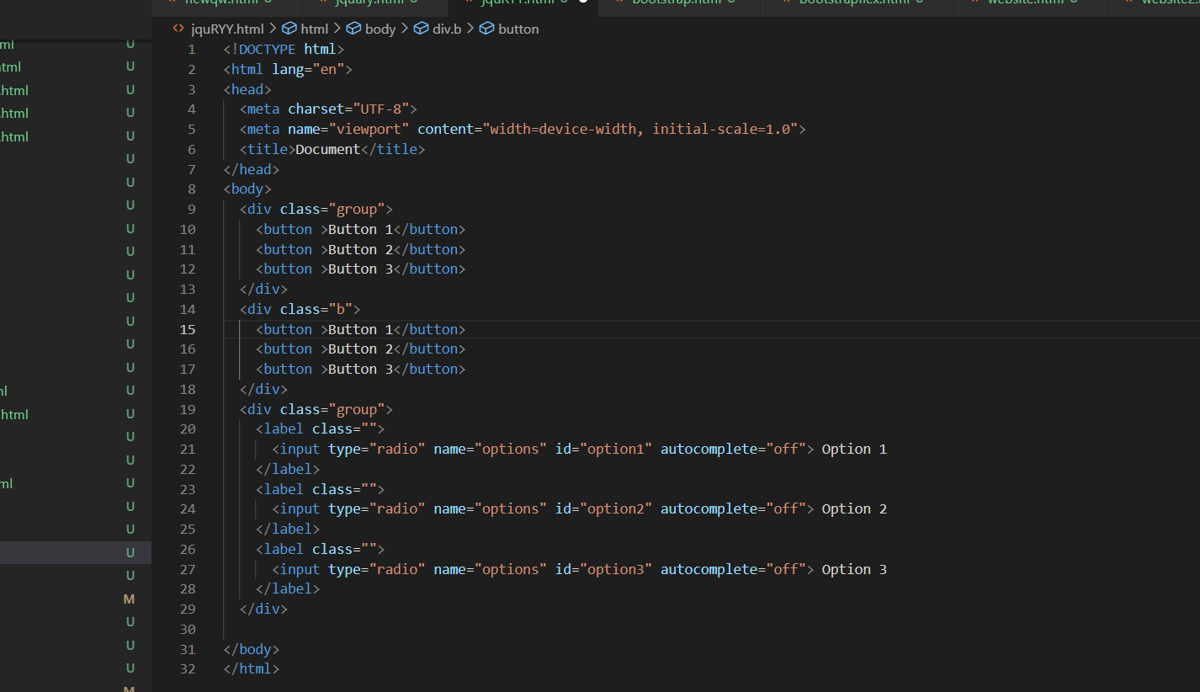

Slide 9
7. How can you use Bootstrap to make thumbnails?
Ans:Bootstrap provides a straightforward way to create thumbnails, which are small image or content containers, using the
Thumbnail, class. Thumbnails are often used to showcase images, videos, or other content in a grid-like layout. Here's how you can use Bootstrap to create thumbnails:
HTML Structure: Start by creating the HTML structure for your thumbnail. You typically use a parent container,

Slide 10
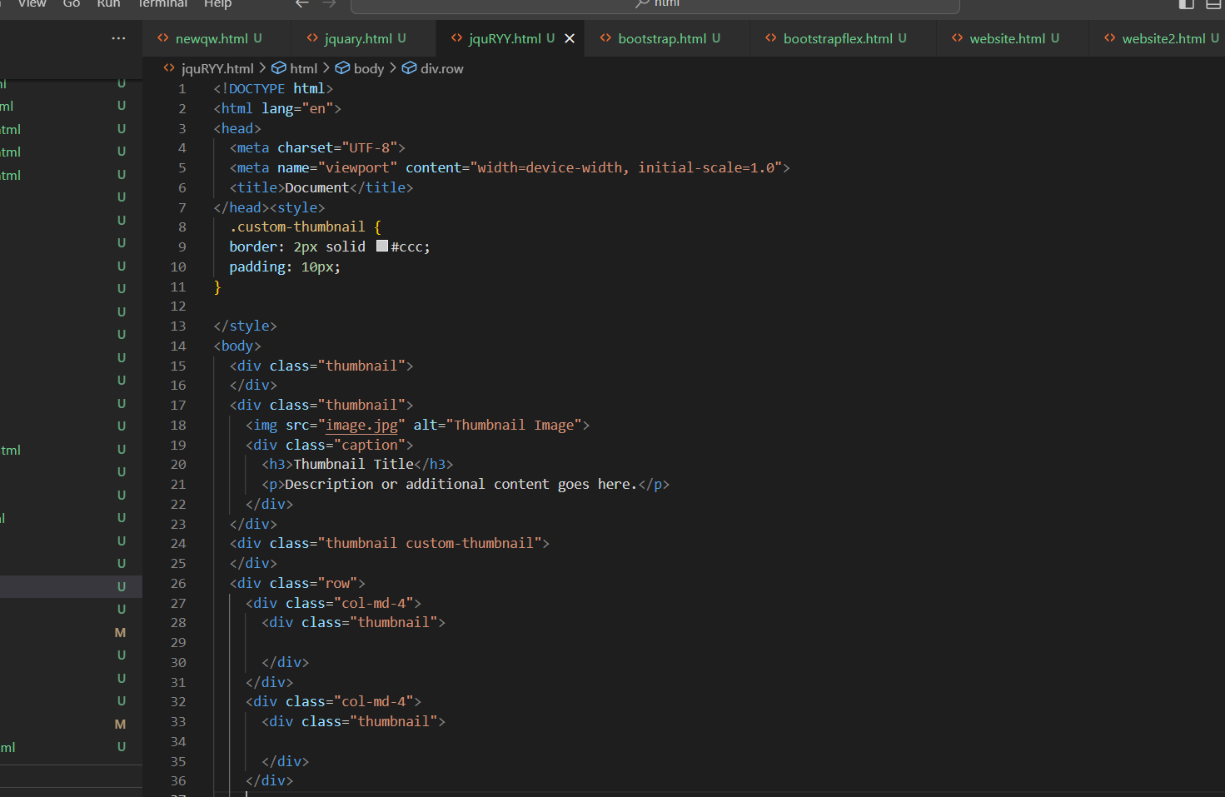

Slide 11
Grid Layout: Thumbnails are often used in a grid layout to display multiple items side by side. You can use Bootstrap's grid system to create a grid of thumbnails.
Responsive Design: Bootstrap's grid system and responsive utilities ensure that your thumbnail grid adapts to different screen sizes and devices.
By following these steps, you can create a set of responsive thumbnails using Bootstrap. You can customize the styling and layout to match your specific design requirements and include any content you'd like within the thumbnail containers. Thumbnails are commonly used for image galleries, product listings, and more on websites.
7. In Bootstrap 4, what is flexbox?
Ans: In Bootstrap 4, Flexbox (short for "Flexible Box Layout") is a powerful CSS layout model that is used to create flexible and efficient page layouts. Bootstrap 4 introduced a significant shift toward using Flexbox as the primary layout system for its grid components, replacing the traditional float-based layout system that was used in Bootstrap 3.
Here are the key points to understand about Flexbox in Bootstrap 4:
Responsive Layout: Flexbox makes it easier to create responsive layouts that adapt to different screen sizes and devices. It simplifies the process of building complex grid structures and aligning content both horizontally and vertically.
Equal Height Columns: One of the notable advantages of Flexbox is its ability to create equal height columns without the need for complex workarounds or JavaScript. This is particularly useful for creating grids of content with consistent heights.

Slide 12
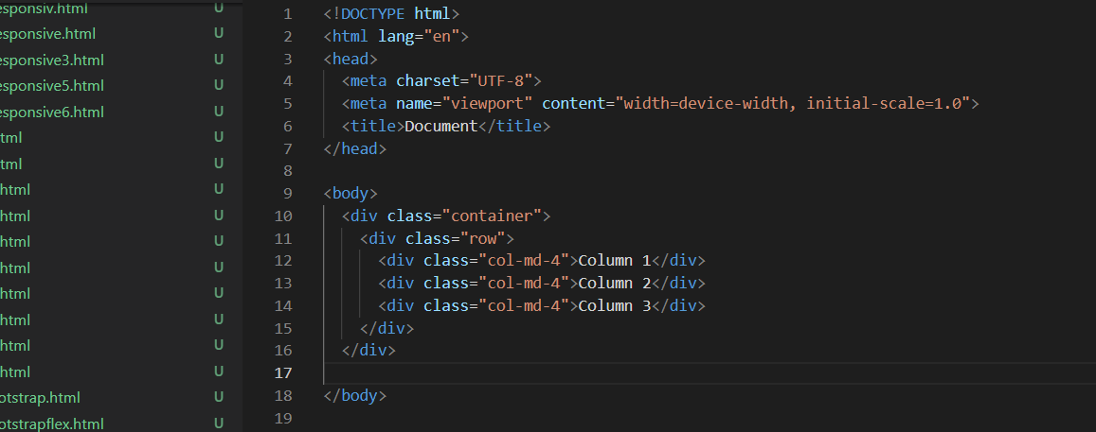
No More Clearfix: With Flexbox, there is no need for the traditional clearfix techniques that were used in Bootstrap 3 to prevent columns from overlapping. Flexbox handles the alignment and spacing of columns more naturally.
Ordering: Flexbox allows for easy reordering of content within a row, which can be useful for creating alternative layouts on different devices
Alignment: Flexbox simplifies content alignment both horizontally and vertically. You can center content, align it to the start or end of a container, and distribute space evenly between elements.
No Floats: In Flexbox-based layouts, there is no need to use floats to achieve proper column alignment. This eliminates many of the issues associated with floated elements.
Nesting Flex Containers: You can nest flex containers within one another, allowing you to create complex and deeply nested layouts.

Slide 13
8.How can one create an alert in Bootstrap?
Ans:In Bootstrap, you can create alerts to provide important information or notifications to your users. Alerts are typically displayed as boxes with text and optional close buttons. Bootstrap provides CSS classes and JavaScript for creating and styling alerts. Here's how you can create an alert in Bootstrap:
HTML Structure: Start by adding an HTML element with the class to create the alert container. Within the alert container, you can place your alert content and optional close button.

Slide 14
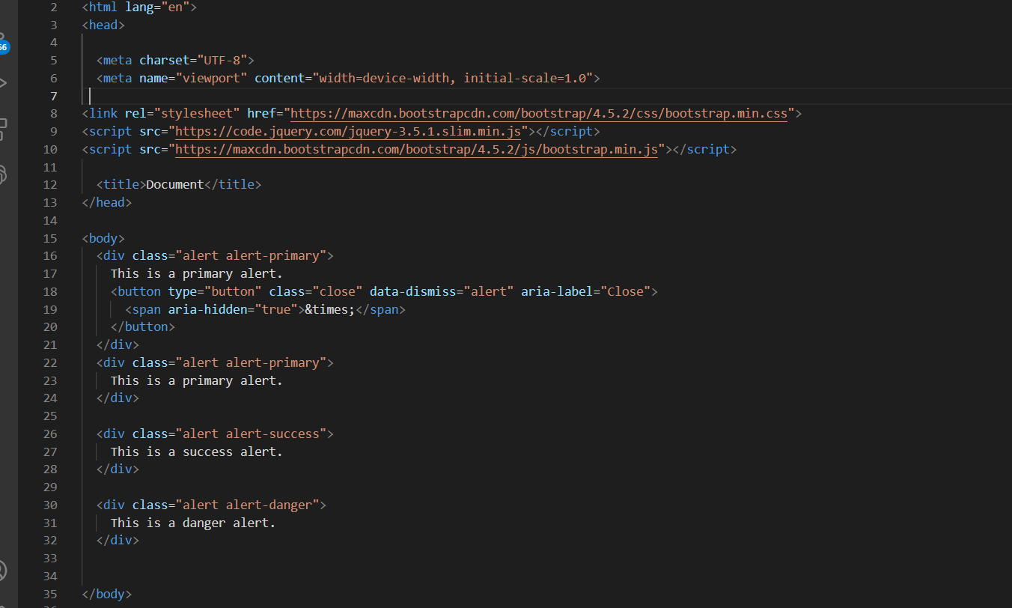

Slide 15
10. What is a bootstrap card and how would you create one?
Ans:A Bootstrap card is a versatile and lightweight container that you can use to display various types of content, such as images, text, links, and more, in a structured and visually appealing way. Bootstrap cards are designed to be easily customizable and responsive, making them an ideal choice for presenting content on your website. Here's how to create a Bootstrap card

Slide 16
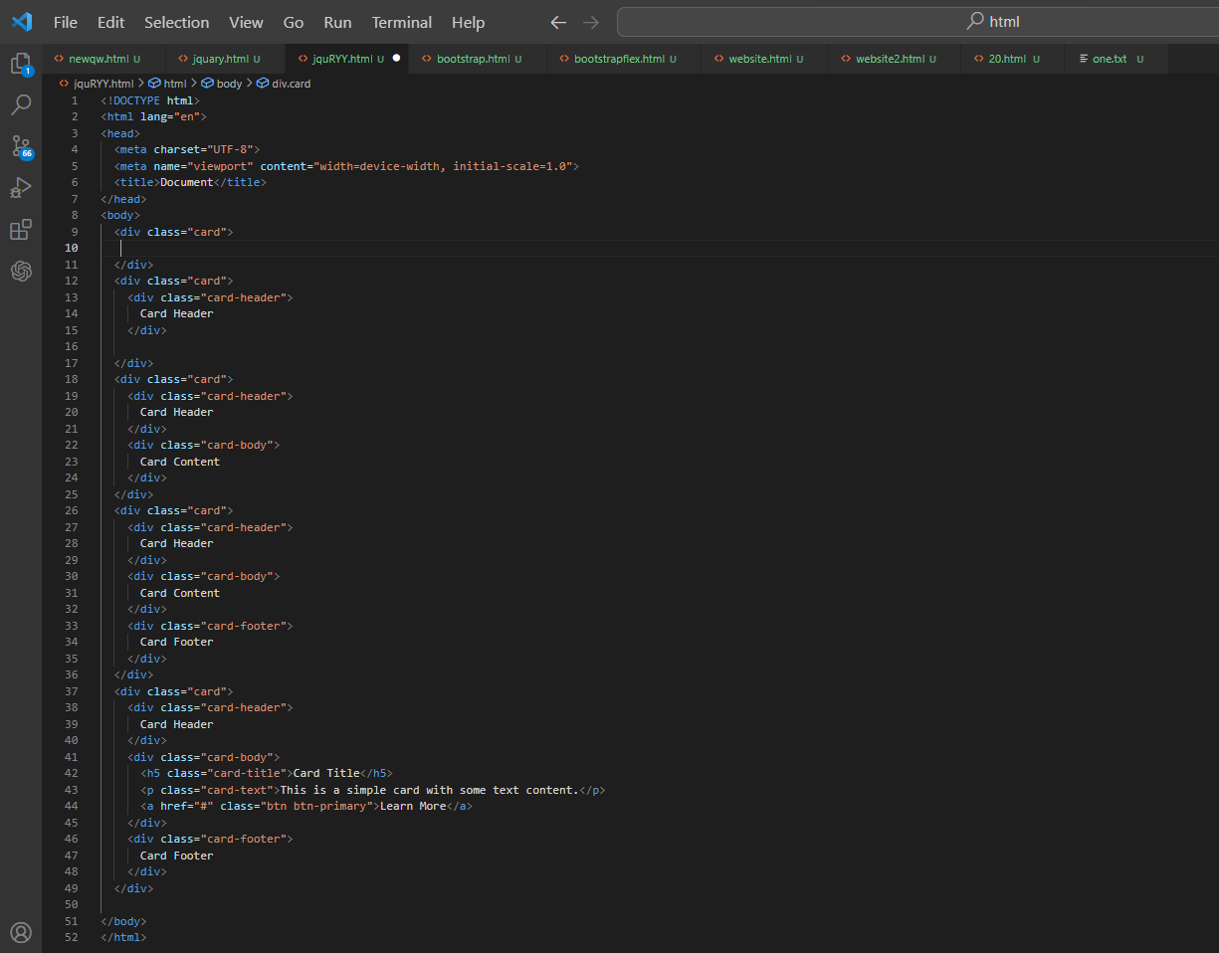

Slide 17
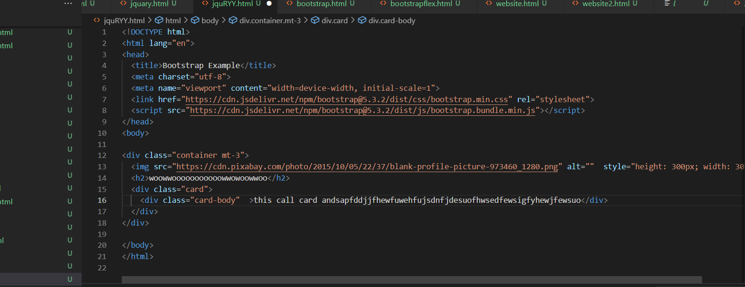
Card:

