Slide 1

CLIENT VISIT TRACKING APPLICATION
Presented by:

Slide 2
Agenda
Introduction
Need Of Client Visit Tracking
Implementation
4. Modules
Flow Diagram
Features of The Application
Project Demo

Slide 3

What is Client Visit ?
What is Health Insurance

Slide 4
Why We Need Client Visit Tracking
Much More Analysis can be done.
Client Satisfaction can be measured.
Project Progress can be tracked.
Client Feedback are given to the respective project teams.
.
.
.
.

Slide 5
Modules of Client Visit
Tracking Application
Basically there are 5 MODULES:
Client
Project
Client Visit
Feedback
Admin

Slide 6
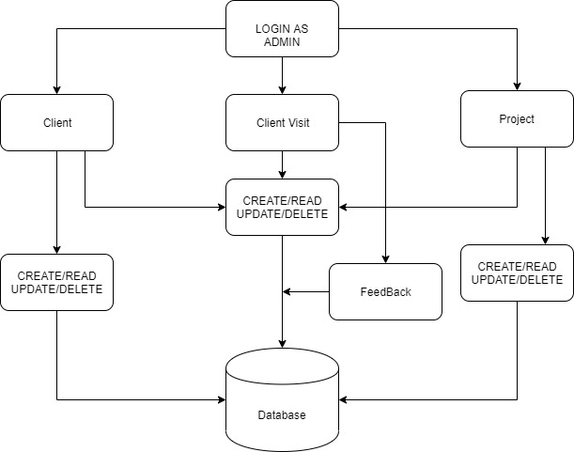
Flow Diagram

Slide 7
Advantages of the Application
Client Visits Between Two Given Dates can be Tracked
Client Visit Based On The Project Chapter
Canceled Visits Can be Tracked
Upcoming Client Visits are given priority

Slide 8


Project Demo
ADD/UPDATE/DELETE/READ CLIENT
ADD/UPDATE/DELETE/READ PROJECT
ADD/UPDATE/DELETE/READ CLIENTVISIT
SEARCH BASED ON PROJECT CHAPTER
SEARCH BETWEEN TWO DATES
FEEDBACK FROM THE CLIENT ADDED TO THE CLIENT VISIT

Slide 9
Thank you.

