Slide 1

CECS-571 Fundamentals of Semantic Web Technologies PROJECT-3
Semantic Data Generation using SPARQL

Slide 2
TEAM MEMBERS
PREM SAI ARROJU
HRISHI KAMAL EARLA
POOJITHA VANKAM
BHARGAV CHINTAPALLI
MURTHY CHINTALAPUDI

Slide 3

CONTENTS
DataSets
Ontology Design
OWL File
Technical Approach
Technical - Apache Jena (Java)
Queries
Code Snippets
User Interface
Outputs

Slide 4

DATASETS
Converted the Following 3 Data Sets into a single ontology file
Hospital General Information
Contains the General Information of all the Name, Location, Hospital Type and Ownership
Medicare Hospital Spending
Contains the Information like State Spendings and Nation Spendings
Timely and Effective Care
Contains the Information like Score.

Slide 5
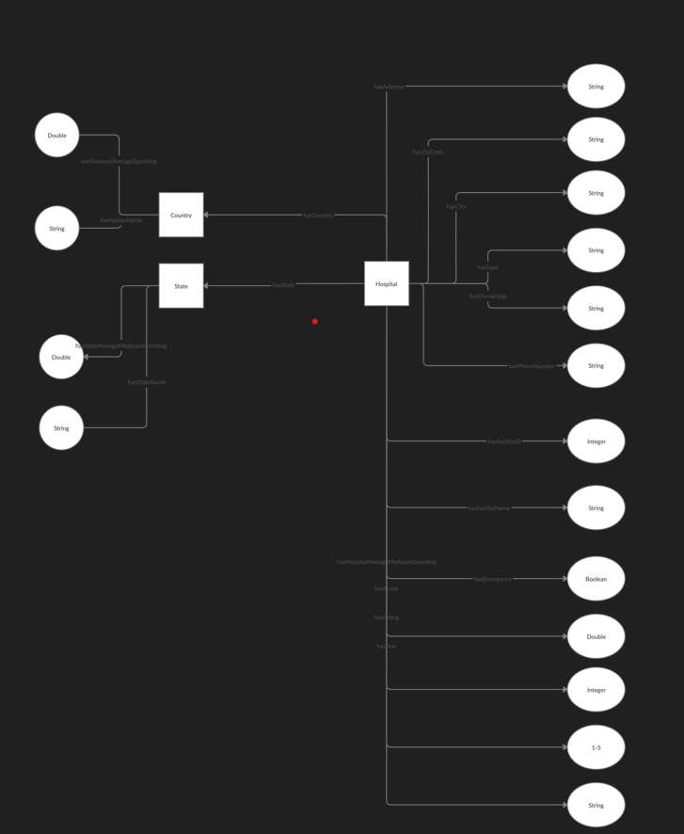
ONTOLOGY DESIGN

Slide 6
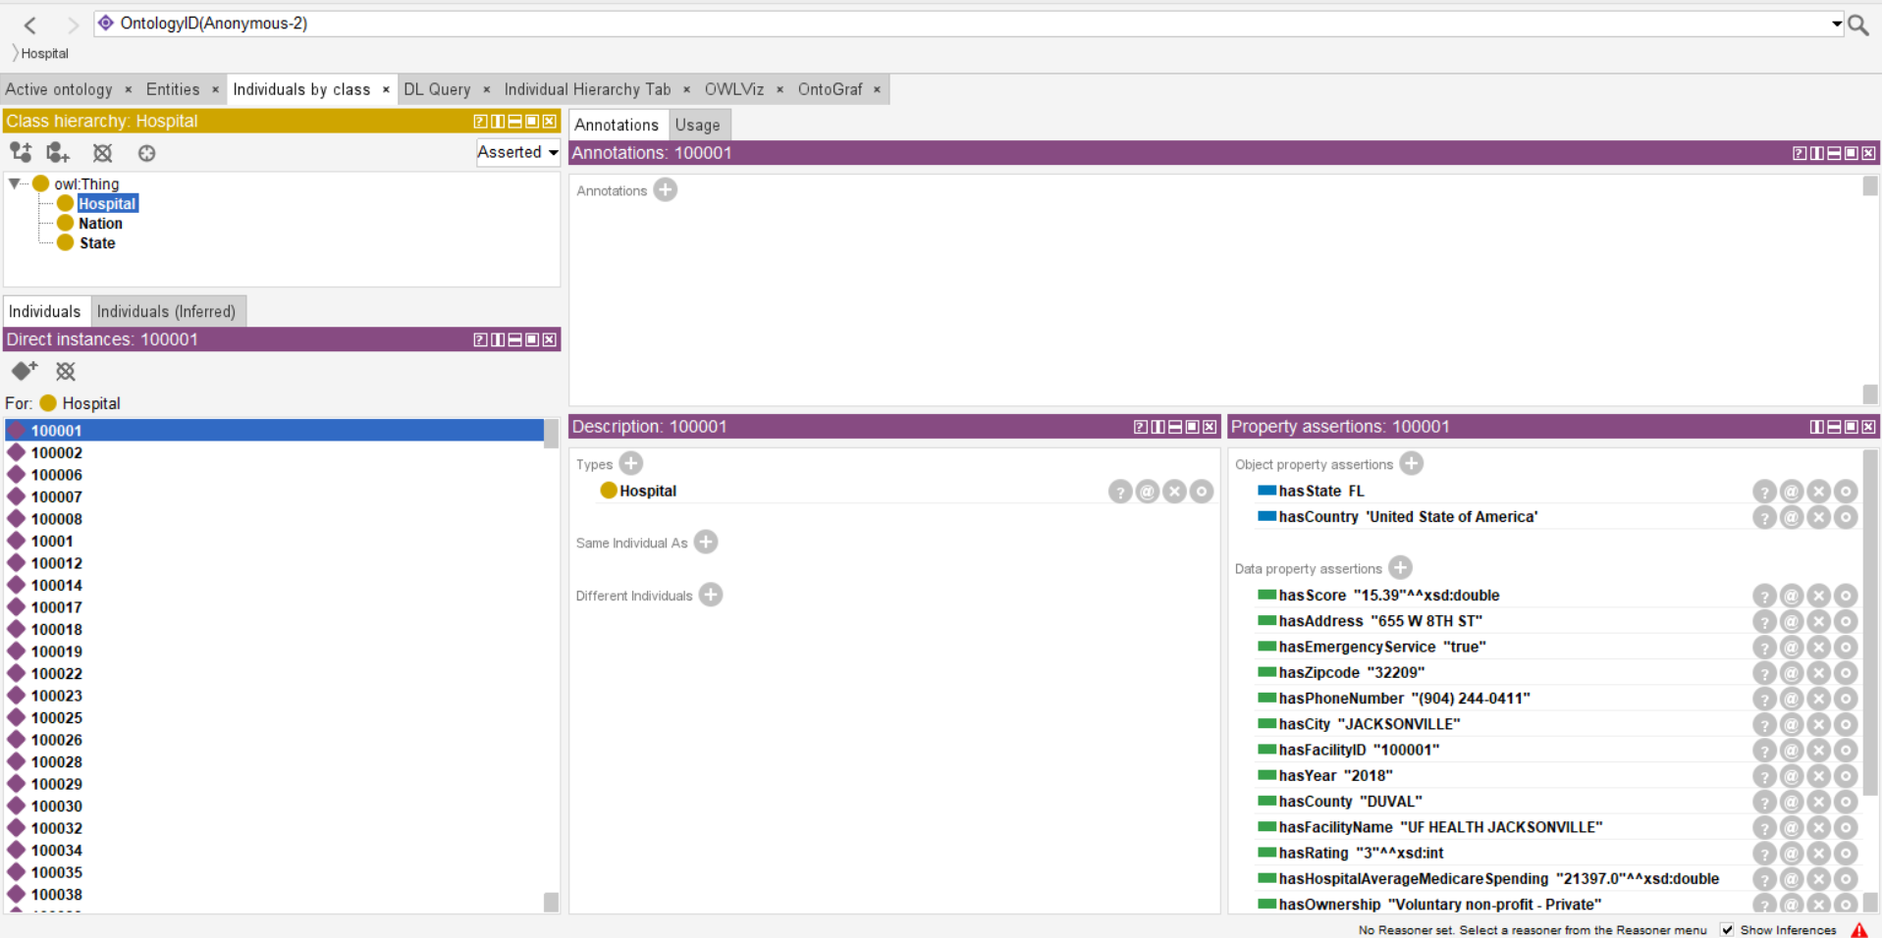
CLASSES REPRESENTATION

Slide 7
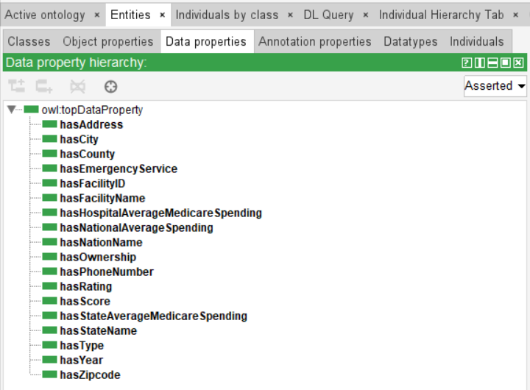
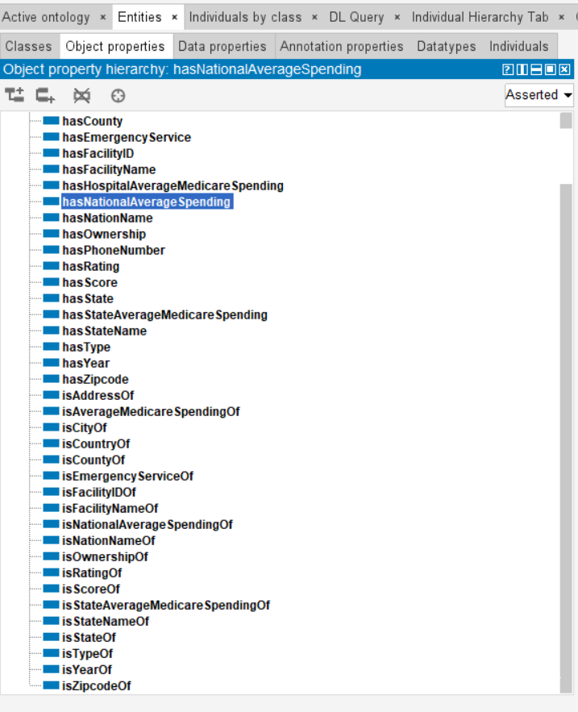
DATA AND OBJECT PROPERTIES

Slide 8
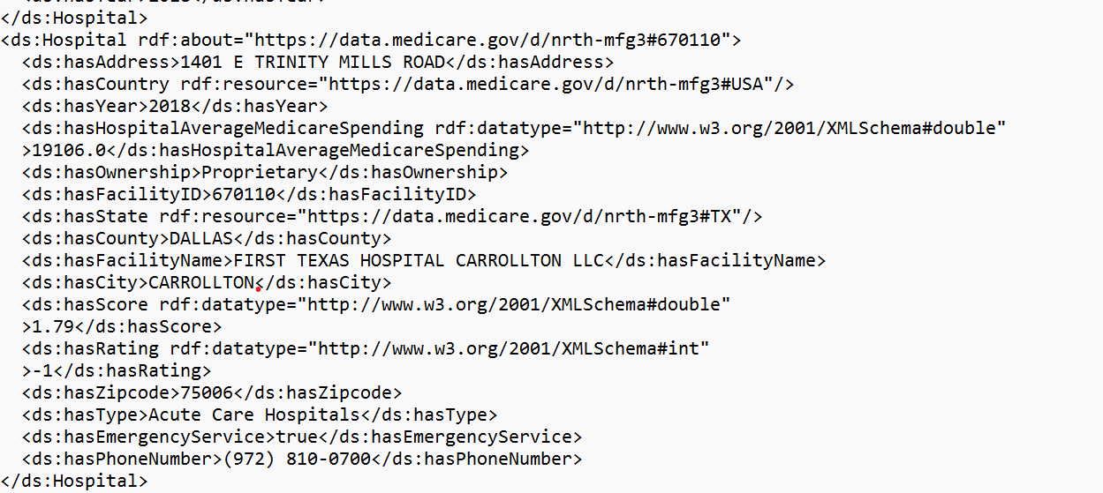
OWL FILE

Slide 9
TECHNICAL APPROACH
Creation of User Interface Design and Development using JSP.
Built Complex SPARQL Queries
Process Queries using Apache Jena.
Integrate the Code to Display the Results in the User Interface.
Deploy and Run the Application on TOMCAT Server.

Slide 10

Technical - Apache Jena (Java)
Apache Jena
A free and Open source Java framework for building Semantic Web and Linked Data applications.
Support RDF, RDFS, OWL
Apache Maven
is a software project management and comprehension tool
XML
Package into JAR

Slide 11
QUERY-1 Which States have a spending BELOW the National average?
PREFIX rdf: <http://www.w3.org/1999/02/22-rdf-syntax-ns#> PREFIX rdfs: <http://www.w3.org/2000/01/rdf-schema#> PREFIX ds: <https://data.medicare.gov/d/nrth-mfg3#> PREFIX owl: <http://www.w3.org/2002/07/owl#> PREFIX xsd: <http://www.w3.org/2001/XMLSchema#> SELECT ?stateName ?averageMedicareSpending ?NationAverageMedicareSpending WHERE { ?state ds:hasStateName ?stateName. ?state ds:hasStateAverageMedicareSpending ?averageMedicareSpending. { SELECT (AVG(?medicareSpending) AS ?NationAverageMedicareSpending) WHERE { ?state ds:hasStateAverageMedicareSpending ?medicareSpending. FILTER(?medicareSpending!=0) } } FILTER(?averageMedicareSpending < ?NationAverageMedicareSpending) } ORDER BY ASC(?stateName)

Slide 12
QUERY-2 Of all the hospital that have higher spending than the national average, what's the percentage of those that have higher score than national average score?
PREFIX rdf: <http://www.w3.org/1999/02/22-rdf-syntax-ns#> PREFIX rdfs: <http://www.w3.org/2000/01/rdf-schema#> PREFIX ds: <https://data.medicare.gov/d/nrth-mfg3#> PREFIX owl: <http://www.w3.org/2002/07/owl#> PREFIX xsd: <http://www.w3.org/2001/XMLSchema#> SELECT ?percentage_nation WHERE { { SELECT (COUNT(?_id) AS ?req_hopitals) WHERE { ?subject ds:hasFacilityID ?_id . ?subject ds:hasHospitalAverageMedicareSpending ?hospital_spending . ?subject ds:hasCountry ?country . ?country ds:hasNationalAverageSpending ?nation_spending . ?subject ds:hasScore ?score . { SELECT (ROUND(AVG(?score)) AS ?avg) WHERE { ?hospital ds:hasScore ?score. } } FILTER(?hospital_spending > ?nation_spending && ?score > ?avg) . } } { SELECT (COUNT(?id) as ?total_hospital) WHERE { ?subject ds:hasFacilityID ?id . ?subject ds:hasHospitalAverageMedicareSpending ?hospital_spending . ?subject ds:hasCountry ?country . ?country ds:hasNationalAverageSpending ?nation_spending . FILTER(?hospital_spending > ?nation_spending) } } BIND(?req_hopitals/?total_hospital*100 AS ?percentage_nation) }

Slide 13
QUERY-3 Percentage of Hospitals that have higher score than national average score?
PREFIX rdf: <http://www.w3.org/1999/02/22-rdf-syntax-ns#>
PREFIX rdfs: <http://www.w3.org/2000/01/rdf-schema#>
PREFIX ds: <https://data.medicare.gov/d/nrth-mfg3#>
PREFIX owl: <http://www.w3.org/2002/07/owl#>
PREFIX xsd: <http://www.w3.org/2001/XMLSchema#>
SELECT ?facility_name ?facility_address ?emergency_service ?ownership
WHERE {
?hospital ds:hasFacilityName ?facility_name .
?hospital ds:hasAddress ?facility_address .
?hospital ds:hasEmergencyService ?emergency_service .
FILTER(?emergency_service = "true")
?hospital ds:hasEmergencyService ?emergency_service .
?hospital ds:hasOwnership ?ownership
FILTER(?ownership = "Government - Federal") .
?hospital ds:hasOwnership ?ownership .
}

Slide 14
QUERY-4 Which hospital has the best ratio of spending to score?
PREFIX rdf: <http://www.w3.org/1999/02/22-rdf-syntax-ns#> PREFIX rdfs: <http://www.w3.org/2000/01/rdf-schema#> PREFIX owl: <http://www.w3.org/2002/07/owl#> PREFIX xsd: <http://www.w3.org/2001/XMLSchema#> PREFIX ds: <https://data.medicare.gov/d/nrth-mfg3#> SELECT ?id?name?address?city?countyName?stateName?zipCode?stateSpending?score(?spending / ?score as ?ratio) WHERE { ?hospital ds:hasFacilityID ?id. ?hospital ds:hasFacilityName ?name. ?hospital ds:hasAddress ?address. ?hospital ds:hasCity ?city. ?hospital ds:hasState ?state. ?state ds:hasStateName ?stateName. ?hospital ds:hasZipcode ?zipCode. ?hospital ds:hasCounty ?countyName. ?hospital ds:hasHospitalAverageMedicareSpending ?spending. ?state ds:hasStateAverageMedicareSpending ?stateSpending. ?hospital ds:hasScore ?score. } ORDER BY DESC(?ratio) LIMIT 2

Slide 15
QUERY-5 What is the most efficient state?
PREFIX rdf: <http://www.w3.org/1999/02/22-rdf-syntax-ns#> PREFIX rdfs: <http://www.w3.org/2000/01/rdf-schema#> PREFIX owl: <http://www.w3.org/2002/07/owl#> PREFIX xsd: <http://www.w3.org/2001/XMLSchema#> PREFIX ds: <https://data.medicare.gov/d/nrth-mfg3#> SELECT ?stateName (ROUND(?efficient_count * 100 / ?total) AS ?percent) ?efficient_count ?total WHERE { { # This is to find # efficent hospitals in each state SELECT ?stateName (COUNT(?efficient) AS ?efficient_count) WHERE { ?efficient ds:hasHospitalAverageMedicareSpending ?hSpending. ?efficient ds:hasScore ?hScore. ?efficient ds:hasState ?state. ?state ds:hasStateName ?stateName. ?state ds:hasStateAverageMedicareSpending ?sSpending. # This is to find out the state average score { SELECT (AVG(?innerScore) AS ?stateAvgScore) WHERE { ?hospital ds:hasState ?state. ?state ds:hasStateName ?stateName. ?hospital ds:hasScore ?innerScore. } } # Filter out by comparison FILTER(?hSpending < ?sSpending && ?hScore > ?stateAvgScore) } GROUP BY ?stateName } # This block is to find the total # hospitals in each state { SELECT ?stateName (COUNT(?hospital) AS ?total) WHERE { ?hospital ds:hasState ?state. ?state ds:hasStateName ?stateName. } GROUP BY (?stateName) } } ORDER BY DESC(?percent)

Slide 16
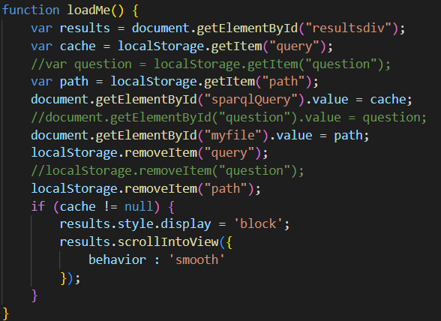
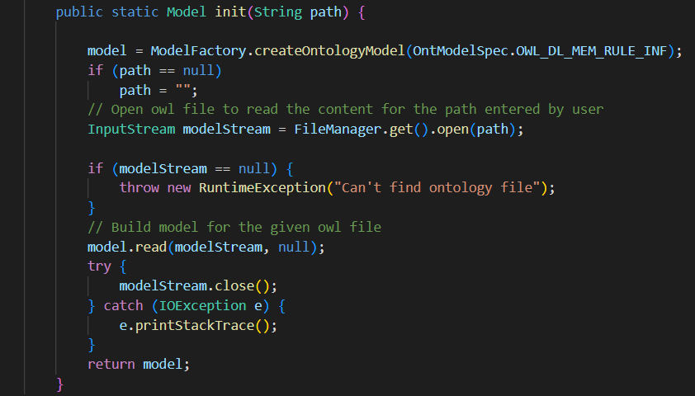
CODE SNIPPETS:

Slide 17
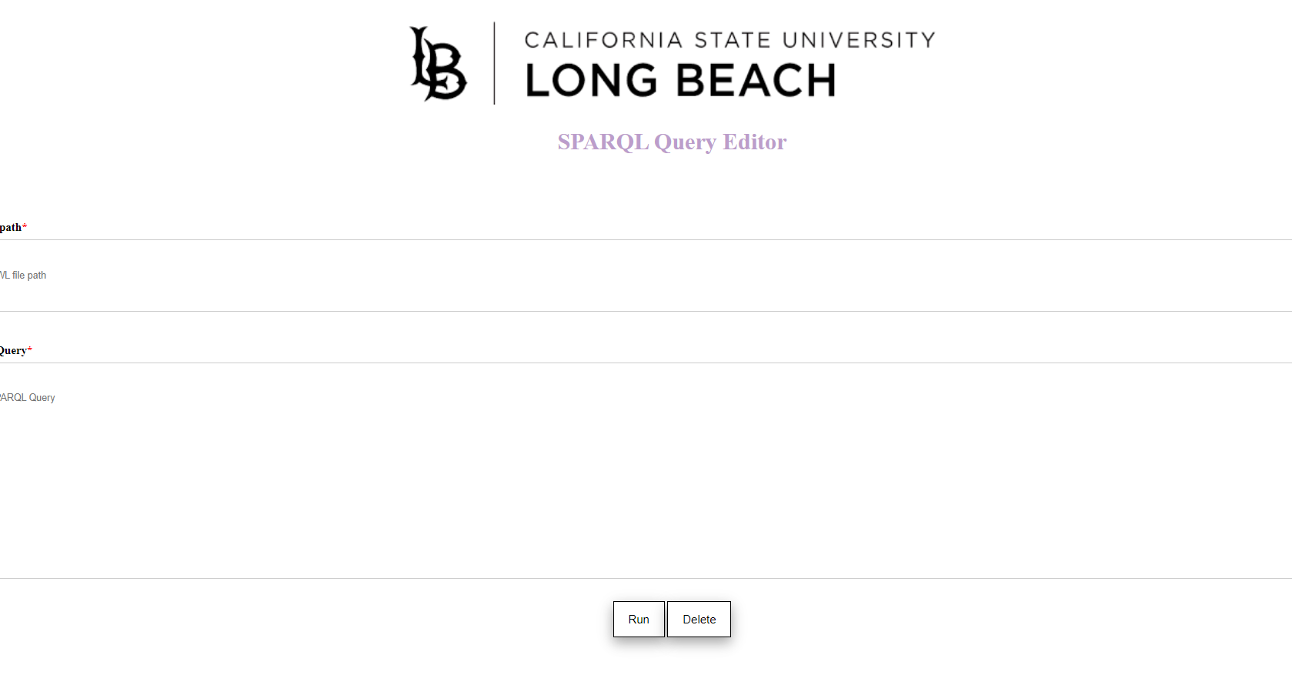
USER INTERFACE

Slide 18
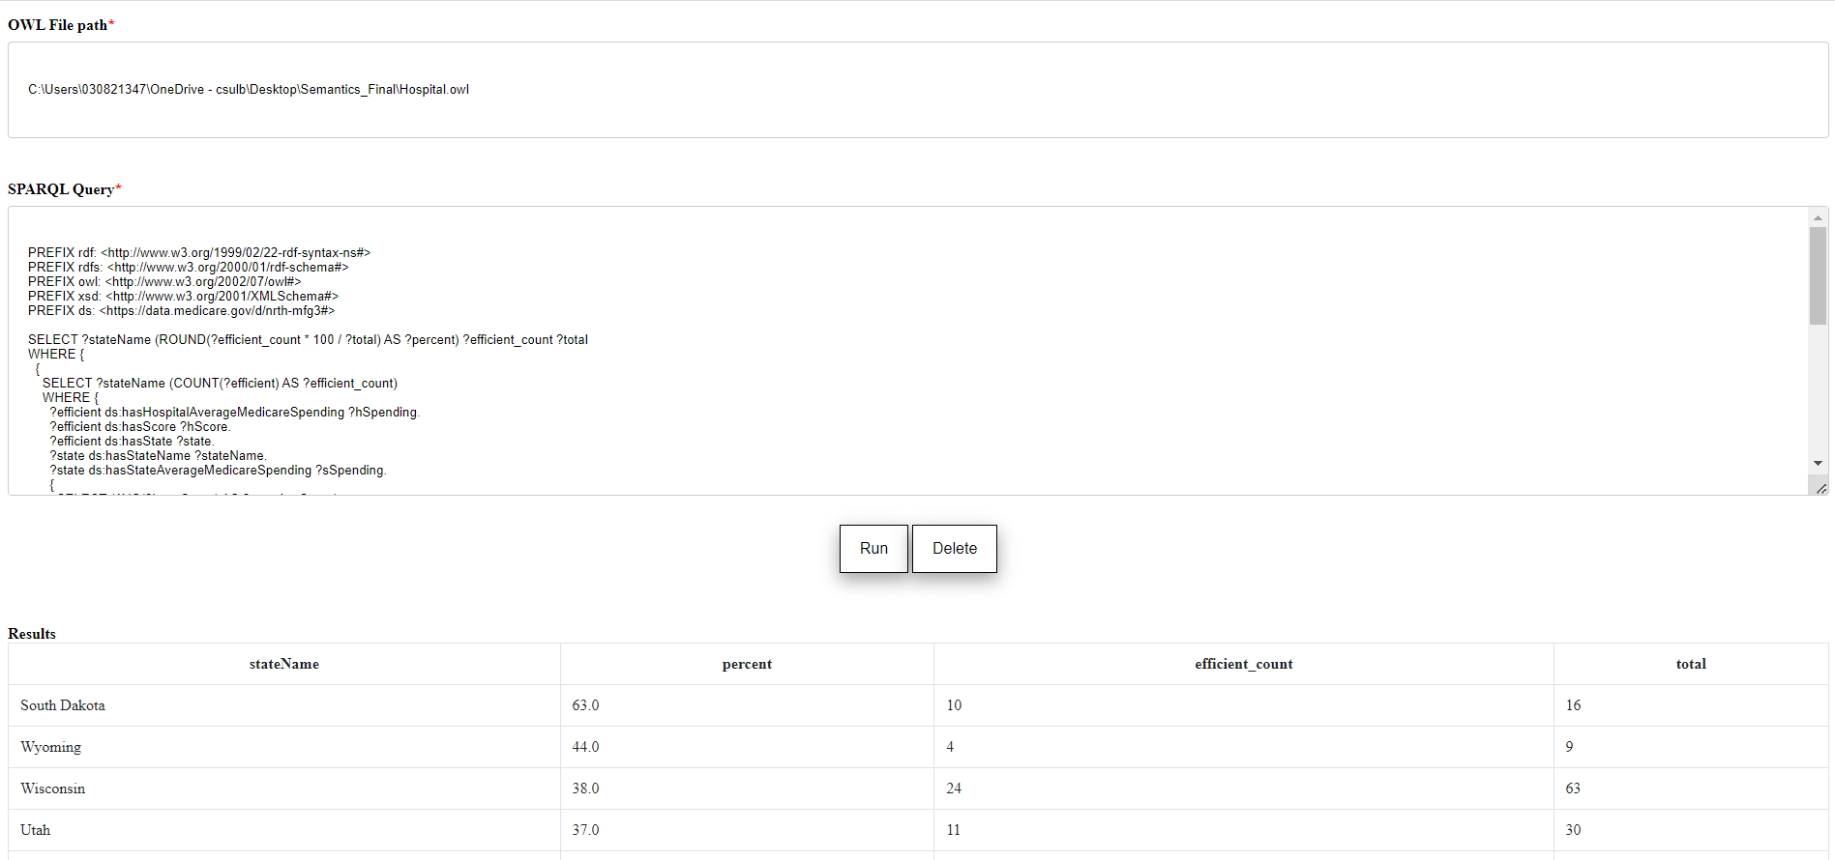
OUTPUTS

Slide 19

TECHNICAL CHALLENGES
Understanding and Implementing the Complex SPARQL Queries
To get the overall statistics of the dataset, we removed few null values and incomplete information.
We have faced challenges in reading the input file and connection of JSP and SparqlQueryProcesssor file.

Slide 20


GITHUB LINK
https://github.com/PremArroju/SemanticSPARQL

Slide 21

REFERENCES
https://en.wikipedia.org/wiki/Jakarta_Server_Pages
https://en.wikipedia.org/wiki/Apache_Tomcat
https://en.wikipedia.org/wiki/Apache_Tomcat#/media/File:Apache_Tomcat_logo.svg
https://en.wikipedia.org/wiki/Apache_Jena
https://www.data.gov/

Slide 22

THANK YOU

