Slide 1


Computer Vision - Week 1
AIML
POST GRADUATE PROGRAM
ARTIFICIAL INTELLIGENCE & MACHINE LEARNING

Slide 2
Week 1
Introduction to Images and Formats

Slide 3
Topics covered in week 1 videos
Introduction to Images
Image formats
Concept of Pixels
Image Manipulation Techniques

Slide 4
Session agenda
Introduction to Computer vision
Basics of Images
Concept of pixels and channels
Types of Image formats
Image Processing
Introduction to Open CV library
Case study
Questions

Slide 5
Intro to Computer Vision

Slide 6
What is computer vision ?
The techniques which enables computers to process the digital images / videos and derive insights from it
Text source

Slide 7
Computer vision generally includes following tasks
Image classification - label an image based on the object in the image
Object detection / localization / segmentation – Detect an object in an image and localize is using a bounding box. Segmentation is pixel-wise classification to give the separation of the objects
Similarity learning – Which two images are similar based on the content of the image
Image captioning – Describing the image (combines NLP with computer vision)
Generative modelling – Generate images based on the style of another image
Video analysis – process the entire set of digital frames for object detection and tracking

Slide 8
Image basics

Slide 9
Image as a data source
Images Provide Large amount of information of the real world without the need to to express it
Hence Images are considered to be one form of data source which can be used for many applications in the real world such as
Object detection : Face detection, Vehicle detection in Roads
Healthcare applications : detection of tumors etc.
Retail applications : Product recognition, Inventory Management, customer registration and identification in applications such as KYC
Defense applications : Combat drones
Security : Vehicle identification, surveillance
Banking : Data extraction from documentation, customer signature authentication etc

Slide 10

Concept of Pixels
Smallest unit of an Image is called as Pixel
Each pixel is identified by its row and column number
Pixel values range from 0 – 255
Image source: wiki

Slide 11
Each pixel has R, G, B layers
Each layer i.e. (R, G, B) can take 256 values from 0 – 255 representing 256 different shades respectively
We need 8 bits / 1 byte to store 256 values because 2^8 = 256
Therefore, we need 3 bytes (for R, G, B layers respectively) for every pixel

Slide 12
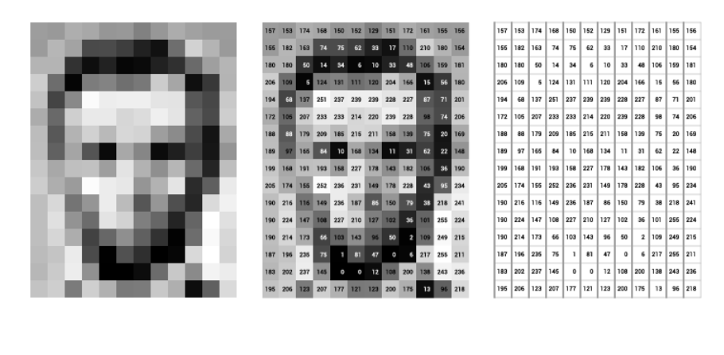
Pixel representation of the image
Text source: stanford

Slide 13
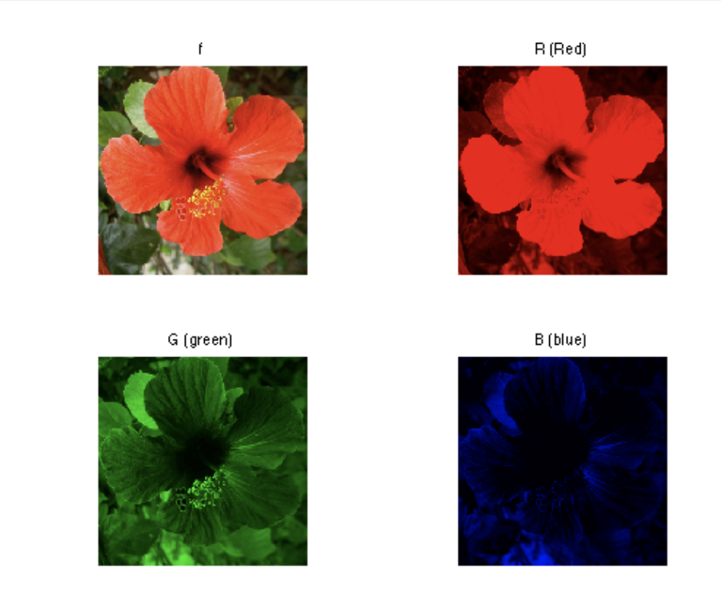
Channels
Source: numerical-tours/

Slide 14
Image formats
H5 :
H5 or HDF5- hierarchical data format designed to store large amount of data
HDF5 uses a "file directory" like structure that allows us to organize data within the file in many different structured ways as inside computer
NPY:
The .npy format is the standard binary file format in NumPy for persisting a single arbitrary NumPy array on disk
The format stores all of the shape and dtype information necessary to reconstruct the array correctly even on another machine with a different architecture
Note: Images stored in H5 and NPY format require python code to read it
Text source: neonscience and numpy

Slide 15
Image formats
PNG:
PNG is short for Portable Network Graphic
The PNG format uses lossless compression ( means it retains all of its original information when compressed )
Used for LOGOS with transparent backgrounds
JPEG OR JPG:
Jpeg is a lossy compression file format ( original information is lost )
Usually small in size hence transfer of images is easy
BMP
BMP- short for bitmap
This file format maintains high image quality and a large amount of detail while treating each individual image pixel as its own entity
Source: Adobe

Slide 16
Image formats
DICOM ( used in medical applications )
Digital Imaging and Communications in Medicine — is the international standard for medical images and related information.
It defines the formats for medical images that can be exchanged with the data and quality necessary for clinical use
DICOM is implemented in almost every radiology, cardiology imaging, and radiotherapy device (X-ray, CT, MRI, ultrasound, etc.),
Source: Dicom

Slide 17
Image Processing

Slide 18
Image processing is a method to perform certain operations on an image to extract useful information from it
Image processing operations include
Smoothing
Sharpening
Edge Detection
Contour detection etc.
Text sourc: stanford

Slide 19
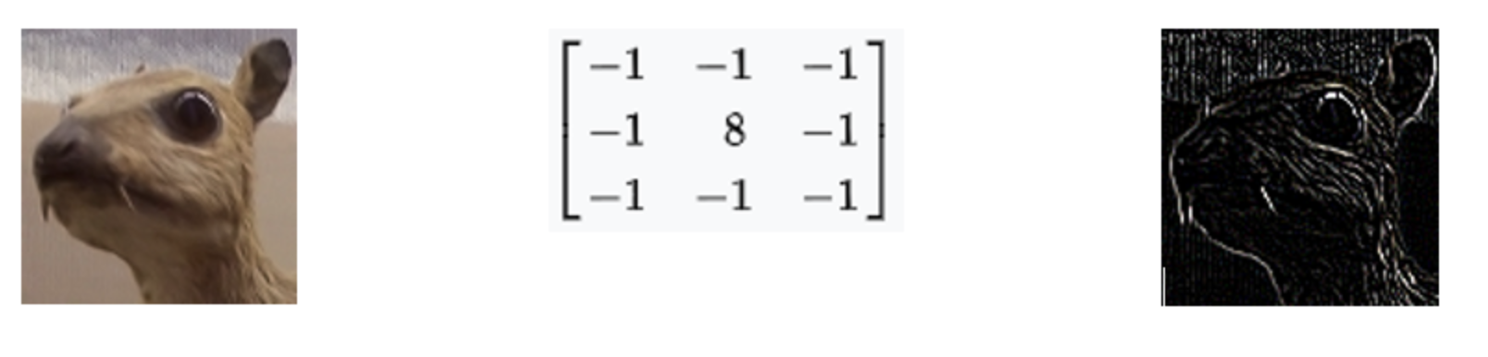
FILTERS
Filters are used to modify or enhance image properties and/or to extract valuable information from the pictures such as edges, corners etc..
Filters take as input an image and extract information out of it in form of pixel intensity gradients and their locations which is used to generate feature map
Ex: EDGE DETECTION OPERATION
IMAGE
FILTER
IMAGE WITH EDGE DETECTED OUTPUT
Text source: stanford
Notes:
Different FILTERS bring out different features from the image
For instance, in the edge detection FILTERS , if all the values in the region the Filter is superimposed on are equal.
The output of the weighted sum is going to be zero. Because there are 8 -1s and 1 +8 in the kernel.
But if the the pixel in the centre has a high value and the surrounding pixels have a low value, then the overall result is going to be a high value. It denotes that there is an edge present in
that region.
More such filters and their results can be visualized in the tutorial notebook.

Slide 20
OpenCV Library
OpenCV is an open-source computer vision and machine learning software library
The library has more than 2500 optimized algorithms
These algorithms can be used to detect and recognize faces, identify objects, classify human actions in videos,
track camera movements, track moving objects etc
Open cv library can be installed via PIP or Conda methods
Source Opencv

Slide 21
Case study

Slide 22
Thank you! :)
Questions ?

Slide 23


AIML @WORK
PGPAIML @ Great Learning
Enabling Learners to Apply the AI/ML Concepts at Work
Apply AIML at your workplace to gain some instant benefits:
Get noticed by your management with your outstanding analysis backed by data science.
Create an impact in your organization by taking up small projects/initiatives to solve critical issues using data science.
Network with members from the data science vertical of your organization and seek opportunities to contribute in small projects.
Share your success stories with us and the world to position yourself as a subject matter expert in data science.
AIML Operations | AIMLAW
@Great Learning Proprietary Content. All rights reserved. Unauthorized use or distribution prohibited

