Slide 1
Prem Kishore V
GROQ Tensor Streaming Multiprocessor

Slide 2
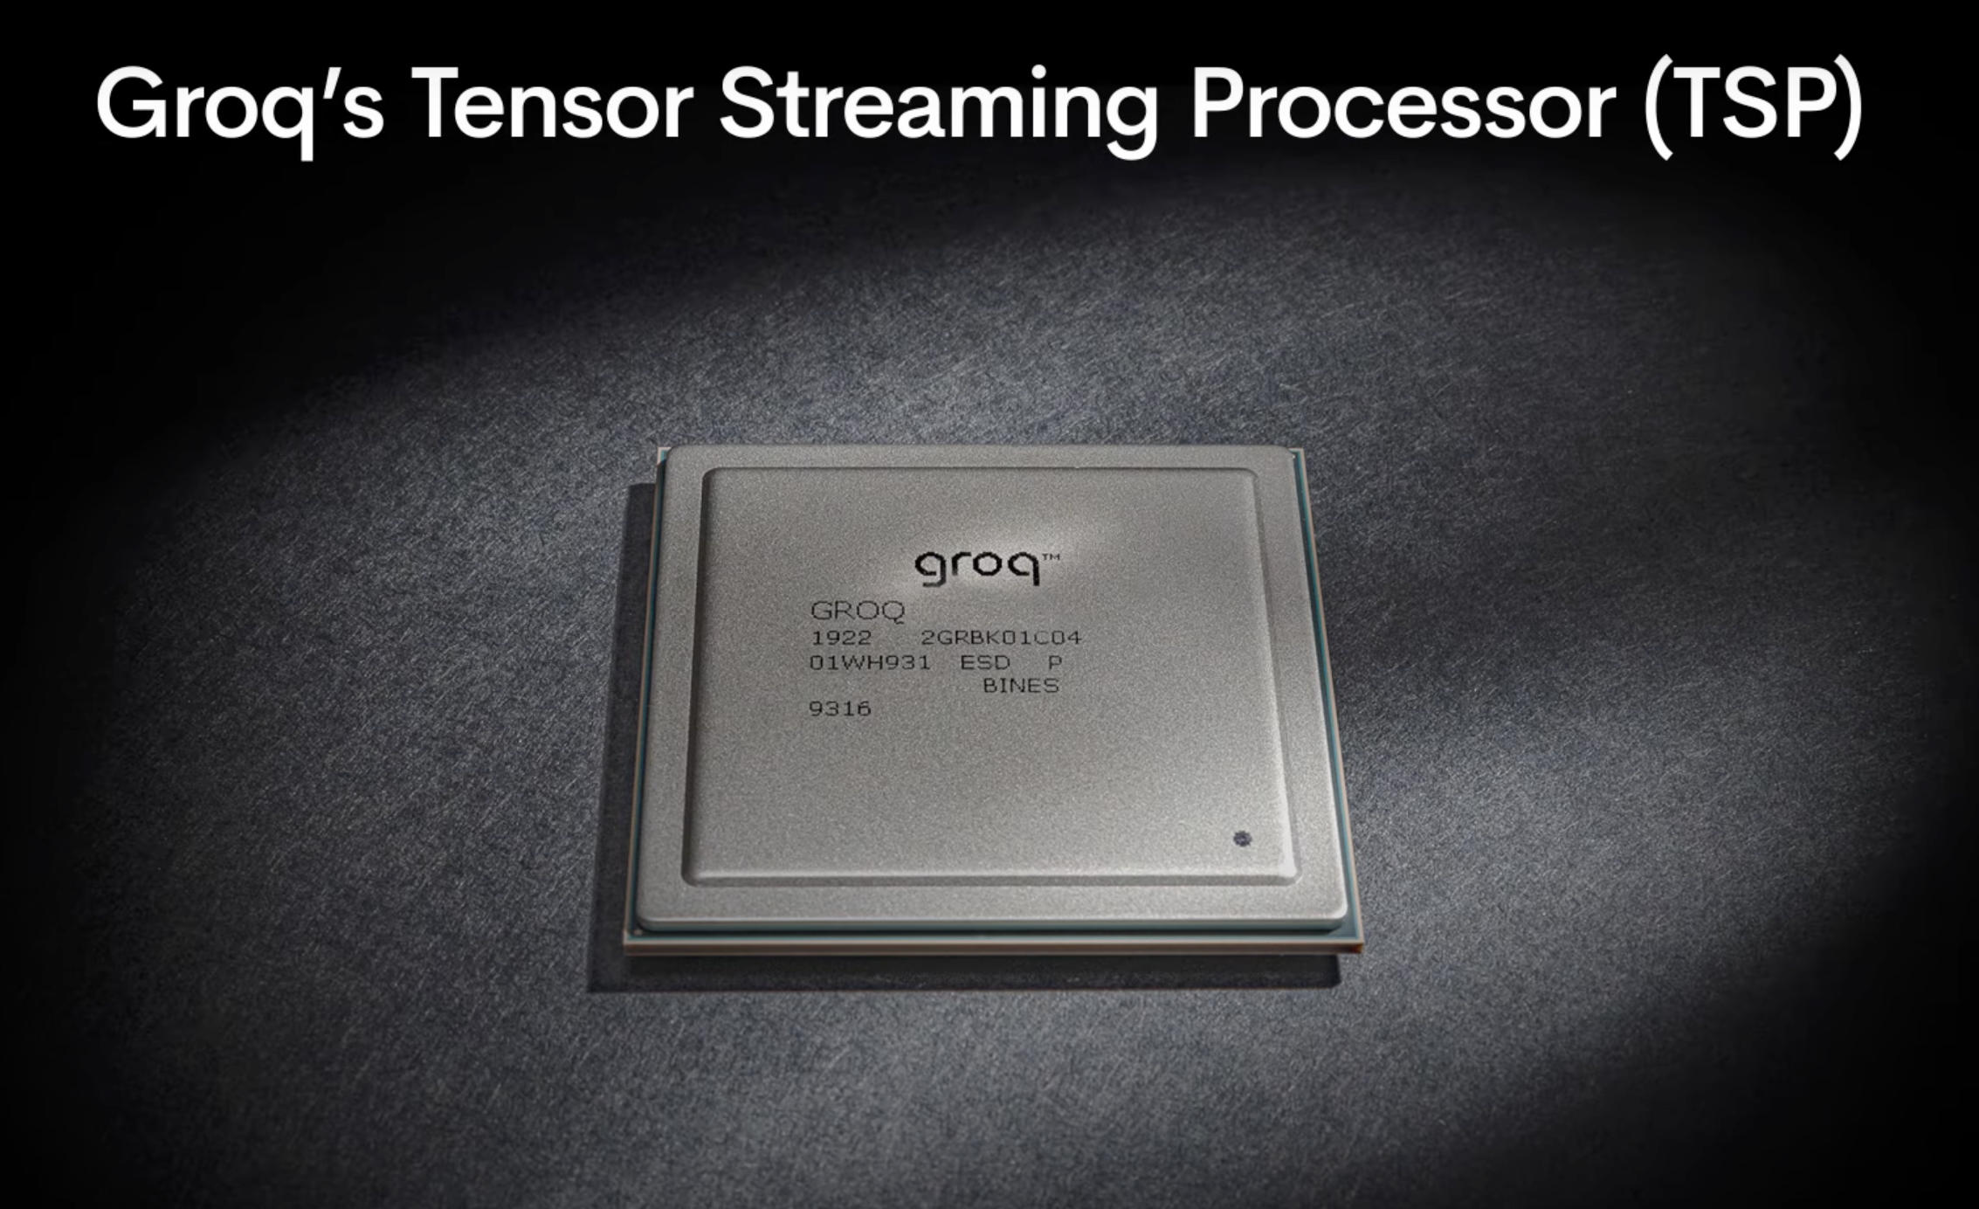

Slide 3
Today’s Agenda
• Introduction to Groq
• Problem with Conventional Architectures
• Groq’s Solution: Tensor Streaming Processor (TSP)
• How Groq Works
• Comparison with Competitors
• Applications of Groq Technology
• Future Directions and Innovations
• Conclusion and Summary
• Q&A

Slide 4
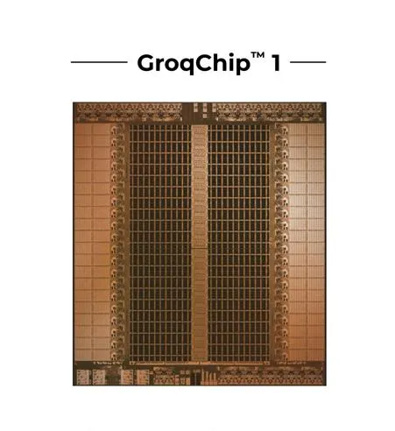
What is Groq?
Founded by Jonathan Ross in 2016, Groq is the AI
infrastructure company that builds the world’s fastest
AI inference technology.
The LPU™ Inference Engine by Groq is a hardware
and software platform that delivers exceptional
compute speed, quality, and energy efficiency.
Groq, headquartered in Silicon Valley, provides cloud and on-prem solutions at scale for AI applications. The LPU and related systems are designed, fabricated, and assembled in North America.

Slide 5
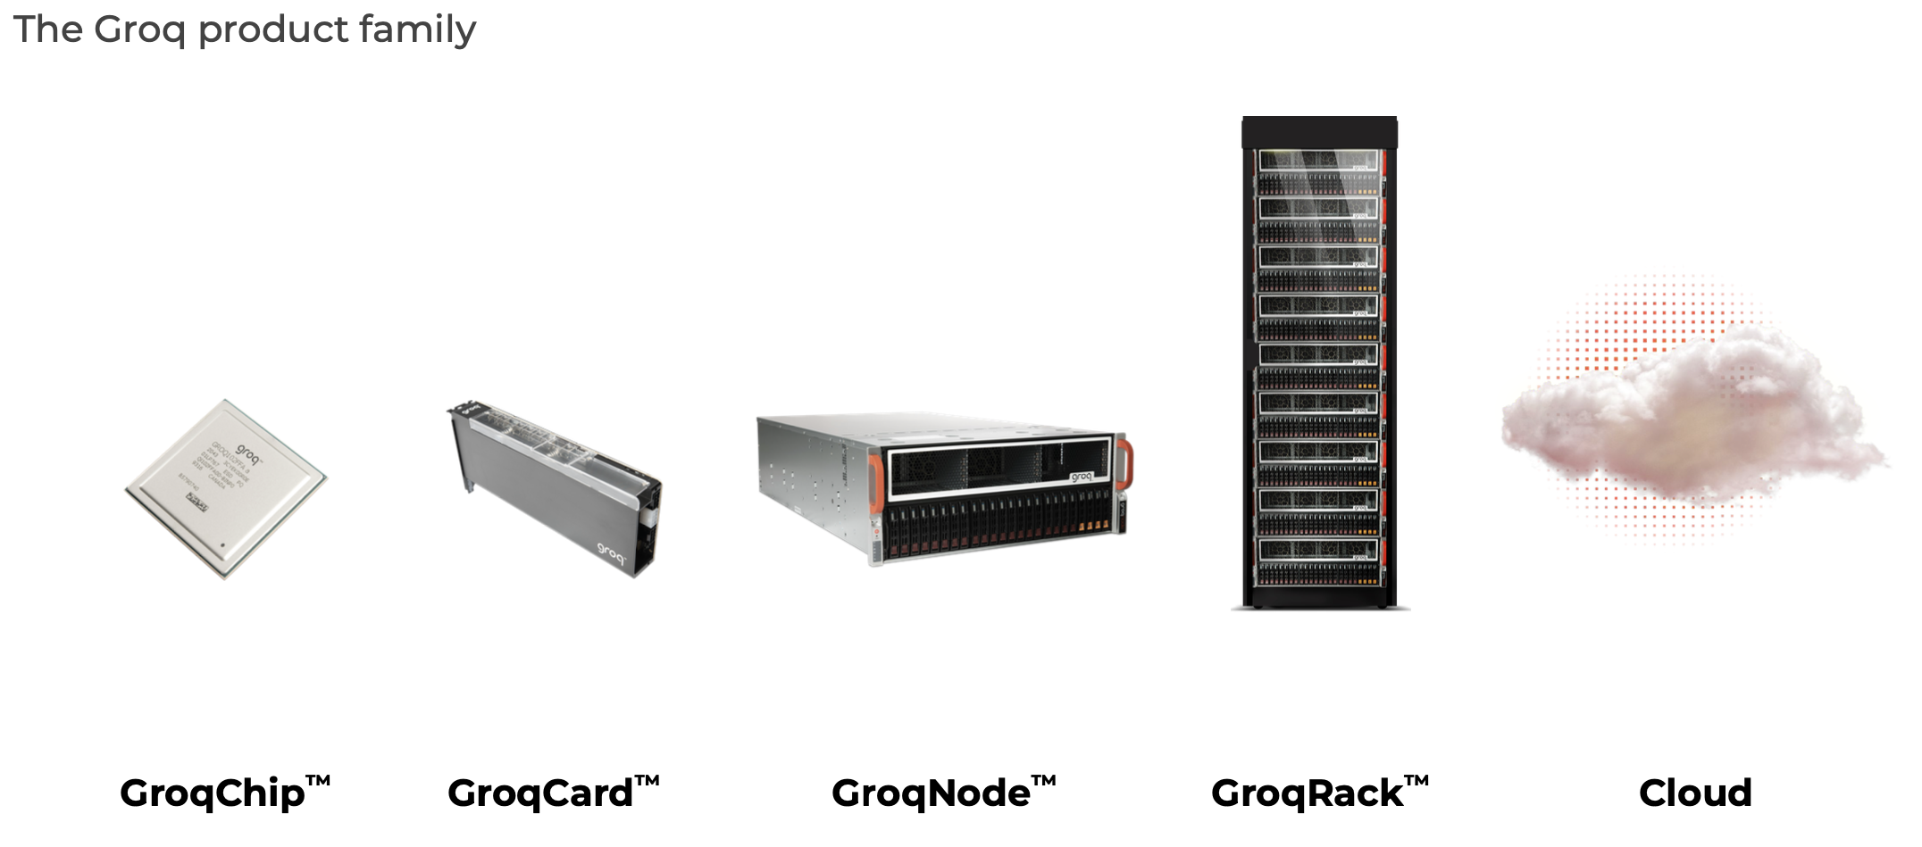
Groq’s Lineup

Slide 6
Problem:
In conventional architectures, performance comes with complexity in the form of complicated control circuitry, multifunctional cores, and multilevel caches.
There’s a lot of silicon, sometimes more than 60% that is not used for compute.
Unpredictability is the unavoidable consequence of out of order and speculative execution and multiple branch prediction. Multicore only compounds this problem. Unpredictability forces developers to test and validate the system iteratively and plan around the worst case performance and latency.

Slide 7
Solution to this problem:
Groq’s Tensor Streaming Processor gets unprecedented computing power and efficiency from simplicity.
In Groq’s TSP architecture, all the execution planning is handled by the compiler. Only a small portion of the silicon is needed to orchestrate on chip compute resources. That leaves more room for on chip memory and arithmetic units.
Data streams into the array of ALUs at a bandwidth of 80 terabytes per second.

Slide 8
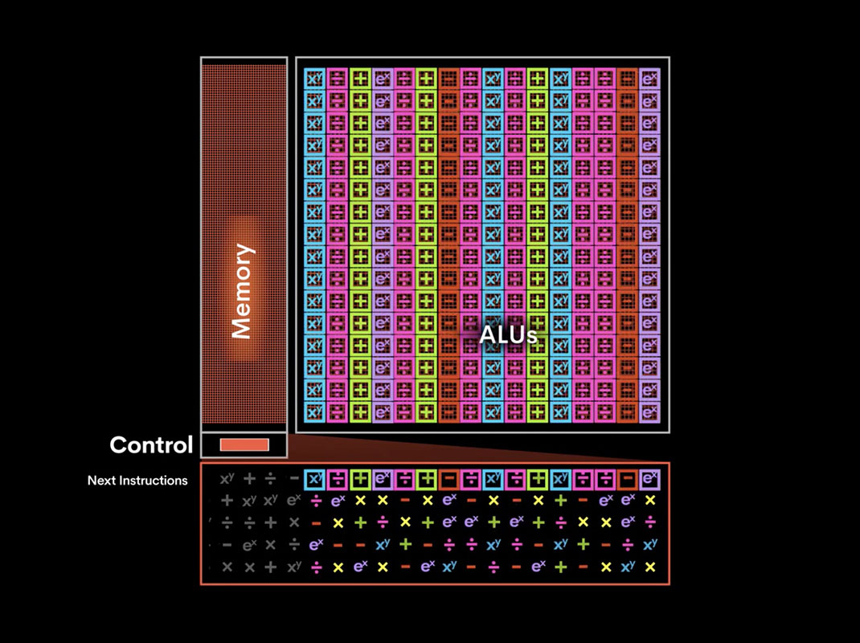
Groq architecture

Slide 9
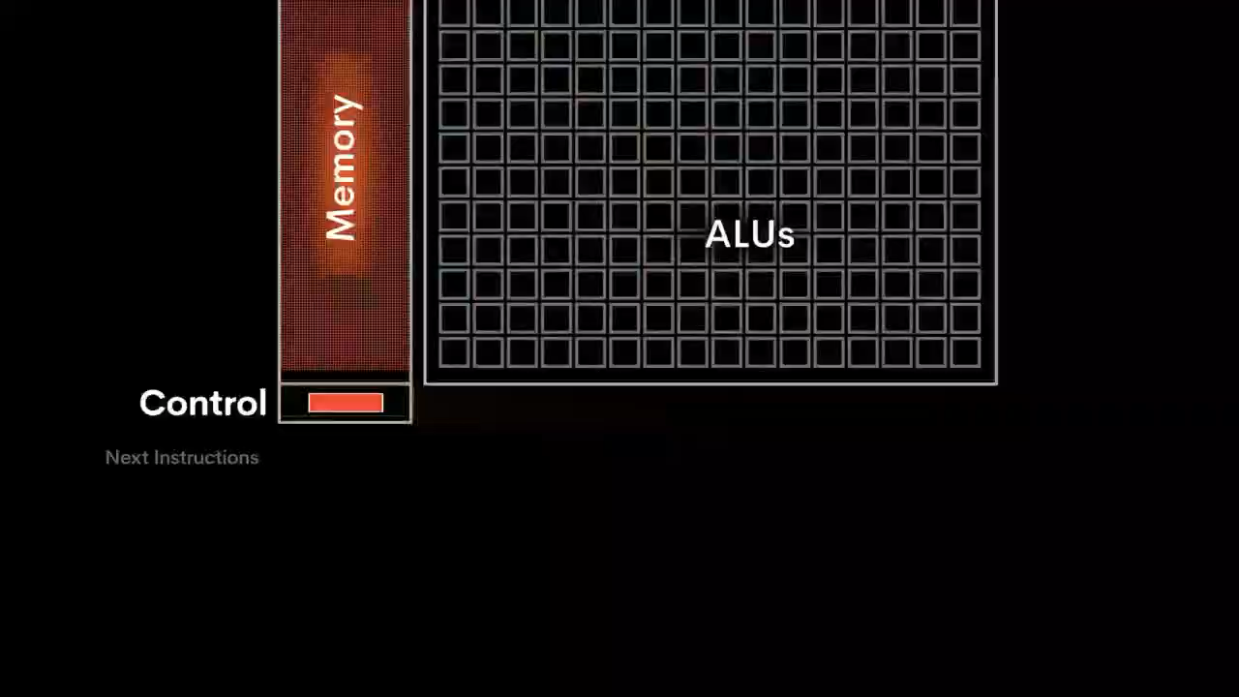
Groq architecture

Slide 10
Here's how it works.
As data is read out of memory, the compiler ensures new instructions are provided for processing the data streaming through the compute logic.
This process continues as new data is read. The TSP is reconfigured by the software every cycle with results returning to globally shared memory.
Because the data is always streaming, latency is dramatically reduced.

Slide 11
Why Groq? And not the competitors
Specialized for Natural Language Processing (NLP) Tasks
Groq's LPUs are purpose-built for sequential processing required for natural language understanding and generation. This specialization allows them to outperform general-purpose processors like GPUs on NLP tasks like translation, text generation, etc.
Extremely High Throughput and Low Latency
The TSM architecture enables breakthrough performance for large language model inference. As claimed in , it can handle "large language models more efficiently with a record-breaking speed of more than 100 tokens per second on a 70-billion-parameter model."This is orders of magnitude faster than traditional hardware for such large models, giving Groq a significant advantage.

Slide 12
Why Groq?
Deterministic and Software-Defined
Unlike GPUs and TPUs that have hardware-defined architectures, Groq takes a software-defined approach optimized through its compiler technology. This allows for deterministic execution crucial for AI reliability.
Scalable Multi-Chip Architecture
The TSM chips can be scaled out to build large multi-chip systems with globally shared memory and high bandwidth interconnects, enabling efficient scaling for massive models and workloads.While GPUs and TPUs can also scale out, Groq's architecture is explicitly designed for this from the ground up.

Slide 13
Why Groq?
Power and Cost Efficiency
Groq claims its software-first approach results in lower power consumption and costs compared to running large models on GPUs or TPUs.
While Nvidia and Google have been leaders in AI hardware, Groq's innovative architecture optimized specifically for large language model inference gives it a compelling performance advantage for these rapidly growing workloads. Its deterministic software-defined nature, efficient scalability, and potential cost/power benefits position it as an attractive alternative, though it may need to co-exist with rather than fully replace other solutions.

Slide 14
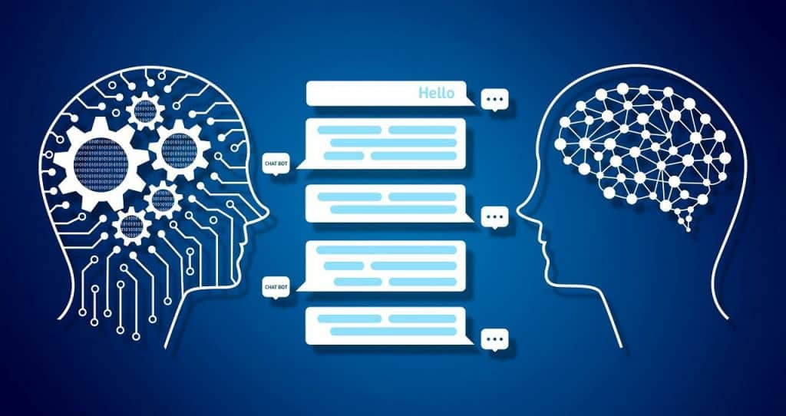
Applications of Groq
1. Natural Language Processing: Extra Accuracy and Speed
Natural Language Processing or NLP is a technology that combines computational linguistics with statistical and machine learning models to understand and generate text and speech. It’s a sub-branch of AI and has wide use cases in speech-to-text processing.

Slide 15
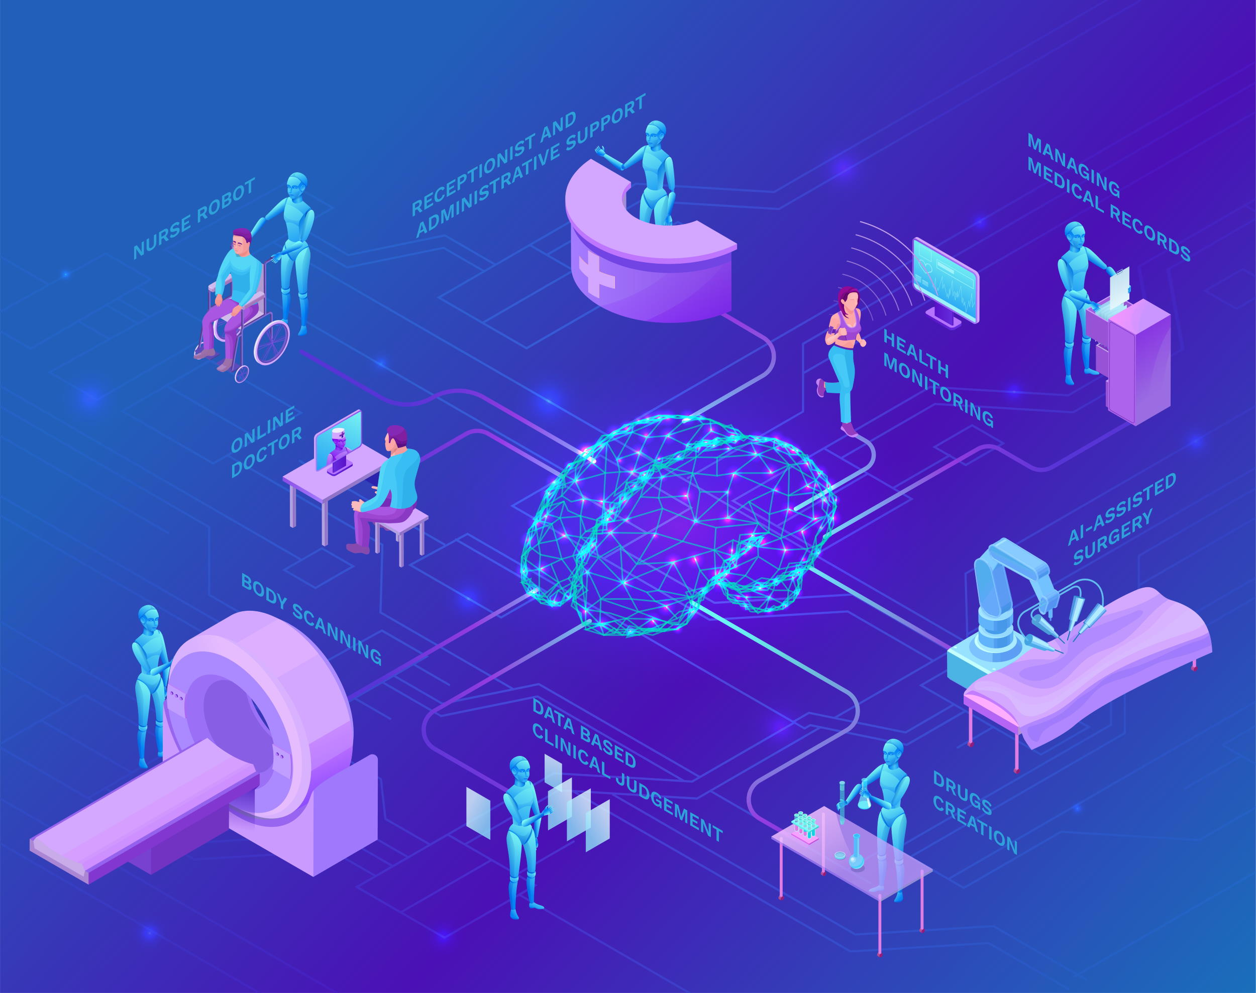
Applications of Groq
2. Healthcare: Better Diagnostic
6% of 130 million people who are admitted to US emergency are misdiagnosed every year
Yes, this is shocking but true.
From improving the results of medical imaging to improving the diagnosis speed, the Groq chip’s deep learning applications in the healthcare industry are vast and laudable. Players of this industry can use this chip for multiple applications.

Slide 16
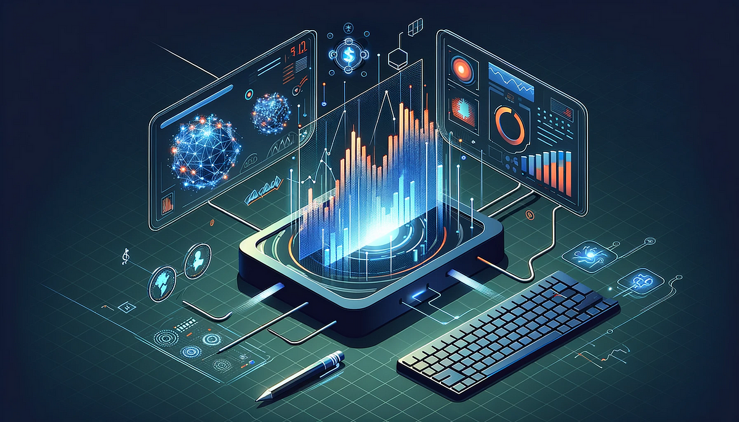
Applications of Groq
3. Finance: Real-Time Risk Analysis
The finance industry leverages AI to perform actions like risk & investor portfolio analysis, predicting market trends, and fraud detection. Groq chip’s deep learning applications in industry are going to foster precision in each of these actions.

Slide 17

Applications of Groq
4. Legal: Quick Case Dispersal
The legal industry is dealing with issues like delayed dispersal, a high number of pending cases, and a lack of evidence. One of the most useful Groq chips applications in industries is for the legal domain where it can take up the work efficiencies of court and lawyers at new highs.

Slide 18
Future Directions and Innovations
1. Enhanced Efficiency and Speed:
Groq aims to further improve the efficiency and speed of their Tensor Streaming Processors (TSP). By optimizing the chip design and leveraging advanced manufacturing techniques, future versions of Groq TSP are expected to deliver even faster processing times and lower power consumption, making them ideal for large-scale AI and machine learning applications .

Slide 19
Future Directions and Innovations
2. Broader Application Scope:
Groq is likely to expand the application scope of their TSP technology. Currently excelling in AI inference tasks, future developments may see Groq TSPs being used more extensively in areas such as autonomous systems, edge computing, and real-time data processing. This expansion will be driven by enhancements in chip architecture and integration capabilities .
3. Integration with AI Frameworks and Software Ecosystems:
To maximize the utility of Groq TSPs, the company is focusing on better integration with popular AI frameworks and software ecosystems. This includes providing robust support for frameworks like TensorFlow and PyTorch, as well as developing proprietary tools that simplify the deployment and management of AI models on Groq hardware .

Slide 20
Conclusion and Summary
Groq’s Tensor Streaming Processor (TSP) revolutionizes AI inference technology by overcoming the complexities of conventional architectures with a simpler, more efficient design.
Its deterministic, software-defined approach ensures predictable performance, superior compute density, and scalability, making it ideal for diverse applications like natural language processing, healthcare, finance, and legal case management. As Groq continues to innovate, its TSP will drive advancements in AI technology, solidifying its role as a leader in the industry.

Slide 21
Q&A
Open Floor for Questions and Discussions

