Slide 1
12.06.2024
Wait for Pedestrian + Overtake :
by
Prem Kishore
Instructor:
Xu, Wenguang
Masters in AI Engineering Of Autonomus Systems

Slide 2
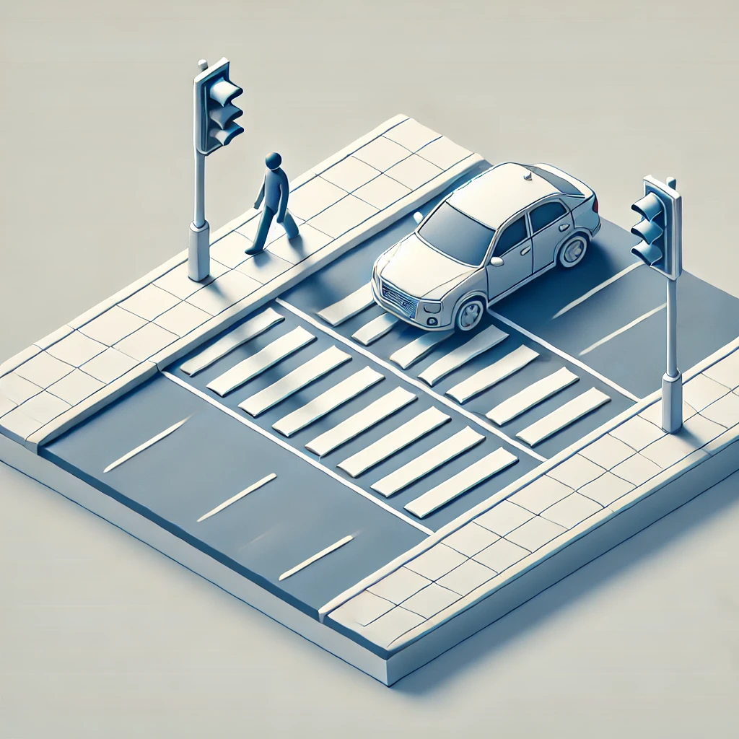
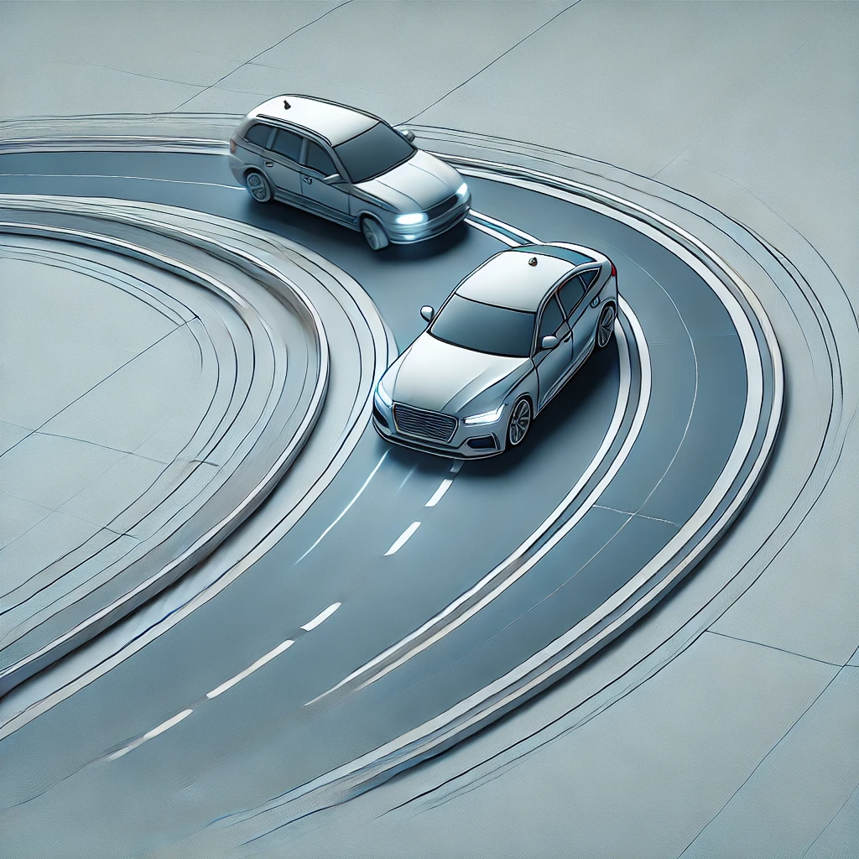
Objective:
1. Wait for Pedestrian on the zebra crossing.
2. Drive again after the Pedestrian leaves.
3. Over take another vehicle and
drive back in the same road.
4. Over take a car in a curve.

Slide 3
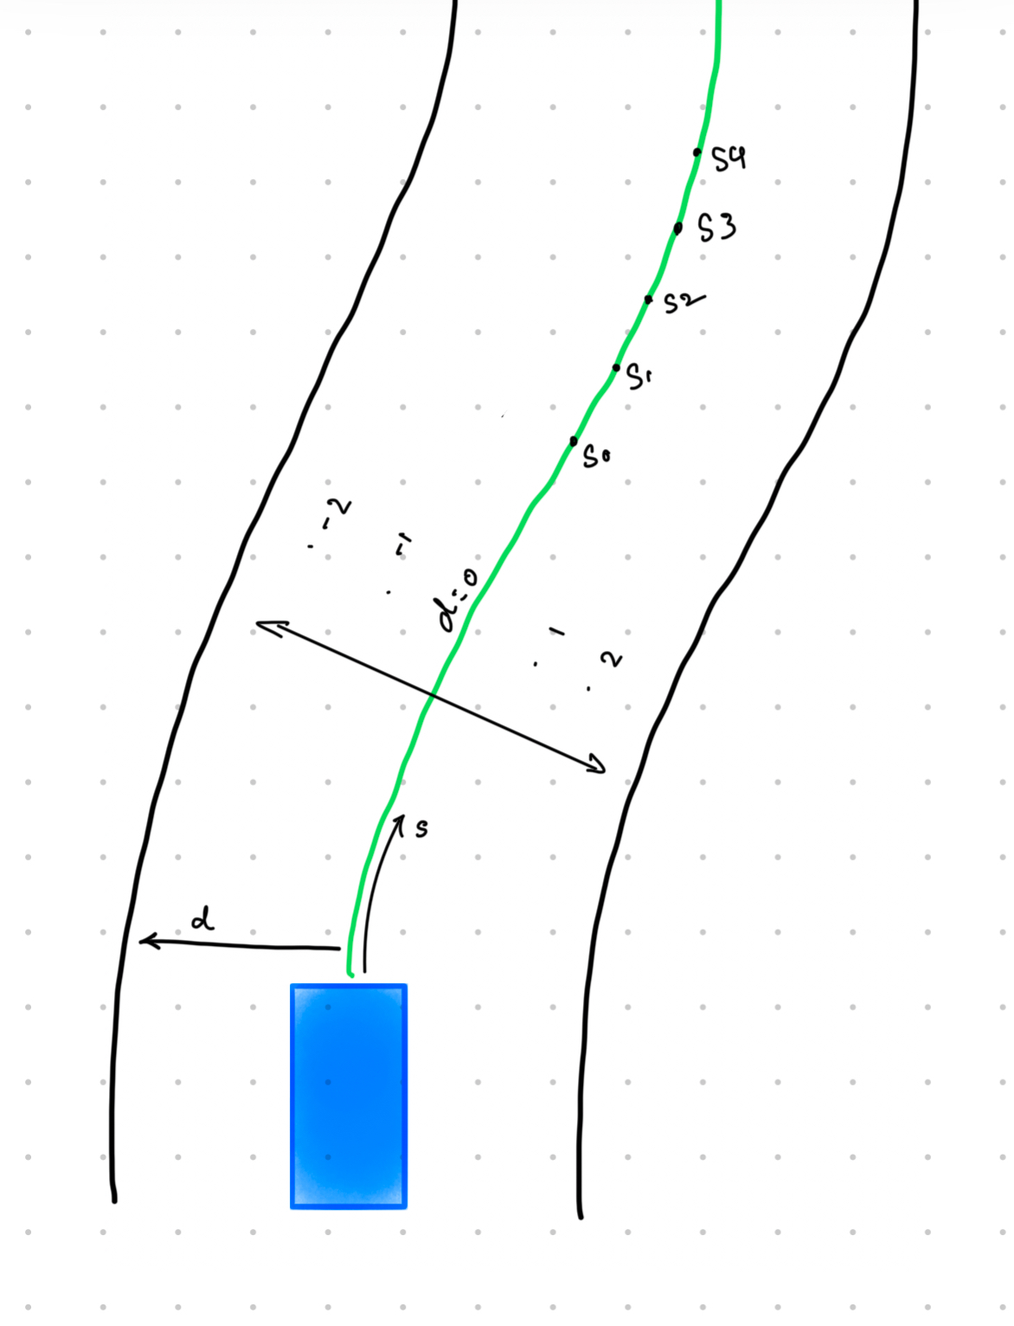
Method Used:
Frenet logic refers to a trajectory planning framework that uses a Frenet coordinate system to simplify the complex task of motion planning. Instead of dealing with global Cartesian coordinates (x, y), it represents positions relative to a road's centerline, using two coordinates:
Longitudinal (s): Represents the position along the road's centerline, often indicating how far the vehicle has traveled along the road.
Lateral (d): Represents the offset or deviation from the centerline, indicating the vehicle's lateral position on the road (e.g., in a lane).

Slide 4
How it Works in Trajectory Planning:
Path Representation: The road is represented by the s and d coordinates, which follow the curvature of the road. This allows planning to adapt easily to road geometry.
Decoupling of Motion: Longitudinal and lateral motions are planned independently, simplifying computations. For example:
  Longitudinal planning can focus on speed and distance (e.g., maintaining safe following distances).
  Lateral planning can focus on lane changes or staying within the lane boundaries.
Dynamic Behavior: The Frenet frame allows for easy representation of dynamic behaviors like lane keeping, lane changes, and obstacle avoidance by manipulating the d and s components.

Slide 5
Modules:
Cubic Spline planner
Ego vehicle
Misc
Obstacles
Main

Slide 6
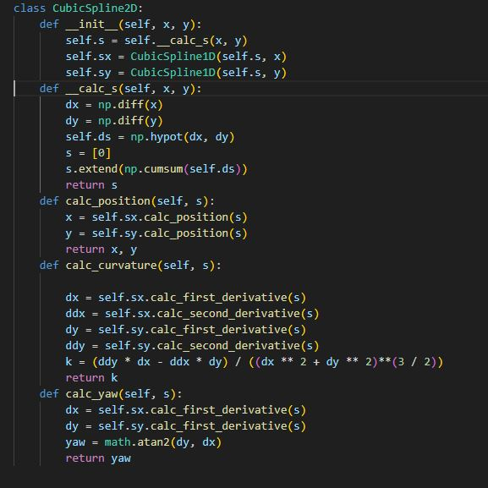
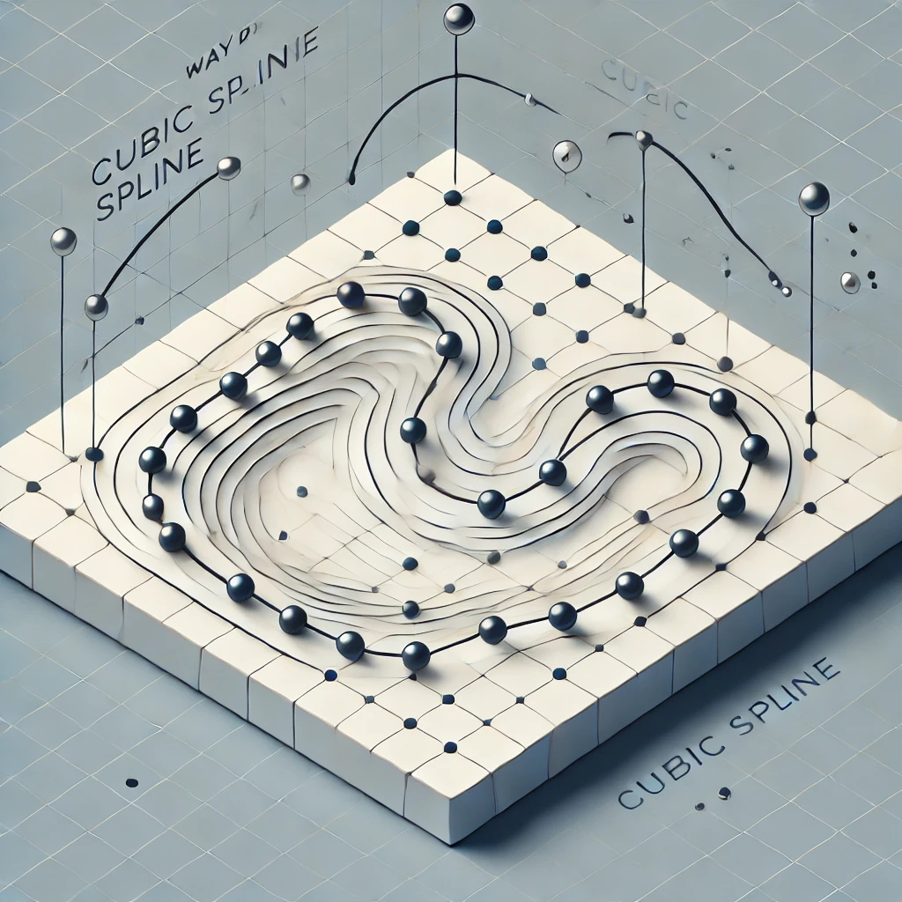
Cubic Spline planner
1D and 2D Cubic Splines: Provides smooth trajectories in both 1D and 2D space.
Calculates Derivatives: Yaw, curvature, and other metrics are derived for motion planning.
Code Snippet:
Functionality:
calc_position(s): Gets x, y position at distance s.
calc_yaw(s): Computes the yaw angle at s.
Notes:
European University Association (EUA)

Slide 7
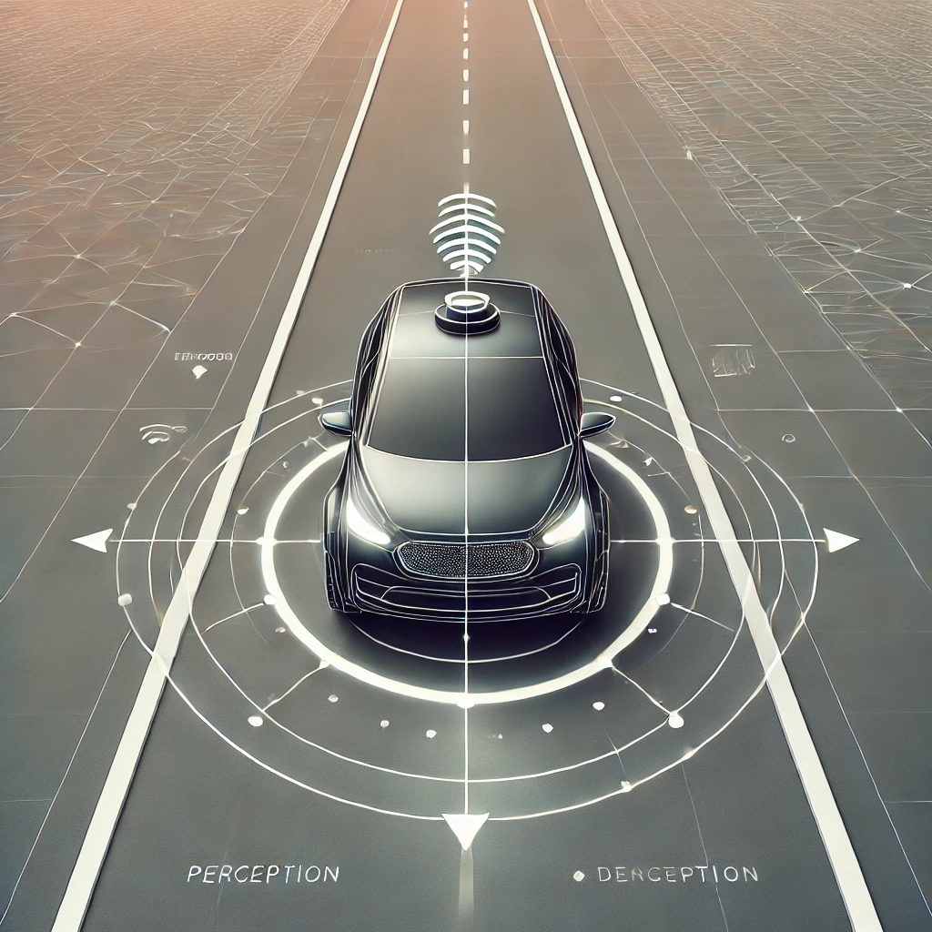

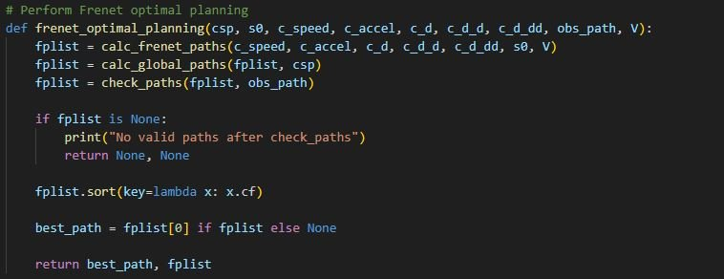
Ego vehicle:
Defines ego vehicle behavior and integrates Frenet paths.
Lateral Path: A quintic polynomial is used to calculate lateral displacement (d) as a function of time.
Longitudinal Path: A quartic polynomial is used to calculate longitudinal position (s) as a function of time.
Frenet Path Selection: Chooses optimal path using dynamic constraints.

Slide 8
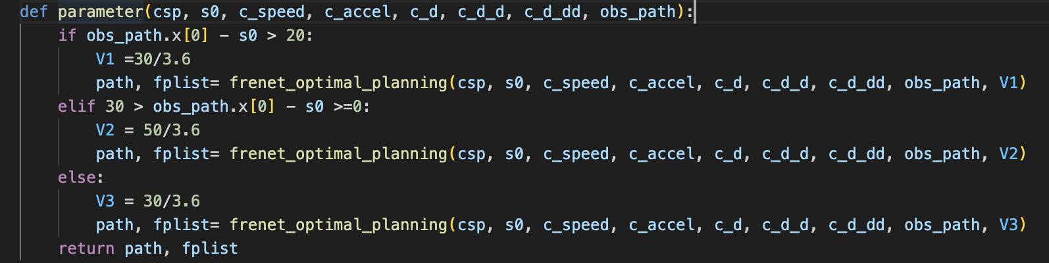
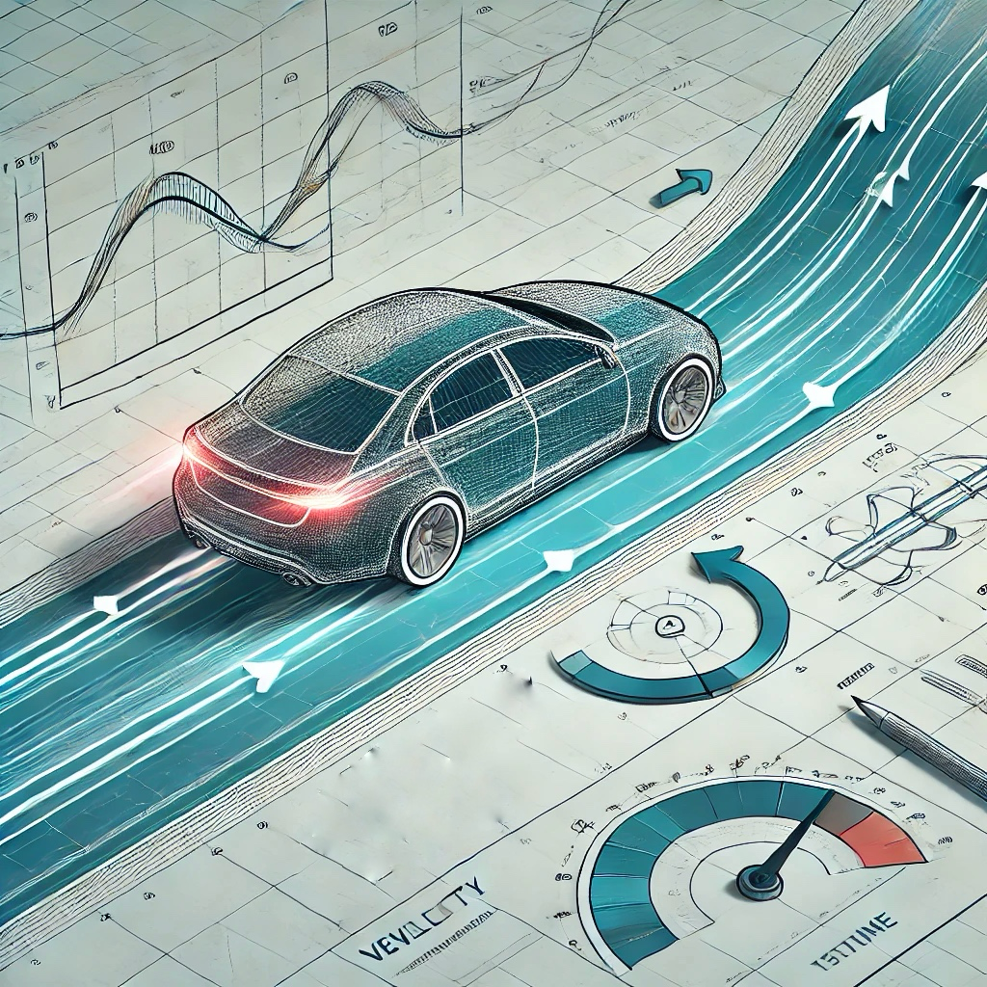
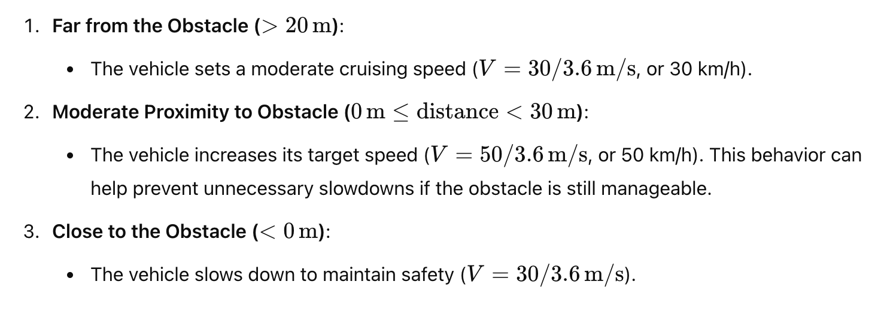
Dynamic Velocity Adjustment: Adjusts speed based on obstacle distance.

Slide 9
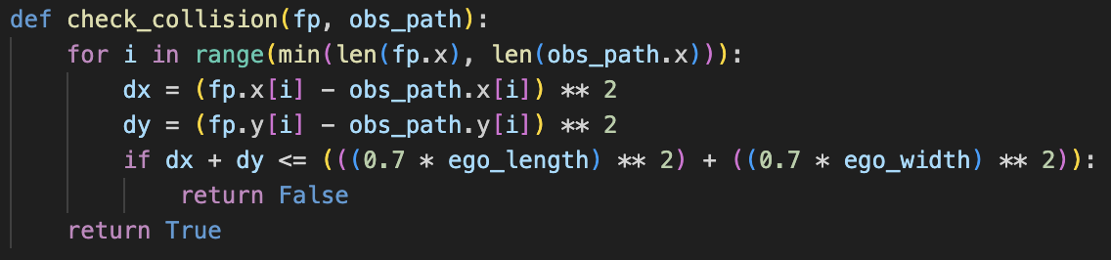
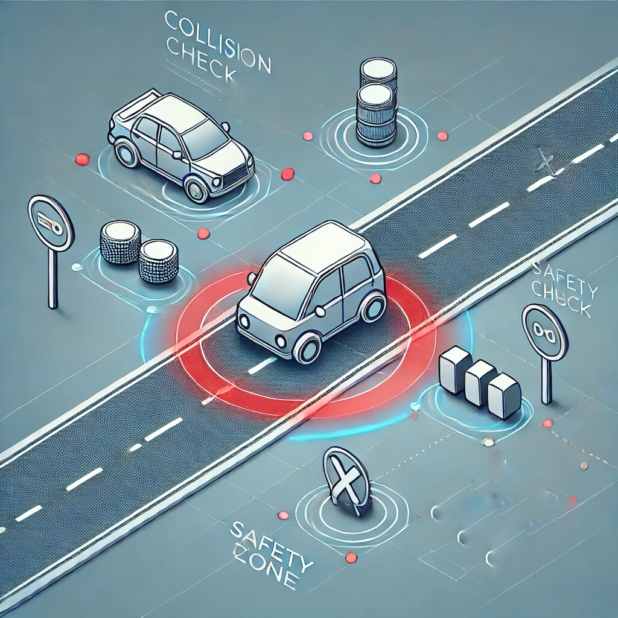
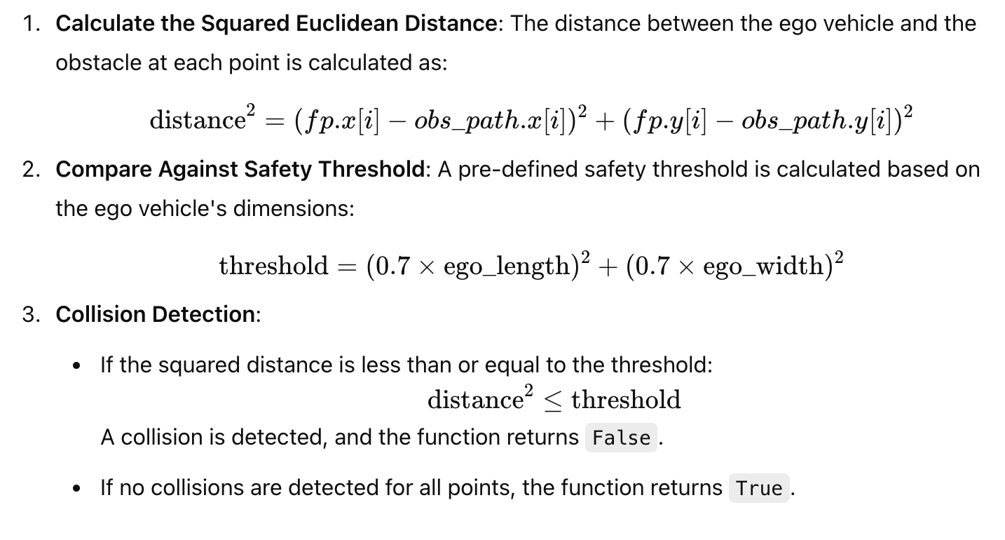
Collision check: The function determines if the ego vehicle is too close to the obstacle by performing the following steps:

Slide 10
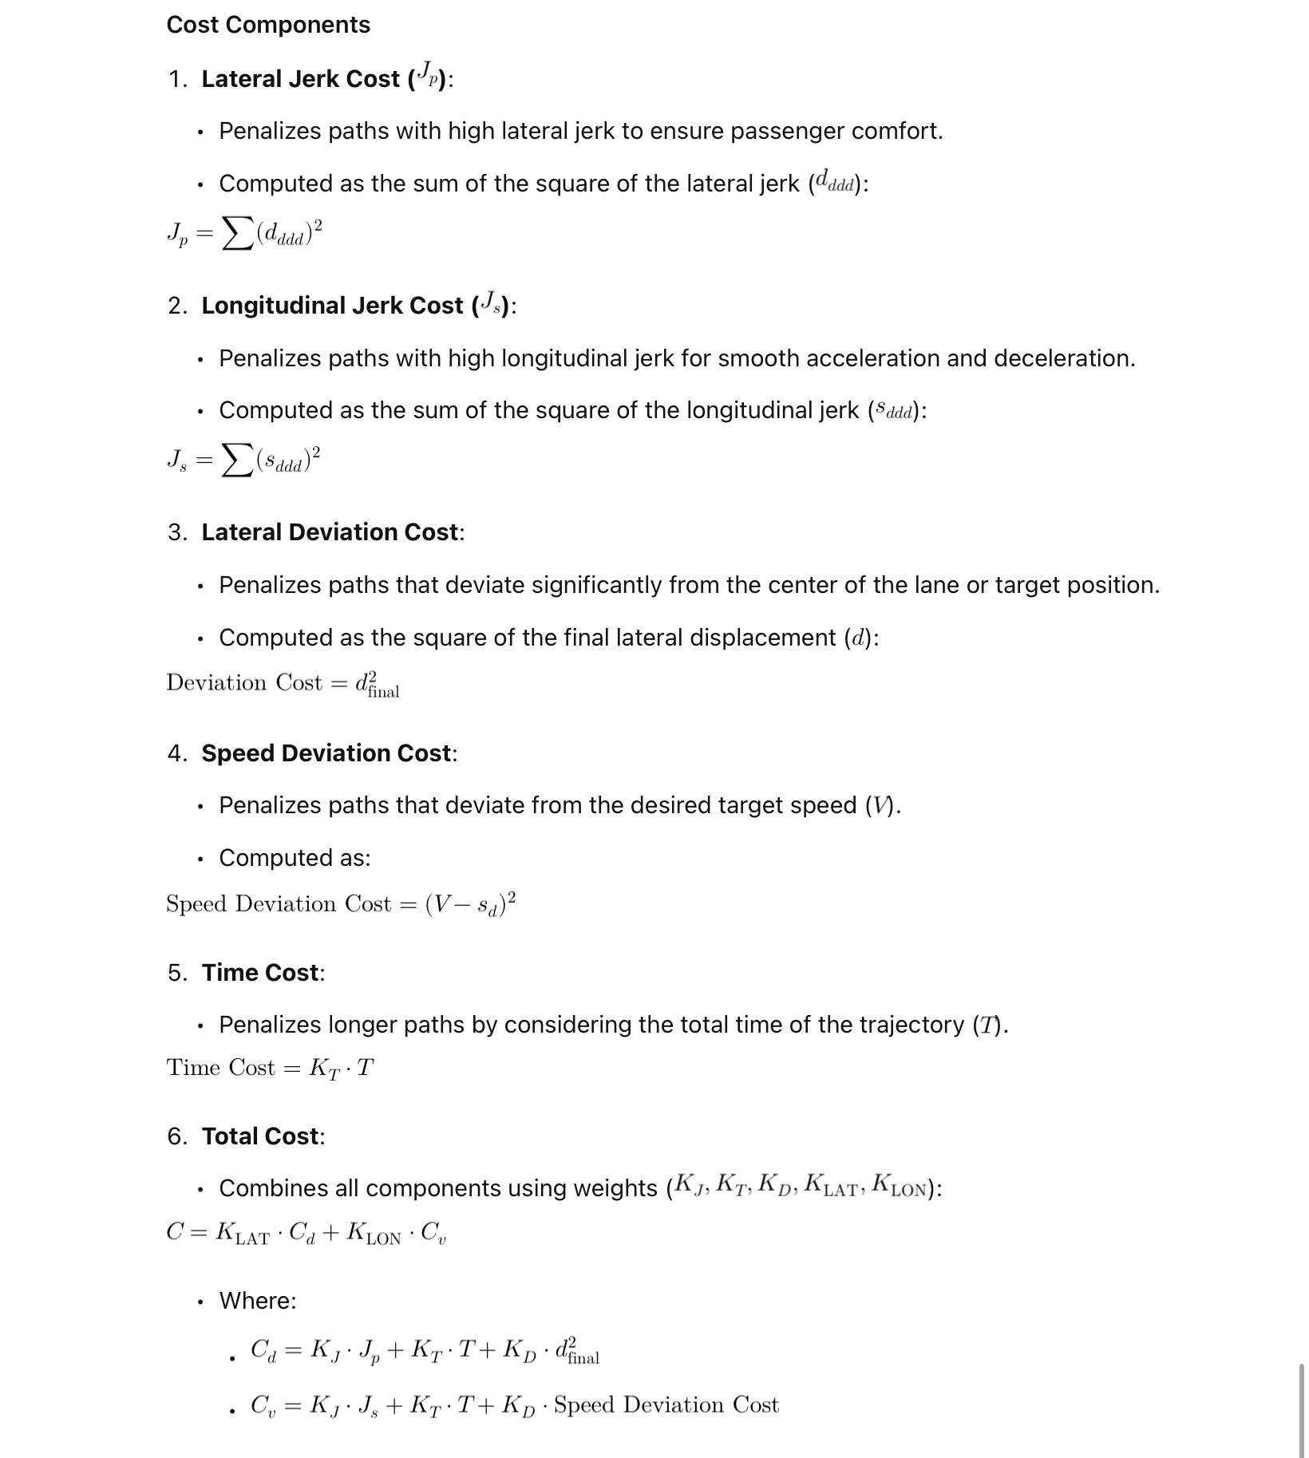
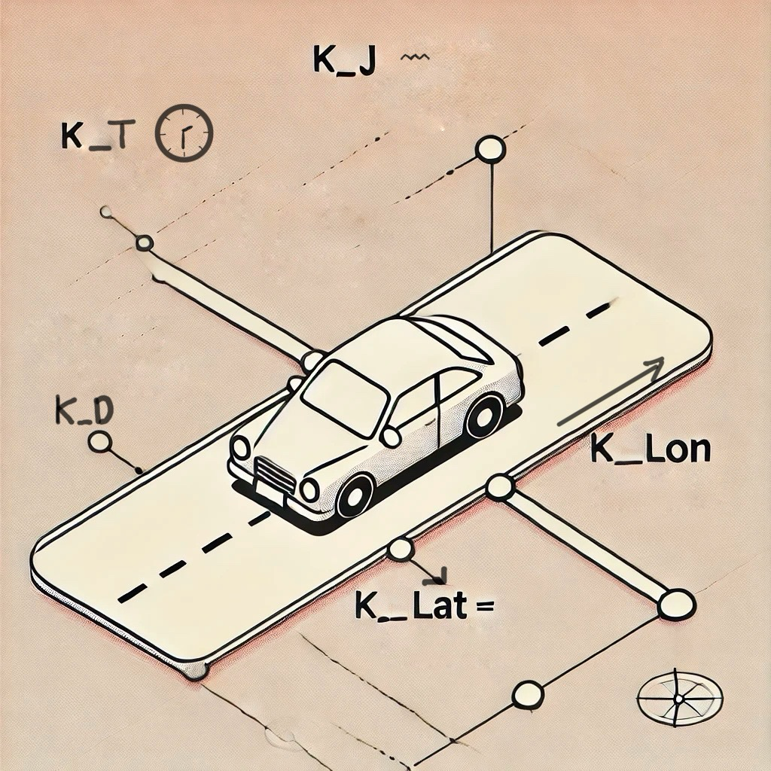
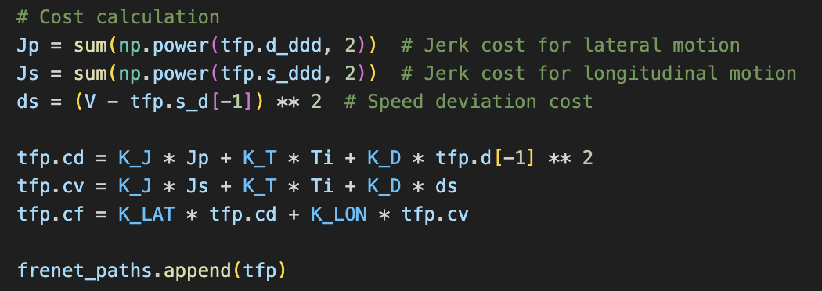
Cost Function in Path Planning

Slide 11
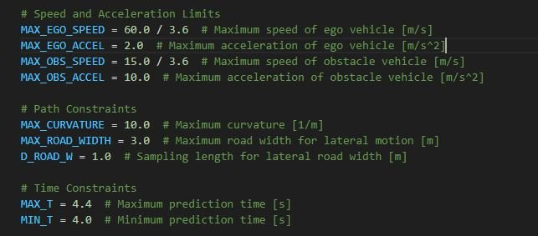
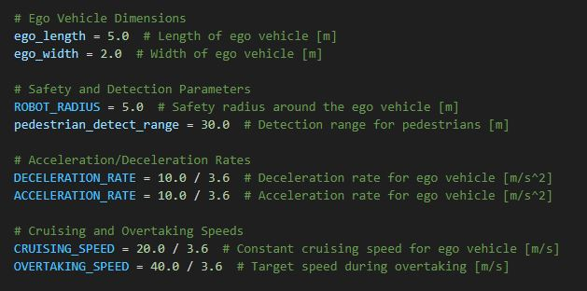
Misc:
This file mostly consists of all the used constants for the program.
Car dimensions
Speed & Acceleration limits
Path & timings
Safety Parameters

Slide 12
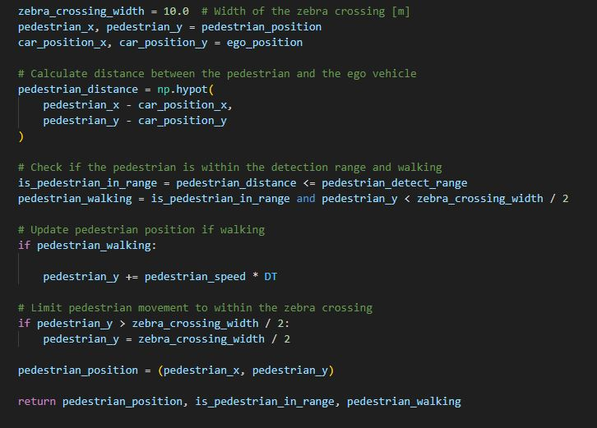
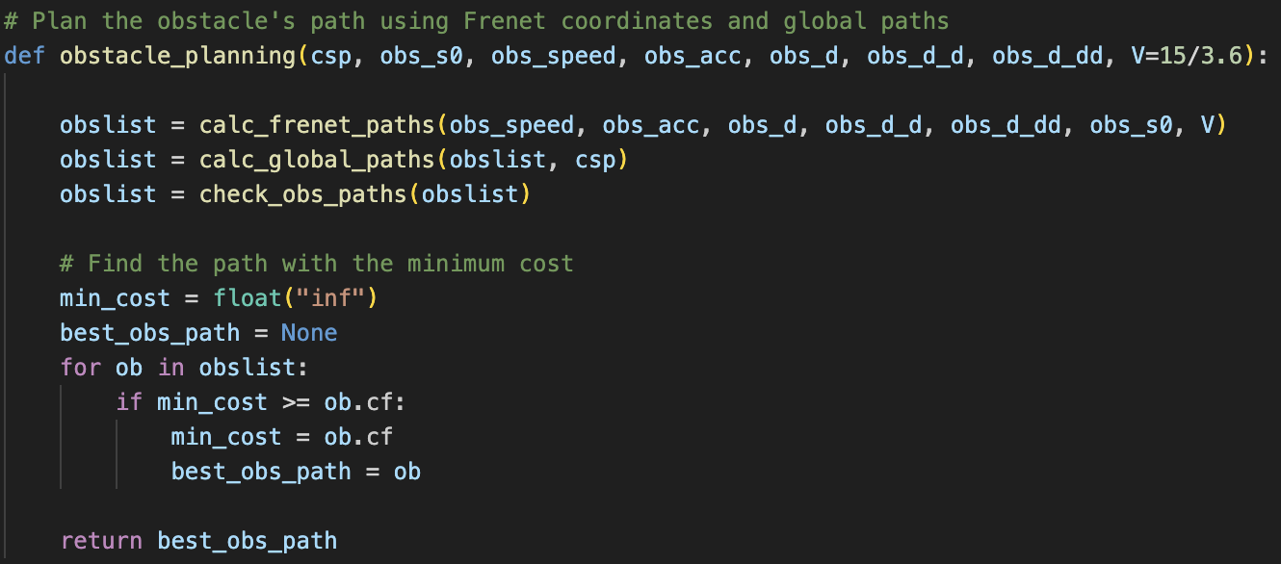
Obstacles:
add_zebra_crossing_and_pedestrian:
Handles pedestrian-vehicle interaction.
Simulate obstacle behavior and pedestrian interaction.
Functionality:
obstacle_planning: Generates obstacle paths.

Slide 13
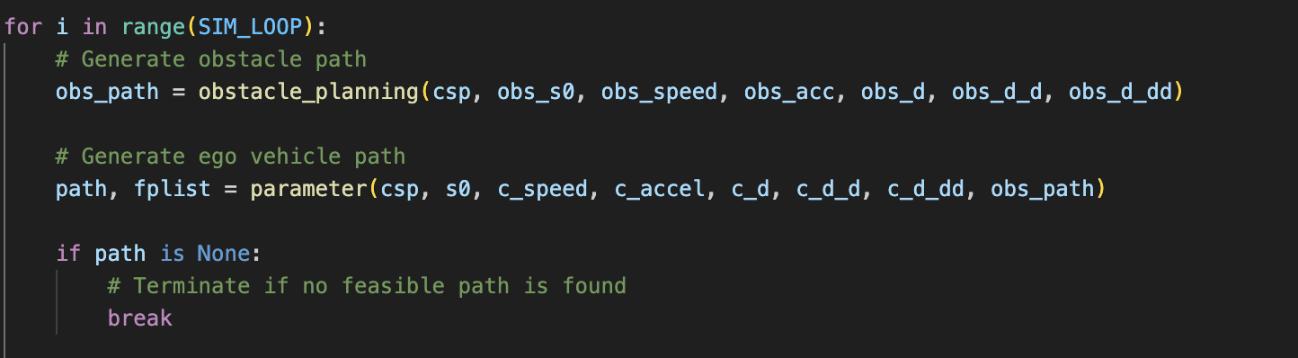
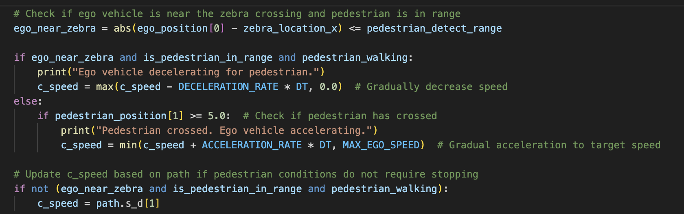
Main:
Purpose: Integrates all modules and runs the simulation loop.
Key Features:
Visualization: Displays the ego vehicle, obstacles, and pedestrians.
Waypoints:
Behavior Control: Manages path selection and updates positions.
Pedestrian Logic:

Slide 14
Advantages:
  Classic , simple and Efficient trajectory planning for different environments.
  Best suited for structured roads like highways or well-marked roads.
  Optimization-based local path planning in the Frenet frame.
  The ego vehicle dynamically adjusts its speed based on obstacles, pedestrian activity, and road geometry.

Slide 15
Limitations:
1. Simplified Pedestrian Modeling
No complex pedestrian behaviors, such as varying speed or unexpected stops.
2. Static Obstacle Paths
Assumes that obstacles follow pre-defined paths which is not the case in reality.
Doesn't account for dynamic or unpredictable obstacle motion (e.g., vehicles making sudden lane changes).
3.Absence of Sensor Simulation
Relies on perfect information (e.g., positions of obstacles and pedestrians).
Doesn't simulate noisy sensor inputs, such as those from LIDAR, RADAR, or cameras, which are common in real-world scenarios.

Slide 16
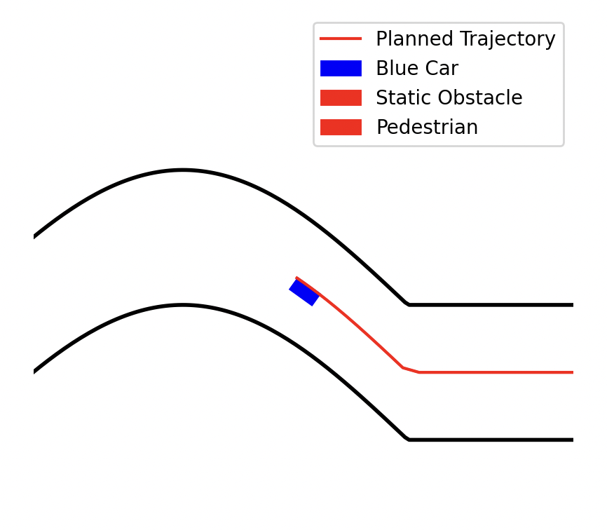
Future Enhancements:
Problems faced:
Implementation of Cubic Spline Planner.
Dynamic speed concept for ego vehicle.
Incorporating Reinforcement Learning (RL) and other advancements could significantly improve the system's adaptability, efficiency, and robustness.
Why RL?
Reinforcement Learning allows the ego vehicle to learn optimal policies through trial and error, improving performance in dynamic and uncertain environments. It eliminates the need for manual tuning of weights in cost functions and can adapt to complex scenarios.

Slide 17
Conclusion
This program provides a strong foundation for autonomous vehicle navigation by integrating path planning, collision avoidance, and pedestrian interaction using Frenet coordinates and cost optimization. While effective in handling dynamic scenarios, limitations like simplified pedestrian modeling and reactive decision-making highlight areas for improvement.
Future enhancements such as Reinforcement Learning, sensor fusion, and adaptive cost functions can make the system more robust, efficient, and applicable to real-world scenarios. With these advancements, it can evolve into a cutting-edge solution for autonomous driving challenges.
THANK YOU

