Slide 1
Most popular component
Prem kumar A

Slide 2
Most popular component
DataGrid | Charts | List view | Scheduler | Diagram | Pdf viewer | Excel libary

Slide 3
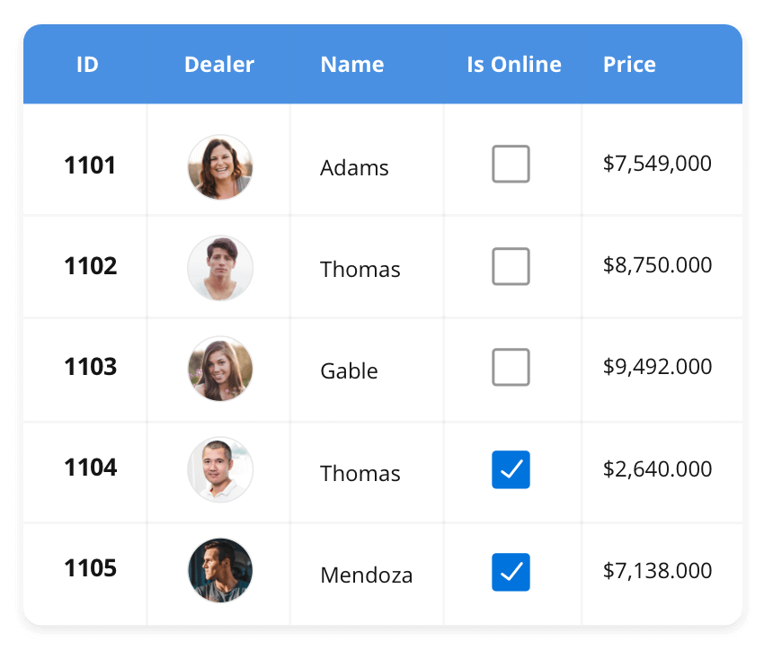



DataGrid
DataGrid
The DataGrid control is a high-performance grid component that helps display and manipulate large amounts of data in a tabular format. Its rich feature set includes functionalities like data binding, sorting, grouping, editing, filtering, swiping, dragging, resizing, loading more items, pull-to-refresh, and exporting to Excel and PDF file formats.
SUPPORTED PLATFORMS
Javascript react Angular vue Blazor
Flutter Asp.net core Asp.net mvc
WinForms .NET MAUI Xamarin
NET MAUI Xamarin javascript

Slide 4
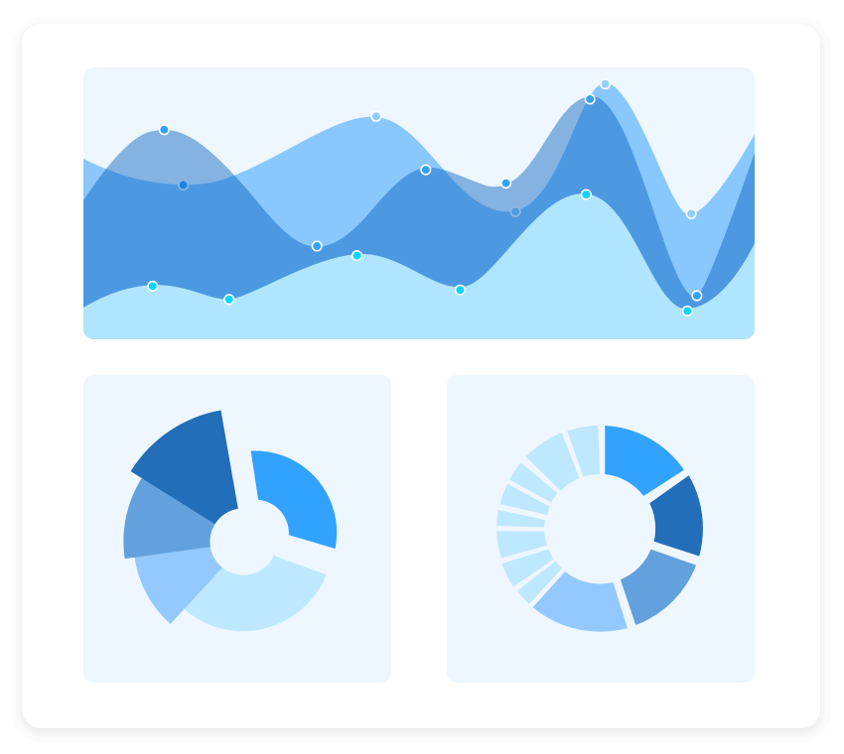
CHARTS
Charts
The Charts control can plot a wide range of chart types, ranging from line charts to specialized financial charts. Its rich feature set includes functionalities like data binding, multiple axes, legends, animation, data labels, annotations, trackballs, tooltips, and zooming.
SUPPORTED PLATFORMS
Javascript react Angular vue Blazor
Flutter Asp.net core Asp.net mvc
WinForms .NET MAUI Xamarin
NET MAUI Xamarin javascript

Slide 5
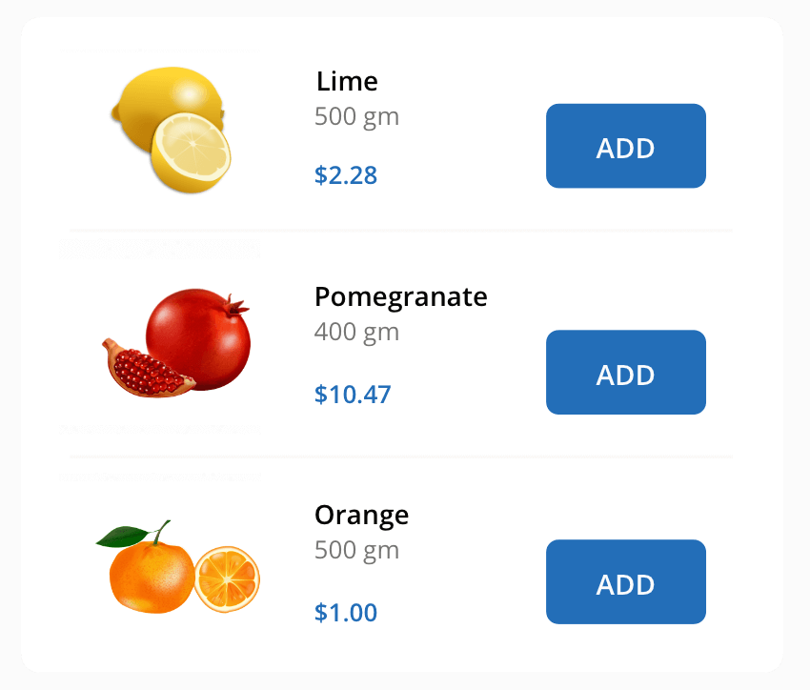
LIST VIEW
List View
The List View renders a set of data items with UI views or custom templates. It has many features like grouping, sorting, filtering, paging, swiping, multiple selection, drag and drop, and different layout types. The ListView control has been optimized to work with large amounts of data.
Supported platform
Javascript react Angular vue Blazor
Flutter Asp.net core Asp.net mvc
WinForms .NET MAUI Xamarin
NET MAUI Xamarin javascript

