Slide 1
Open Case - Student Placement Analysis
Alfido Tech Analytics Use Case

Slide 2
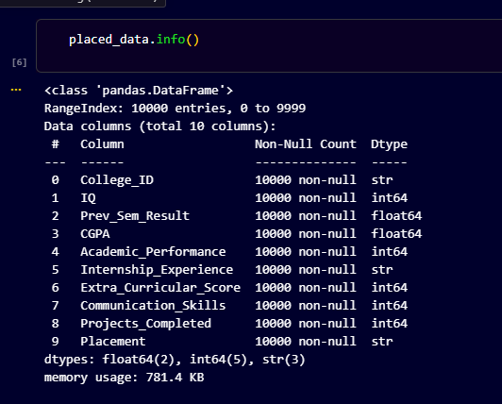
Dataset Overview
Rows: 10000
Columns: 10
Student placement dataset

Slide 3
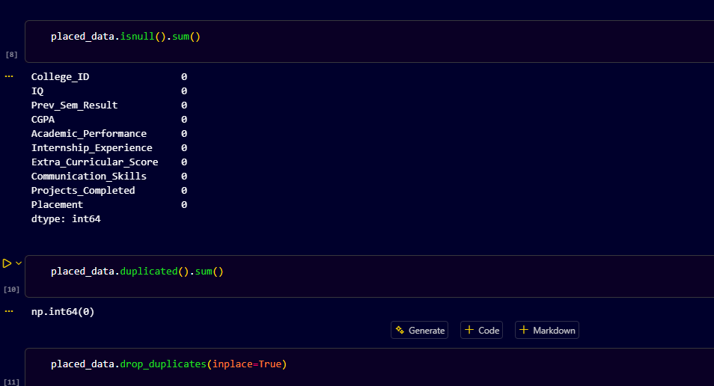
Data Analysis
Summary statistics, missing values, and data cleaning performed.

Slide 4
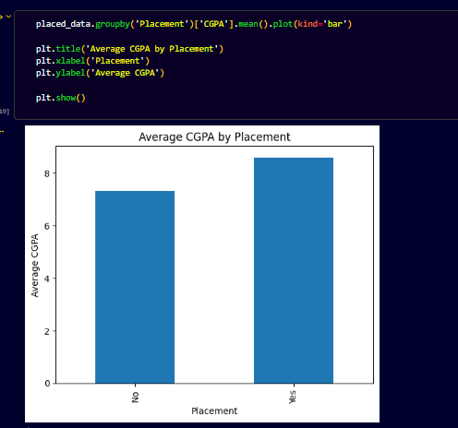
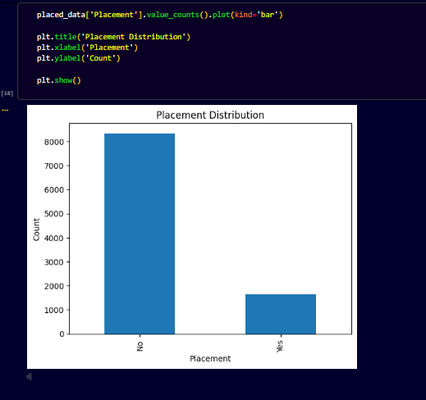
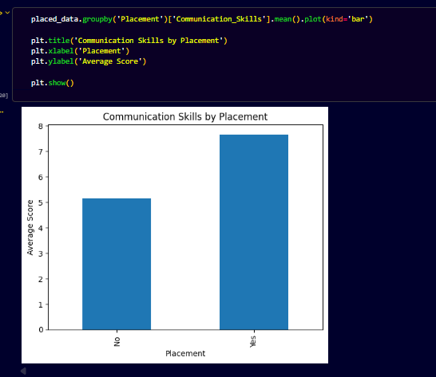
Visualizations

Slide 5
Key Insights
1. Higher CGPA improves placement chances.
2. Communication skills matter.
3. More projects improve employability.

Slide 6
Recommendations & Conclusion
Focus on academic support, communication training, and project-based learning.

