Slide 1
Modeling and Forecasting Natural Gas Prices in India
using Generalized Additive Models
Bachelor Thesis Project Mid-Term Presentation
Prem Pastagia 23IM10049

Slide 2
Introduction, Necessity, & Ramifications
Accurate forecasting of Compressed Natural Gas prices is critical for India's energy transition and macroeconomic stability.
Why is this forecasting imperative?
• The Reality of Pricing Dynamics: Natural gas prices are highly susceptible to non-linear fluctuations.
• The Discrepancy Between Demand and Consumption: A reduction in vehicle loan interest rates augments actual consumption significantly compared to theoretical demand.
The Substantial Impact We Can Generate:
• For Policymakers: Furnishes a rigorous mathematical foundation to comprehend economic augmentations.
• For City Gas Distribution Corporations: Facilitates robust revenue forecasting predicated upon actual consumption.

Slide 3
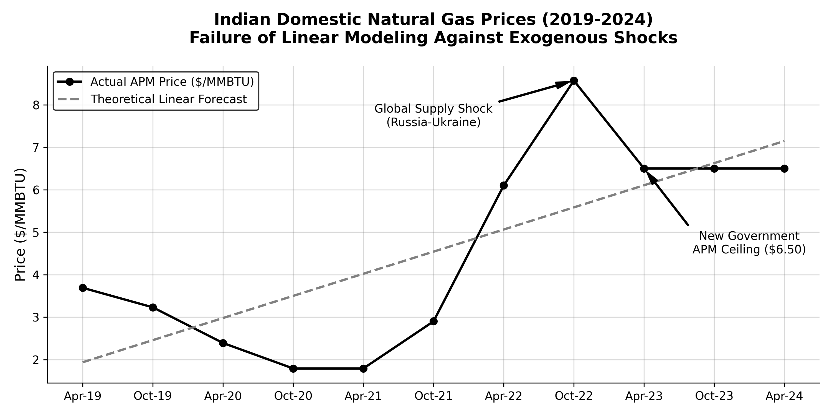
The Forecasting Deficit: Linear Models vs Market Reality

Slide 4
Literature Review & Methodological Novelty
Traditional modeling architectures fail to apprehend the complex, non-linear realities.
The Deficiency in Current Literature
• Predominant academic papers primarily employ Linear Regression or Exponential Smoothing.
• The Inherent Flaw: These models erroneously enforce a strictly proportional, linear relationship.
Our Novel Approach: Generalized Additive Models
• We circumvent strict linear coefficients by instituting smooth splines: y = α + f1(x1) + f2(x2).
• These mathematical splines calibrate the model to ascend, plateau, and descend organically.

Slide 5
Variable Selection & Data Architecture
Variable Classification | Specific Influencing Factor | Verified Institutional Data Source
Dependent Variable (Y) | Natural Gas Price | Petroleum Planning and Analysis Cell
Independent Variable (X1) | Theoretical Demand Estimates | Ministry of Petroleum and Natural Gas
Independent Variable (X2) | Consumption: Vehicle Miles Traveled | Ministry of Road Transport and Highways
Independent Variable (X3) | Consumption: Household Utility | Petroleum and Natural Gas Regulatory Board
Independent Variable (X4) | Gross Domestic Product | Ministry of Statistics and Programme Implementation
Independent Variable (X5) | Disposable Income | Reserve Bank of India Database

Slide 6
Methodology - GAM Framework & Gram-Schmidt Process
Applying polynomial trends, harmonic bases, and mathematical orthogonalization.
The Foundational Generalized Additive Model Structure
1. Trend: Polynomial tracking of the long-term trajectory.
2. Seasonality: Harmonic-based cyclicity (routine fluctuations).
3. Holiday and Regulatory Events: Abrupt, localized shocks.
Resolving Multicollinearity (The Gram-Schmidt Process)
• The Statistical Jeopardy: Gross Domestic Product and Disposable Income generates severe multicollinearity.
• The Mathematical Resolution: Transform these into orthogonal polynomials utilizing the Gram-Schmidt process.

Slide 7
Current Status & Future Execution Blueprint
We have successfully established the theoretical framework; the subsequent phase encompasses computational modeling.
What we have accomplished thus far:
1. Finalized the overarching problem statement.
2. Identified and validated uninterrupted access to authentic Indian institutional datasets.
3. Selected the Generalized Additive Model incorporating smooth splines.
4. Defined the explicit mathematical resolution (Gram-Schmidt process).
Subsequent execution steps:
• Data Cleansing & Mathematical Normalization
• Gram-Schmidt Orthogonalization Implementation
• Program Generalized Additive Model Architecture
• Cross-Validation & Concurvity Diagnostics

