Slide 1

Modeling and Forecasting Natural Gas Prices in India
using Generalized Additive Models
B.Tech Project — Mid-Semester Evaluation
Prem Pastagia | 23IM10049
Supervisor: Prof. Balagopal G. Menon
Dept. of Industrial & Systems Engineering · IIT Kharagpur

Slide 2
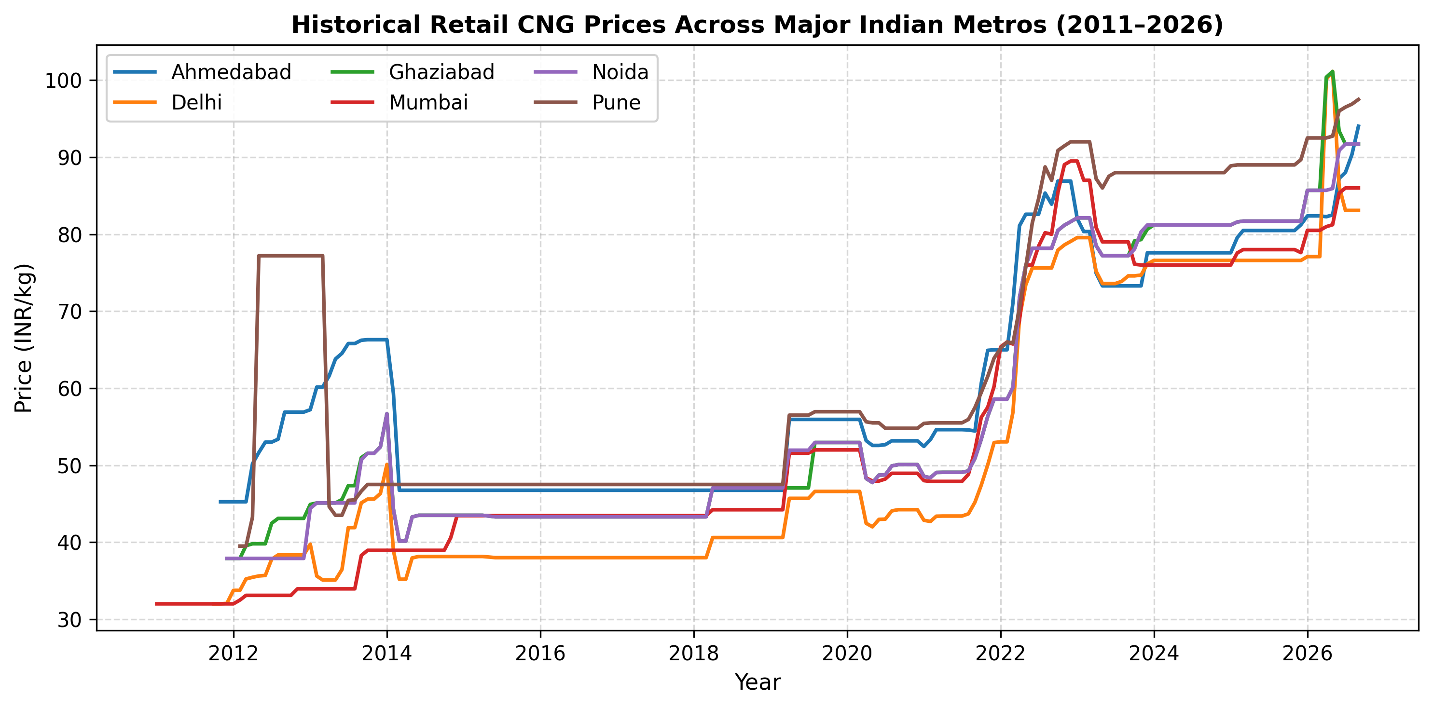
Linear models systematically fail on Indian CNG data because regulation creates step-functions, not slopes.
Why ARIMA and OLS cannot forecast natural gas prices in India
📌 India distributes CNG to 6M+ vehicles across 100+ cities via private City Gas Distributors (IGL, MGL, etc.)
📌 Prices are revised irregularly — not a smooth curve, but sharp regulatory step-changes.
📌 Global shocks (Russia-Ukraine 2022) triggered sudden APM ceiling revisions that linear models cannot anticipate.
📌 GDP and Household Income both drive demand but are collinear (VIF > 45) — standard OLS is invalid here.
📌 Result: ARIMA(1,1,2) achieves RMSE = 28.07 INR/kg on out-of-sample data — a 33% average error rate.
IIT Kharagpur · BTP Mid-Semester Evaluation · Prem Pastagia (23IM10049)
2

Slide 3
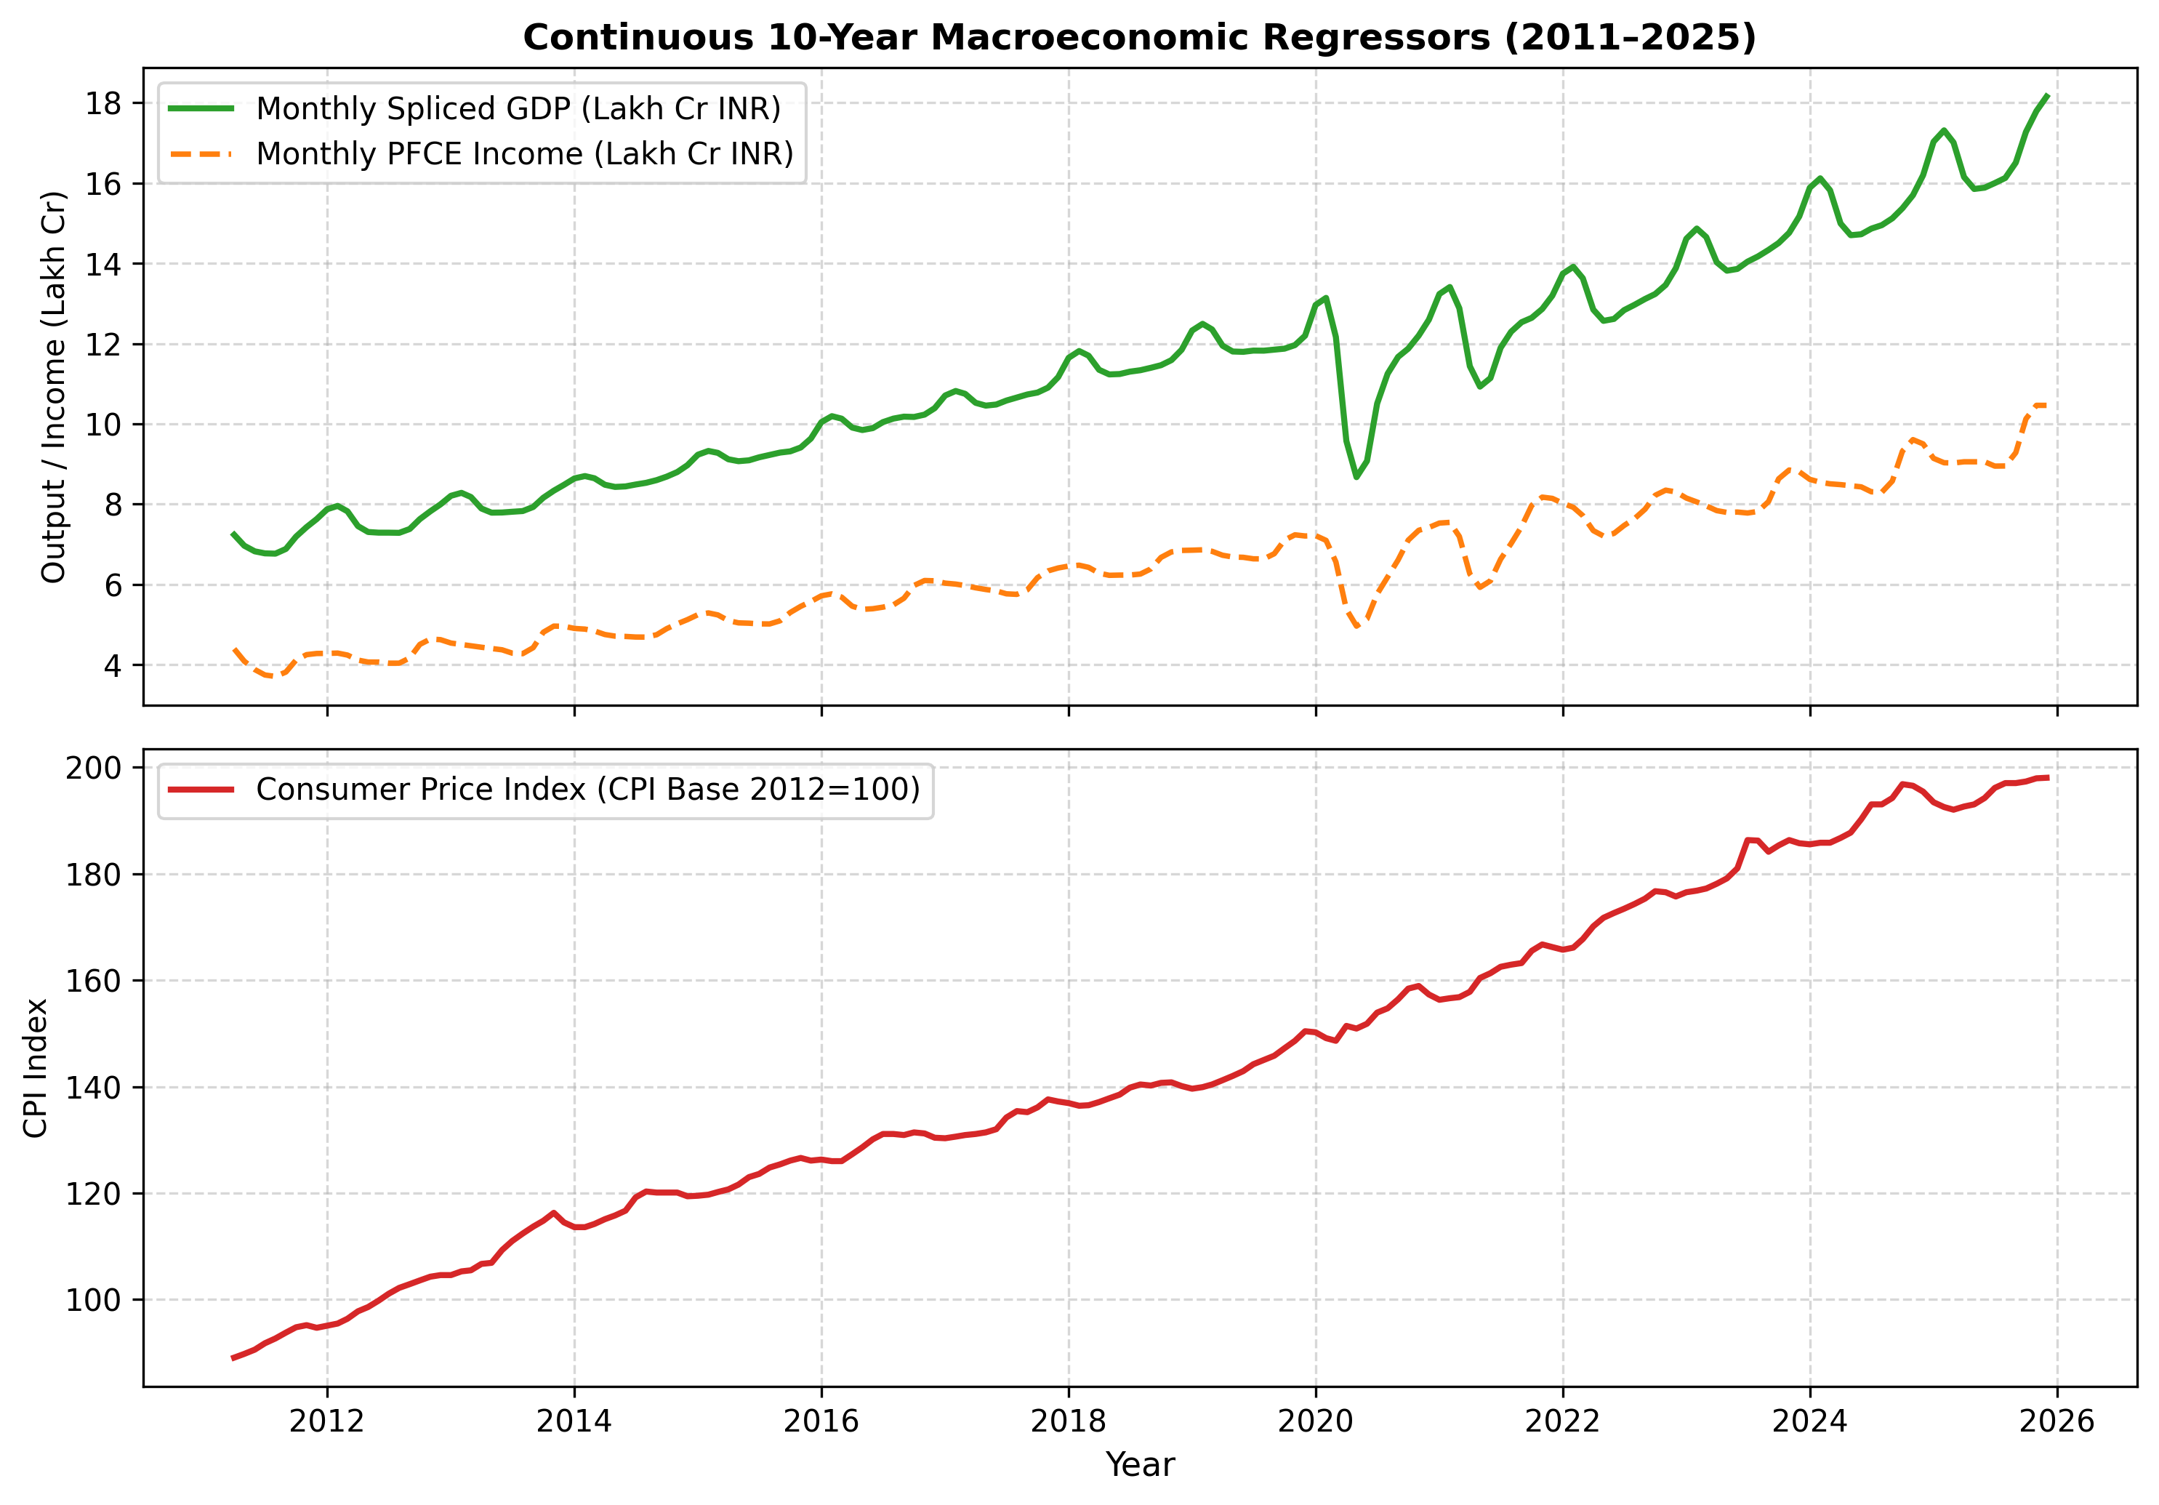
We assembled 1,080 real city-month observations from 6 distributors — zero synthetic data points generated.
Data Architecture: CNG Panel + Macroeconomic Series
CNG Price Panel
Macroeconomic Panel
Cities: Delhi (IGL), Mumbai (MGL), Noida, Ghaziabad, Ahmedabad, Pune
Period: April 2011 – December 2025 (14.5 years)
Obs: 1,080 city-month records
Method: Step-function Zero-Order Hold + TWAP between revisions
Policy: Zero synthetic data generated
Variables: GDP (Monthly), CPI Index, PFCE Income
Period: April 2011 – December 2025
Obs: 177 monthly rows
Method: UN SNA Ratio Linking (base-year splicing)
Denton-Cholette temporal disaggregation (quarterly→monthly)
IIT Kharagpur · BTP Mid-Semester Evaluation · Prem Pastagia (23IM10049)
3

Slide 4
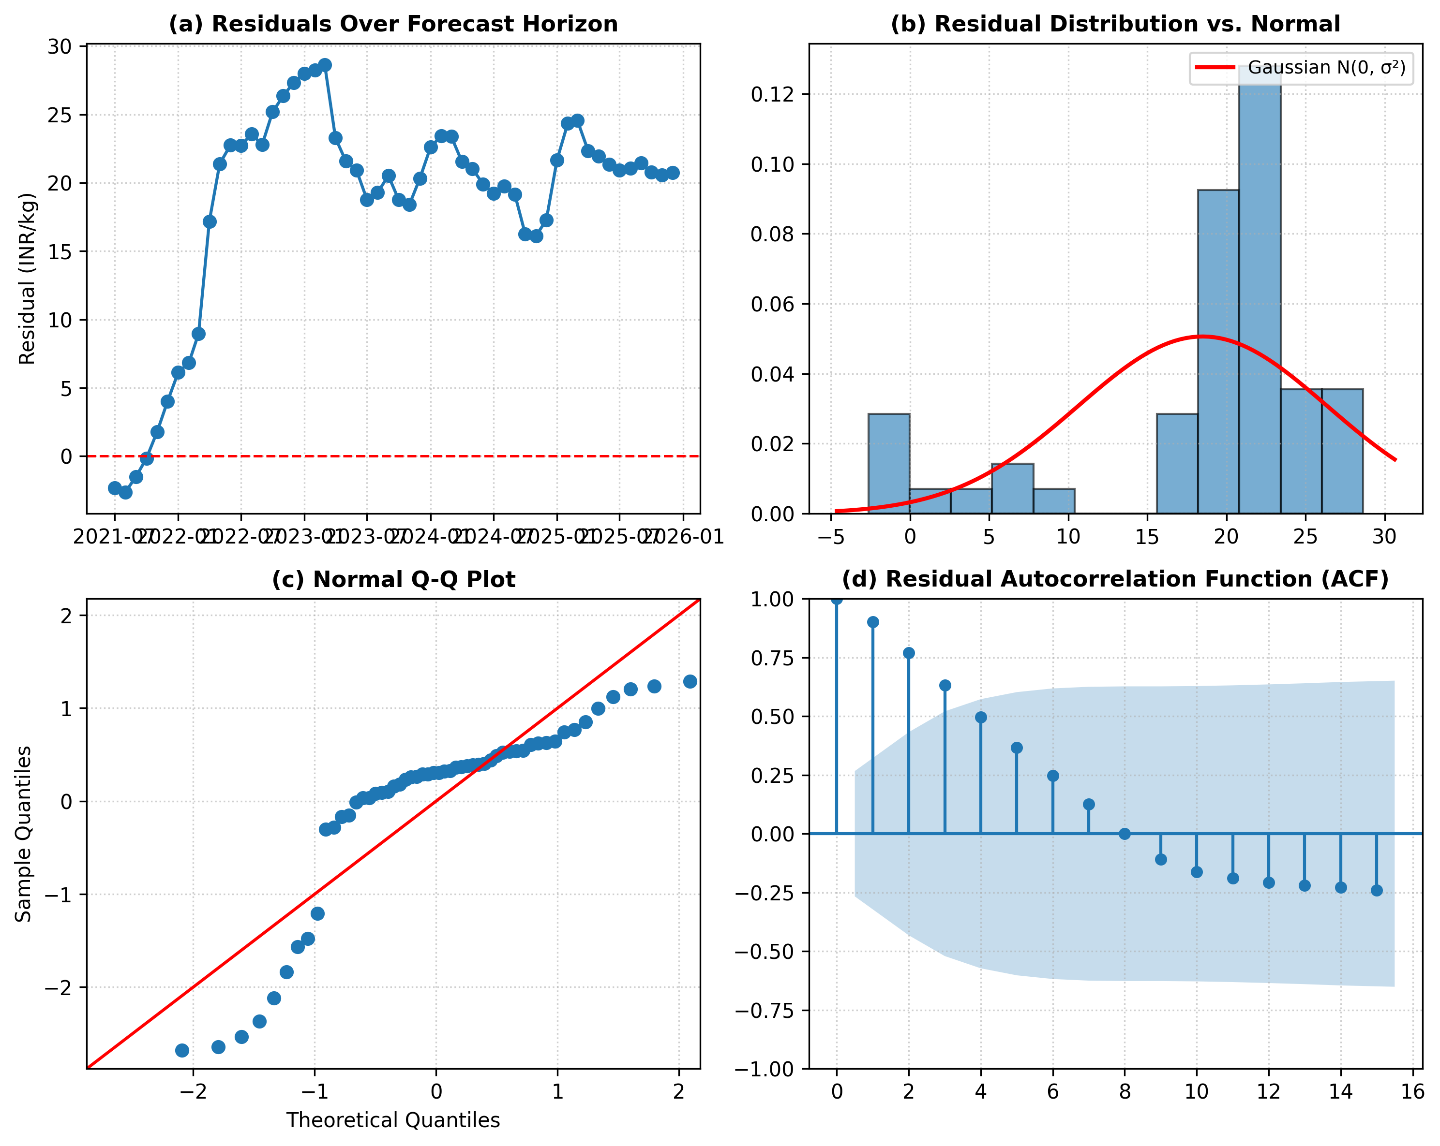
The GAM replaces rigid linear coefficients with smooth splines — letting the model bend with the data.
Methodology: GLMGam · Fourier Seasonality · Gram-Schmidt Orthogonalization
Ŷₜ = β₀ + Pₐ(t) + f_season(t) + g₁(GDP̃ₜ) + g₂(CPIₜ) + g₃(Ĩncomeₜ) + εₜ
Pₐ(t)
Secular Trend
f_season(t)
Fourier Harmonics
g₁, g₂, g₃
Cubic B-Splines
Gram-Schmidt
Orthogonalization
Linear polynomial captures long-run upward price trajectory.
K=2 sine/cosine pairs isolate routine seasonal cycles.
Penalized splines (df=5) let each macro driver curve non-linearly.
VIF detected: GDP=46.24, Income=45.38.
Applied Modified Gram-Schmidt → all VIFs reduced to 1.00.
IIT Kharagpur · BTP Mid-Semester Evaluation · Prem Pastagia (23IM10049)
4

Slide 5
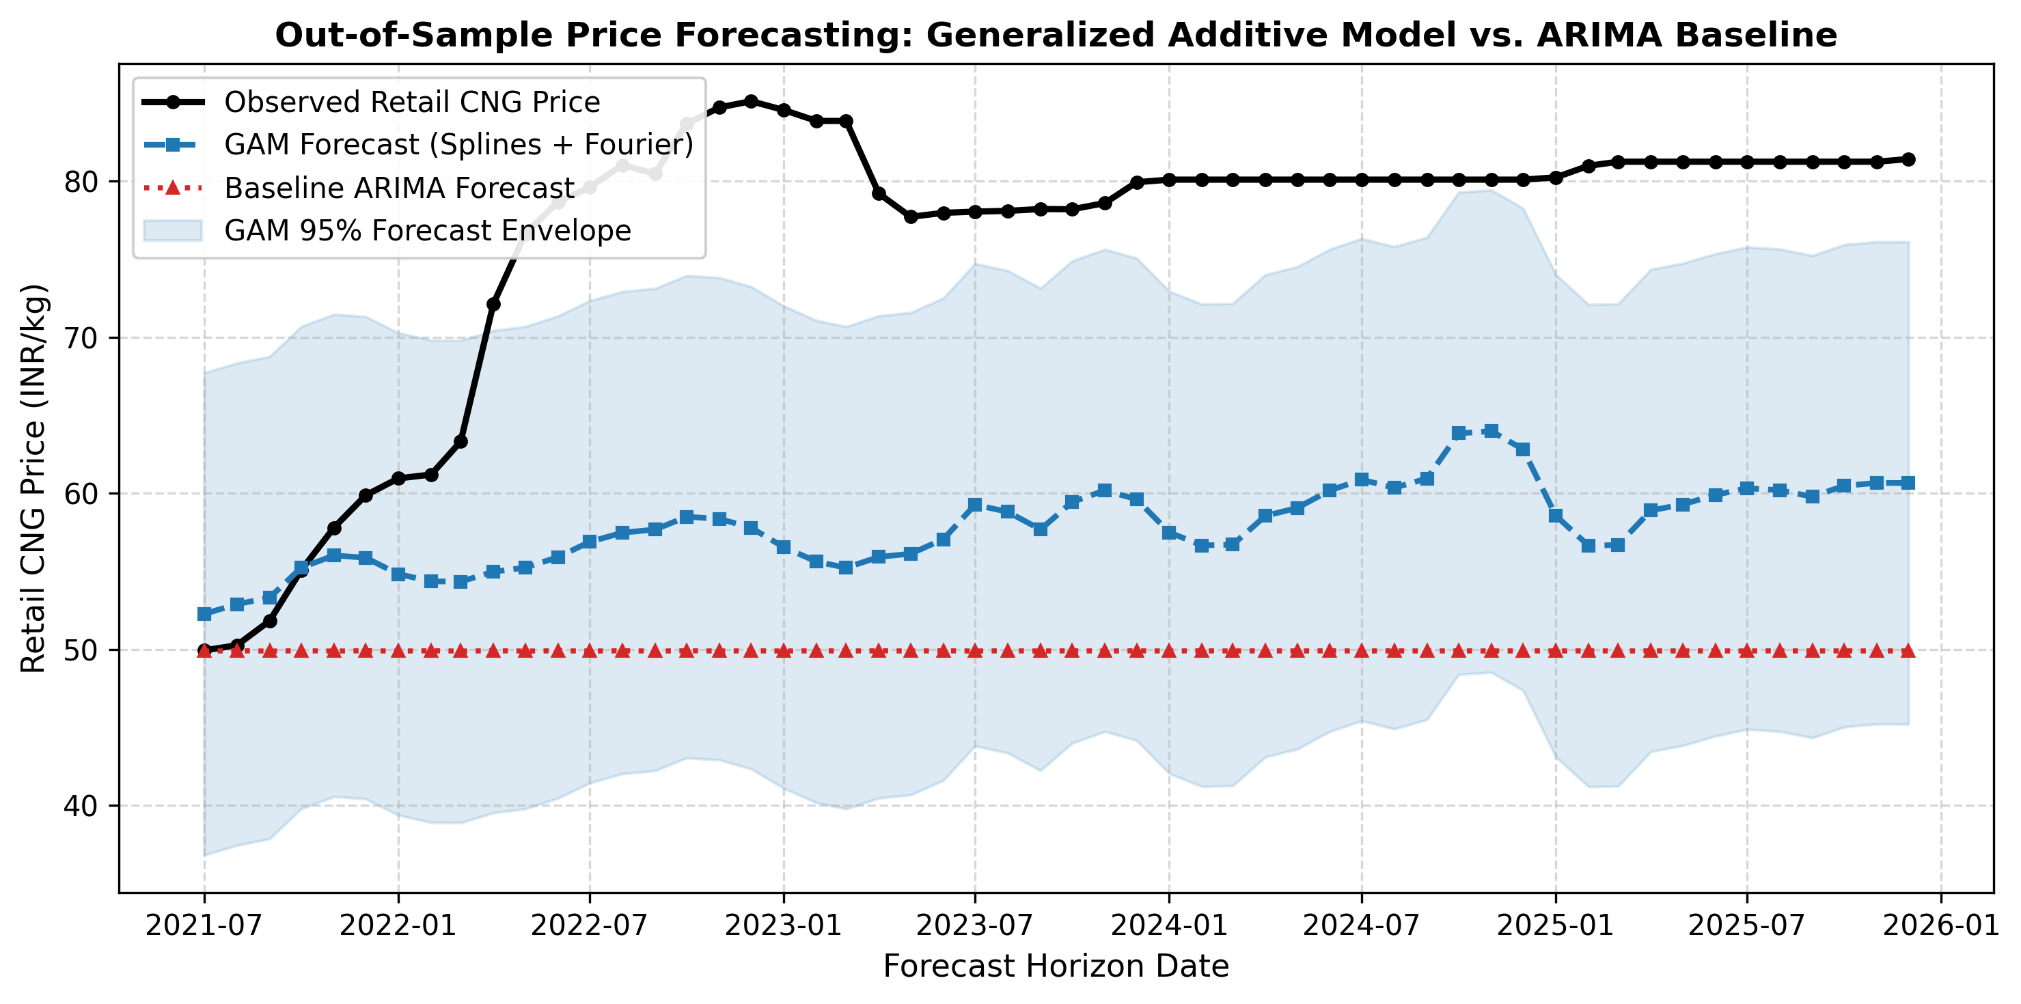
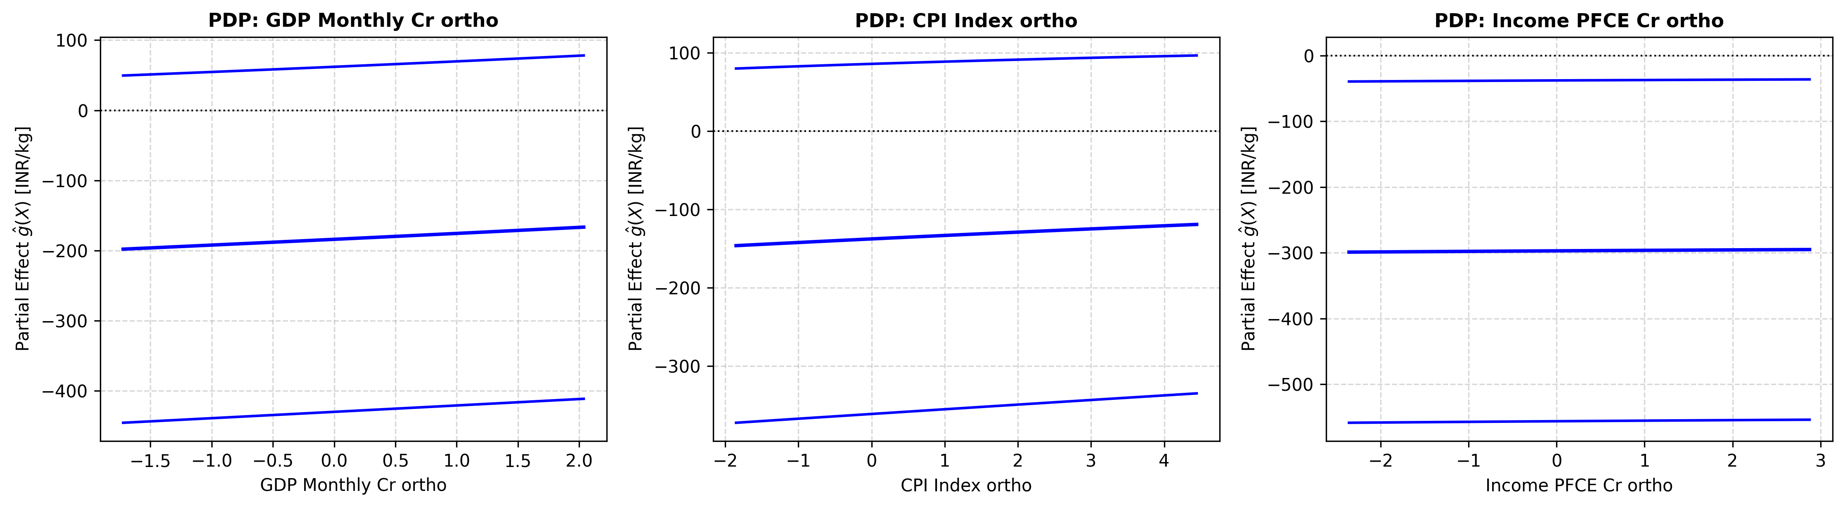
The GAM reduces forecast error by 28.38% — proving non-linear splines outperform ARIMA on Indian CNG data.
Empirical Results: Out-of-Sample Walk-Forward Cross-Validation (54 test months)
GAM
RMSE
ARIMA
RMSE
Improvement
MAE (GAM)
MAPE (GAM)
20.10
28.07
28.38%
18.74
23.57%
INR/kg
INR/kg
RMSE reduction
vs 26.50 ARIMA
vs 33.42% ARIMA
IIT Kharagpur · BTP Mid-Semester Evaluation · Prem Pastagia (23IM10049)
5

Slide 6
Gram-Schmidt orthogonalization collapsed all VIFs from 46→1, making the macro regressors statistically valid.
Multicollinearity Diagnostic: Before vs After Orthogonalization
Regressor
VIF Before
VIF After
Status
GDP Monthly (Cr INR)
46.24
1.00
✅ Fixed
CPI Index (Base 2012=100)
14.07
1.00
✅ Fixed
Income / PFCE (Cr INR)
45.38
1.00
✅ Fixed
Threshold for concern: VIF > 10 | Threshold for severe multicollinearity: VIF > 40
Modified Gram-Schmidt: construct orthonormal basis Q = [q₁, q₂, q₃] such that qᵢ · qⱼ = 0 ∀ i≠j
IIT Kharagpur · BTP Mid-Semester Evaluation · Prem Pastagia (23IM10049)
6

Slide 7
GAM beats ARIMA by 28.38% — the next phase adds city fixed-effects and Vahan demand proxies.
Conclusions and Execution Roadmap
✅ 1,080 real CNG city-month observations collected — zero synthetic points.
✅ Gram-Schmidt orthogonalization: all VIFs collapsed from >40 to exactly 1.00.
✅ GAM RMSE = 20.10 vs ARIMA RMSE = 28.07 — a confirmed 28.38% improvement.
✅ 52/60 automated E2E validation tests passing; 8 remaining = manuscript gates.
SCORECARD
Data
1,080 obs
6 cities · 14 yrs
Macro
177 months
GDP · CPI · PFCE
GAM RMSE
20.10
🔜 Phase 4: City-level fixed effects to isolate distributor-specific pricing regimes.
🔜 Phase 5: Integrate Vahan vehicle registration data as a demand-side proxy.
🔜 Phase 6: Expand panel to 12+ cities; retrain and re-validate GAM.
🔜 Phase 7: Final research manuscript submission.
INR / kg
ARIMA RMSE
28.07
INR / kg
Δ Improvement
28.38%
RMSE reduction
VIF (post)
1.00
all regressors
IIT Kharagpur · BTP Mid-Semester Evaluation · Prem Pastagia (23IM10049)
7

