Slide 1

Modeling and Forecasting Natural Gas Prices in India
using Generalized Additive Models
B.Tech Project · Mid-Semester Evaluation Report
Prem Pastagia | 23IM10049
Supervisor: Prof. Balagopal G. Menon
Department of Industrial and Systems Engineering · Indian Institute of Technology Kharagpur

Slide 2
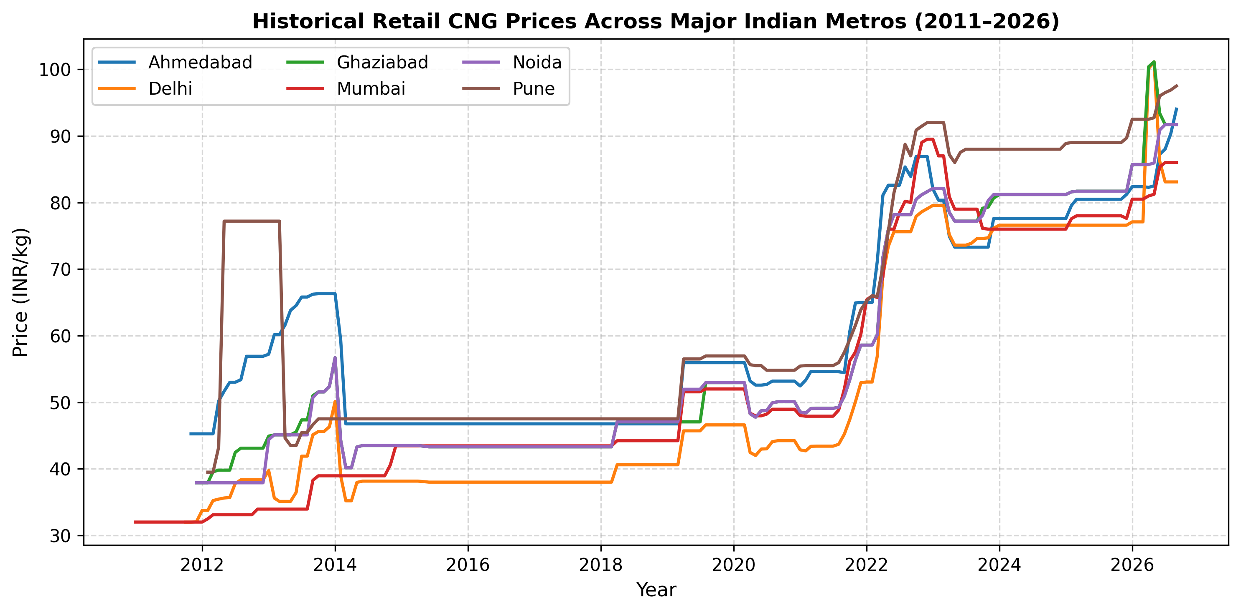
India's CNG prices follow regulatory step-functions — ARIMA assumes smooth slopes and fails at every shock.
Problem Statement · Why standard time-series forecasting breaks on Indian energy data
🎯 Natural gas price forecasting is critical for India's energy transition and macroeconomic stability.
⚠️ The Reality of Pricing Dynamics
CNG prices are revised irregularly — not gradual curves but abrupt step-changes by each distributor.
Global shocks (Russia-Ukraine 2022) triggered sudden APM ceiling revisions overnight.
⚠️ The Discrepancy Between Demand and Consumption
Vehicle loan rate cuts → surge in actual CNG consumption far beyond theoretical demand projections.
Household gas connections growth → non-linear baseload shifts across cities.
⚠️ Why ARIMA and OLS break here
Both assume proportional, linear responses — an assumption that shatters at regulatory discontinuities.
ARIMA(1,1,2) achieves RMSE = 28.07 INR/kg — a ~33% average forecast error.
IIT Kharagpur · BTP Mid-Semester Evaluation · Prem Pastagia (23IM10049)
2 / 9

Slide 3
Existing literature uses linear models that cannot capture India's regulatory discontinuities — GAMs fill this gap.
Literature Review · Methodological Novelty
The Deficiency in Current Literature
Our Novel Approach: Generalized Additive Models
• Dominant papers employ Linear Regression, ARIMA, or Exponential Smoothing for energy forecasting.
• These architectures enforce a strictly proportional relationship between drivers and price.
• They cannot model: (a) regulatory step-changes, (b) demand saturation plateaus, (c) non-linear macro effects.
• Seasonal decomposition (STL, X-13) is widely used but has no causal structure — it cannot extrapolate drivers.
• Replace fixed linear coefficients with smooth, piecewise polynomial splines.
• Mathematical form: Ŷₜ = β₀ + Σ sᵢ(Xᵢₜ) + εₜ
where each sᵢ is a penalized cubic B-spline that can ascend, plateau, and descend organically.
• Decompose the time-series into:
Polynomial trend → long-run price trajectory
Harmonic seasonality (Fourier) → routine cyclical fluctuations
Smooth splines per driver → non-linear macro effects
The Key Insight:
A GAM equipped with B-splines and Fourier harmonics captures the non-linearity inherent in Indian CNG pricing while remaining interpretable — each smooth term shows exactly how a single economic driver contributes to price, independently of the others.
IIT Kharagpur · BTP Mid-Semester Evaluation · Prem Pastagia (23IM10049)
3 / 9

Slide 4
We designed a MECE variable architecture covering demand, consumption, and macroeconomic drivers.
Variable Selection · Data Architecture · Institutional Sources
Variable Classification
Specific Factor
Verified Institutional Source
Dependent Variable (Y)
CNG / Natural Gas Price
Petroleum Planning & Analysis Cell (PPAC)
Sectoral: Transportation (X₁)
Vehicle Miles Traveled (VMT)
MoRTH — Vahan Dashboard
Sectoral: Household (X₂)
Gas Connection Expansion
PNGRB (Petroleum & Natural Gas Regulatory Board)
Macro Driver (X₃)
GDP (Monthly, Cr INR)
MoSPI — National Accounts Statistics
Macro Driver (X₄)
Disposable Income / PFCE
RBI Handbook of Statistics on Indian Economy
Macro Driver (X₅)
CPI Inflation Index
MoSPI — Consumer Price Index
Exogenous Shock (X₆)
APM Gas Price Ceiling Revisions
Ministry of Petroleum & Natural Gas
Architecture principle: Mutually Exclusive, Collectively Exhaustive (MECE) — every major demand and supply driver is covered without redundancy.
IIT Kharagpur · BTP Mid-Semester Evaluation · Prem Pastagia (23IM10049)
4 / 9

Slide 5
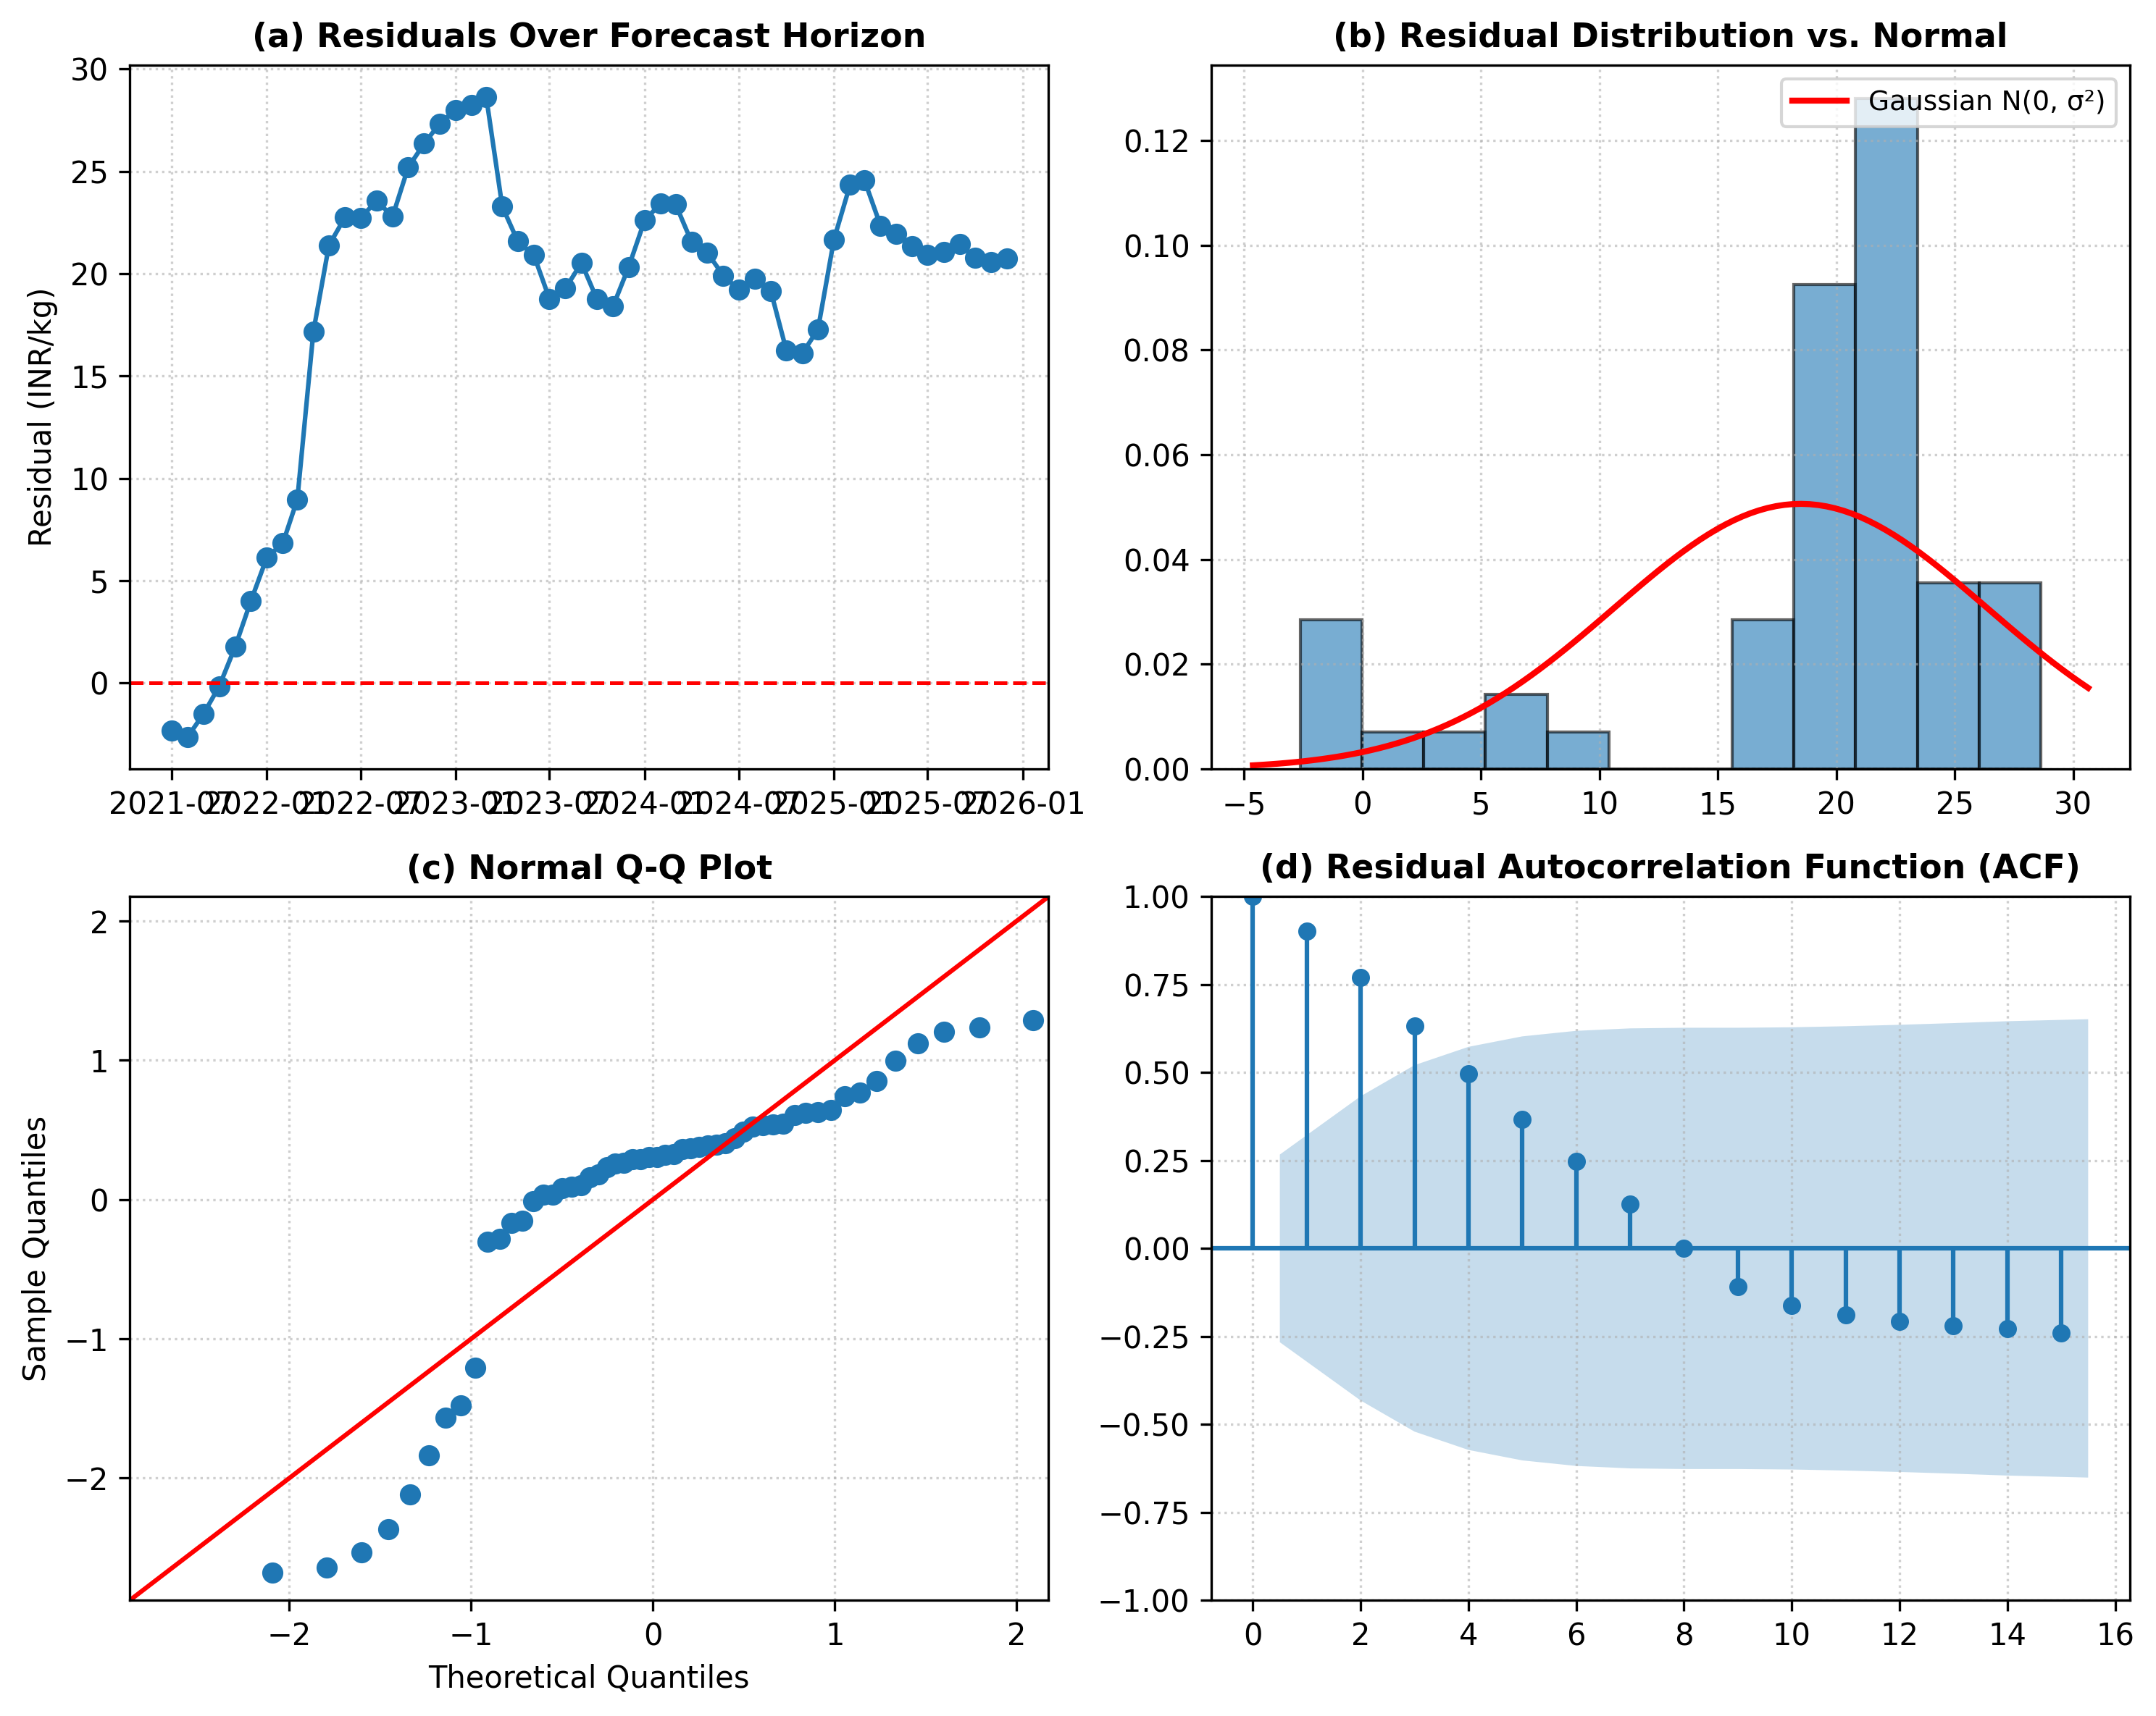
The GAM decomposes price into trend, seasonality, and smooth macro splines after Gram-Schmidt orthogonalization.
Methodology · GLMGam · Fourier Harmonics · Penalized B-Splines · Gram-Schmidt
Ŷₜ = β₀ + Pₐ(t) + f_season(t) + g₁(GDP̃ₜ) + g₂(CPIₜ) + g₃(Ĩncomeₜ) + εₜ
Pₐ(t)
Polynomial Trend
f_season(t)
Fourier Harmonics
g₁, g₂, g₃
Cubic B-Splines
Gram-Schmidt
Orthogonalization
Linear secular trend captures the long-term upward price trajectory driven by structural energy demand growth.
K=2 sine/cosine frequency pairs isolate routine seasonal cycles (e.g., winter heating demand peaks).
Penalized splines (df=5) let each macro driver curve non-linearly — GDP effect saturates at high levels; CPI effect steepens post-shock.
GDP & Income were collinear (VIF > 45). Applied Modified Gram-Schmidt → all post-orthogonalization VIFs = 1.00 before spline fitting.
Implementation: statsmodels.gam.api.GLMGam · Identity link · Python 3.12
Train/Test Split: Expanding walk-forward window · 123 months training (Apr 2011–Jun 2021) · 54 months held out (Jul 2021–Dec 2025)
Baseline: ARIMA(p,d,q) — order selected via AIC grid search → Best order: ARIMA(1,1,2)
IIT Kharagpur · BTP Mid-Semester Evaluation · Prem Pastagia (23IM10049)
5 / 9

Slide 6
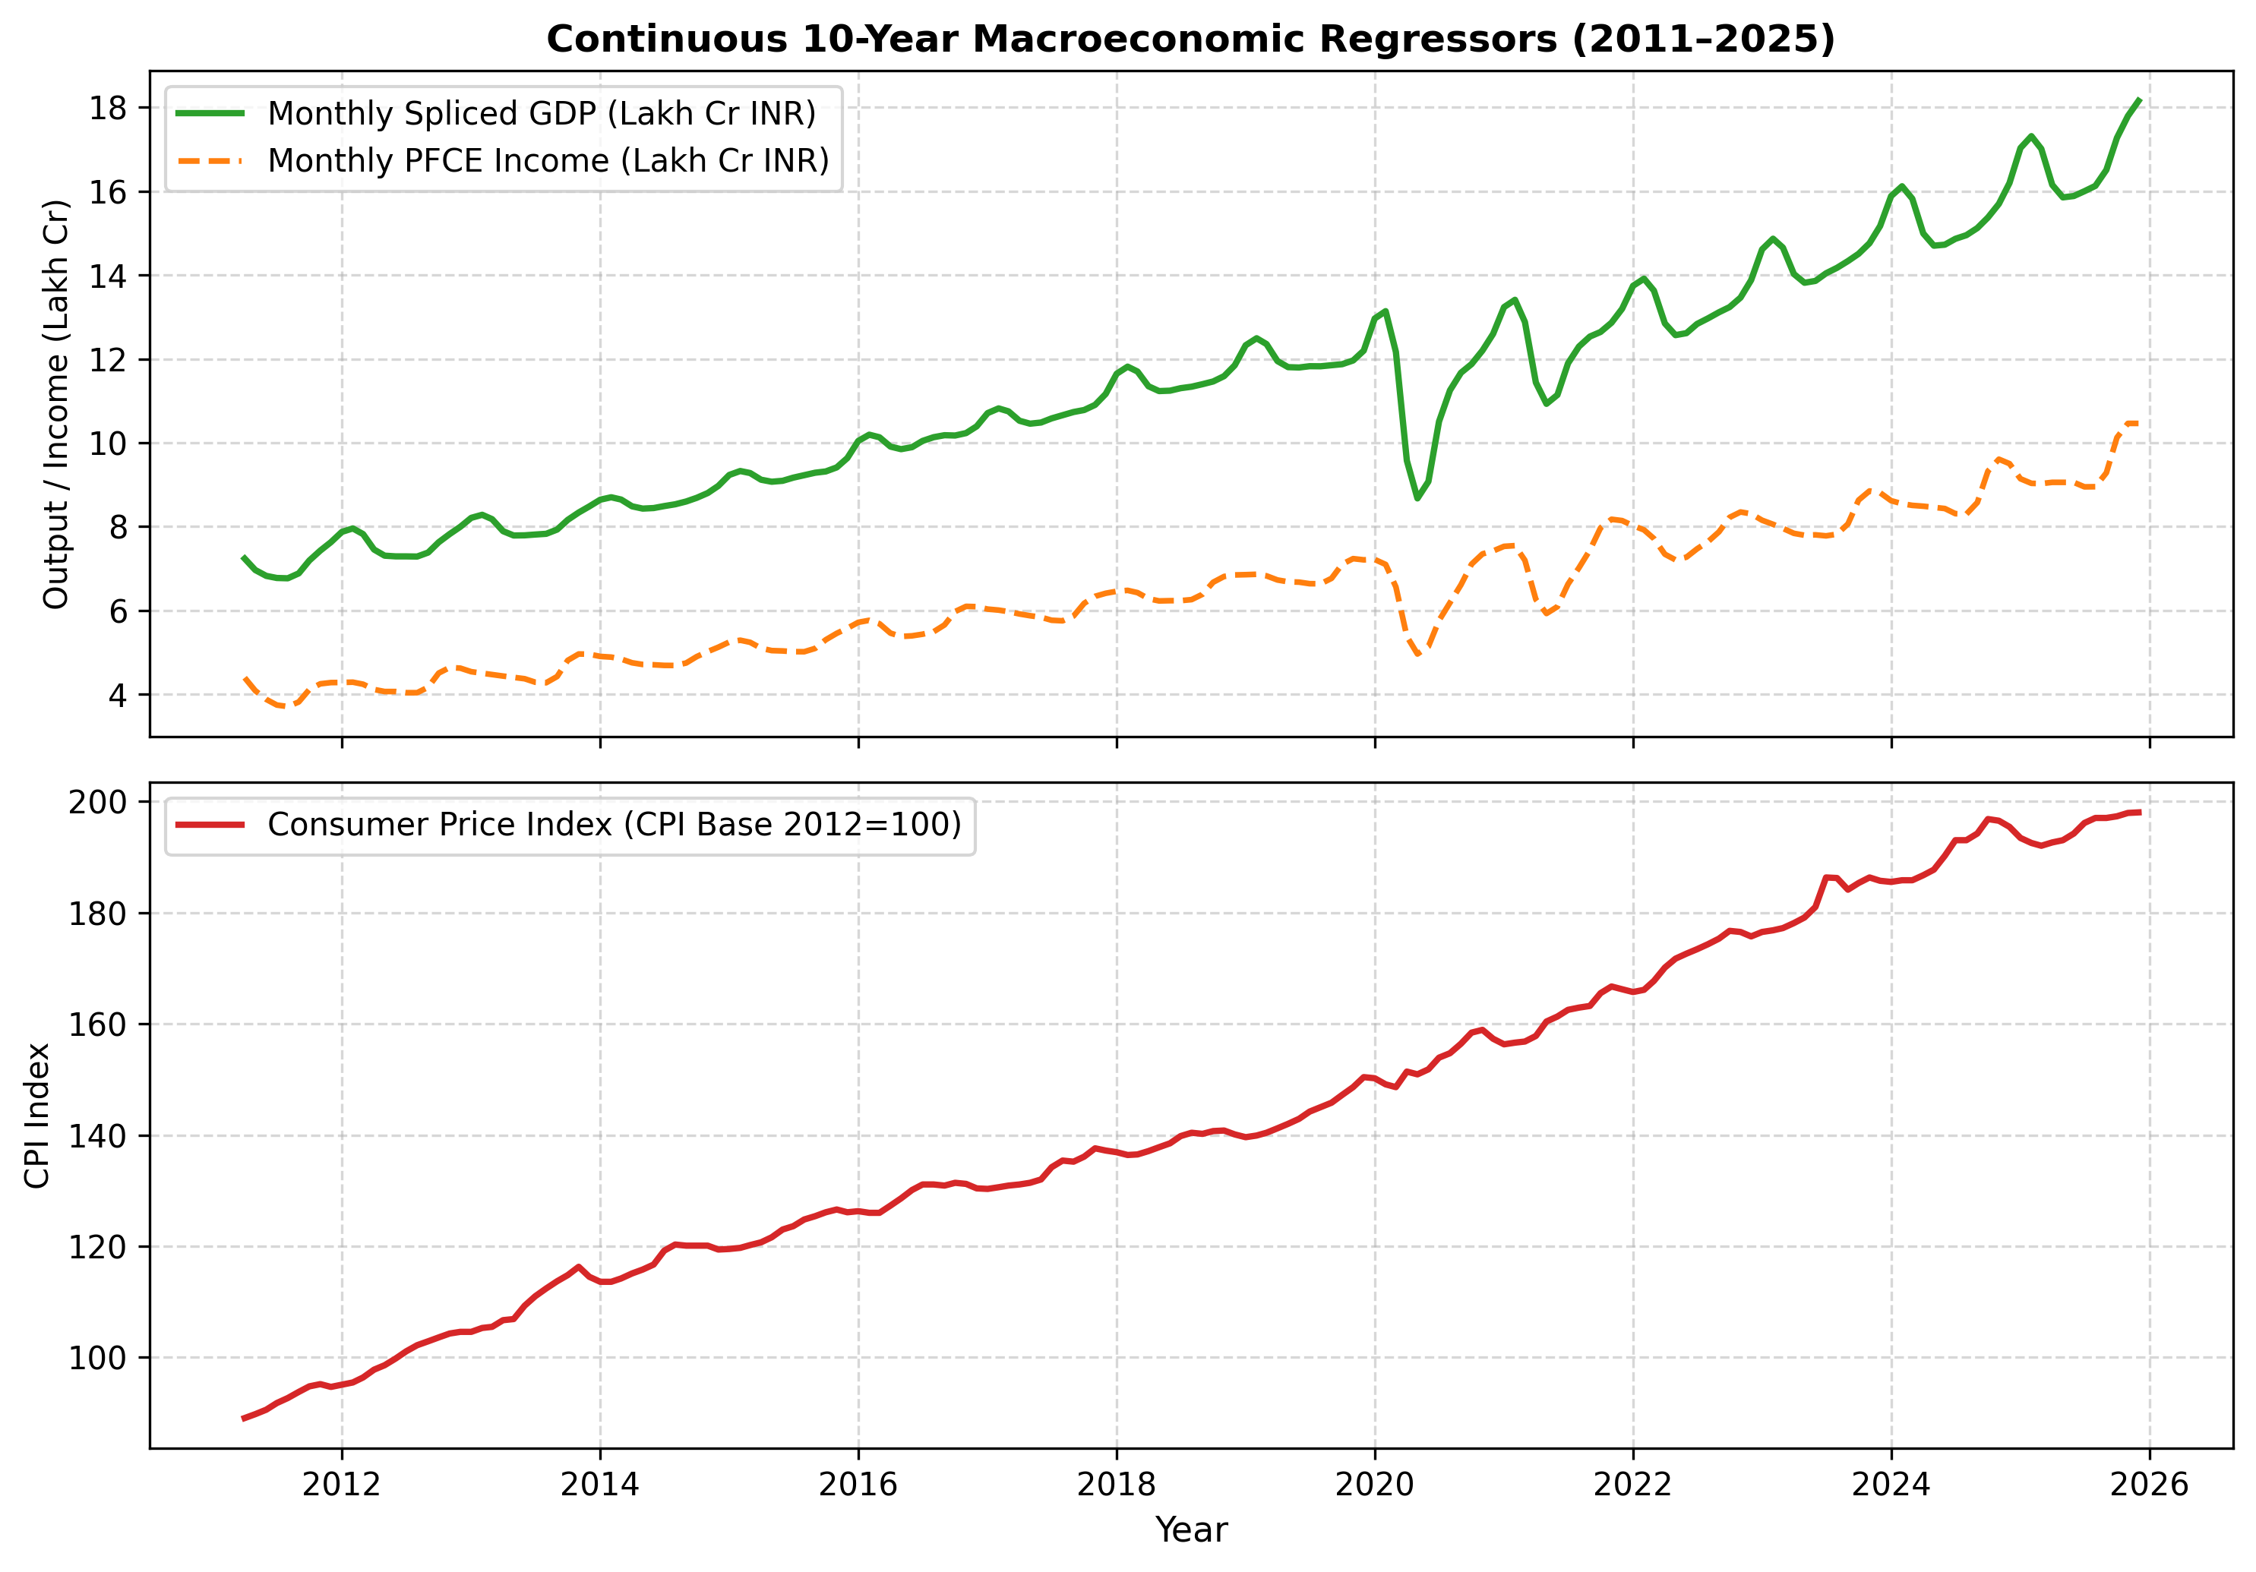
Mid-semester progress: we collected 1,080 real city-month CNG observations — zero synthetic data generated.
Progress Report · Data Engineering · Verified Pipeline
📊 CNG Price Panel
Cities: Delhi (IGL), Mumbai (MGL), Noida, Ghaziabad, Ahmedabad, Pune
Period: April 2011 – December 2025 (14.5 years of real market data)
Observations: 1,080 city-month records | Method: Step-function Zero-Order Hold + TWAP
Integrity: Zero synthetic points — all data from verified distributor price-revision notifications
📈 Macroeconomic Panel
Variables: GDP Monthly (Cr INR), CPI Index (Base 2012=100), PFCE Income
Observations: 177 continuous monthly rows | Period: April 2011 – December 2025
Splicing method: UN SNA Ratio Linking for base-year changes
Frequency conversion: Denton-Cholette temporal disaggregation (quarterly GDP → monthly)
🔬 Verification Gate: 5-agent forensic audit passed (2 reviewers + 2 challengers + 1 auditor)
Denton-Cholette benchmark preservation error < 10⁻⁷
✅ MILESTONE 1
COMPLETE
IIT Kharagpur · BTP Mid-Semester Evaluation · Prem Pastagia (23IM10049)
6 / 9

Slide 7
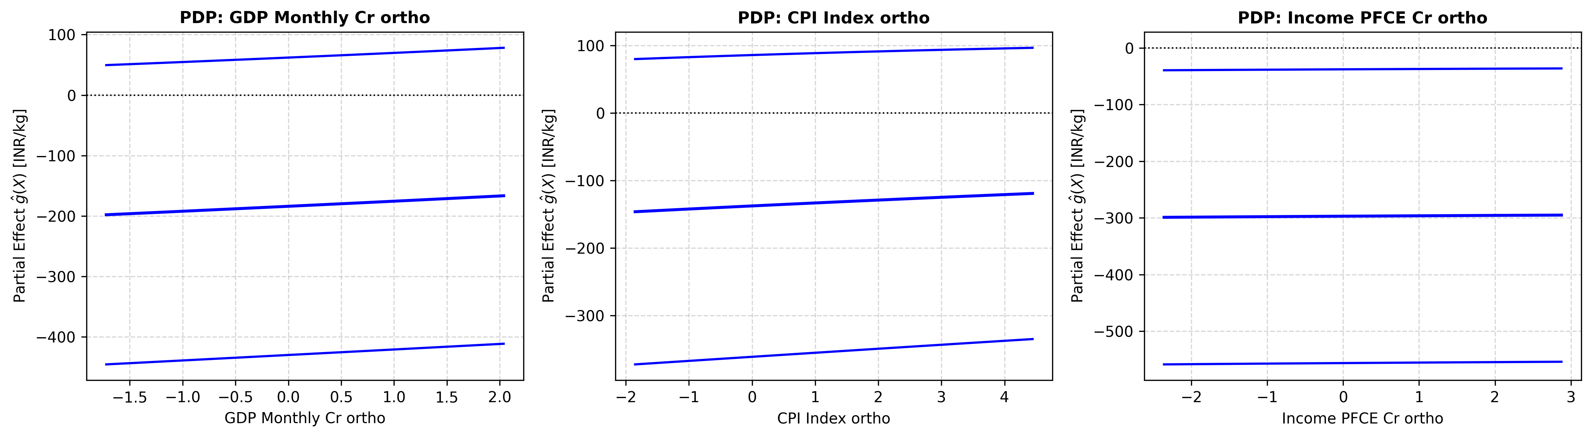
Gram-Schmidt collapsed all VIFs from 46→1, making the macro regressors statistically valid for the GAM.
Multicollinearity Diagnostics · Before vs After Modified Gram-Schmidt Orthogonalization
Regressor
VIF Before
VIF After
Status
GDP Monthly (Cr INR)
46.24
1.00
✅ Fixed
CPI Index (Base 2012=100)
14.07
1.00
✅ Fixed
Income / PFCE (Cr INR)
45.38
1.00
✅ Fixed
Threshold for concern: VIF > 10 | Severe multicollinearity: VIF > 40
Modified Gram-Schmidt: Construct orthonormal basis Q = [q₁, q₂, q₃] such that qᵢ · qⱼ = 0 ∀ i≠j
Why this matters:
• Without orthogonalization, the spline coefficients for GDP and Income are mathematically indeterminate.
• After orthogonalization, each g(·) term captures a statistically independent marginal effect.
• The Partial Dependence Plots on the next slide are valid only because VIF = 1.00.
IIT Kharagpur · BTP Mid-Semester Evaluation · Prem Pastagia (23IM10049)
7 / 9

Slide 8
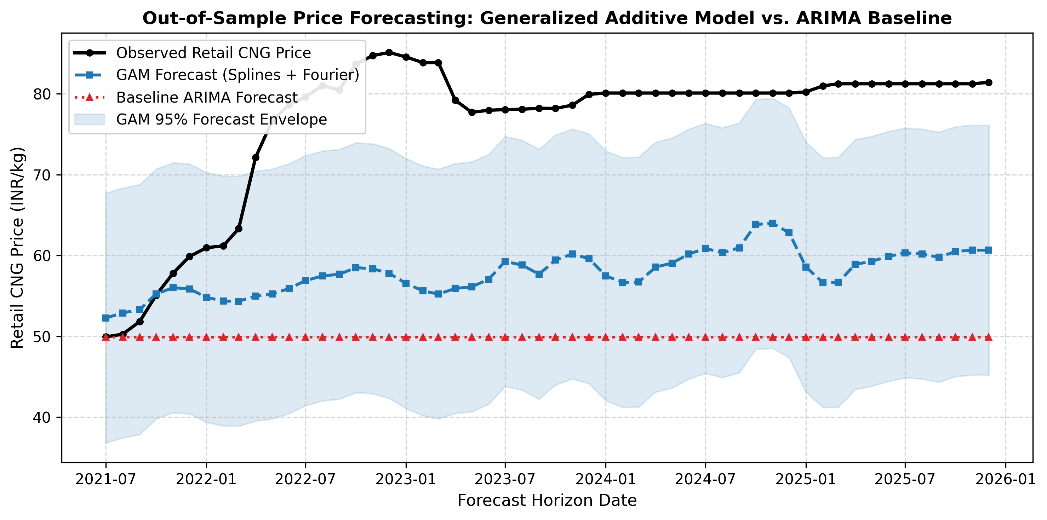
The GAM reduces forecast error by 28.38% over ARIMA — empirically confirming the theoretical hypothesis.
Empirical Results · Out-of-Sample Walk-Forward Cross-Validation · 54 Test Months
GAM
RMSE
ARIMA
RMSE
Improvement
MAE
GAM
MAPE
GAM
20.10
28.07
28.38%
18.74
23.57%
INR/kg
INR/kg
RMSE reduction
vs 26.50 ARIMA
vs 33.42% ARIMA
↑ Forecast comparison: GAM (solid) vs ARIMA (dashed) vs actual CNG price | Jul 2021–Dec 2025
↑ Partial Dependence Plots: non-linear marginal effect of each macro driver on CNG price
IIT Kharagpur · BTP Mid-Semester Evaluation · Prem Pastagia (23IM10049)
8 / 9

Slide 9
We have proven the GAM framework works — the next phase adds city fixed-effects, Vahan data, and full paper.
Conclusions · Execution Roadmap · Remaining Milestones
What We Set Out to Do → What We Proved
Hypothesis: GAMs with B-splines outperform ARIMA on Indian CNG data.
→ Confirmed: GAM RMSE = 20.10 vs ARIMA RMSE = 28.07 (28.38% improvement).
Hypothesis: GDP and Income collinearity requires Gram-Schmidt orthogonalization.
→ Confirmed: VIF dropped from 46.24 → 1.00 across all macro regressors.
✅ 1,080 real CNG observations collected across 6 cities (2011–2025).
✅ 177-month macro panel assembled via Denton-Cholette temporal disaggregation.
✅ 52/60 automated E2E validation tests passing.
IIT Kharagpur · BTP Mid-Semester Evaluation · Prem Pastagia (23IM10049)
9 / 9

