Slide 1
DEEP-TECH INNOVATION · FOOD SECURITY & SAFETY
SensoPack
Biodegradable smart packaging that actively protects fresh shrimp and senses its true freshness — starting with India's ₹62,408 crore shrimp-export chain, and built to be affordable where refrigeration cannot reach.
Active bio-film + one low-cost freshness sensor
Beachhead: shrimp · extends to fish & meat
Protect · Sense · Sustain
Team Sentinel · IIT Kharagpur Platinum Jubilee Innovation Challenge · Round 2

Slide 2
01 · PROBLEM SIGNIFICANCE
Criterion 1
India exports the world's shrimp — and loses a fortune to spoilage
INDIA SHRIMP EXPORT vs LOSS (₹ cr)
Farm / Landing
Cold store / Transit
Port / Export
Retail / Consumer
62,408
melanosis
thermal excursion
quality downgrade
Shrimp spoils in 3–14 days by temperature — a static "Best By" label is blind to it
~15,000
Export
Loss
FY 2024–25 · 1.69M MT exported
69%
$2.71B
~35%
2 gaps
of India's seafood dollar earnings come from shrimp
India → USA shrimp alone (FY25) — the premium market
of harvested fish/seafood lost globally before a plate
no active protection; no real-time information

Slide 3
CLARITY OF INSIGHT
Criterion 1
The fixes exist — they never reach the market that needs them
FIX 1 — TOO COSTLY
FIX 2 — UNREADABLE
FIX 3 — BOLT-ON
Sensor tags > $2.50/unit
Needs special scanners
Not packaging-integrated
~90%
IoT tags exceed the 5–8% of product value a shrimp pack can bear. Absent from the informal market.
Senoptica-type optical labels need industrial readers — a consumer smartphone can't read them at retail.
Blakbear-style add-on tags aren't built into the film — extra steps, extra cost. "Best By" ignores temperature.
~90% unrefrigerated / informal · ~10% organised
The unserved opportunity: an affordable, integrated solution that both extends shrimp freshness and proves it — readable by the naked eye, deployable with no cold storage at all.

Slide 4
THE PRODUCT
Protect + Sense
What SensoPack looks like in the customer's hands
PROTECT
Active biodegradable film — chitosan + essential oils (thymol/carvacrol/clove) that doubles shrimp shelf life, without refrigeration.
SensoPack
FRESH (anthocyanin)
FRESH
TVB-N low · ~10 days left
SENSE
One <₹5 anthocyanin dye patch (butterfly pea / roselle) that shifts colour with spoilage amines — naked-eye readable, no electronics; optional NFC tap.
Purple — fresh
Olive — use soon
Brown — do not consume
One decisive sensor, not a stack of five. Cheaper, more robust, genuinely affordable.
Product visualisation (concept render — physical unit in development).

Slide 5
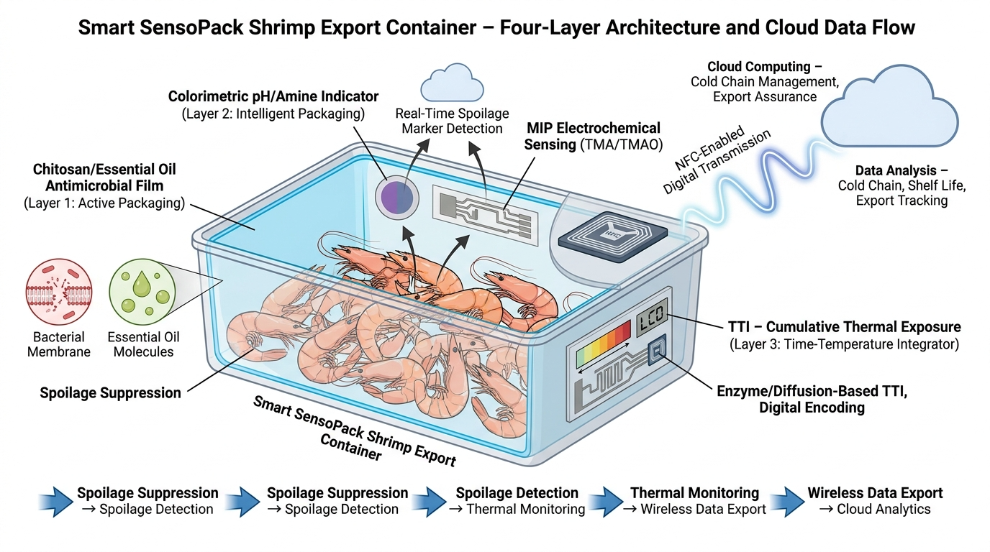
ARCHITECTURE
How it works
An affordable base — with a full export-tier platform
BASE TIER · MASS MARKET
Active chitosan + EO film + a <₹5 anthocyanin colour patch — naked-eye, no electronics, no battery. What a wet-market vendor actually buys.
PREMIUM / EXPORT TIER · OPTIONAL
Adds electronic amine sensing (MIP), an NFC digital freshness certificate, and a time-temperature log — for MPEDA exporters needing a cold-chain audit trail.
One decisive signal for everyone; electronics only where the value justifies it. We never force a five-sensor stack onto a ₹200 tray.
Full-platform architecture (premium / export tier). The mass-market base tier is the film + ₹5 colour patch only.

Slide 6
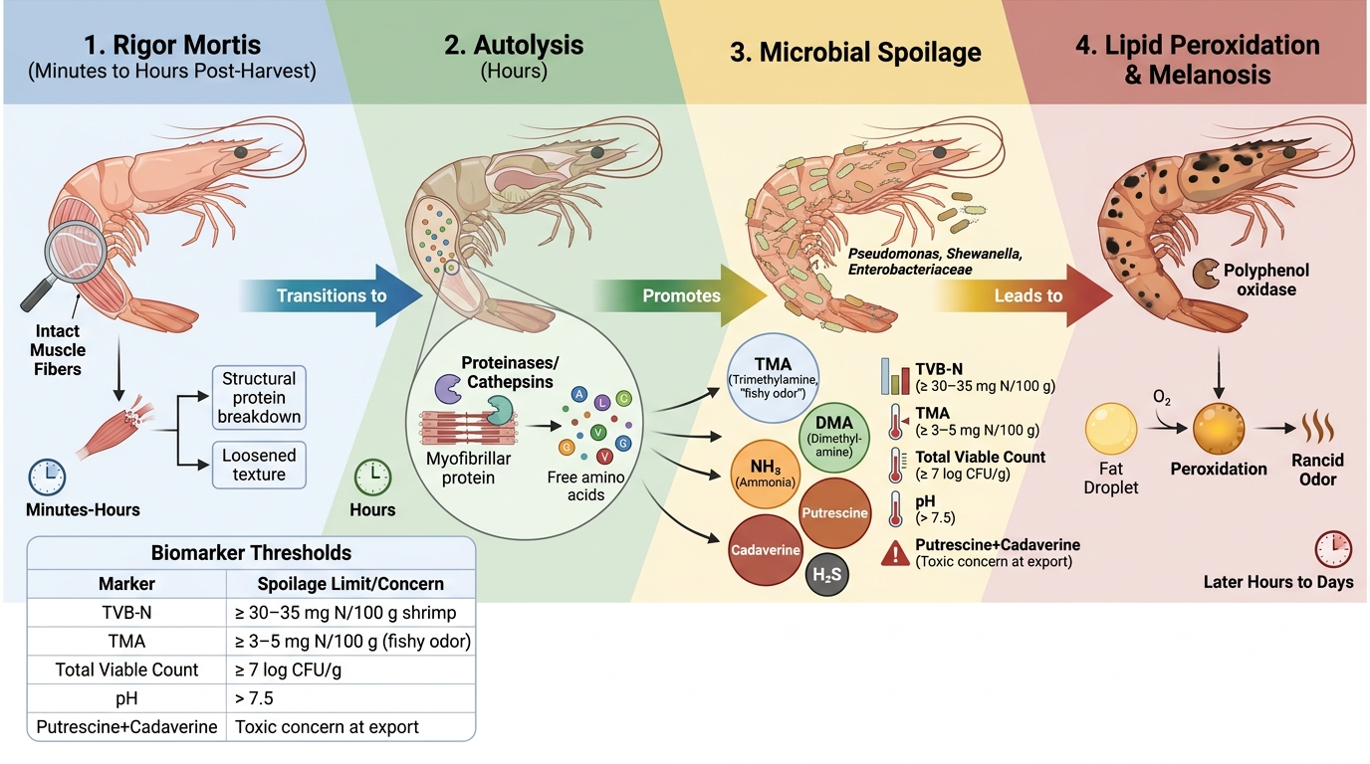
02 · TECHNICAL FEASIBILITY & SOUNDNESS
Criterion 3
Measuring the markers regulators already trust
Protect — established science
• Chitosan + EO coatings extend chilled shrimp ~8 → 16 days
• Low OTR arrests oxidation & melanosis; balanced WVTR stops drip loss
• Antimicrobials extend the microbial lag phase (stages 3–4)
Sense — the earliest reliable signal
• We target stage-3 amines — TVB-N ≥30, TMA ≥3 mg N/100g
• Anthocyanin dye shifts colour with these amines — correlated with TVB-N
• Compensated read-out cancels humidity/temperature drift — the deep-tech edge
The four-stage shrimp spoilage cascade & accepted biomarker thresholds. Ref: Das & Mishra (2023).

Slide 7
PERFORMANCE
Protect × Sense
Double the shelf life — and flag the exact moment it ends
8 → 16
Control — spoiled ~8 days
days of chilled shelf life (published chitosan-EO coatings)
30 mg/100g — spoilage limit
Arrhenius
shelf life: 0°C ≈ 14 d · 5°C ≈ 7 d · 10°C ≈ 3–4 d — a fixed date can't capture this
1 dye
SensoPack — saleable ~16 days
flips at the exact TVB-N limit — no false "fresh"
0
4
8
12
16
Days in chilled storage

Slide 8
03 · ORIGINALITY & CREATIVITY
Criterion 2
The only solution that both protects and reports — affordably
Extends ↑ Reports →
SensoPack
Capability | SensoPack | Colour labels Senoptica | IoT tags TrackingPacking | Add-on Blakbear | Plain MAP
Extends shelf life | Yes | No | No | No | Partial
Reports freshness | Yes | Yes | Temp only | Yes | No
Naked-eye / no scanner | Yes | Needs scanner | Phone/reader | Reader | —
Packaging-integrated | Yes | Yes | No | Bolt-on | Yes
Cost / unit | <₹5–120 | >High | >$2.50 | Med | Low
Biodegradable | Yes | Varies | No | No | No
Plain MAP
Colour labels
RFID/IoT
Protect + Sense in one film
Every incumbent solves one axis. SensoPack is the only entry combining active protection, honest sensing, biodegradability and affordability in one package.
Circular — chitosan from shell waste
Naked-eye affordable (<₹5)

Slide 9
04 · IMPACT — SCALE, DEPTH, REACH
Criterion 4
From a rural pond to a US hypermarket
SCALE
DEPTH
REACH
₹62,408 cr
8 → 16 d
3 tiers
India shrimp export (FY25); ~₹15,000 cr lost to spoilage — a fraction recovered is enormous.
doubled shelf life ends distress pricing, displaces carcinogenic formalin/ammonia-ice, preserves drip-loss weight.
one material serving wet market, organised retail and premium export.
Informal / rural
Organised retail
Export (USA/EU/JP)
₹5 colour patch + liner
film + NFC tap
plastic-free ESG premium
Not a premium gadget for the organised cold chain — quality & safety infrastructure for the part of the food system that has none.

Slide 10
05 · PROTOTYPE QUALITY & STAGE
Criterion 5
A real material, an honestly-stated stage
TECHNOLOGY READINESS LEVEL
Built
Next (8–12 wks)
We are here — TRL 3–4
A cast bio-film prototype with high optical transparency and coherent, flexible film formation — the two commercially critical properties.
Quantitative OTR/WVTR/tensile, antimicrobial assays, anthocyanin-dye calibration to TVB-N, and shrimp shelf-life trials.
Parameter | Prototype status | Scale-up hurdle
Transparency | High clarity, no phase separation | Hold on thin-gauge rolls
Integrity | Clean edges, uniform, no cracking | Survive heat-seal / MAP
Resilience | Well-formed standalone sheet | Barrier under humid cold storage
1
2
3
4
5
6
7
8-9

Slide 11
06 · VIABILITY & ROADMAP
Criterion 6
A cost tier for every buyer — from vendor to exporter
TIER 1 · BASIC
TIER 2 · INTERMEDIATE
TIER 3 · PREMIUM
<₹5
₹15–40
₹60–120
anthocyanin colour patch + film → domestic retail & small exporters
film + NFC tag + freshness log → MPEDA-certified organised export
full smart film + digital freshness certificate → USA / EU / Japan
Now — TRL 3–4
Validate
Pilot
Scale
film + dye design
shelf-life + dye calibration
landing-centre trial + WTP
roll-to-roll · export tier
Who pays: shrimp farmers, exporters/MPEDA units, processors & retailers — the actors who absorb the spoilage loss today.

Slide 12
SUMMARY
Scorecard
Every judging criterion, answered
Criterion | SensoPack's answer
1 · Problem | India's ₹62,408 cr shrimp export bleeds ~₹15,000 cr to spoilage — scoped to the unrefrigerated segment others ignore.
2 · Originality | The only solution that protects and senses in one biodegradable, circular, naked-eye-affordable package.
3 · Soundness | Chitosan-EO shelf-life (8→16 d) + anthocyanin sensing keyed to accepted TVB-N/TMA thresholds — one sensor, not five.
4 · Impact | Export earnings protected, formalin displaced, waste recovered — across three market tiers.
5 · Prototype | A real cast-film prototype at TRL 3–4 with a concrete validation roadmap — stated honestly.
6 · Viability | <₹5 to ₹120 cost tiers, capital-light, staged from wet market to premium export.
Protect. Sense. Sustain.
SensoPack — affordable, biodegradable smart packaging keeping India's shrimp safe, fresh and saleable. · Team Sentinel · Thank you.

