Slide 1
TITLE: HAIR FALL PREDICTION SYSTEM
Presenting by
Project Team:
1. A. Prempaul [22C31A6904]
2. N. Divya [22C31A6943]
3. K. Bhavya [22C31A6930]
4. B. Vamshi [22C31A6909]

Slide 2
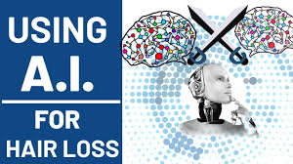
ABSTRACT
Hair fall is a prevalent concern affecting individuals worldwide, with causes ranging from genetics, diet, and stress to medical conditions and environmental factors. Traditional diagnosis methods often lack precision, failing to analyze multiple contributing factors effectively. This project leverages Artificial Intelligence (AI) and Machine Learning (ML) to create a predictive system capable of assessing an individual's risk of hair fall based on various parameters.
By applying ML algorithms, we extract meaningful insights from extensive datasets, offering personalized predictions and actionable recommendations for hair care and prevention. The integration of AI/ML enhances the accuracy of hair fall prediction, automates the analysis process, and ensures a user-friendly interface for real-time assessments. The proposed system bridges the gap between conventional diagnostic approaches and data-driven solutions, empowering individuals with effective strategies for hair health management.

Slide 3
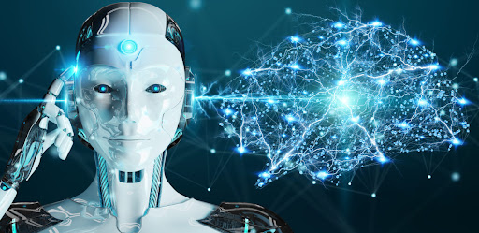
INTRODUCTION
Hair loss affects millions, leading to emotional distress and low self-confidence.
Contributing factors: genetics, hormones, environmental conditions, and lifestyle choices.
Early detection and monitoring are key to preventing further damage.
IoT (Internet of Things) uses sensors to track scalp conditions like temperature, humidity, and air quality.
AI (Artificial Intelligence) analyzes data to predict hair fall trends and detect early signs of thinning or damage.

Slide 4
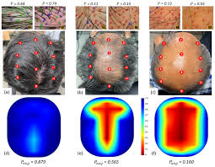
PROBLEM STATEMENT
Hair loss is a widespread issue, impacting millions globally and affecting emotional well-being and self-confidence.
Multiple factors contribute to hair fall, including genetics, hormonal imbalances, environmental conditions, lifestyle choices, and stress.
Current methods primarily focus on symptom management after hair loss occurs, rather than early detection or prevention.
There is a lack of real-time monitoring and predictive systems to track and forecast hair fall trends.
Early detection of hair thinning or damage can significantly reduce the impact of hair loss and allow for timely interventions.

Slide 5
OBJECTIVES
Develop a real-time monitoring system using IoT to track key factors influencing hair health, such as scalp temperature, humidity, air quality, and hair follicle conditions.
Integrate AI algorithms to analyze the collected data, detect patterns, and predict hair fall trends based on environmental, lifestyle, and individual hair health factors.
Provide early detection of potential hair thinning or damage, enabling users to take timely preventive measures.
Offer personalized recommendations for hair care routines, lifestyle adjustments, and interventions based on individual data insights and predictive analysis.
Alert users to potential underlying health issues (e.g., hormonal imbalances, nutritional deficiencies) that may contribute to hair loss.

Slide 6
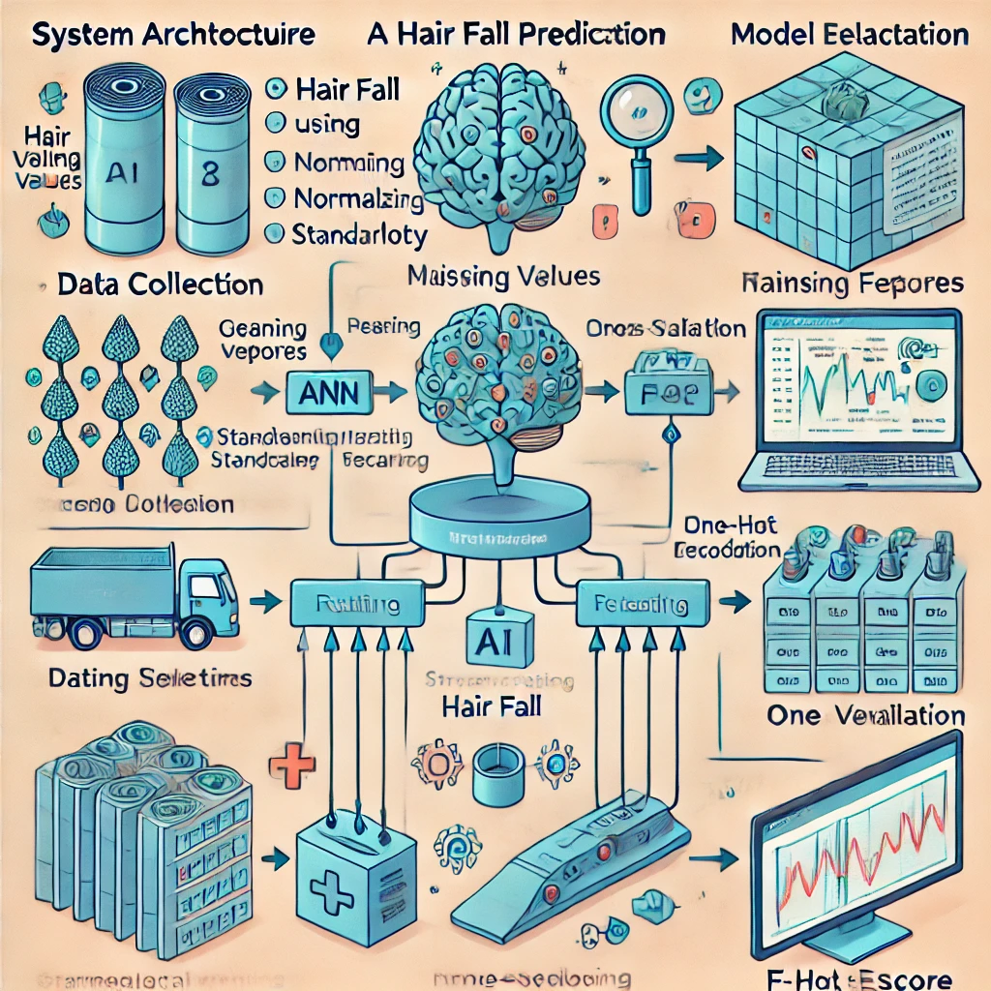
System Architecture
Data Collection: Gather data from online surveys, medical reports, dermatology case studies, and user-reported inputs to ensure a diverse dataset.
Preprocessing: Clean data, handle missing values using imputation techniques, normalize numerical features using StandardScaler, and encode categorical variables using One-Hot Encoding.
Model Selection: Implement and optimize a Neural Network (ANN) model tailored for hair fall prediction, leveraging hyperparameter tuning and regularization techniques.
Training & Evaluation: Train the model using an 80-20 training-testing split, apply cross-validation for robustness, and evaluate using metrics such as accuracy, precision, recall, and F1-score.
Deployment: Deploy the trained model using a web-based Streamlit interface, ensuring seamless user interaction and real-time prediction capabilities

Slide 7
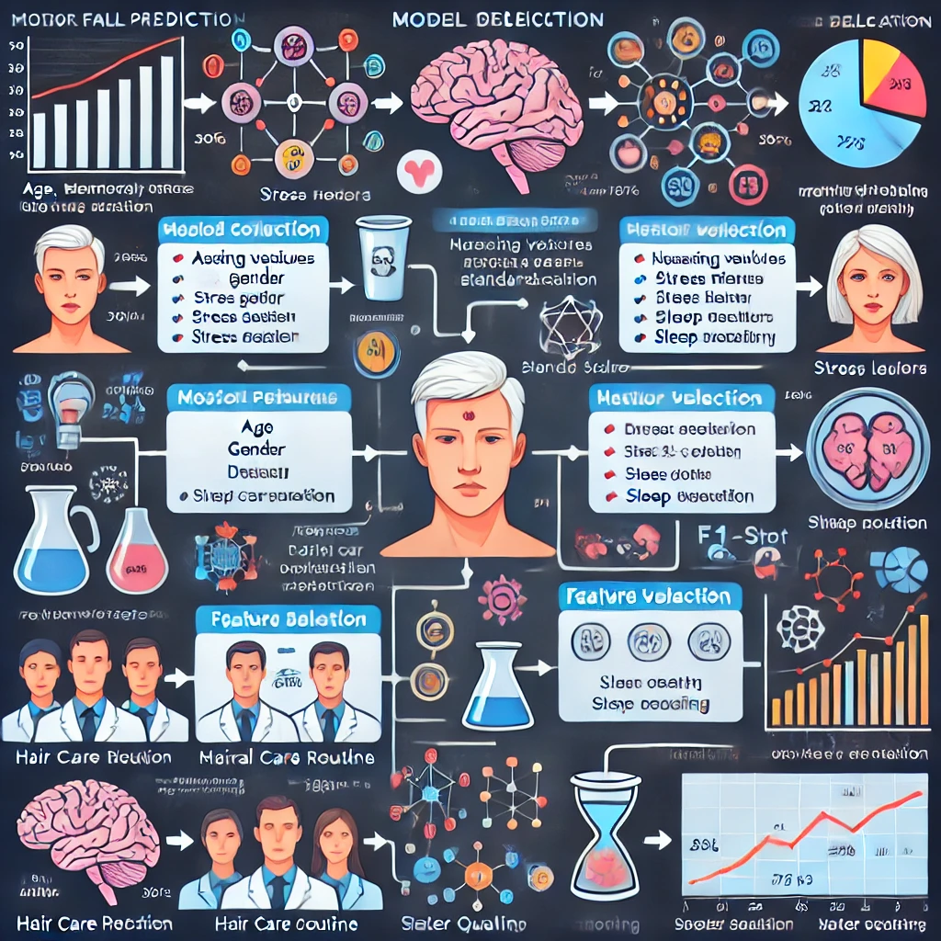
METHODOLOGY
Data Collection:
Sources: Online surveys, medical reports, dermatology case studies, user-reported data.
Features: Age, gender, stress levels, diet, sleep patterns, medical history, environmental factors.
Preprocessing:
Handle missing values (mean/mode imputation).
Normalize numerical features.
Model Selection:
Neural Network (ANN) with multiple dense layers optimized for classification.
Training & Evaluation:
80-20 split (Training & Testing).
Metrics: Accuracy, Precision, Recall, F1-score.

Slide 8
Implementation
Code Explanation:
The model is developed and trained using Jupyter Notebook, where data preprocessing, feature selection, and model training are performed.
The trained model is deployed using a Streamlit application for user-friendly interaction.
The application takes user inputs, processes the data, and provides real-time predictions based on the trained model.
Dependencies:
Programming Language: Python
Libraries Used: pandas, numpy, scikit-learn, tensorflow, streamlit, joblib, matplotlib, seaborn
Model Deployment: Streamlit framework for web-based interface
Installation: Requirements file (requirements.txt) provided for easy setup
Data Processing Tools: StandardScaler for feature normalization, LabelEncoder for categorical encoding
•

Slide 9
Results & Analysis
Model Performance (Neural Network - ANN)
Accuracy: 82%
Training Accuracy: 78.01%
Loss: 0.5452
Metrics: Precision: 84%, Recall: 83%, F1-score: 83%
Optimized ANN Model: Accuracy: 88%, Precision: 86%, Recall: 87%, F1-score: 87%
Example Input & Prediction
Input Factors: Age: 25, Male, High Stress, Poor Diet, Sleep Disturbance, Anemia, Hair Chemicals
Prediction: High Hair Fall Risk (90.29%)
Personalized Recommendations ✔ Increase protein & iron intake for hair growth ✔ Manage stress with meditation & exercise ✔ Improve sleep quality (6-8 hrs per night) ✔ Reduce hair chemical usage & switch to natural products ✔ Follow a balanced diet, avoid fast food

Slide 10
CONCLUSION
Summary of Findings: This project successfully demonstrates the application of AI/ML in predicting hair fall risk and providing personalized recommendations. By analyzing multiple contributing factors such as age, diet, stress levels, medical history, and environmental conditions, the system offers a data-driven approach for proactive hair care management. The model's accuracy and usability highlight the potential of AI in healthcare and wellness applications.
Final Thoughts: The integration of AI and ML into personal healthcare solutions opens new opportunities for preventive care. While the current system provides valuable insights, future enhancements such as real-time monitoring, more diverse datasets, and improved explainability will further refine predictions. Expanding the system to include mobile applications and wearable technology integration can enhance accessibility and impact. Continuous research and model optimization will be crucial in making the system more robust and effective for widespread adoption.

