Slide 1




HAIR FALL PREDICTION SYSTEM
Project Title
Team ID - Team_10137
Team Leader Name : A. Prempaul
Team Member 1: N. Divya
Team Member 2 : K. Bhavya Sri
Team Member 3 : B. Vamshi

Slide 2

Project Objectives
Problem Statement
Project Overview – Introduction
End Users
Wow Factor in Project
Modelling/Block Diagram/Flow of Project
Result/outcomes
Conclusion
Future Perspective

Slide 3
Problem Statement Hair fall is a complex and multifactorial issue influenced by genetics, environmental exposure, medical history, lifestyle choices, and stress levels. Traditional diagnostic approaches often rely on subjective assessments, making prediction and prevention challenging. These methods fail to consider the interdependencies between various contributing factors, leading to less accurate assessments. Without an advanced predictive model, individuals struggle to identify the root causes of their hair fall and take timely preventive actions. An AI/ML-based predictive system offers a solution by analyzing multiple parameters simultaneously, providing personalized insights and proactive recommendations for hair care management. By leveraging AI and ML, this project aims to fill the gap left by conventional diagnostic methods and improve the accuracy of hair fall prediction.

Slide 4
Project overview – Introduction Hair fall is a widespread concern affecting millions of people worldwide. It can result from multiple factors, including genetics, hormonal imbalances, poor nutrition, high stress levels, underlying medical conditions, and environmental influences. Traditional diagnostic methods primarily rely on visual assessments and self-reported symptoms, which can be subjective and prone to inaccuracies, often failing to capture all underlying causes. With advancements in Artificial Intelligence (AI) and Machine Learning (ML), predictive models can analyze large datasets to identify patterns and risk factors contributing to hair fall. AI-driven models offer a systematic approach to processing complex datasets, uncovering hidden correlations, and generating personalized insights. This project aims to improve the accuracy of hair fall prediction, enabling users to take proactive measures for prevention and treatment. By leveraging AI/ML, we aim to create an intelligent system that enhances diagnostic precision, automates analysis, and provides user-friendly recommendations for hair care.

Slide 5
End User
Dermatologists & Healthcare Professionals
General Users (Individuals Concerned About Hair Health)
Hair Care & Wellness Industry
Medical Researchers & Data Scientists
Smart Tech & IoT Enthusiasts (Future Expansion)

Slide 6
Wow Factor in Solution
AI-Driven Personalized Hair Fall Prediction
Real-Time Web-Based System
Smart AI-Powered Recommendations
Future-Ready Approach (Scalability)

Slide 7
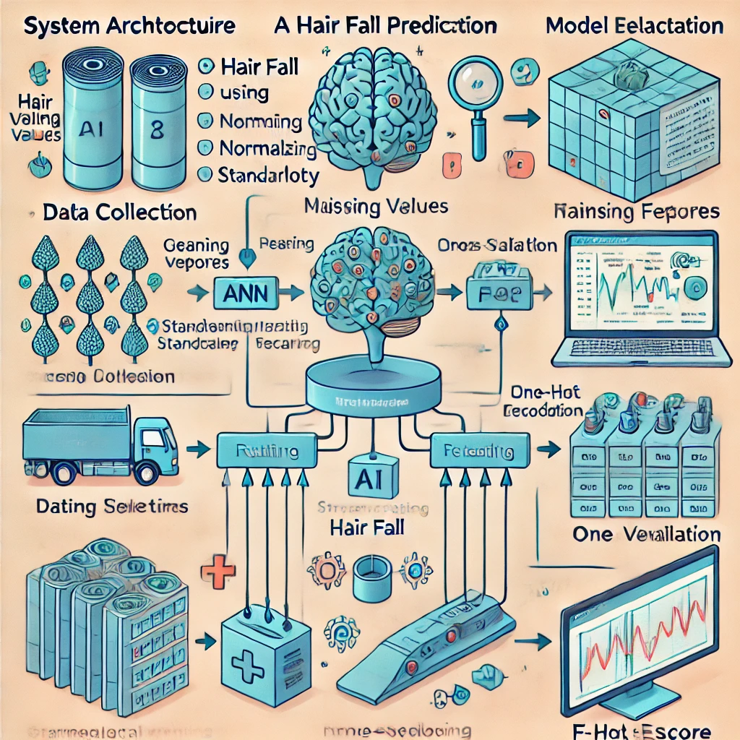
Modelling
Data Collection: Gather data from online surveys, medical reports, dermatology case studies, and user-reported inputs to ensure a diverse dataset.
Preprocessing: Clean data, handle missing values using imputation techniques, normalize numerical features using StandardScaler, and encode categorical variables using One-Hot Encoding.
Model Selection: Implement and optimize a Neural Network (ANN) model tailored for hair fall prediction, leveraging hyperparameter tuning and regularization techniques.
Training & Evaluation: Train the model using an 80-20 training-testing split, apply cross-validation for robustness, and evaluate using metrics such as accuracy, precision, recall, and F1-score.
Deployment: Deploy the trained model using a web-based Streamlit interface, ensuring seamless user interaction and real-time prediction capabilities

Slide 8
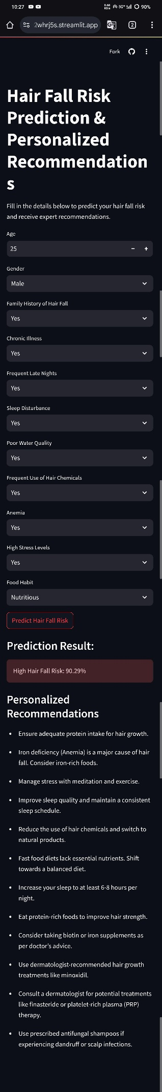
Result / Outcomes
Model Accuracy, Metrics, and Performance:
Neural Network (ANN):
Accuracy: 82%
Training Accuracy: 78.01%
Loss: 0.5452, Precision: 84%, Recall: 83%, F1-score: 83%. , Precision: 75%, Recall: 77%, F1-score: 76%. , Precision: 79%, Recall: 78%, F1-score: 78%.
Neural Network: Accuracy: 88%, Precision: 86%, Recall: 87%, F1-score: 87%.
You can test the model and get predictions using the following link: https://hairfallpredictionsystem-sxrfvgtztqp4uye2whrj5s.streamlit.app/

Slide 9
Conclusion
Summary of Findings: This project successfully demonstrates the application of AI/ML in predicting hair fall risk and providing personalized recommendations. By analyzing multiple contributing factors such as age, diet, stress levels, medical history, and environmental conditions, the system offers a data-driven approach for proactive hair care management. The model's accuracy and usability highlight the potential of AI in healthcare and wellness applications.
Final Thoughts: The integration of AI and ML into personal healthcare solutions opens new opportunities for preventive care. While the current system provides valuable insights, future enhancements such as real-time monitoring, more diverse datasets, and improved explainability will further refine predictions. Expanding the system to include mobile applications and wearable technology integration can enhance accessibility and impact. Continuous research and model optimization will be crucial in making the system more robust and effective for widespread adoption.

Slide 10
Future Perspective
Enhance the neural network model with more advanced deep learning techniques, such as CNNs or transformers, for better accuracy.
Integrate real-time monitoring using IoT sensors to track environmental factors affecting hair health.
Expand dataset collection to include more diverse demographic and genetic factors for improved generalization.
Develop a mobile-friendly version of the application to increase accessibility.
Implement explainable AI techniques to provide users with clearer insights into how predictions are made.
Add multilingual support to cater to a global audience.
Incorporate blockchain for secure and tamper-proof medical records related to hair health analysis.
Enable personalized treatment plans based on AI-driven analysis, integrating feedback loops for adaptive learning.

Slide 11
Thank you...!
Notes:
11

