Slide 1

B.M.S. COLLEGE OF ENGINEERING
(Autonomous Institute, Affiliated to VTU, Belagavi)
DEPARTMENT OF MACHINE LEARNING
(UG Program: B.E. in Artificial Intelligence and Machine Learning)
Course : Natural Language Processing for LLM
Course Code: 24AM7PCLLM
Sentiment Analysis of Movie Reviews: Lexicon, Classical ML and Transformer Embeddings
Alternative Assessment Tool (AAT)
Presented By,
Student Name & USN :
Student Name & USN :
Semester & Section: 7B
Date:
Faculty In-Charge:
Dr. Monika Puttaramaiah
Associate Professor
Department of Machine Learning
BMS College of Engineering

Slide 2
Agenda
Introduction
Selected NLP Topic Overview
Real-Time Application / API Identified
NLP Model / Architecture Study
Dataset and Preprocessing
Implementation Methodology
Results and Evaluation
Discussion
Conclusion
References

Slide 3
Introduction
Why sentiment analysis?
Objectives
Companies, studios and platforms track millions of opinions in reviews and social media.
Short opinion sentences are hard: negation ('not good'), contrast ('stunning, but dull'), sarcasm.
NLP offers three generations of solutions: lexicons, statistical ML and Transformer embeddings.
Which works best, and why? We measure them side by side.
1
Identify the task, a real-time application and APIs
2
Measure the effect of Unit 1 preprocessing
3
Compare 7 approaches: lexicon, NB, LR, SVM, word vectors, RoBERTa, ensemble
4
Evaluate with accuracy, P, R, F1, ROC-AUC + significance test
5
Analyse negation, contrast, sarcasm and data efficiency
6
Deliver a working, explainable sentiment analyser

Slide 4
Selected NLP Topic Overview
Task: binary text classification — given a review sentence x, predict y ∈ {negative, positive}.
Classifier: learn f(x) = P(positive | x) from labelled examples; predict positive if f(x) ≥ 0.5. Lexicon: sum word valences and apply rules.
Real-world use cases
Unit | Used in this project
1 | Regex, normalisation, tokenisation, stopwords, negation
2 | Bag-of-words, TF-IDF, static and contextual embeddings
3 | N-grams, RoBERTa Transformer, self-attention
4 | Case study: NLP-powered opinion mining
5 | Deployment trade-offs, responsible AI
Product reviews: flag unhappy customers
Brand monitoring on social media
Film reviews: audience reaction
Support tickets: prioritise angry customers
Finance: news sentiment as a market signal

Slide 5
Real-Time Application / API Identified
Movie-Review Sentiment Analyser (predict.py) built on NLTK VADER (rule-based API), scikit-learn and RoBERTa-base via spaCy. Cloud equivalents: Google Cloud Natural Language, Amazon Comprehend, Azure AI Language.
INPUT
PROCESSING
OUTPUT
One review sentence
Clean → tokenise → TF-IDF + RoBERTa → 2 × Logistic Regression → average
Label, P(positive), key words, VADER baseline
"a masterpiece of quiet , heartbreaking performances ."
TF-IDF LR 0.99, RoBERTa LR 1.00
POSITIVE (0.99); masterpiece (+)
Functionality
Limitations
Label + confidence + explanation
Fast mode (TF-IDF, ~0.02 ms)
Accurate mode (ensemble with RoBERTa)
Trained on critic snippets only
Binary: no neutral or mixed class
Sarcasm not handled reliably

Slide 6
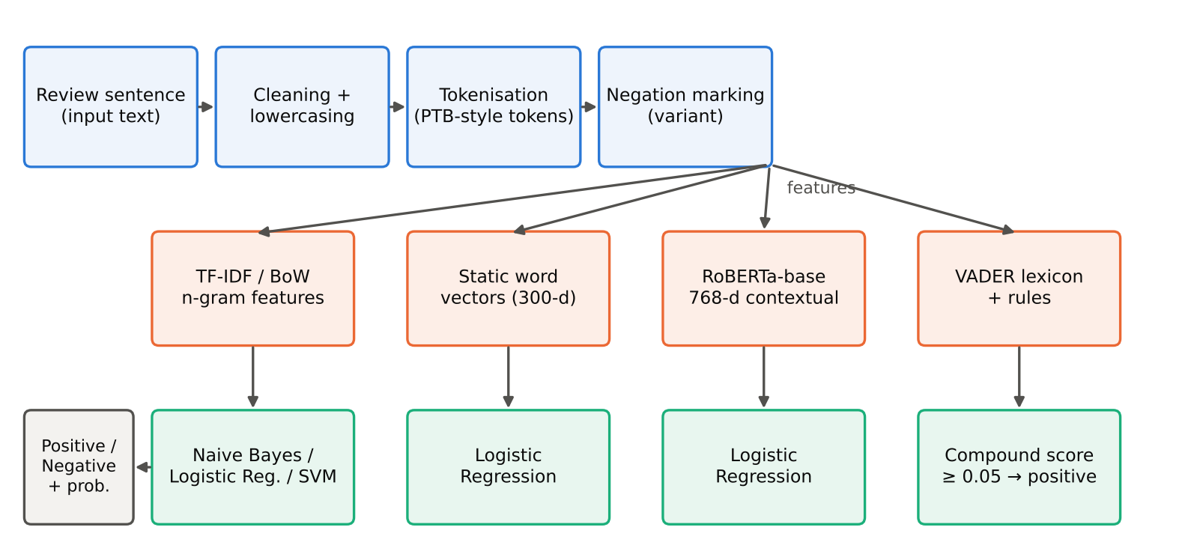
NLP Model / Architecture Study
6 components
Input sentence
Preprocessing (clean, tokenise, negation)
Feature extractors (TF-IDF, vectors, RoBERTa, lexicon)
Classifiers (NB, LR, SVM, rule)
Ensemble (average)
Output label + explanation
RoBERTa-base: 12 Transformer layers × 12-head self-attention, softmax(QKᵀ/√d)V, 768-d token states, byte-level BPE (50,265 tokens). Sentence vector = mean of last-layer states (frozen, no fine-tuning).

Slide 7
Approaches and Language Models Compared
# | Approach | Features → decision
1 | VADER | Valence lexicon + rules → compound ≥ 0.05
2 | Multinomial Naive Bayes | Word counts → Bayes' rule
3 | Logistic Regression | TF-IDF → σ(wᵀx + b)
4 | Linear SVM | TF-IDF → max-margin hyperplane
5 | Static word vectors + LR | Mean 300-d vectors → LR
6 | RoBERTa + LR | Mean 768-d contextual → LR
7 | Ensemble | Average of LR and RoBERTa-LR
Key formulas
TF-IDF: (1 + log tf) · idf
NB: argmax log P(c) + Σ log P(t | c)
LR: P(+|x) = 1 / (1 + e^−(wᵀx+b))
SVM: min ½‖w‖² + C Σ hinge
F1: 2PR / (P + R)
ROC-AUC: area under TPR vs FPR

Slide 8
Dataset and Preprocessing
10,662
50 / 50
21
8,529 / 2,133
review sentences (Pang & Lee 2005)
positive / negative
words per sentence (avg.)
train / test (stratified)
Source: Rotten Tomatoes snippets, sentence polarity v1.0
Cleaning: UTF-8, HTML remnants, whitespace, lowercase
Tokenisation: PTB-style tokens (n't, 's split); BPE for RoBERTa
Stopword removal hurts: removes 'not', 'too', 'very'
Negation marking: not a good film → not NOT_a NOT_good NOT_film
Choices made by 5-fold CV on train only

Slide 9
Implementation Methodology
1. Load corpus, stratified 80/20 split
Item | Setting
Environment | Python 3.13, CPU only (2 cores, 8 GB)
Libraries | scikit-learn, NLTK (VADER), spaCy 3.8, PyTorch
Naive Bayes | alpha = 1.0
Logistic Regression | C = 4
Linear SVM | C = 0.3
RoBERTa + LR | C = 0.03 (standardised features)
Ensemble | Equal-weight average of probabilities
Protocol | Tune on train (5-fold CV); test used once
2. Preprocessing ablation (5-fold CV)
3. VADER on test set (no training)
4. Grid-search NB, LR, SVM
5. Extract word-vector and RoBERTa embeddings (cached)
6. Train LR on embeddings; build ensemble
7. Metrics, learning curve, McNemar, slices
8. Package predict.py

Slide 10
Results: Model Comparison
0.808
0.883
Ensemble accuracy
Ensemble ROC-AUC
Ensemble best: +2.9 pts over best single model
SVM ≈ LR ≈ NB (0.779 / 0.775 / 0.774); McNemar p = 0.22
VADER 0.642: 18% scored neutral
Frozen RoBERTa 0.753 alone

Slide 11
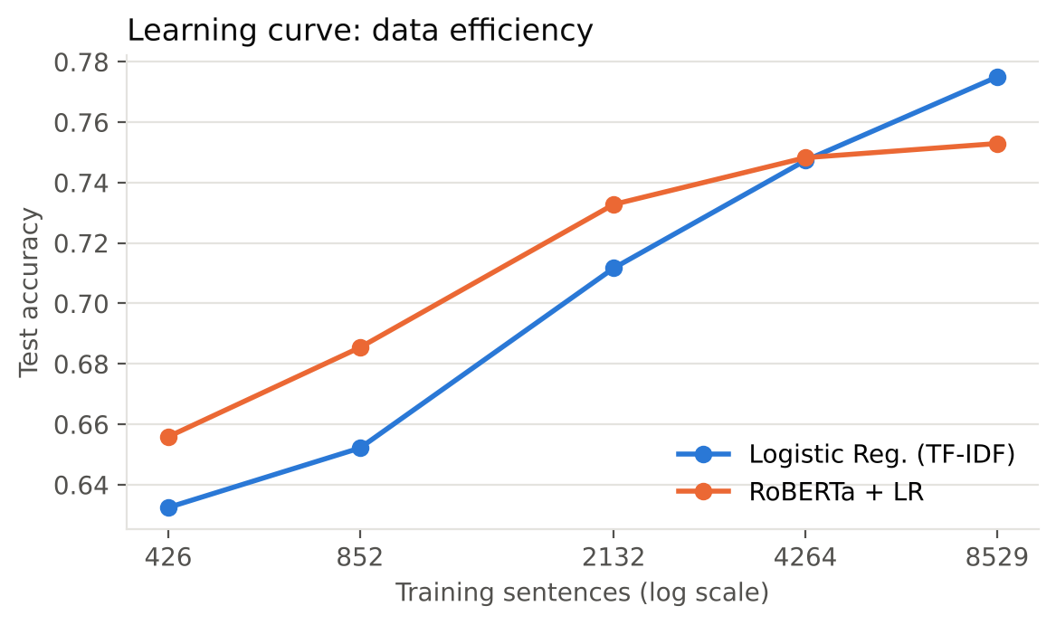
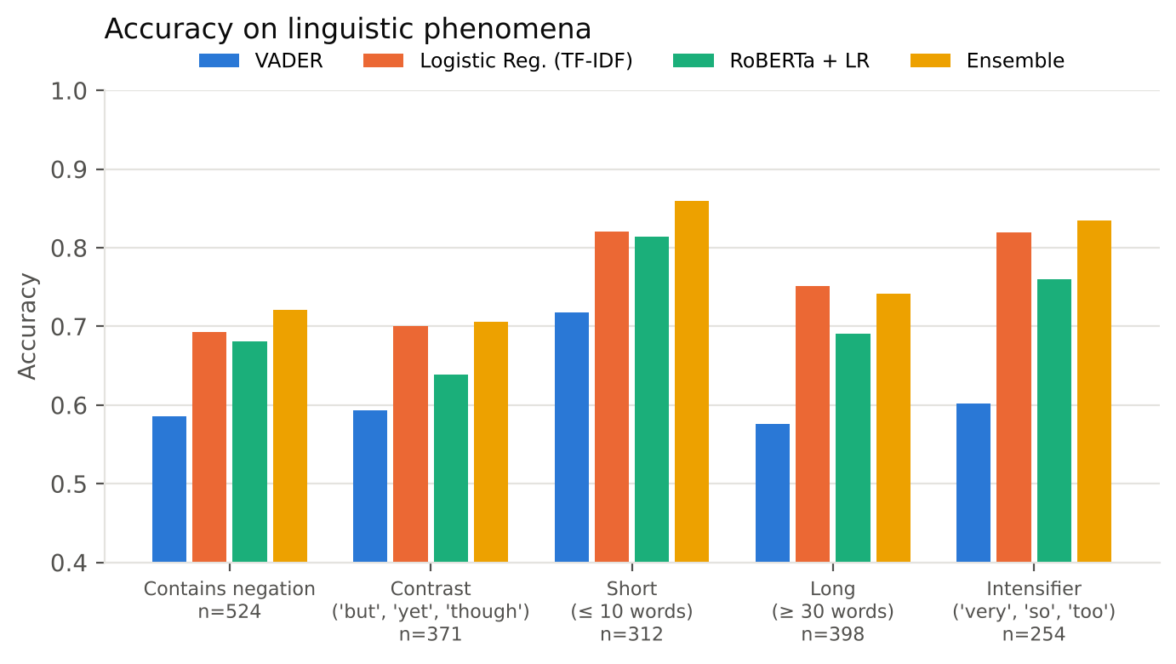
Results: Data Efficiency and Linguistic Patterns
With only 426 training sentences RoBERTa leads (0.656 vs 0.632); TF-IDF overtakes after ~4,000 sentences.
Pre-training = prior knowledge; frozen features saturate.
Negation: TF-IDF LR 0.693, VADER 0.586
Negation marking (post-hoc) lifts this to 0.742
Contrast hurts RoBERTa most (0.639)

Slide 12
Demonstrated Test Cases
# | Sentence | Gold | TF-IDF LR | RoBERTa | LR+neg | VADER
TC1 | a masterpiece of quiet , heartbreaking performances . | Pos | ✓ 0.99 | ✓ 1.00 | ✓ 1.00 | ✓ +0.27
TC2 | the plot is predictable and the dialogue is painfully flat . | Neg | ✓ 0.04 | ✓ 0.17 | ✓ 0.01 | ✓ -0.53
TC3 | not bad at all -- i actually enjoyed it . | Pos | ✗ 0.14 | ✗ 0.20 | ✗ 0.11 | ✓ +0.73
TC4 | it is not a good film . | Neg | ✗ 0.89 | ✓ 0.38 | ✓ 0.45 | ✓ -0.34
TC5 | the visuals are stunning , but the story never comes alive . | Neg | ✗ 0.54 | ✓ 0.37 | ✓ 0.08 | ✓ -0.24
TC6 | i wanted to like this movie , but i could n't . | Neg | ✓ 0.09 | ✓ 0.19 | ✓ 0.08 | ✗ +0.19
TC7 | oh great , another two hours of my life i will never get back . | Neg | ✓ 0.45 | ✓ 0.36 | ✓ 0.37 | ✗ +0.62
TC8 | the cast is charming and the script is sharp and funny . | Pos | ✓ 0.97 | ✓ 0.67 | ✓ 0.99 | ✓ +0.77

Slide 13
Discussion and Error Analysis
Key observations
Error types
Simple linear models on TF-IDF remain hard to beat with enough data
Transformers help most with little data and in ensembles
Stopword removal hurts sentiment (negations are stopwords)
Averaged static vectors blur sentiment words
A generic lexicon (VADER) misses film vocabulary
Contrast / concession
'more depressing than liberating, but it's never boring' → wrong
Double negation
'isn't nearly as terrible as it could have been' → wrong
Faint praise
'a solid film … but more conscientious than stirring' → wrong
Sarcasm / casual style
'oh great, another two hours…' fools VADER

Slide 14
Conclusion and Future Work
Summary
Future work
7 approaches compared on 10,662 sentences
Best: ensemble 80.8% accuracy, AUC 0.883
Best single: Linear SVM 77.9%
VADER without training: 64.2%
Working, explainable analyser delivered
Fine-tune RoBERTa / DistilBERT (or LoRA) on GPU
Negation scope + contrast-aware weighting
Zero/few-shot LLM prompting comparison
Neutral class and aspect-based sentiment
Indian-language and code-mixed reviews
Classical features + pre-trained Transformer knowledge together give the most reliable sentiment classifier.

Slide 15
References
[1] Jurafsky and Martin, Speech and Language Processing, 3rd ed., 2024 (Ch. 4)
[2] Pang and Lee, Seeing Stars, ACL 2005 (sentence polarity dataset)
[3] Pang, Lee and Vaithyanathan, Thumbs up? Sentiment Classification, EMNLP 2002
[4] Hutto and Gilbert, VADER, ICWSM 2014
[5] Das and Chen, negation marking, APFA 2001
[6] Wang and Manning, Baselines and Bigrams, ACL 2012
[7] Socher et al., Sentiment Treebank, EMNLP 2013
[8] Liu et al., RoBERTa, arXiv:1907.11692, 2019
[9] Vaswani et al., Attention Is All You Need, NeurIPS 2017
[10] McNemar, Psychometrika, 1947
[11] Tunstall et al., NLP with Transformers, O'Reilly, 2022

Slide 16
Thank you !

