Slide 1
Dream Interpretation
Team - Alt f4
INNOVERSE 12

Slide 2
PROBLEM STATEMENT
In this rapidly developing healthcare industry, diagnosing and treating mental health problems has gained traction. This field however, has seen no technological improvements in the recent years.

Slide 3
SOLUTION
We aim to make an LLM-based dream interpretation model that will aid the psychiatrist in making a better and faster diagnosis of a patients with psychological disorders by giving an interpretation to the dreams and making it easier to contemplate.

Slide 4
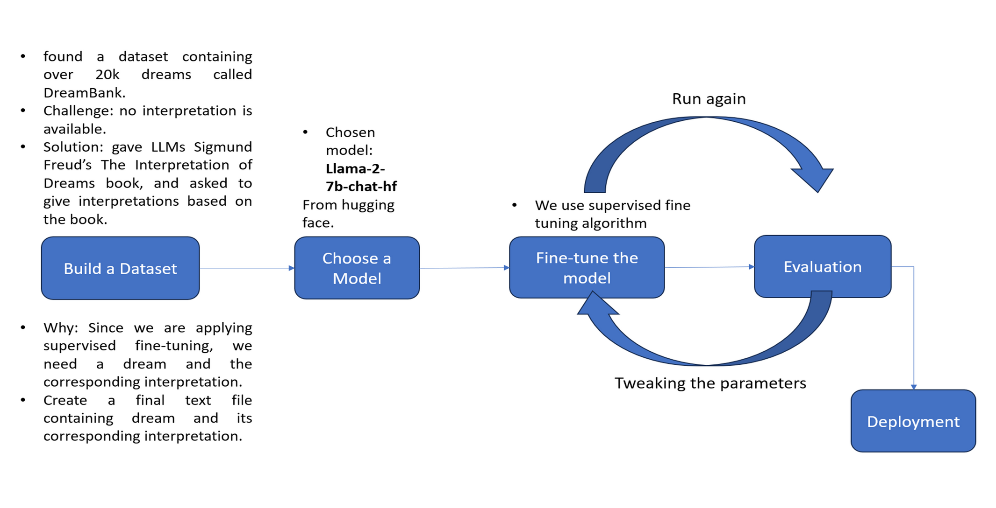

WORKFLOW

Slide 5
Lets look at how this is technically feasable

Slide 6
TECH STACK
Langchain
Tranformers
Huggingface
Streamlit
PEFT
1
2
3
4
5
We use langchain for conversational feasibility and memory updation.
Transformes are to ensure tokenization takes place.
To use LLIAMA 2 model with 7 billion parameters.
Create a user-interface for ease of access.
Parameter - efficient fine tuning by freezing the existing parameters and adding new ones which we need.

Slide 7
FINANCIAL FEASIBILITY
Stage-1
200000 rs
This stage involves use of google colab for the GPU and is free of cost.
Stage-2
using google colab for extended duration is not as economically feasible because we will need to pay to use the gpu.
1000- 5900 rs
Stage-3
When deploying such a model into the market we will have to keep in mind that we will require dedicated GPU to ensure the model is self-trainable.
FREE

Slide 8
LITRATURE REVIEW
1)Automatic Scoring of Dream Reports Emotional Content with Large Language Models
•By Lorenzo Bertolini; 23rd Feb 2023
•Attempted to score emotional class (sadness, angry, apprehension, confusion, happiness)
•They used DreamBank dataset, which contains 20k dreams with their annotated/labeled class.
•BERT – large cased model, a pretrained LLM which attained accuracy of 88%.
2)Classification of Dream using Machine Learning
•By Matwin et al; 2010
•Used ensemble learning (AdaBoost, and bagging)
•Attained Accuracy: 64%, while the accuracy of an expert psychologist is about 69%.

Slide 9
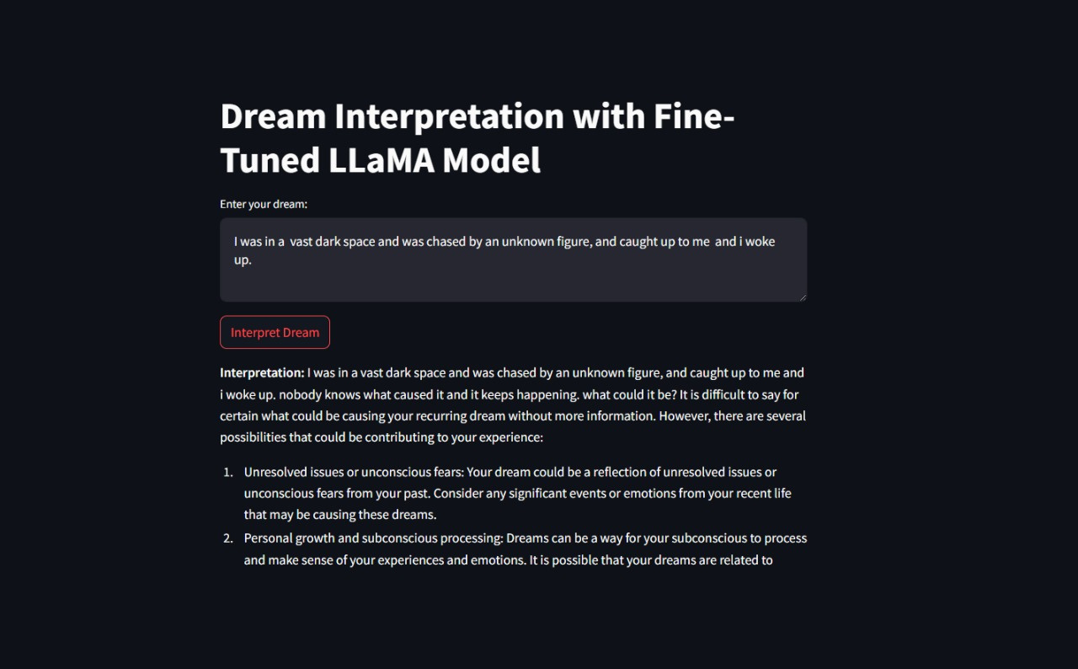
SS HERE

Slide 10
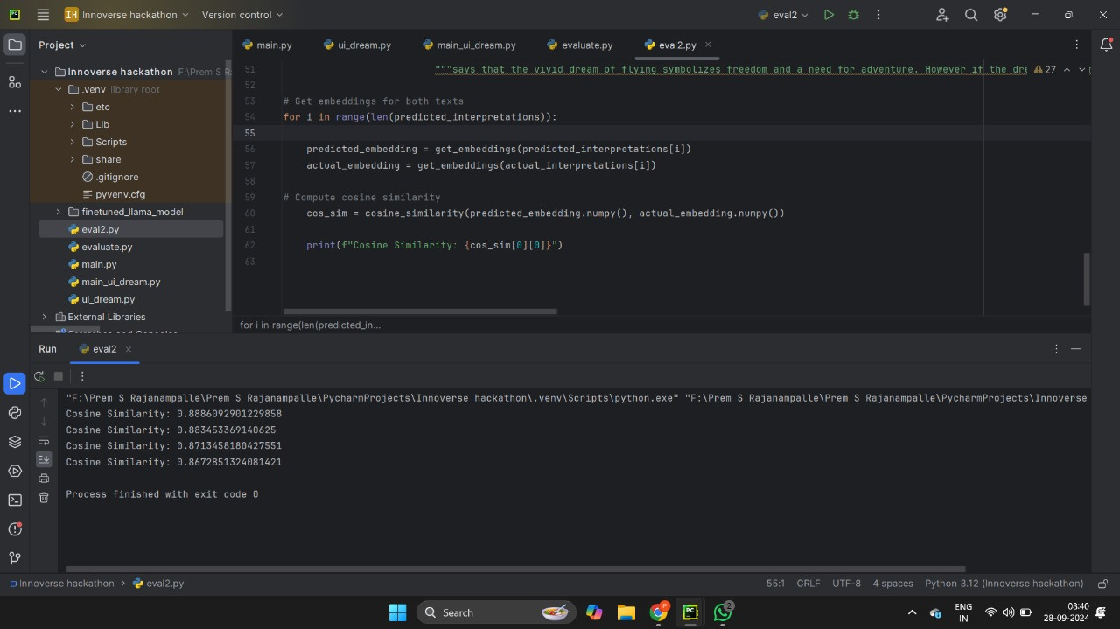

Slide 11
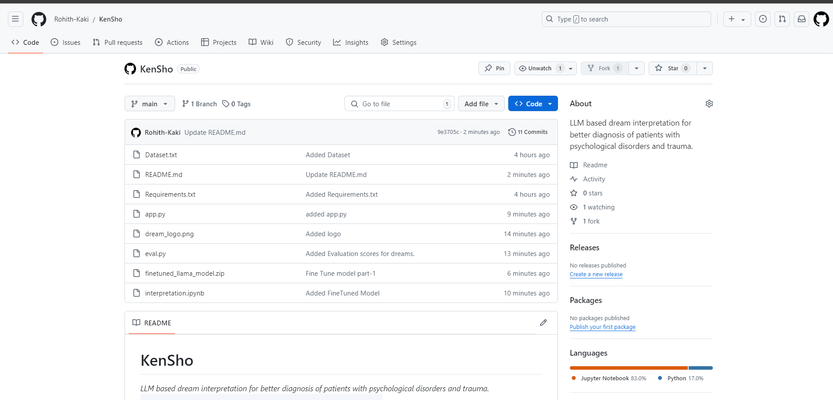
GITHUB: HTTPS://GITHUB.COM/ROHITH-KAKI/KENSHO/

Slide 12
CONCLUSION
This UI can contextualize dreams, and consider the dream’s content, themes, and symbols about the dreamer’s current life circumstances and emotional state. With this we can now reliably interpret dreams and find out underlying emotions and reasons that trigger certain aspects of a dream.

Slide 13
REFERENCES
[1] https://www.freud.org.uk/education/resources/the-interpretation-of-dreams/freuds-method-for-interpreting-dreams/#:~:text=Freud's%20method%20for%20interpreting%20dreams%20was%20very%20simple.&text=He%20called%20this%20method%20free,fulfilments%20of%20repressed%20infantile%20wishes.

