Slide 1

Machine learning- Internship project
Presented by-
B. Prem Sagar
R.V.R. & J.C. COLLEGE OF ENGINRRING
TEAM NO:127

Slide 2
LEUKEMIA CANCER PREDICTION IN BLOOD CELLS
by using Convolutional Neural Networks

Slide 3
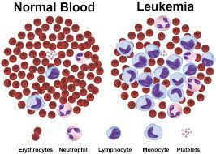
Purpose of the project
The purpose of the project is to develop a system that can automatically detect cancer in the Leukemia blood cells images.
This System uses a Convolutional Neural Network that inputs Leukemia cell images and outputs whether the cell is infected or not.

Slide 4
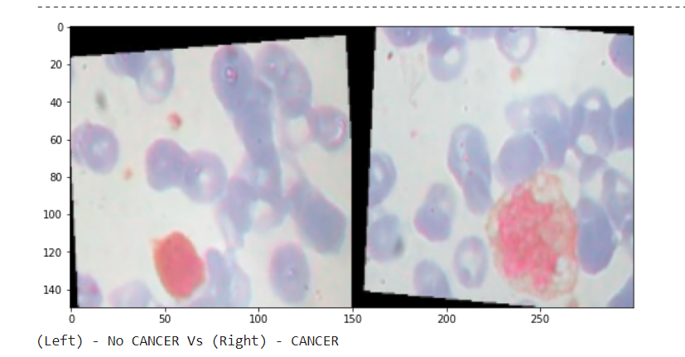
Data set Description
Images used in this project is obtained from Kaggle.
This dataset is divided into two classes.
There are 4961 training images, where 2483 images from healthy patients and 2478 images from patients affected with blood cancer.
Also we tested the model with 1240 images 620 of each class.
These images had resolution of 320*240.

Slide 5
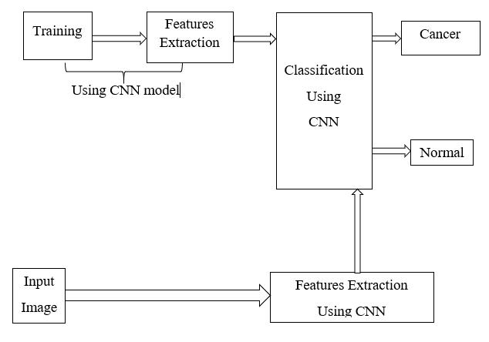
Steps to implement the project
Knowing the dataset, i.e Downloading the dataset and import to google colab notebook.
Preprocessing the images and visualise them and split the dataset.
Building a CNN network.
Training a CNN network.
Testing the model.
Evaluate the model.

Slide 6
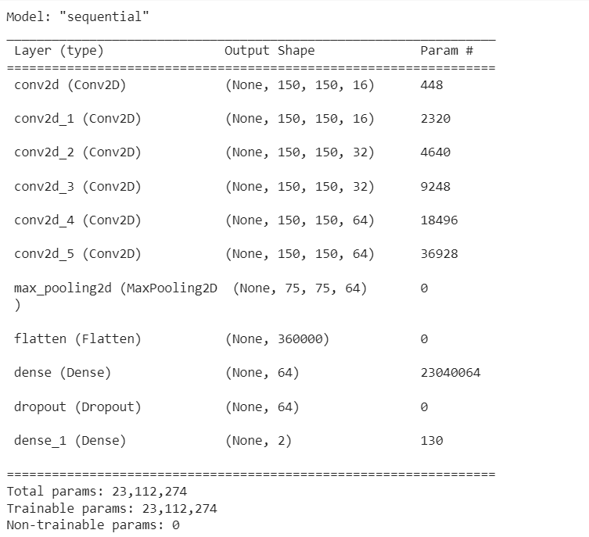
Summary of CNN ARCHITECTURE USED

Slide 7
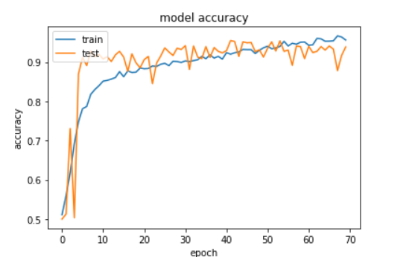
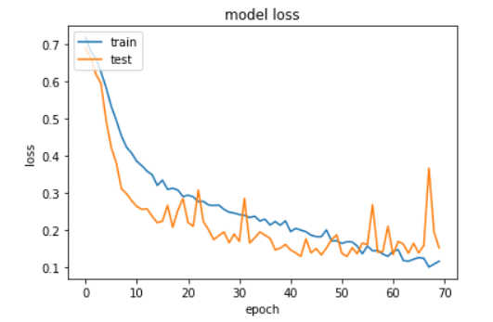
Prediction graph
With the increase of epoch number the training accuracy and validation accuracy are increasing parallel
with the decrease of training loss the validation loss is decreasing parallel.

Slide 8
Thank you

