Slide 1
IMDb DATABASE
Team 12 members:
Prem Salina (premsali)
Rohith Varma Palukuri (rpalukur)
Sai Kiran Mundra (smundra)

Slide 2
Problem statement
For a long time, everyone's main source of amusement has been movies and television. Even after COVID, when everyone was confined to their homes, movies or television programs remained the only significant sources of amusement. Searching for information on a movie, its actors or actresses, or even a simple fact is one of the most frequent activities people engage in fetching data from the IMDb database after analysis in order to give consumers the information they require. This IMDb database includes comprehensive information about movies, their cast members, and staff members. The database consists of 7 datasets with information related to movies.

Slide 3
Target users
Our target user base would be all the people who are interested in movies. Through this solution, users can find answers to frequently asked questions about their favorite entertainment programs using the movie database. The actors, voting totals, cast, crew, ratings, budget, revenue, posters, release dates, languages, production firms, nations, and genres are among the data elements in this database.

Slide 4
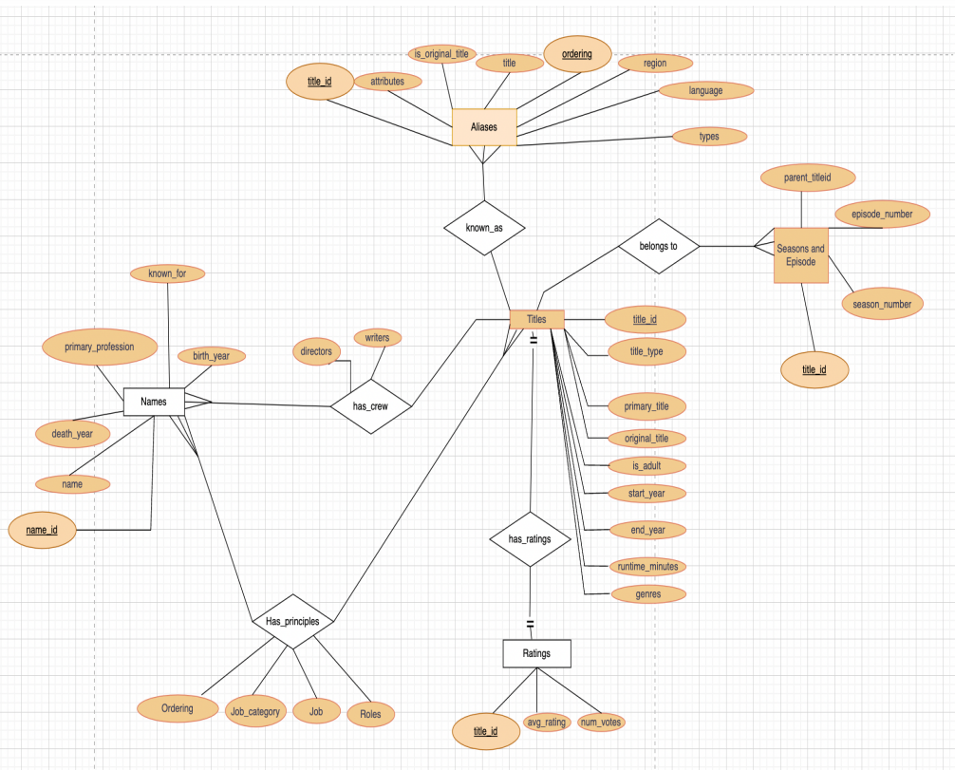
ER – DIAGRAM

Slide 5
ATTRIBUTE DESCRIPTION
client
Title_Info:
This table contains the details of the titles. Following are the attributes related to title information such as titleId, name, language etc. and their data types.
• titleId (string) → An alphanumeric unique identifier of the title.
• ordering (integer) → A number to uniquely identify rows for a given titleId.
• title (string) → The localized title of the show.
• region (string) → The region for this version of the title
• language (string) → The language of the title
• types (array) → Enumerated set of attributes for this alternative title. One or more of the following: "alternative", "dvd", "festival", "tv", "video", "working", "original", "imdbDisplay". New values may be added in the future without warning.
• attributes (array) → Additional terms to describe this alternative title, not enumerated
• isOriginalTitle (boolean) → 0 for not original title; 1 for original title

Slide 6
ATTRIBUTE DESCRIPTION
Title_Basics:
This table gives the detailed information of the titles such as whether the tile is related to a movie or webseries etc.
• tconst (string) → Alphanumeric unique identifier of the title.
• titleType (string) → The type/format of the title (e.g. movie, short, tvseries, tvepisode, video, etc.).
• primaryTitle (string) → The more popular title / the title used by the filmmakers on promotional materials at the point of release.
• originalTitle (string) → Original title, in the original language.
• isAdult (boolean) → 0 for nonadult title; 1 for adult title.
• startYear (YYYY) → Represents the release year of a title. In the case of TV Series, it is the series start year.
• endYear (YYYY) → TV Series end year. ‘\N’ for all other title types.
• runtimeMinutes → Primary runtime of the title, in minutes
• genres (string array) → Includes up to three genres associated with the title.

Slide 7
ATTRIBUTE DESCRIPTION
Title_Crew:
This table gives information aboutcrew members such as director, writers etc.
• tconst (string) → alphanumeric unique identifier of the title
• directors (array of nconsts) → director(s) of the given title
• writers (array of nconsts) → writer(s) of the given title

Slide 8
ATTRIBUTES DESCRIPTION
Title_Episode:
This table contains details aboutthe TV episode information.
• tconst (string) → alphanumeric identifier of episode.
• parentTconst (string) →alphanumeric identifier of the parent TV Series.
• seasonNumber (integer) → season number the episode belongs to.
• episodeNumber (integer) → episode number of the tconst in the TV series.

Slide 9
ATTRIBUTES DESCRIPTION
Title_Principal_Crew:
This table contains detailed information of the cast and crew of titles.
• tconst (string) → alphanumeric unique identifier of the title.
• ordering (integer) → a number to uniquely identify rows for a given titleId.
• nconst (string) → alphanumeric unique identifier of the name/person.
• category (string) → the category of job that person was in.
• job (string) → the specific job title if applicable, else '\N'.
• characters (string) → the name of the character played if applicable, else '\N'.

Slide 10
ATTRIBUTES DESCRIPTION
Title_Ratings:
This table contains the IMDB ratings and votes polled by audience for different titles.
• tconst (string) → alphanumeric unique identifier of the title.
• averageRating → weighted average of all the individual user ratings.
• numVotes → number of votes the title has received.

Slide 11
ATTRIBUTES DESCRIPTION
Crew_Basic_Info:
This table contains information related to crew members of the movie or TV show.
• nconst (string) → alphanumeric unique identifier of the name/person.
• primaryName (string) → name by which the person is most often credited.
• birthYear → in YYYY format.
• deathYear → in YYYY format if applicable, else '\N'.
• primaryProfession (array of strings) → the top-3 professions of the person.
• knownForTitles (array of tconsts) → titles the person is known for.

Slide 12
BCNF PROOF
The functional dependencies and normalization for each relation in our database is explained below:
• Let us consider one relation which completely explains the Normalization of our database.
• Functional Dependencies of the Relation is : {title_id → title_name, title_type, primary_title, gender, original_title}.
• As we can observe the above relation consists of atomic values and has no dependent multi-valued attributes associated with it, we can say that the above realtion is in 1NF.
• In the above functional dependency, the primary key is title_id. Primary attribute is therefore title_id. And title_name, title_type, original_title, gender are non-prime attributes. The relation is in 2NF as there are no partial dependencies between non-prime and prime attributes.
• As the relation is in 2NF and there are no transitive dependencies between the non-prime and prime attributes we can conclude that the relation is in 3NF.
• The dependent attribute set is a super key as it uniquely identifies the dataset. Therefore, in the above functional dependency the attribute set is a super key. Hence, the above relation is in BCNF.
• All the relations in this database satisfies the normalization and follows the BCNF.

Slide 13
Data Insertion
Below are the steps we followed to implement the IMDb database:
1. Create a database server called IMDb.
2. Create 7 different tables using create queries as mentioned in the Create.sql file.
3. Load the data files from local into the created tables using the following commands.
All the create table queries are mentioned in the Create.sql file.
All the load data queries are mentioned in the Load.sql file.
All the SQL queries tested on the database are mentioned in the Queries.sql file.
All the csv formatted data files mentioned in the .dat file.
Below are the queries we used to load the data into the database.
copy Title_Information FROM 'C:\Users\Public\title_akas.csv' with csv header;
copy Title_Basic_Info FROM 'C:\Users\Public\title_basics.csv' with csv header;
copy Title_Crew_Info FROM 'C:\Users\Public\title_crew.csv' with csv header;
copy Title_Episode_Info FROM 'C:\Users\Public\title_episode.csv' with csv header;
copy Title_Principal_Cast FROM 'C:\Users\Public\title_principals.csv' with csv header;
copy Title_Ratings FROM 'C:\Users\Public\title_ratings.csv' with csv header;
copy Crew_Basic_Info FROM 'C:\Users\Public\name_basics.csv' with csv header;

Slide 14
SQL Queries

Slide 15
Basic SQL queries
Insert a row
INSERT INTO public.crew_basic_info( nconst, primaryname, birthyear, deathyear, primaryprofession, knownfortitles) VALUES ('nm00999999', 'test', 1023, 2013, 'actor', 'tt053137');
Update a row
UPDATE public.crew_basic_info SET primaryname='asdfgh' WHERE nconst = 'nm0000008'; select * from public.crew_basic_info WHERE nconst = 'nm0000008';
Delete a row
DELETE FROM public.crew_basic_info WHERE nconst='nm00999999';

Slide 16
Select Queries
How many different types of titles are there in the database?
SELECT B.titletype, COUNT(*)FROM Title_Basics AS B GROUP BY B.titletype ORDER BY B.titletype ASC;
What is the count of movies made in each year from 1990 to 2019 in ascending order?
SELECT runtimeMinutes, titleType, primaryTitle FROM Title_Basics WHERE runtimeMinutes >(10*60) ORDER BY runtimeMinutes DESC, titleType ASC;
What are the different types of professions in the database and the count of each type of profession?
SELECT P.category, COUNT(*) FROM Title_Principal_Crew AS P GROUP BY P.category ORDER BY P.category ASC;

Slide 17
Advanced Queries
How many different types of genres are there and number of movies in each genre?
SELECT G.genres, COUNT(G.genres) AS CountG FROM Title_basics AS G, Title_basics AS B WHERE B.tconst = G.tconst AND B.titleType = 'movie' GROUP BY G.genres ORDER BY CountG DESC;
What is the count of movies made in each year from 1990 to 2019 in ascending order?
SELECT B.startYear, COUNT(*) AS Total_Num_Of_Movies FROM Title_Basics AS B WHERE B.titleType IN ('movie','video') GROUP BY B.startYear HAVING B.startYear BETWEEN 1990 AND 2019 ORDER BY B.startYear ASC;
Rating of a movie?
SELECT B.primaryTitle, R.averageRating FROM Title_Basics AS B, Title_Ratings AS R WHERE B.tconst = R.tconst AND B.titleType = 'movie' AND B.primaryTitle like 'James Bond';

Slide 18
Optimized Queries
Total number of actors present in the entire database ?
CREATE OR REPLACE VIEW Num(Number_of_actors) AS SELECT COUNT(DISTINCT N.nconst) AS Number_of_actors FROM Crew_Basic_Info AS N WHERE N.primaryprofession IN ('actor','actress');
select * from Num;
Top 100 movies based on ratings with votes more than 100,000 ?
CREATE OR REPLACE VIEW Top_movies(tconst ,primaryTitle,averageRating) AS SELECT T.tconst, T.primaryTitle, R.averageRating FROM Title_Basics AS T, Title_Ratings AS R WHERE T.tconst = R.tconst AND T.titleType = 'movie' AND R.numVotes > 100000 ORDER BY R.averageRating DESC LIMIT 100;
SELECT * FROM Top_movies LIMIT 15;

Slide 19
Individual Contribution
a) Prem Salina: Converted and loaded data files. Created and loaded data into 3 tables => Title_Episode_Info, Title_Principal_Cast and Title_Ratings. Designed and implemented Entity- Relationship (ER) diagram. Checked 3NF and BCNF for the relations. Designed 3 queries and tested them on the IMDb database. Prepared report and presentation to the portion explained in the presentation video.
b) Sai Kiran: Converted and loaded data files. Created and loaded data into 2 tables => Title_Information and Title_Basic_Info and. Designed and implemented Logical schema diagram. Checked 3NF and BCNF for the relations. Designed 4 queries and tested them on the IMDb database. Prepared report and presentation to the portion explained in the presentation video.
c) Rohith Varma: Converted and loaded data files. Created and loaded data into 2 tables => Title_Crew_Info and Crew_Basic_Info. Designed and implemented Entity Relationship (ER) diagram. Checked 3NF and BCNF for the relations. Designed 4 queries and tested them on the IMDb database. Prepared report and presentation to the portion explained in the presentation video.

Slide 20
Challenges faces
Converting the dataset files from .tsv to .csv format
Making of ER diagram by analyzing the large datasets.
Insertion of data from .csv files to database
Optimizing the SQL queries

