Slide 1
FAKE VOTERS DETECTION SYSTEM USING DIGITAL IMAGE PROCESSING
Name of students:- Amith.R.T
Prashant.B
Laxmi.B.K
Laxmi.S.K
Batch number:-2016-2020
College name:-KLS’s VDIT,HALIYAL
Department name:-ECE

Slide 2
Introduction
In the development of any country democracy plays a vital role. Democracy system runs by a leader of the country who is selected by citizen of a country. Citizens have right to choose leader through election. Process of election consumes lots of manpower as well as resources and preparation is started many days before commencement of the election. During this preparation it may happen that involved people make an illegal arrangement with each other and in the existing system there are certain drawbacks such as damage of machines, dummy voting and problem of proper monitoring. Human face recognition plays an important role in applications such as video surveillance, human computer interface, and face image database management. The algorithm constructs eye, mouth, and boundary maps for verifying each face candidate. Face recognition also refers to the psychological process by which humans locate and attend to faces in a visual scene.. It is analogous to image detection in which the image of a person is matched bit by bit. Image matches with the image stores in database. Any facial feature changes in the database will invalidate the matching process. Through this paper we are aiming that voters do not need to wait for longer period of time as they do not have to wait in a queue and there is no time constraint; this system provides mobility for voters. The advantages of this proposed system is that,it is less time consuming compared to existing system. With this system man power can be reduced and there is no need to apply ink on the fingers. The proposed system is highly secure and no chances of data lost and also unlimited number of candidate information is being stored. A voter can vote only once, so voting multiple times or dummy voting shall be prohibited.

Slide 3
Overview of project
The algorithm constructs different finger maps for verifying each fingers candidate. Fingers recognition also refers to the psychological process by which humans locate and attend to fingers in a visual scene.
The advantages of this proposed system is that, it is less time consuming compared to existing system. With this system man power can be reduced and there is no need to apply ink on the fingers.
The proposed system is highly secure and no chances of data lost and also unlimited number of candidate information is being stored. A voter can vote only once, so voting multiple times or dummy voting shall be prohibited

Slide 4
Scope and Objective
Use of cameras, closed circuit televisions and digital cam are common method used for surveillance, in view of the security aspects. But these systems possess several disadvantages, like, its viewing angle is restricted and there are numerous blind spots that make the detection process difficult. This project tries to overcome this by introducing Viola-Jones algorithm and using geometric and graph matching approaches for face detection and recognition. As every operation is performed through internet connectivity so, it is one time investment for government. Voters‟ location is not important but their voting is important. As data is stored in centralized repository so, data is accessible at any time as well as backup of the data is possible. Also requires less man power and resources. Person identification is to be done from a group of people and the result is stored in a defined destination .The plan of the project is to develop it as a face recognition for voting purpose so that fake voting can be eliminated. So far matching of captured images (folder) with data base images was done. In the future perspective there will be an introduction of central server system, were all units will be connected.

Slide 5
System Requirement specification
RASPBERRY PI
FINGER PRINT SENSOR
CAMERA MODULE

Slide 6
Foss tool used
Raspberry pi software
Pycharm
PUTTY: It is useful application to connect serial port to raspberry pi.

Slide 7
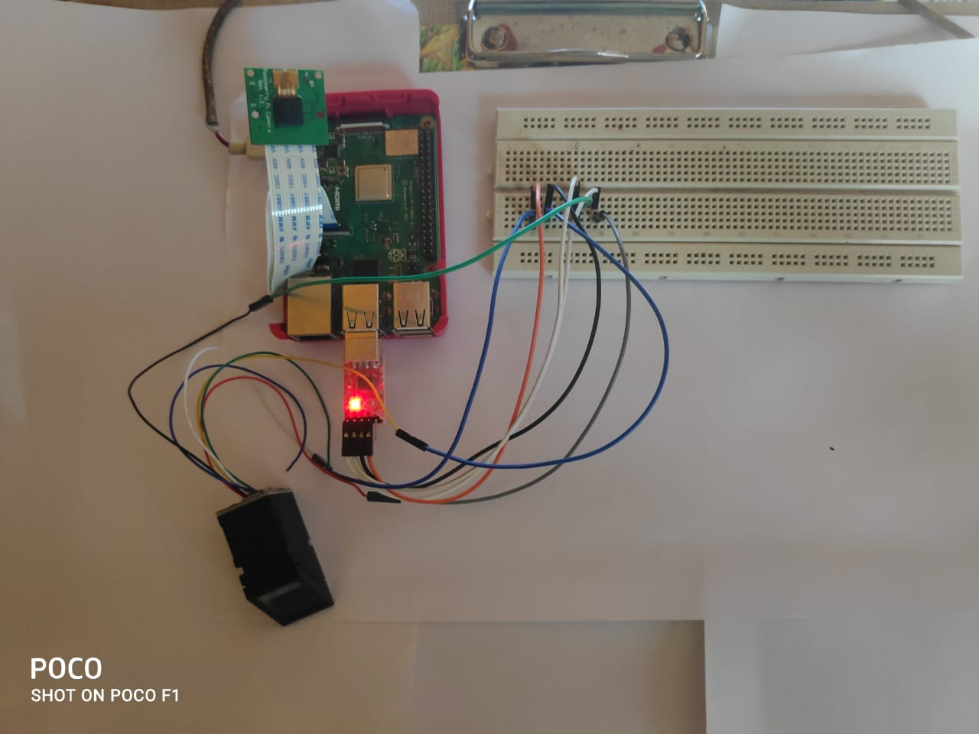
Prototype of project

Slide 8
Conclusion
No fake voting
Everyone can vote
Accuracy
A voter can cast vote only once
It provides chance to avoid invalid votes
It reduces the polling time existing system
It provides easy and accurate counting without any troubles
Provisioning of voting preventing measures
Can identify terrorists, criminals, etc
Prevents voter fraud
Targets shoppers

Slide 9
Thank you

