Slide 1
EMPLOYEE DATA ANALYSIS USING EXCEL
STUDENT NAME : Prema Latha L
REGISTER NO : 2213371036140
DEPARTMENT : B.COM (GENERAL)COMMERCE
COLLEGE : QUAID-E-MILLATH GOVERNMENT COLLEGe

Slide 2

PROJECT TITLE
Employee Performance Analysis using Excel

Slide 3

AGENDA
Problem statement
Project overview
Our solution and proposition
Dataset description
Results and discussion
Conclusion

Slide 4
PROBLEM STATEMENT
This analysis evaluates the performance of employees over the past [time period, e.g., quarter, year] to identify strengths, areas for improvement, and development needs
It include productivity, quality of work, attendance, teamwork, and adherence to company values.
Highlighted the top-performing employees and teams, showcasing exceptional contributions and achievements.
Identified common challenges faced by employees, such as skill gaps, time management, and communication issues.
It also analyse the time management of the employees to level up

Slide 5
PROJECT OVERVIEW
Slide explaining the methods used for performance analysis (e.g., data collection, rating scales, performance metrics)
Where excel data set includes the data of the employee for the analysis
Visual representation (e.g., bar chart, pie chart) to show the distribution of ratings across the organization
Visual representation (e.g., heatmap or grouped bar chart) to show which teams or departments have the highest and lowest performance ratings

Slide 6

OUR SOLUTIONAND ITS VALUE PROPOSITION
Used conditional formatting to highlight the analysing data
Used formula for performance analysis of each employee
Used pivot table (Employee ID, Employee name, department, Role ,Employee Type (e.g., Fulltime, Part-time)Performance Rating
Used graph for data visualization

Slide 7
Dataset Description
Employee master data
Employer ID
Name
Gender
Department
Salary
Start Date FTE
Employee type
Work location
current employee rating
performance level

Slide 8
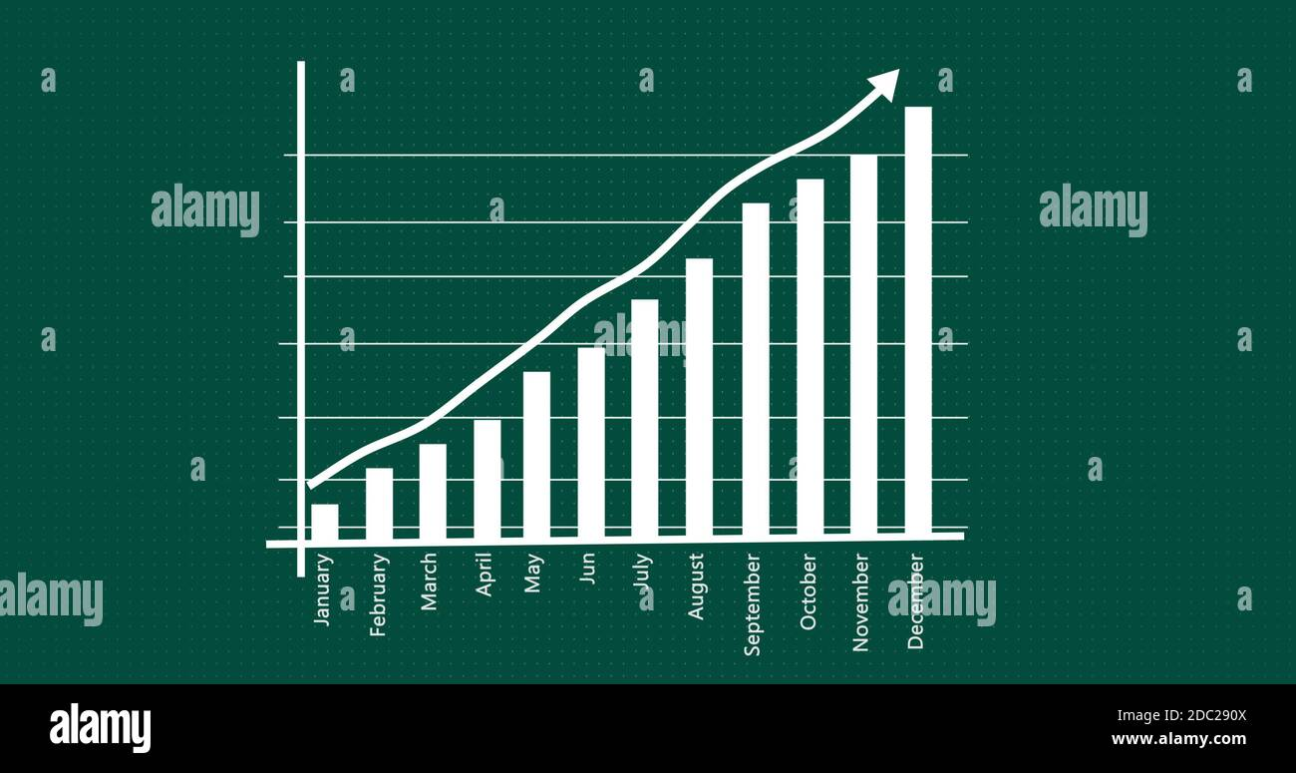
RESULTS

Slide 9
conclusion
The graph illustrates the distribution of employees across various departments by employment type (Fixed Term, Permanent, Temporary). The data highlights that:
Permanent employees dominate most departments, indicating a stable workforce with a focus on longterm employment.
Fixed Term and Temporary roles are significantly fewer across all departments, suggesting limited reliance on short-term or temporary staffing.

