Slide 1
Course Recommendation System
CMPE 256: Individual Project Presentation
Advisor:
Professor Shih Yu Chang
Submission By: Premal Dattatray Samale (012566333)

Slide 2


Background
Nowadays recommendation system is widely used in commercial and educational domain.
In commercial industry recommendation systems are used to increase the sale of items. For example, Amazon.com, Netflix etc. All these recommendation systems are also helpful for users in choosing the right product.
In today's world of digital media, many on-line or in class training courses are available considering need of students. Many students find hard to select the right course, when they have little information about the course and lack of guidance.

Slide 3
Introduction:
In the educational industry, incorporation of effective course recommendation system in university will help students in selecting course and ultimately improving student’s success rate and reducing stress.
In this paper, solution is purposed to build intelligent course recommendation system using collaborative filtering methodology along with student’s grade predictions.
Collaborative filtering recommendation algorithm suggests courses based on student interest and major.
Additionally, similarity between students is evaluated based on historical preferences of student,using pearson correlation.

Slide 4
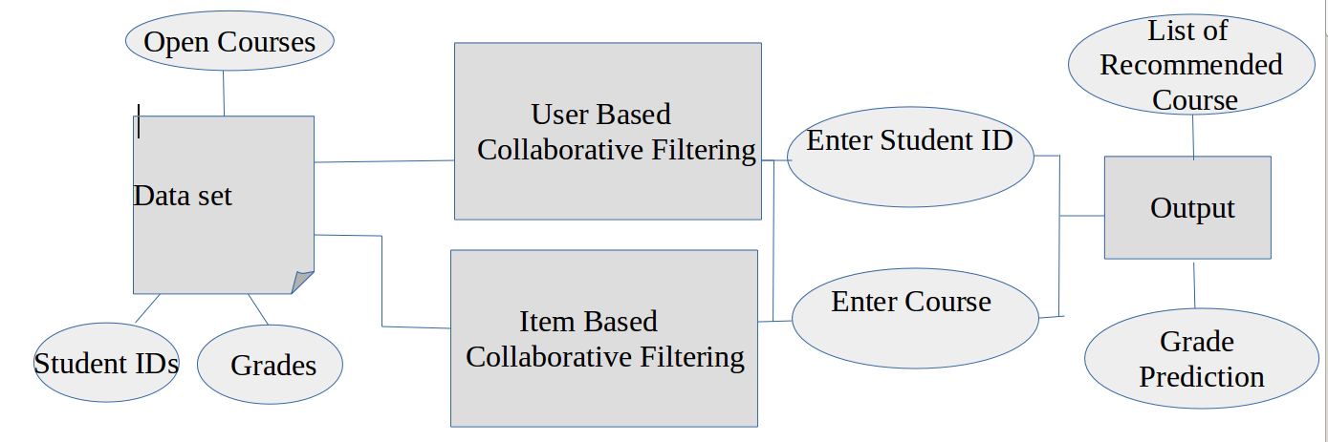
System Design

Slide 5
Methods:
There are multiple ways of implementation using collaborative filtering.
In this paper user based and item based collaborative filtering approach is used to recommend courses.
In user-based filtering algorithm, computed similarity between two students based on their earlier choices of courses. Then for suggesting new course, algorithms check into courses which user similar to target user preferred previously.
In item based filtering algorithm similarity between two courses are computed. And based on similarity score similar courses are recommended to students.
For example, consider the real-life scenario where junior students take guidance of senior students of the same major to select courses.

Slide 6
Data Collection:
First challenge in building intelligent course recommendation system is to collect proper data.
Due to privacy reasons students’ actual grades are not disclosed. Therefore, data is simulated to make data similar to real data.
Initially implementation is performed on 30 courses and 50 students. Data is generated and stored in excel sheet and weight for each course is given based on random function and grades between 1 to 10 range.
StudentIds | CourseID1(cmpe 256) | CourseID2 (cmpe 257) | CourseID3 (cmpe 255)
1 | 4 | 3 | 2
2 | 10 | 2 | 5

Slide 7
Experiments-User Based Filtering
First compute the similarity between student A and other students using pearson correlation.
Then based on similarity score, select list of students who have high similarity score.
After that, compute grade of student A for course selected by student A. Predicted grade is weighted average grades of other similar students.

Slide 8
Experiments-Item Based Filtering
In item-based collaborative filtering, first, similarities between the courses are calculated. Then from the set of courses previously taken (score) by the target user, k courses most similar to the target course are selected.
For computing the prediction for the target course, weighted average is taken of the target student’s scores on the k similar courses earlier selected.

Slide 9
System Evaluation
system evaluation can be performed by external user. User can search course and recommendation are provided to user based on user’s interest. User can provide rating to recommendation to evaluate weather provided suggestions are satisfying or not.

Slide 10
Results
Below is the screenshot of output. System ask student to enter the roll no and then recommended course ids are displayed to students.
Then system ask student to enter course id to get to know grade prediction. Then system evaluate grade based on similar other students’ grades.

Slide 11
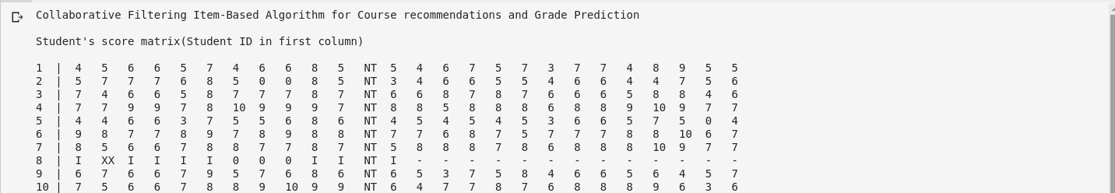
Output Screenshots-Item Based Filtering

Slide 12
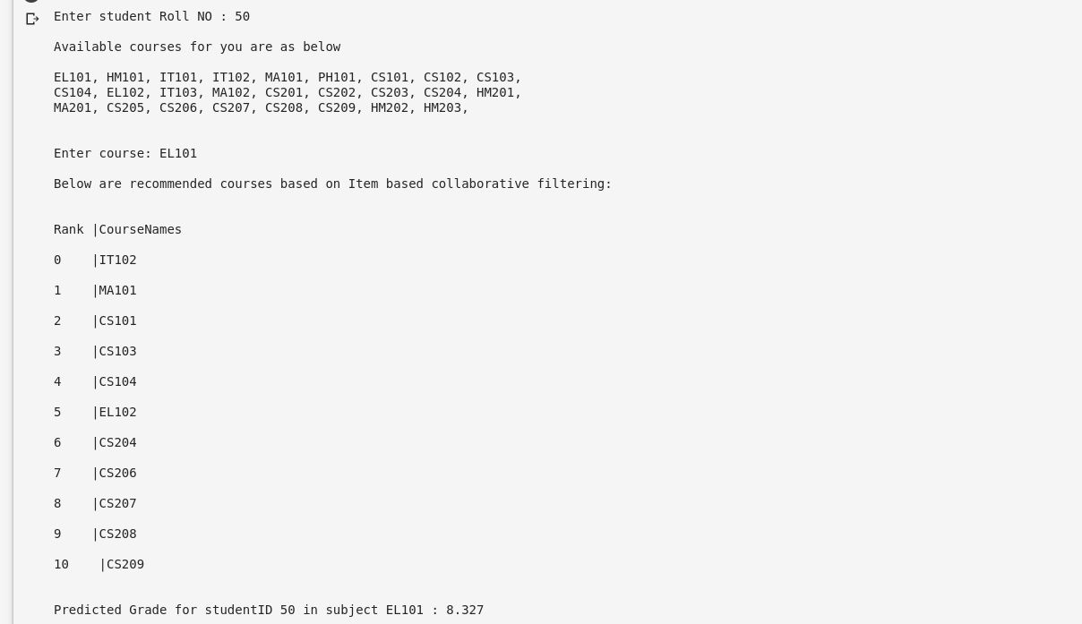
Output Screenshots-Item Based Filtering

Slide 13
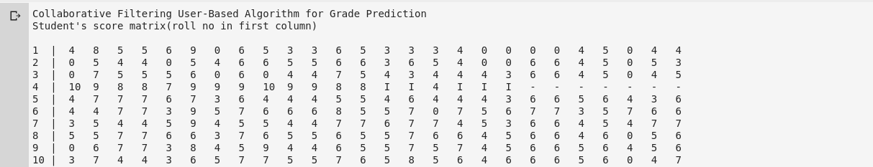
Output Screenshots-User Based Filtering

Slide 14
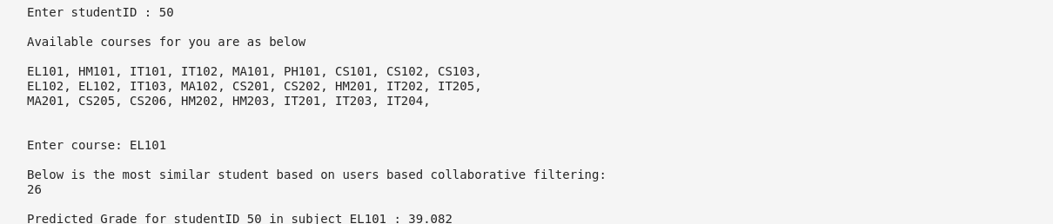
Output Screenshots-User Based Filtering

Slide 15
Conclusion
In conclusion, course recommendation and grade prediction are performed by using user based and item based collaborative filtering to suggest courses to students. According to experimental results user-based filtering gives better results than item-based filtering. It is also observed that collaborative filtering is best to predict the grades of courses. In future few other methodologies can be combine with collaborative to improve the accuracy of results.
Below is the link of GitHub repository of project which includes code and documents.
GitHub Repository: https://github.com/PremalSamale/Course-Recommendation-System

Slide 16
References:
[1] Al-Badarenah, A., & Alsakran, J. (2016). An automated recommender system for course selection.
International Journal of Advanced Computer Science and Applications, 7(3), 1166-1175.
[2] Bozyiğit, A., Bozyiğit, F., Kilinç, D., & Nasiboğlu, E. (2018, September). Collaborative Filtering based
Course Recommender using OWA operators. In 2018 International Symposium on Computers in Education
(SIIE) (pp. 1-5). IEEE.
[3] Ma, H., Wang, X., Hou, J., & Lu, Y. (2017, August). Course recommendation based on semantic
similarity analysis. In 2017 3rd IEEE International Conference on Control Science and Systems
Engineering (ICCSSE) (pp. 638-641). IEEE.

Slide 17
References:
[4] Huang, C. Y., Chen, R. C., & Chen, L. S. (2013, July). Course-recommendation system based on
ontology. In 2013 International Conference on Machine Learning and Cybernetics (Vol. 3, pp. 1168-1173).
IEEE.
[5] O’Mahony, M. P., & Smyth, B. (2007). A recommender system for on-line course enrolment: an initial
study.
[6]https://www.researchgate.net/post/Can_someone_differentiate_between_Cosine_Adjusted_cosine_and
_Pearson_correlation_similarity_measuring_techniques
[7] https://towardsdatascience.com/how-to-build-a-simple-recommender-system-in-python-375093c3fb7d
[8] https://brenocon.com/blog/2012/03/cosine-similarity-pearson-correlation-and-ols-coefficients/

Slide 18
THANK YOU

