Slide 1
Building Intelligent AI Agents: A Hands-on Journey from Deep Learning to Agentic AI

Slide 2
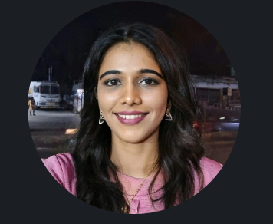
WHO AM I?
LinkedIn: https://www.linkedin.com/in/latha-t-k-b21018128/
Data Science ,AIML
Data Analysis ,SQL,Pyspark
Data Visualization ,PowerBI,Tableau
Natural Language Processing (NLP)
Computer Vision
Generative AI,Prompt Engineering
BigData and Data Engineering

Slide 3
Agenda
Day1 :Introduction to ML
Day 2: Deep learning and nlp
Day 3: LLm and how its useful for agents
Day 4:building agents
Day 5:capstone project

Slide 4

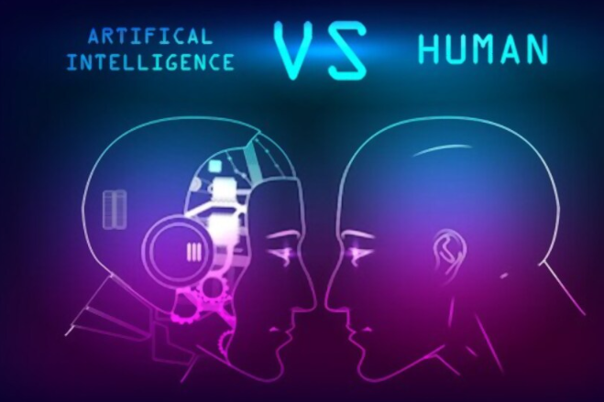


Slide 5
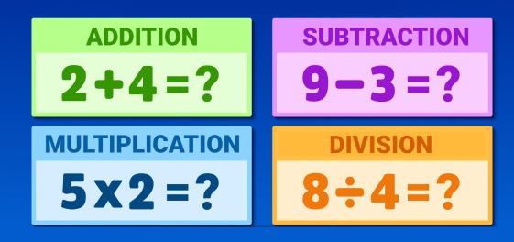

Slide 6
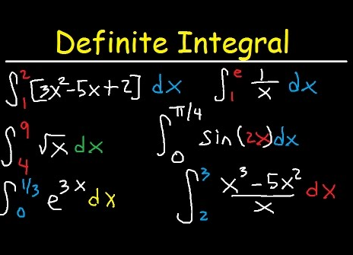

Slide 7
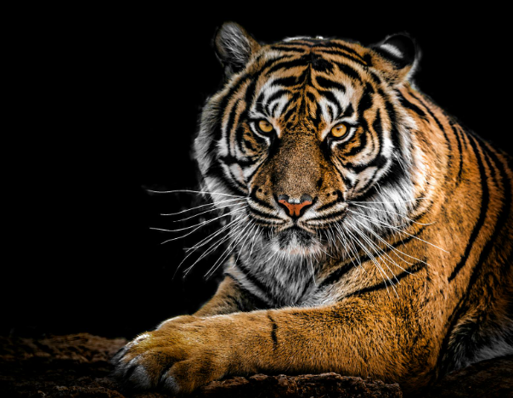

Slide 8
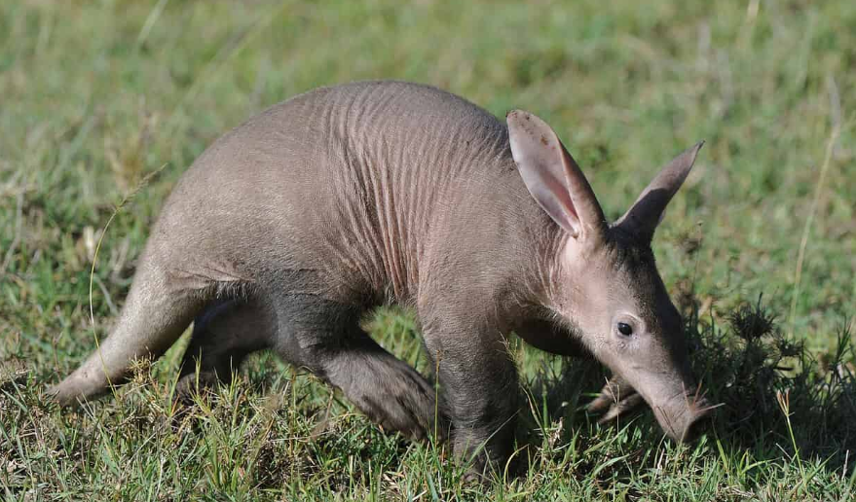

Slide 9


Slide 10


Slide 11
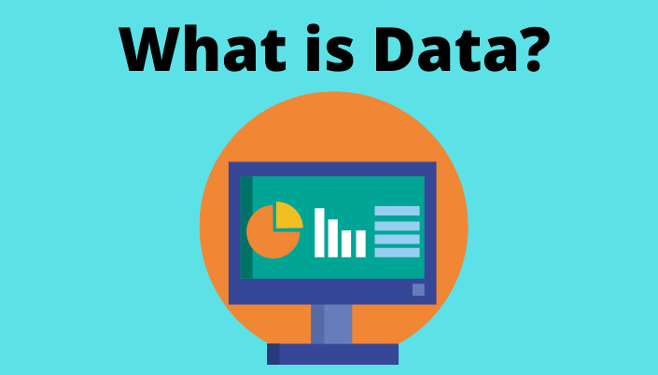

Slide 12
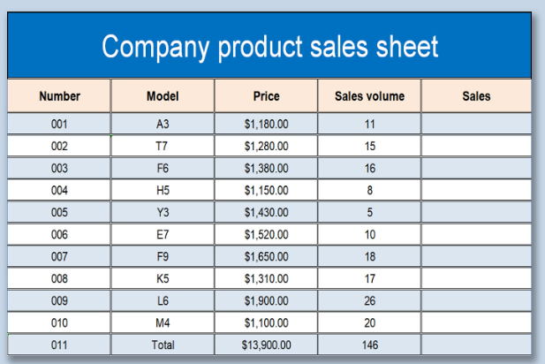
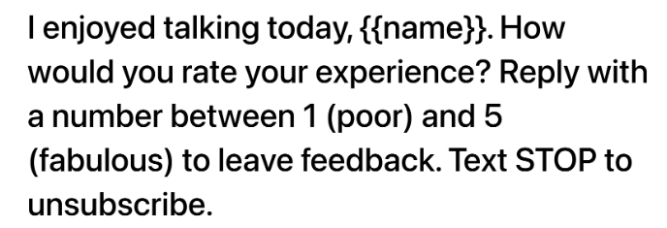

Slide 13
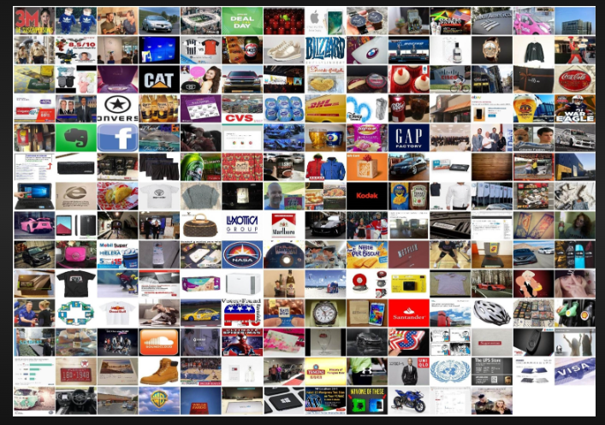
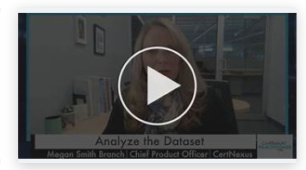
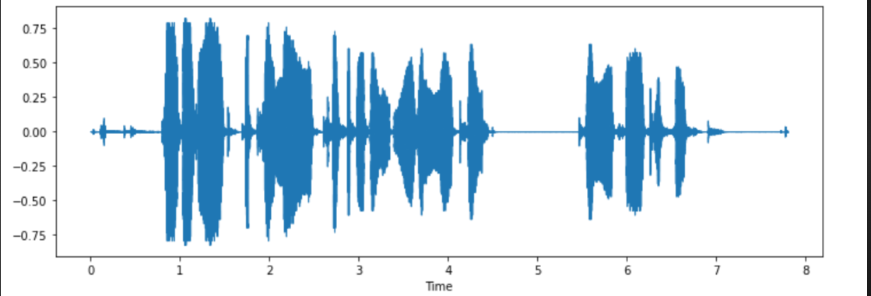

Slide 14






Slide 15
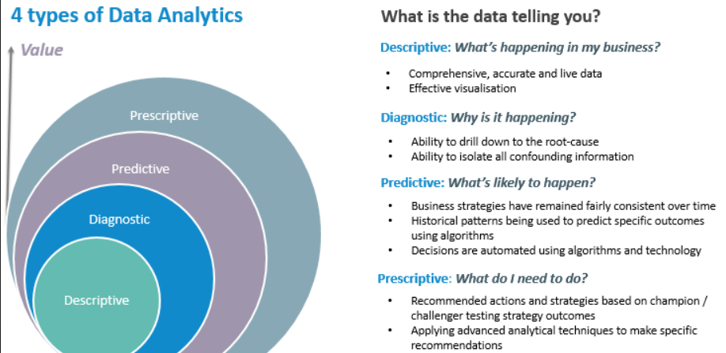

Slide 16
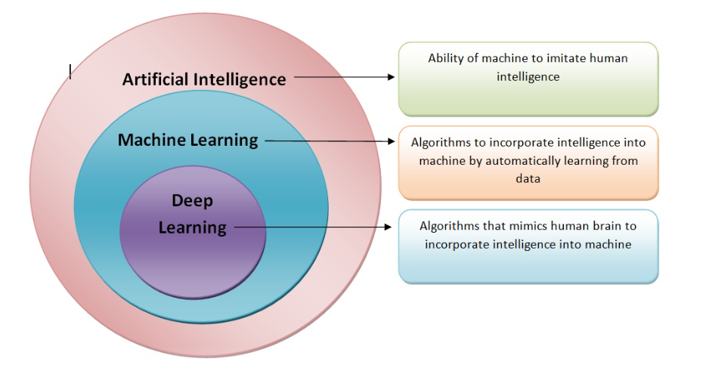

Slide 17
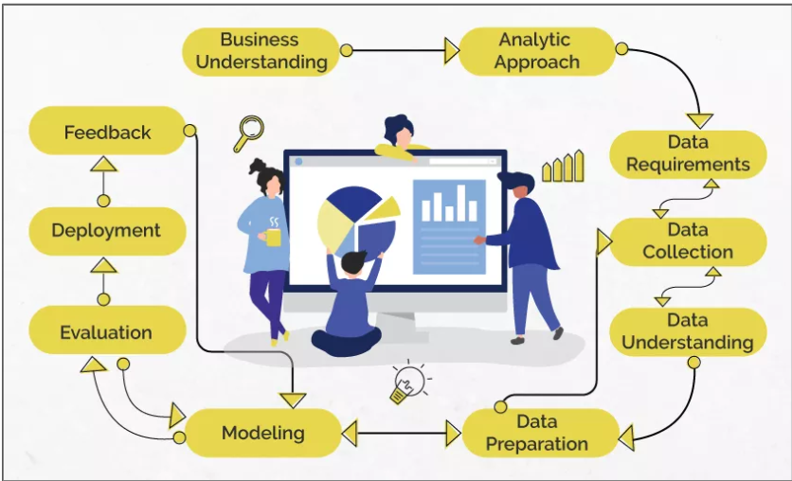
Data Science/Machine Learning

Slide 18
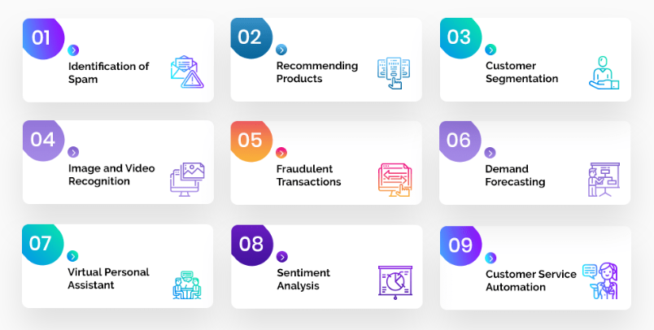
Problem Statement

Slide 19
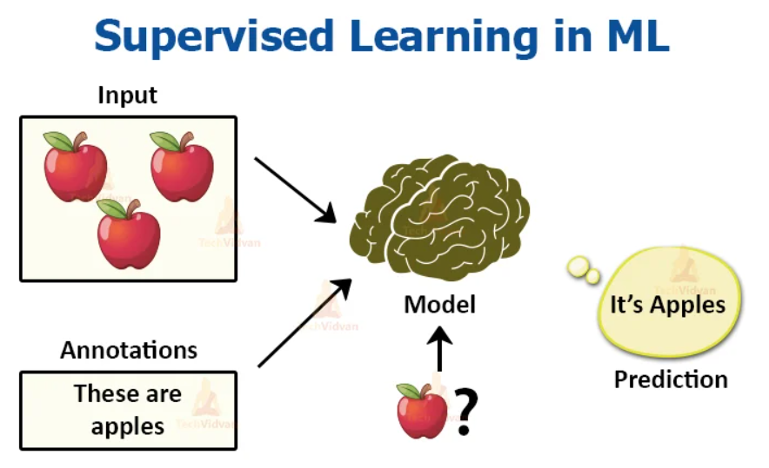
Analytic Approach

Slide 20
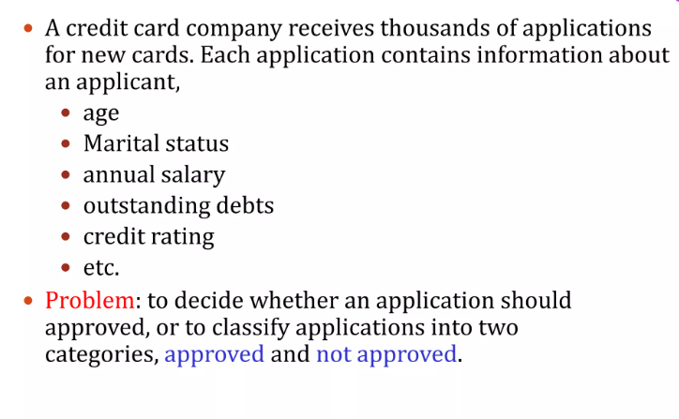
Supervised Learning

Slide 21
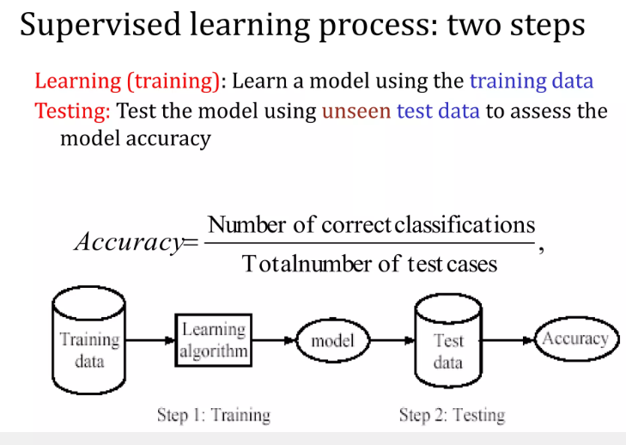

Slide 22
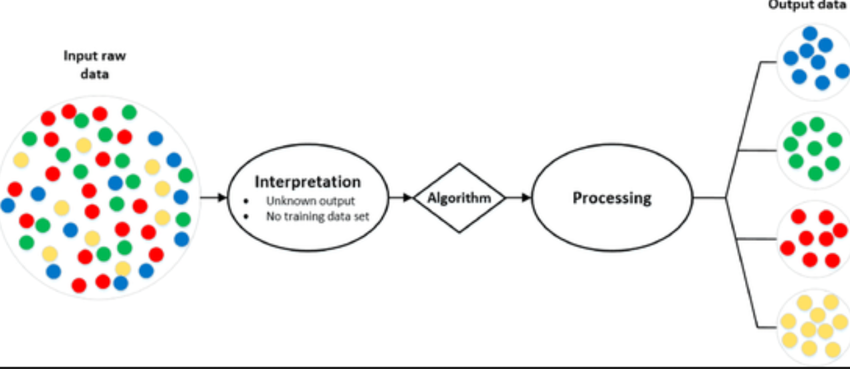
Analytic Approach

Slide 23
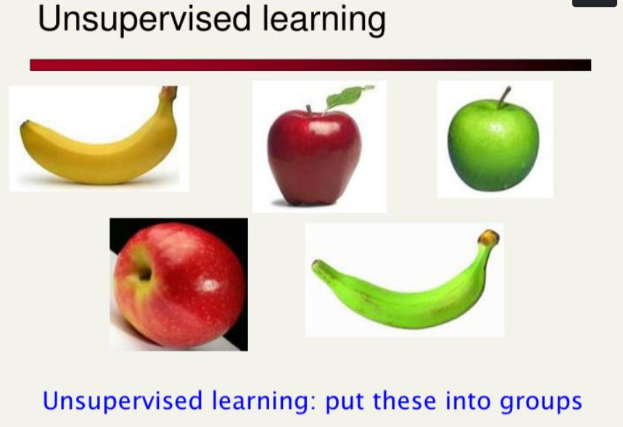

Slide 24
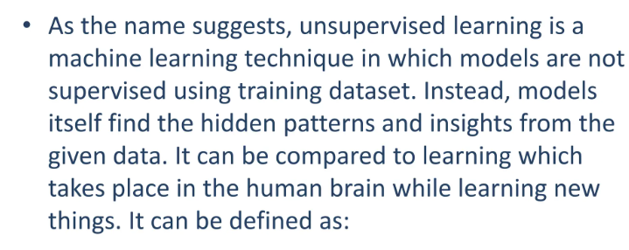

Slide 25


Slide 26
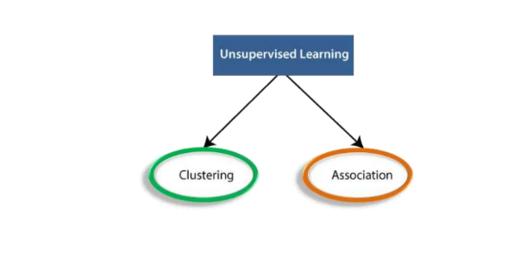

Slide 27
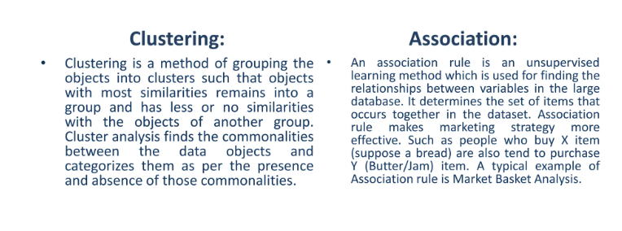

Slide 28


Slide 29
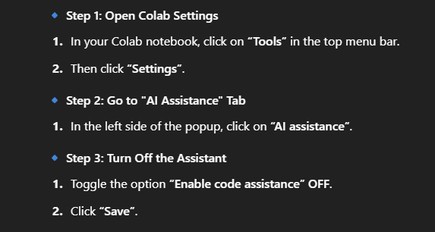

Slide 30


Slide 31
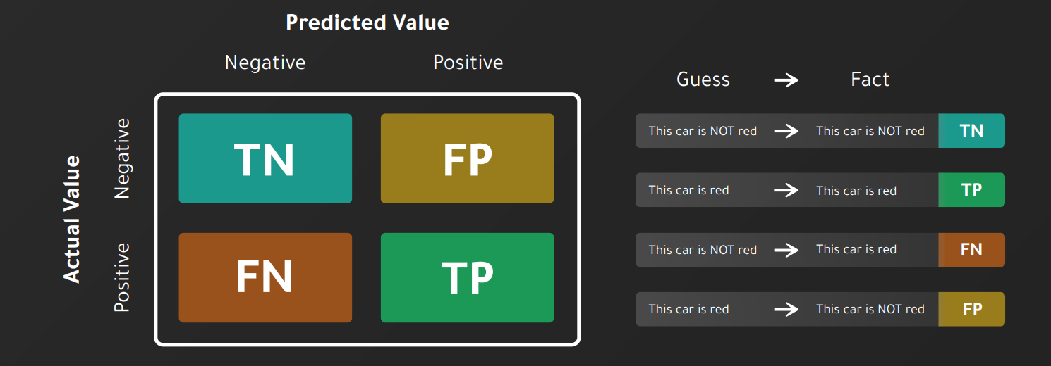

Slide 32
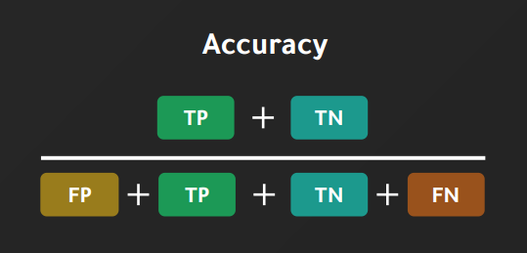

Slide 33
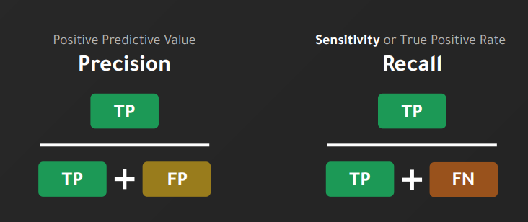

Slide 34
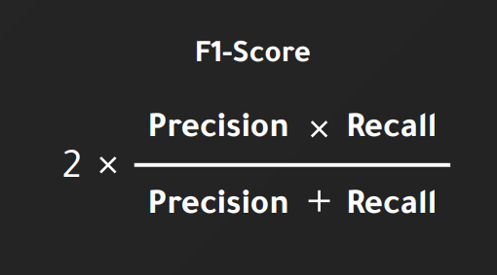

Slide 35
Questions ????

Slide 36
Day 1_Part2
Premalatha T

Slide 37
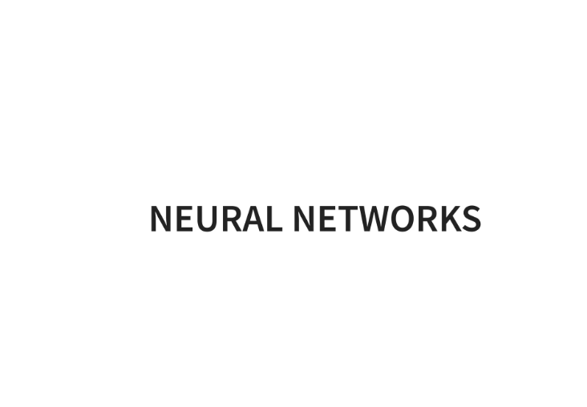

Slide 38
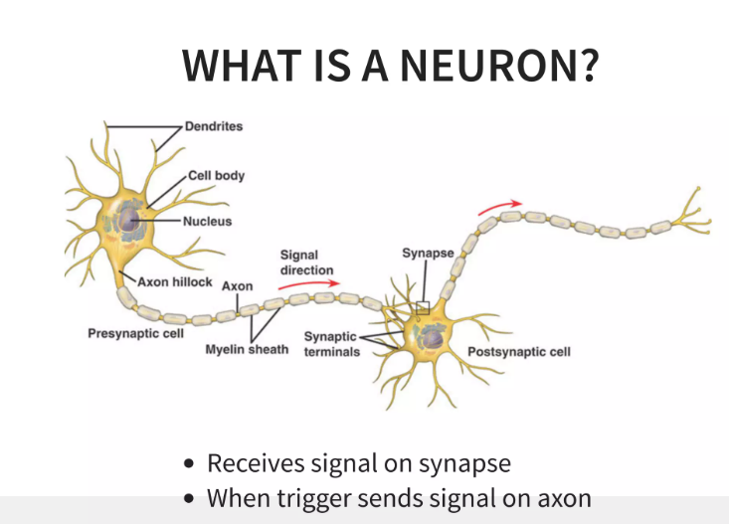

Slide 39
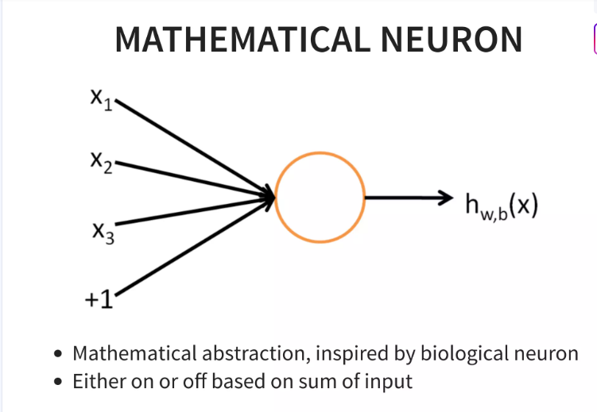

Slide 40
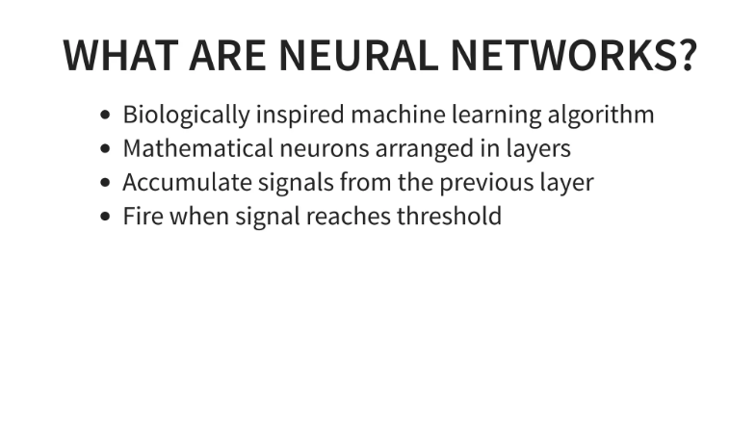

Slide 41
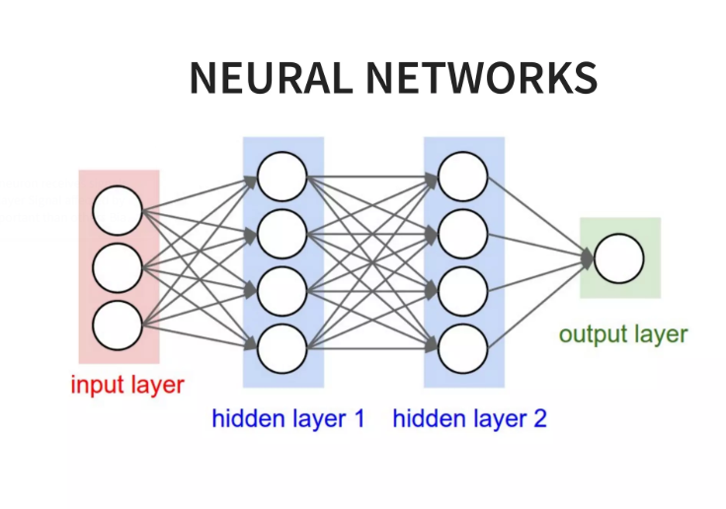

Slide 42
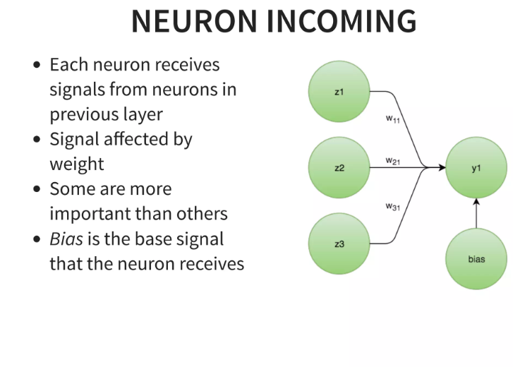

Slide 43
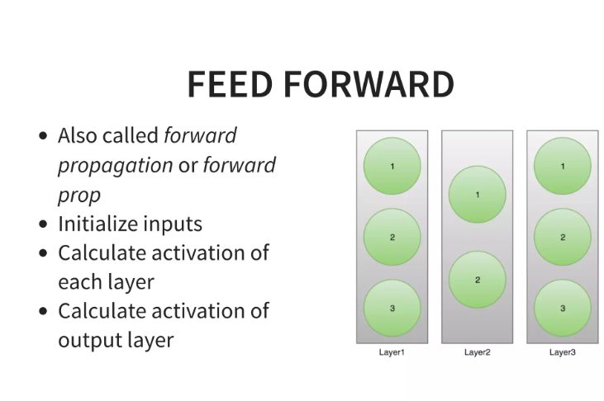

Slide 44
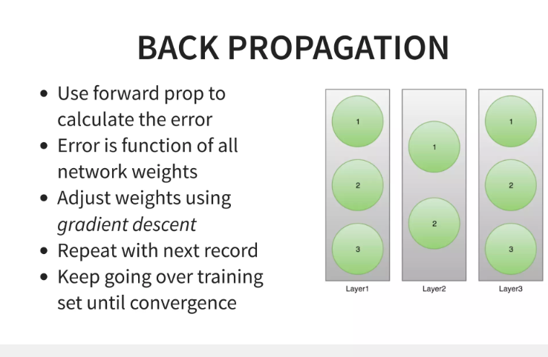

Slide 45
