Slide 1
AI and Agents
CS 171/271
(Chapters 1 and 2)
Some text and images in these slides were drawn from
Russel & Norvig’s published material

Slide 2
What is Artificial Intelligence?
Definitions of AI vary
Artificial Intelligence is the study of systems that
think like humans
think rationally
act like humans
act rationally

Slide 3
Systems Acting like Humans
Turing test: test for intelligent behavior
  Interrogator writes questions and receives answers
  System providing the answers passes the test if interrogator cannot tell whether the answers come from a person or not
Necessary components of such a system form major AI sub-disciplines:
  Natural language, knowledge representation, automated reasoning, machine learning

Slide 4
Systems Thinking like Humans
Formulate a theory of mind/brain
Express the theory in a computer program
Two Approaches
  Cognitive Science and Psychology (testing/ predicting responses of human subjects)
  Cognitive Neuroscience (observing neurological data)

Slide 5
Systems Thinking Rationally
“Rational” -> ideal intelligence
  (contrast with human intelligence)
Rational thinking governed by precise “laws of thought”
  syllogisms
  notation and logic
Systems (in theory) can solve problems using such laws

Slide 6
Systems Acting Rationally
Building systems that carry out actions to achieve the best outcome
Rational behavior
May or may not involve rational thinking
  i.e., consider reflex actions
This is the definition we will adopt

Slide 7
Intelligent Agents
Agent: anything that perceives and acts on its environment
AI: study of rational agents
A rational agent carries out an action with the best outcome after considering past and current percepts

Slide 8
Foundations of AI
Philosophy: logic, mind, knowledge
Mathematics: proof, computability, probability
Economics: maximizing payoffs
Neuroscience: brain and neurons
Psychology: thought, perception, action
Control Theory: stable feedback systems
Linguistics: knowledge representation, syntax

Slide 9
Brief History of AI
1943: McCulloch & Pitts: Boolean circuit model of brain
1950: Turing's “Computing Machinery and Intelligence”
1952—69: Look, Ma, no hands!
1950s: Early AI programs, including Samuel's checkers program, Newell & Simon's Logic Theorist, Gelernter's Geometry Engine
1956: Dartmouth meeting: “Artificial Intelligence” adopted

Slide 10
Brief History of AI
1965: Robinson's complete algorithm for logical reasoning
1966—74: AI discovers computational complexity; Neural network research almost disappears
1969—79: Early development of knowledge-based systems
1980—88: Expert systems industry booms
1988—93: Expert systems industry busts: `”AI Winter”

Slide 11
Brief History of AI
1985—95: Neural networks return to popularity
1988— Resurgence of probability; general increase in technical depth, “Nouvelle AI”: ALife, GAs, soft computing
1995— Agents…

Slide 12
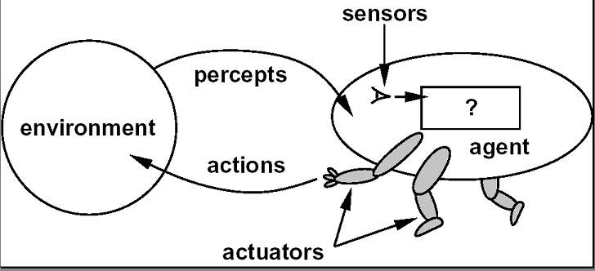
Back to Agents

Slide 13
Agent Function
a = F(p)
  where p is the current percept, a is the action carried out, and F is the agent function
F maps percepts to actions
F: P → A
  where P is the set of all percepts, and A is the set of all actions
In general, an action may depend on all percepts observed so far, not just the current percept, so…

Slide 14
Agent Function Refined
a_{k} = F(p₀ p₁ p₂ …p_{k})
  where p₀ p₁ p₂ …p_{k} is the sequence of percepts observed to date, a_{k} is the resulting action carried out
F now maps percept sequences to actions
  F: P* → A

Slide 15
Structure of Agents
Agent = architecture + program
architecture
  device with sensors and actuators
  e.g., A robotic car, a camera, a PC, …
program
  implements the agent function on the architecture

Slide 16
Specifying the Task Environment
PEAS
Performance Measure: captures agent’s aspiration
Environment: context, restrictions
Actuators: indicates what the agent can carry out
Sensors: indicates what the agent can perceive

Slide 17
Properties of Environments
Fully versus partially observable
Deterministic versus stochastic
Episodic versus sequential
Static versus dynamic
Discrete versus continuous
Single agent versus multiagent

Slide 18
Example: Mini Casino world
Two slot machines
Costs 1 peso to play in a machine
  Takes 10 seconds to play in a machine
Possible pay-offs: 0, 1, 5, 100
Given:
  Amount of money to start with
  Amount of time to play
  Expected payoff for each machine
Objective: end up with as much money as possible

Slide 19
Mini Casino World
PEAS description?
Properties
  Fully or partially observable?
  Deterministic or stochastic?
  Episodic or sequential?
  Static or dynamic?
  Discrete or continuous?
  Single agent or multi-agent?

Slide 20
Types of Agents
Reflex Agent
Reflex Agent with State
Goal-based Agent
Utility-Based Agent
Learning Agent

Slide 21
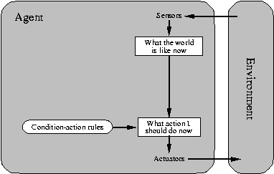
Reflex Agent

Slide 22
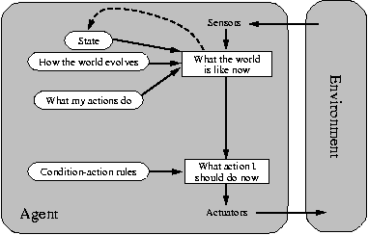
Reflex Agent with State

Slide 23
State Management
Reflex agent with state
  Incorporates a model of the world
  Current state of its world depends on percept history
  Rule to be applied next depends on resulting state
state’ ← next-state( state, percept )
action ← select-action( state’, rules )

Slide 24
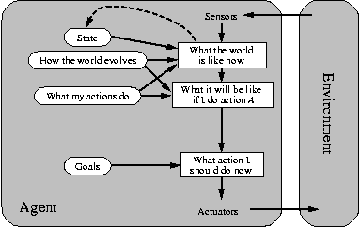
Goal-based Agent

Slide 25
Incorporating Goals
Rules and “foresight”
  Essentially, the agent’s rule set is determined by its goals
  Requires knowledge of future consequences given possible actions
Can also be viewed as an agent with more complex state management
  Goals provide for a more sophisticated
  next-state function

Slide 26
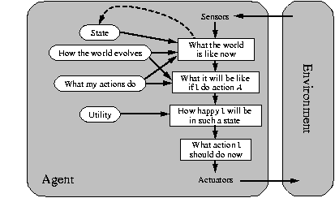
Utility-based Agent

Slide 27
Incorporating Performance
May have multiple action sequences that arrive at a goal
Choose action that provides the best level of “happiness” for the agent
Utility function maps states to a measure
  May include tradeoffs
  May incorporate likelihood measures

Slide 28
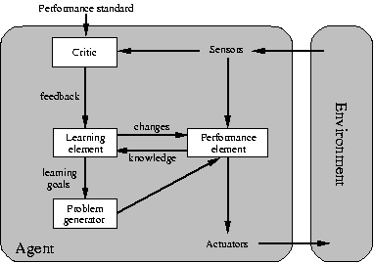
Learning Agent

Slide 29
Incorporating Learning
Can be applied to any of the previous agent types
  Agent <-> Performance Element
Learning Element
  Causes improvements on agent/ performance element
  Uses feedback from critic
  Provides goals to problem generator

Slide 30

Next: Problem Solving
Agents (Chap 3-6)

