Slide 1
SUPERVISED LEARNING
ALGORITHMS

Slide 2
SUPERVISED LEARNING
Supervised learning provides you with a powerful tool to classify and process data using machine language.
With supervised learning you use labeled data, which is a data set that has been classified, to infer a learning algorithm.
The data set is used as the basis for predicting the classification of other unlabeled data through the use of machine learning algorithms.

Slide 3
SUPERVISED LEARNING (cont..)
Techniques used :
Linear Regression
Classification Techniques

Slide 4
CLASSIFICATION TECHNIQUES
The classification techniques focus on predicting a qualitative response by analyzing data and recognizing patterns.
Example: To classify whether or not a credit card transaction is fraudulent.

Slide 5
CLASSIFICATION TECHNIQUES(Cont..)
Classification
algorithms
Logistic regression
KNN
SVM
Naïve baye’s

Slide 6
LOGISTIC REGRESSION
Logistic regression measures the relationship between the categorical dependent variable and one or more independent variables by estimating probabilities using a logistic function, which is the cumulative distribution function of logistic distribution.
It is a parametric model.
Even though the name ‘Regression’ comes up, it is not a regression model, but a classification model.
It uses a logistic function to frame binary output model.
The output of the logistic regression will be a probability (0≤x≤1), and can be used to predict the binary 0 or 1 as the output ( if x<0.5, output= 0, else output=1).

Slide 7
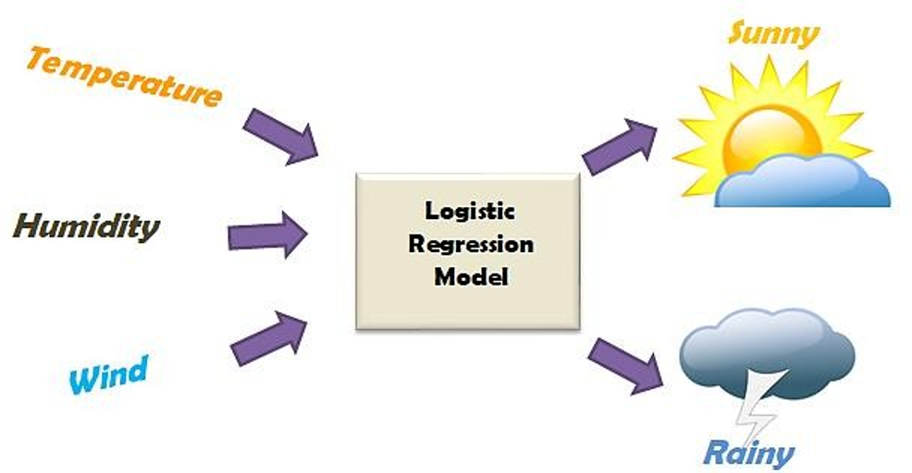
Example:

Slide 8
Why do we go for logistic regression?
To predict an outcome variable that is categorical from predictor variables that are continuous and/or categorical
Used because having a categorical outcome variable violates the assumption of linearity in normal regression
The only “real” limitation for logistic regression is that the outcome variable must be discrete
Logistic regression deals with this problem by using a logarithmic transformation on the outcome variable which allow us to model a nonlinear association in a linear way.

Slide 9
Where do we use logistic regression?
The logistic regression is a predictive analysis.
It is used to describe data.
It explains the relationship between one dependent binary variable and one or more nominal, ordinalinterval or ratio-level independent variables.
Examples:
To predict whether an email is spam (1) or (0).
Whether the tumor is malignant (1) or not (0)

Slide 10
How is it done?
1.Obtain the data set and analyze the input variables and target variables
2.Explore the data(check for the missing values,outliers,imbalances in distri.of data)
3.Visualize the data (using histograms,crosstabs)and interpret the relationship b/w variables
4.Create dummy variable in required cases.
5.Split the training and testing data ,then fit the data in the regression model.
6.Predict the test set results and calculate the accuracy.
7.Compute various metrics like confusion matrix,precision, recall,accuracy.
8.Predict the ROC curve and auc values and compute the accuracy of the model for various threshold values.
9.Compare the accuracy of the model for various threshold values and choose the best model.

Slide 11
When do we go for logistic regression?
We go for logistic regression when your target variable(Y) takes on only two values.
Such a variable is referred to a “binary” or “dichotomous.” “
Dichotomous” basically means two categories such as yes/no, defective/non-defective, success/failure, and so on

Slide 12
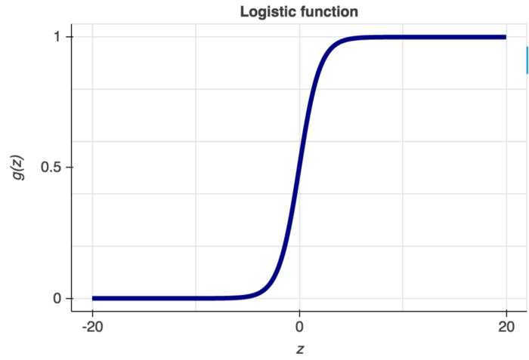
Logistic function:

Slide 13
Pros of Logistic Regression:
It is easier to implement, interpret, and very efficient to train.
It gives good accuracy for many simple data sets and it performs well when the dataset is linearly separable.
It can easily extend to multiple classes(multinomial regression).
It not only provides a measure of how appropriate a predictor(coefficient size)is, but also its direction of association (positive or negative)

Slide 14
Cons of Logistic Regression:
The major limitation of Logistic Regression is the assumption of linearity between the dependent variable and the independent variables.
Non-linear problems can’t be solved with logistic regression because it has a linear decision surface,Linearly separable data is rarely found in real-world scenarios.
Logistic Regression requires average or no multicollinearity between independent variables.

Slide 15
Naive Baye’s algorithm:
It is a classification technique based on Bayes’ Theorem with an assumption of independence among predictors.
It is a parametric model.
It assumes that the presence of a particular feature in a class is unrelated to the presence of any other feature.
Example, a fruit may be considered to be an apple if it is red, round, and about 3 inches in diameter. Even if these features depend on each other or upon the existence of the other features, all of these properties independently contribute to the probability that this fruit is an apple and that is why it is known as ‘Naive’.

Slide 16
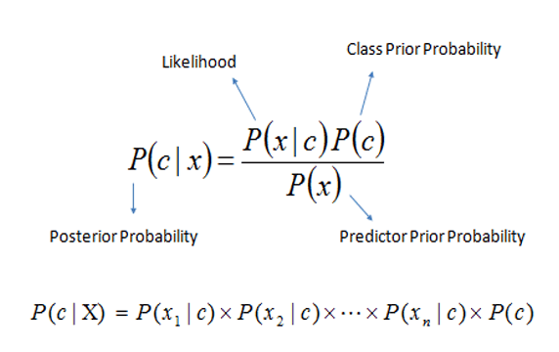
Baye’s Theorem:

Slide 17
Why do we go for naive baye’s?
Naive Baye’s model is easy to build and particularly useful for very large data sets.
Along with simplicity, Naive Baye’s is known to outperform even highly sophisticated classification methods.
Baye’s rule can be used to answer the probabilistic queries conditioned on one piece of evidence.

Slide 18
Where do we use naive bayes?
Real time Prediction: Naive Bayes is an eager learning classifier thus, it could be used for making predictions in real time.
This algorithm is also well known for multi class prediction feature. Here we can predict the probability of multiple classes of target variable.
Text classification,Spam Filtering,Sentiment Analysis.
Recommendation System: Naive Bayes Classifier and Collaborative Filtering together builds a Recommendation System that uses machine learning and data mining techniques to filter unseen information and predict whether a user would like a given resource or not.

Slide 19
How is it done?
1.Obtain the data set and analyze the input variables and target variables
2.Explore the data(check for the missing values,outliers,imbalances in distri.of data)
3.Visualize the data (using histograms,crosstabs)and interpret the relationship b/w variables
4.Split the training and testing data ,then fit the data in the regression model.
6.Perform prediction on test set features.
7.Evaluate the model based on accuracy obtained.
5.Generate the model

Slide 20
When do we use naive baye’s?
Naïve Baye’s is a probabilistic machine learning algorithm based on the Baye’s Theorem, used in a wide variety of classification tasks.
The Naive Baye’s method characterizes the problem, so it can be used for making predictions about unseen data.

Slide 21
Types of naive baye’s:
Standard Naive Baye’s :supports categorical features.
Gaussian Naive Baye’s :supports continuously valued features.
Bernoulli Naive Baye’s: supports independent booleans features.

Slide 22
Pros of Naïve Baye’s:
Naives Baye’s is a stable algorithm. A small change in the the training data will not make a big change in the model.
It is a highly extensible algorithm which is very fast.
It can be used for both binary as well as multiclass classification.
It can be easily trained on small datasets and can be used for large volumes of data as well.
It performs even on noisy data.

Slide 23
Cons of Naïve Baye’s:
Limitation of Naive Baye’s is the assumption of independent predictors. In real life, it is almost impossible that we get a set of predictors which are completely independent.
naive Baye’s is also known as a bad estimator, so the probability outputs from predict_proba are not to be taken too seriously.
If a categorical variable has a category in the test dataset, which was not observed in training dataset, then the model will assign a 0 (zero) probability and will be unable to make a prediction

Slide 24
K-Nearest Neighbor(KNN):
KNN is a non-parametric, lazy learning algorithm.
Its purpose is to use a database in which the data points are separated into several classes to predict the classification of a new sample point.
This K nearest neighbor will be identified by using the distance measure like euclidean distance or manhattan distance or minkowski distance.

Slide 25
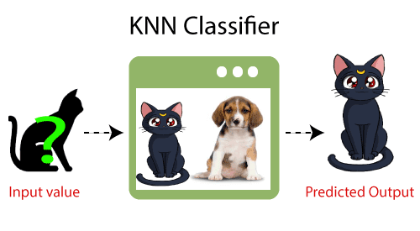
Example:

Slide 26
Where do we use KNN?
Knn is used in economic forecasting.
It is predominantly used in data compression and genetics.
Many new transaction-scrutinizing software applications use KNN algorithms to analyze register data and spot unusual patterns that indicate suspicious activity.
It plays a significant role in forecasting stock market.

Slide 27
Why do we go for KNN?
It makes no assumptions.
It immediately adapts to changes.
It can be used for classification & regression tasks.
Only one hyper parameter to be set(k).

Slide 28
When do we go for KNN?
We have properly labeled data. For example, if we are predicting someone is having diabetes or not the final label can be 1 or 0. It cannot be NaN or -1.
When we have a small dataset.
KNN algorithm can be used for both regression and classification.
KNN is still the better choice for applications where predictions are not requested frequently but where accuracy is important.

Slide 29
How is it done?
1.Obtain the data set and analyze the input variables and target variables
2.Check the data and calculate the data summary
3.Visualize the data (using histograms,crosstabs)and interpret the relationship b/w variables
4.Split the training and testing data
6.Perform prediction on test set features for KNN and calculate the accuracy.
7.Obtain accuracy for various K values.
5.Calculate the distance (Euclidean ,Manhattan,minchowski)
8.Evaluate the model based on accuracy obtained.

Slide 30
Pros of KNN:
It is simple to implement.
It is robust to the noisy training data
It can be more effective if the training data is large.
Can be applied to both classification and regression
Works easily on multi-class problems

Slide 31
Cons of KNN:
Always needs to determine the value of K which may be complex some time.
The computation cost is high because of calculating the distance between the data points for all the training samples.
Memory Intensive / Computationally expensive.
Sensitive to scale of data.
Fails to work well on rare event (skewed) target variable.
Model struggles when there are high number of independent variables.

Slide 32
Support Vector Machine(SVM):
Support-vector machine constructs a hyperplane or set of hyperplanes in a high- or infinite-dimensional space, which can be used for classification, regression.
It is a parametric model with RBF kernel as an exception.
Hyper planes are decision boundaries that help classify the data points.
In the SVM algorithm, we plot each data item as a point in n-dimensional space (where n is number of features you have) with the value of each feature being the value of a particular coordinate. Then, we perform classification by finding the hyper-plane that differentiates the two classes very well (look at the below snapshot).

Slide 33
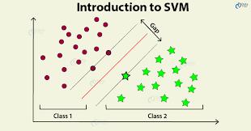
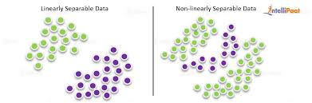
Examples:
LINEARLY SEPARABLE DATA
NON LINEARLY
SEPARABLE DATA
SVM
KERNELTRICKS:The kernels are mapping functions to map the data from one space to a new space which is simpler for SVM to dealt with.
>>Linear:used when the data is Linearly separable, that is, it can be separated using a single Line.
>>Poly: used in SVMs that represents the similarity of samples in a feature space over polynomials of the original variables, allowing learning of non-linear models.
>>Radial basis function: used in the cases of non linearly separable data.

Slide 34
Where do we use?
SVMs are helpful in text and hypertext categorization.
Classification of images can also be performed using SVMs. Experimental results show that SVMs achieve significantly higher search accuracy than traditional query refinement schemes.
Classification of satellite data like SAR data using supervised SVM.
Hand-written characters can be recognized using SVM.
The SVM algorithm has been widely applied in the biological and other sciences. They have been used to classify proteins and in Posthoc interpretation.

Slide 35
When do we go for SVM?
SVMs are very good when you have a huge number of features. For example for text classification in a bag of words model.
SVMs with non-linear kernels perform quite well in most cases.
SVMs are also particularly useful when you want ordinal classification (ranking), they are widely used in "learning to rank" algorithms.

Slide 36
Where do use SVM?
Handwriting recognition – We use SVMs to recognize handwritten characters.
Face recognition.
Classification of images.
Text and hypertext categorization.
Generalized predictive control(GPC).

Slide 37
How is it done?
1.Obtain the data set and analyze the input variables and target variables
2.Check the data for missing values and calculate the data summary.
3.Visualize the data (using histograms,crosstabs)and interpret the relationship b/w variables
4.Split the training and testing data
6.Predict the accuracy of the model based on kernel values.
5.Fit in the svm model
7.Evaluate the model based on accuracy obtained.

Slide 38
Pros of SVM:
Effective on datasets with multiple features, like financial or medical data.
Effective in cases where number of features is greater than the number of data points.
Uses a subset of training points in the decision function called support vectors which makes it memory efficient.
Different kernel functions can be specified for the decision function. You can use common kernels, but it's also possible to specify custom kernels.

Slide 39
Cons of SVM:
If the number of features is a lot bigger than the number of data points, avoiding over-fitting when choosing kernel functions and regularization term is crucial.
SVMs don't directly provide probability estimates. Those are calculated using an expensive five-fold cross-validation.

