Slide 1
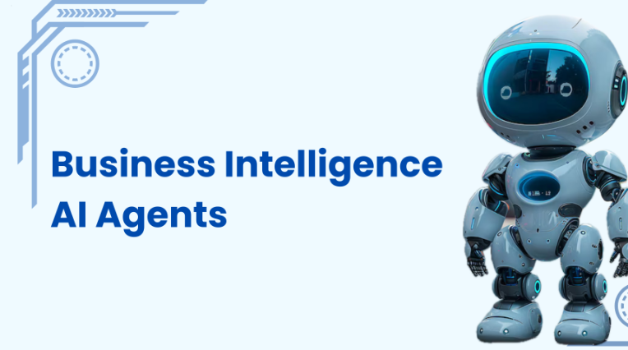
Premalatha T

Slide 2
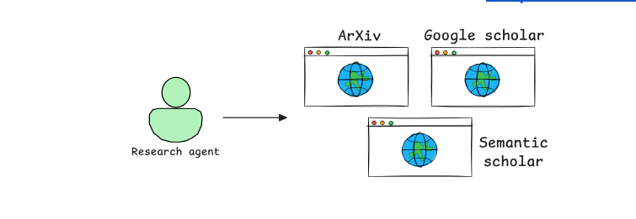


Slide 3



Slide 4
What is an AI Agent?
AI Agents are autonomous systems that can reason, plan, act, and self-correct.
They can search, filter, summarize, and format results with minimal human input.
Reason
Plan
Act
Self-
Correct

Slide 5
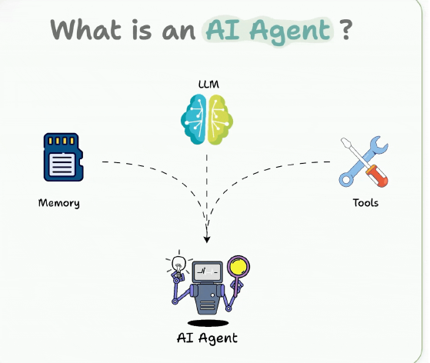

Slide 6



Agent vs LLM vs RAG
LLM = Brain (knowledge and reasoning).
RAG = Fresh knowledge source (retrieval + generation).
Agent = Decision-maker (uses LLM + tools + planning).

Slide 7
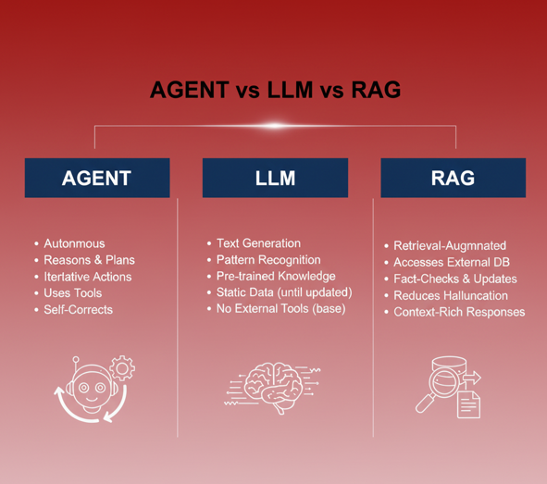

Slide 8
Feature | Large Language Model (LLM) | Retrieval-Augmented Generation (RAG) | AI Agent
Core Function | Generates human-like text based on its static training data. | Augments an LLM's response by retrieving external, current data before generation. | An autonomous system that uses an LLM/RAG as its "brain" to plan, act, and self-correct toward a goal.
Knowledge Source | Internal (what it was trained on). | Internal + External (documents, databases, etc.). | Internal + External + Real-time Tools/APIs.
Action & Autonomy | Minimal (Generate text only). | Passive (Retrieves data, still needs a prompt/user). | High (Reasons, plans, executes multi-step tasks).
Primary Goal | Answer, complete, or create text. | Provide grounded, up-to-date, and cited answers. | Achieve a complex, defined objective.
Relationship | The foundation of the other two. | An enhancement for the LLM. | An orchestrator that often uses LLM and RAG as tools.

Slide 9
Building Blocks of AI Agents
Role-playing: Define clear roles (e.g., Product Manager, Data Analyst, Auditor).
Focus/Tasks: Keep scope narrow to reduce hallucinations.
Tools: Use APIs, databases, code execution when needed.
Cooperation: Multi-agent collaboration improves accuracy.
Memory: Short-term, long-term, entity-based memory.

Slide 10
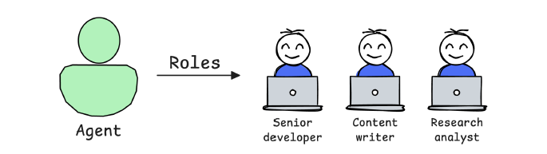
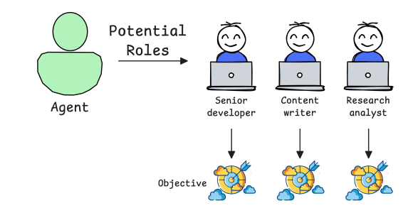

Slide 11
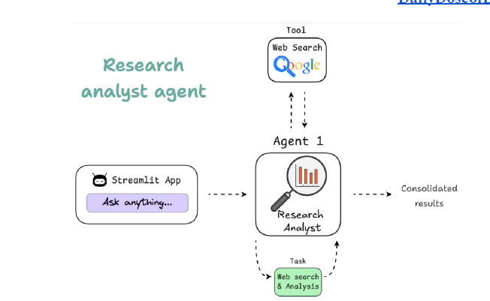

Slide 12
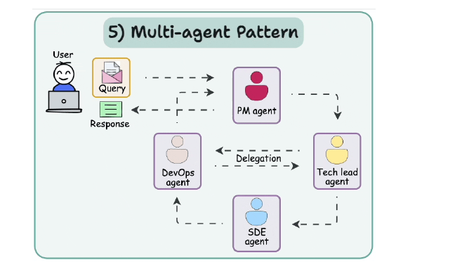

Slide 13
Agentic AI Design Patterns
Reflection: Self-evaluate outputs.
Tool Use: Gather extra info via APIs, scripts, DBs.
ReAct: Loop of Thought → Action → Observation.
Planning: Break tasks into roadmap & objectives.
Multi-Agent: Specialized agents collaborating.

Slide 14
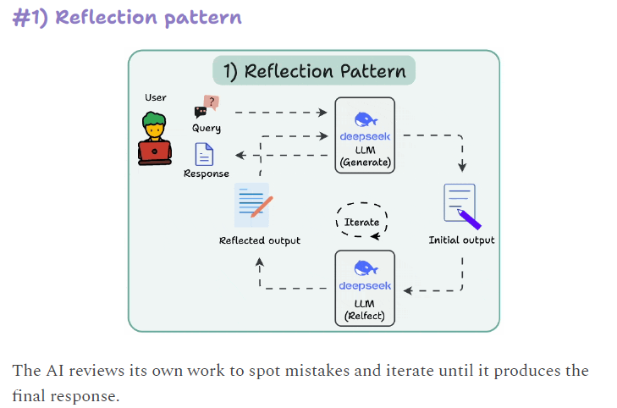

Slide 15
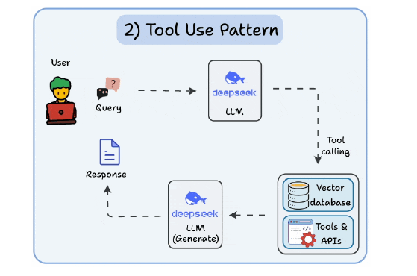

Slide 16
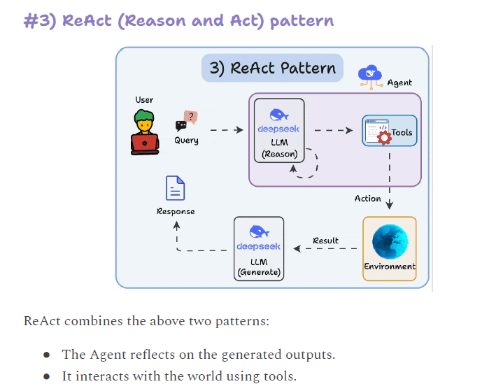

Slide 17
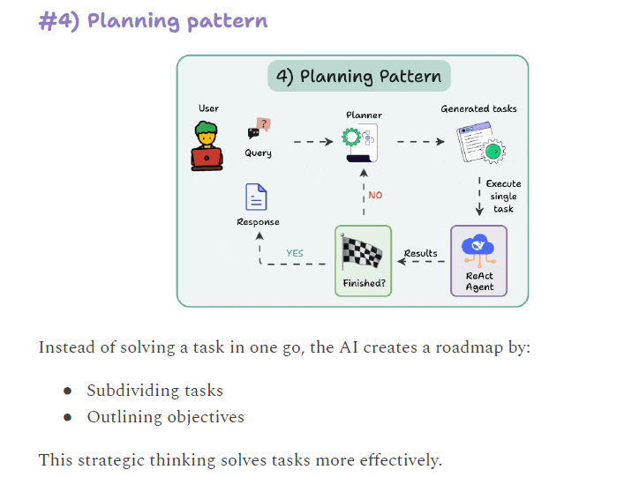

Slide 18
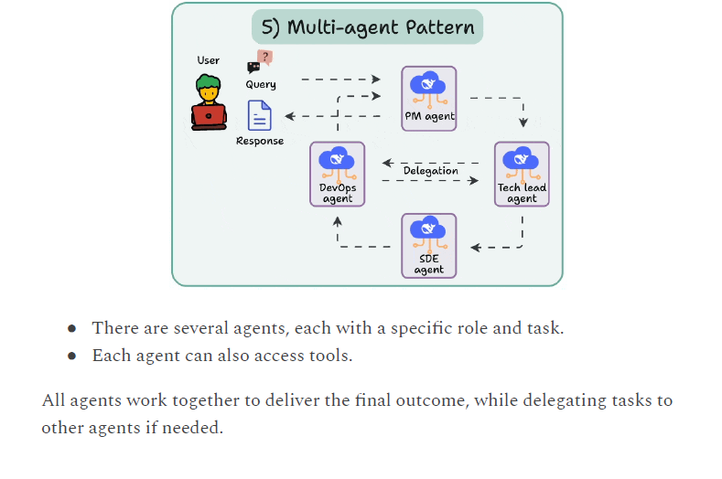

Slide 19
Levels of Agentic AI Systems
1. Basic responder: LLM answers directly.
2. Router: Directs to predefined functions.
3. Tool calling: Chooses and uses external tools.
4. Multi-agent: Manager agent orchestrates sub-agents.
5. Autonomous: Fully independent AI developer.

Slide 20
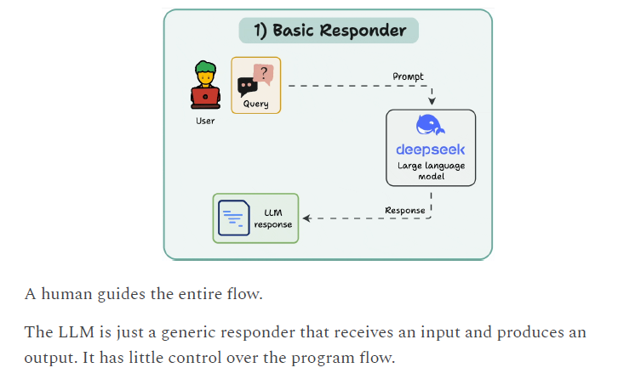

Slide 21
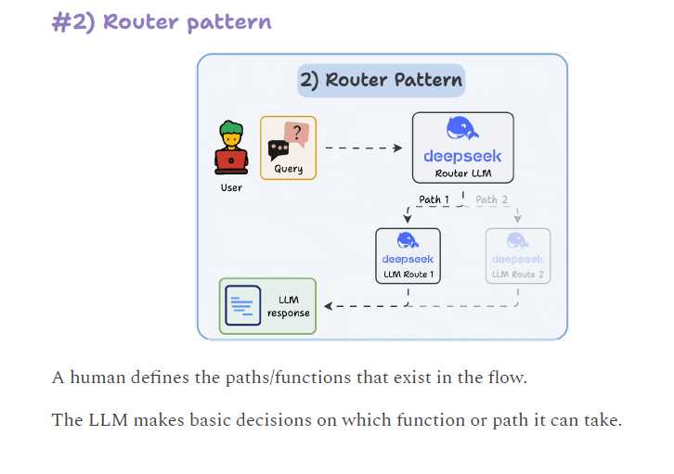

Slide 22
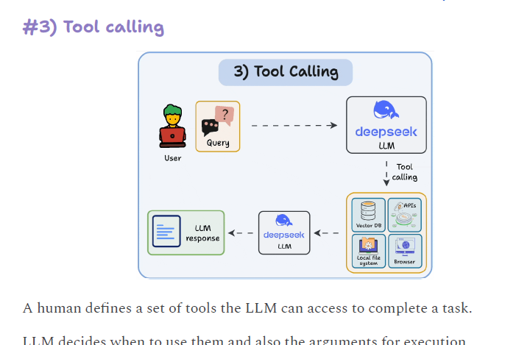

Slide 23
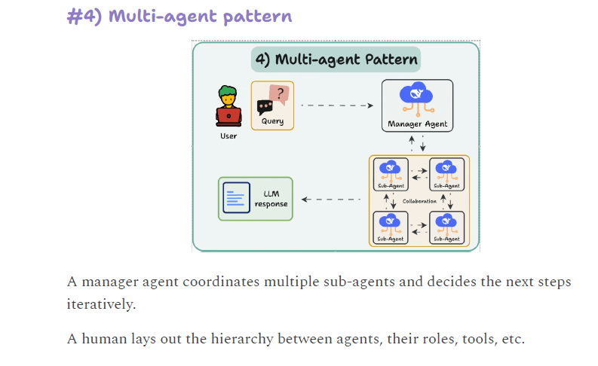

Slide 24
