Slide 1
Machine Learning-Premalatha T

Slide 2
Agenda
Types of Analytics
Steps in a ML Project
Supervised and Unsupervised Learning
Regression and Classification

Slide 3
Types of Analytics
Descriptive
Diagnostic
Predictive
Prescriptive

Slide 4
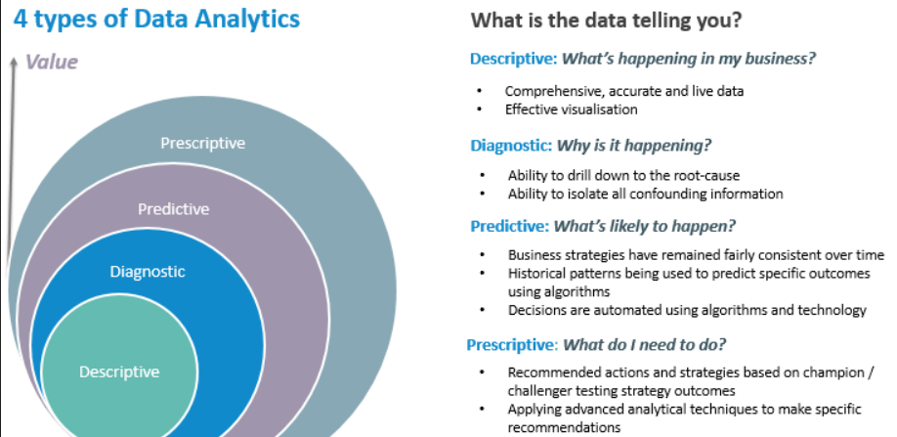

Slide 5
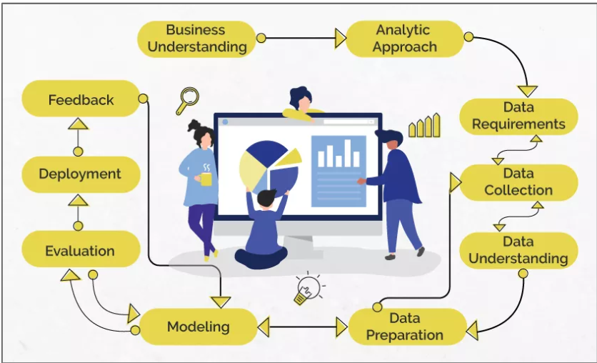
Data Science

Slide 6
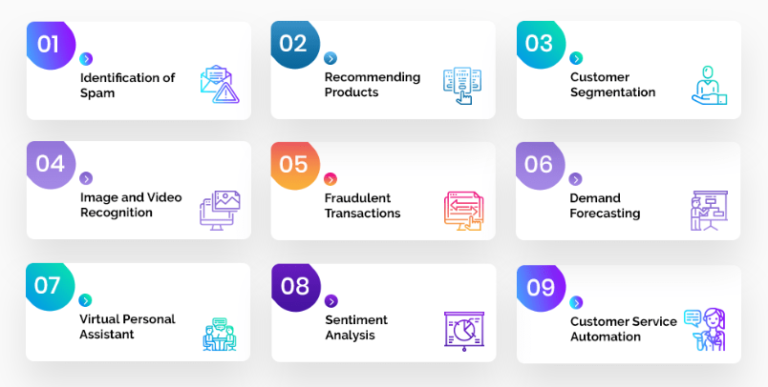
Problem Statement

Slide 7
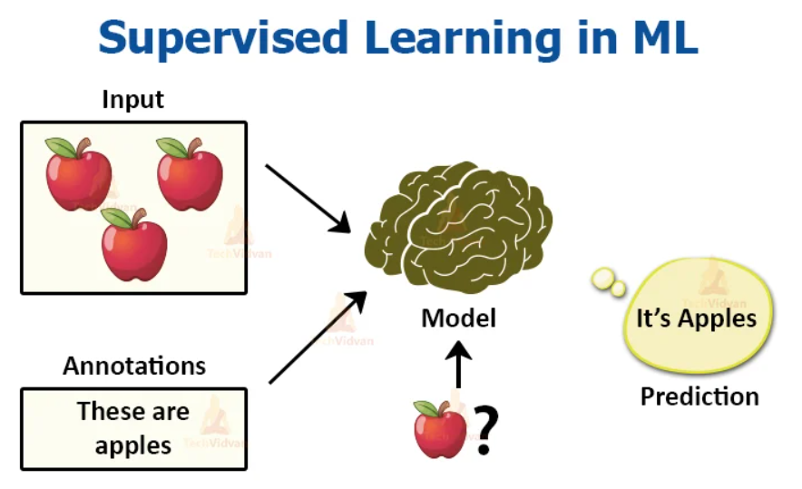
Analytic Approach

Slide 8
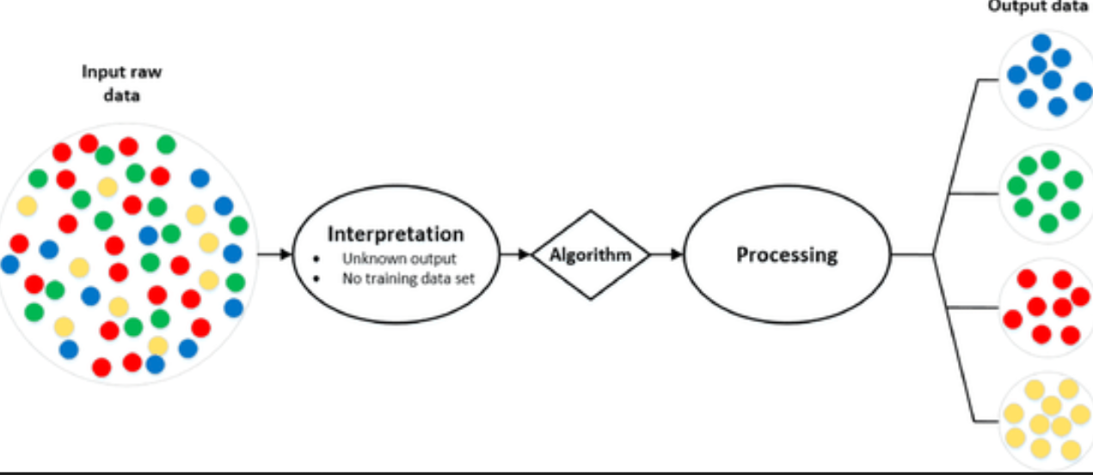
Analytic Approach

Slide 9
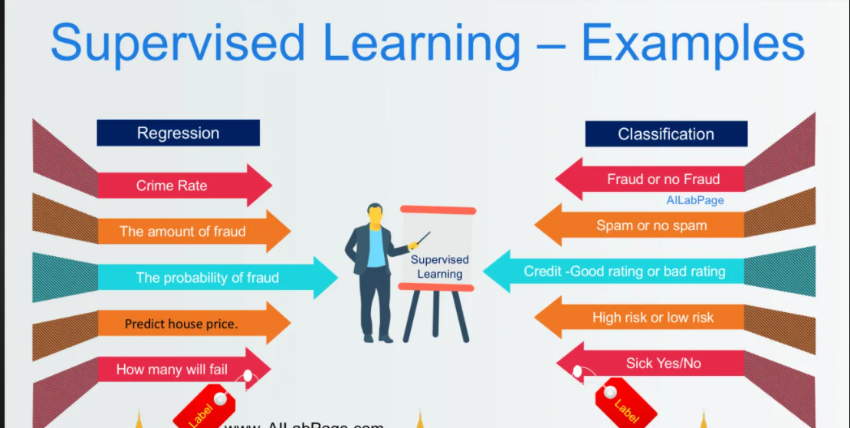
Supervised Learning

Slide 10
Machine Learning
Supervised Learning
Unsupervised Learning

Slide 11
Data understanding
Qualitative
Quantitative
Discrete
Continuous
Categorical
Ordinal

Slide 12
Data preparation
Missing Values
Outliers
Handling Categorical variables
Redundancy in data

Slide 13
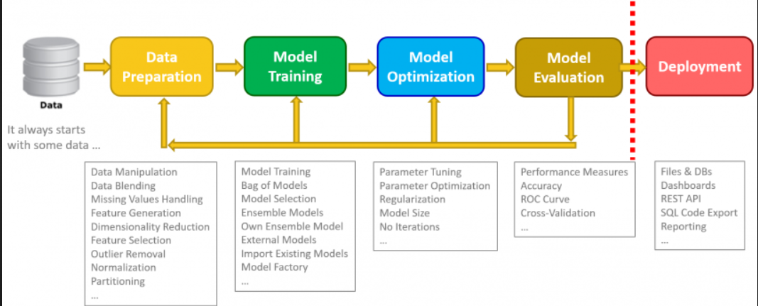
Data Science

Slide 14
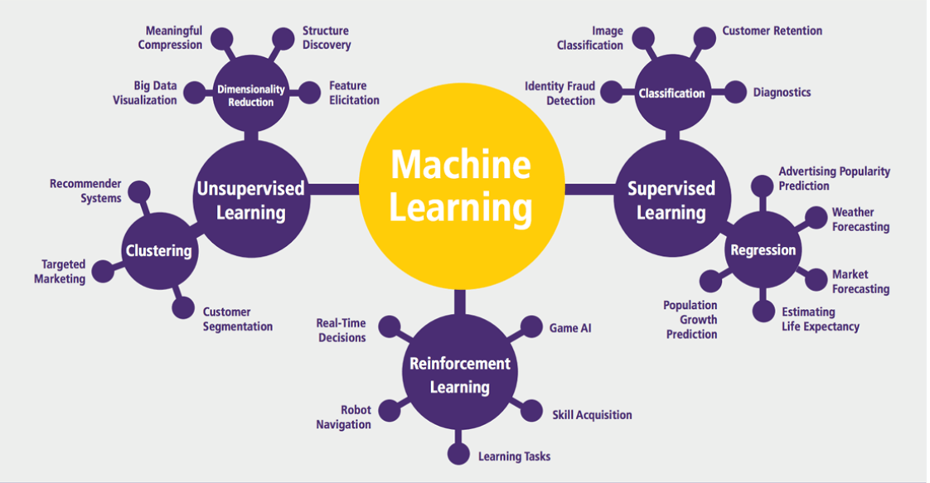
Machine Learning

Slide 15
Applications in Manufacturing
Price Optimization
Predictive Analytics
Demand Forecasting and Inventory Management
Supply Chain Management

Slide 16
Applications in Retail and E-Commerce
Market Basket Analysis
Warranty analytics
Price Optimization
Inventory Management
Location of new stores
Customer sentiment analysis

Slide 17
Applications in Education
Improve Adaptive Learning
Better Assessment of Teachers
Improve Student’s Performance
Better Parent Involvement

Slide 18
Other Applications
Agriculture
Customer Service
Airline Route Planning
Product Recommendation Systems
Digital marketing and Advertising
Internet Search

Slide 19
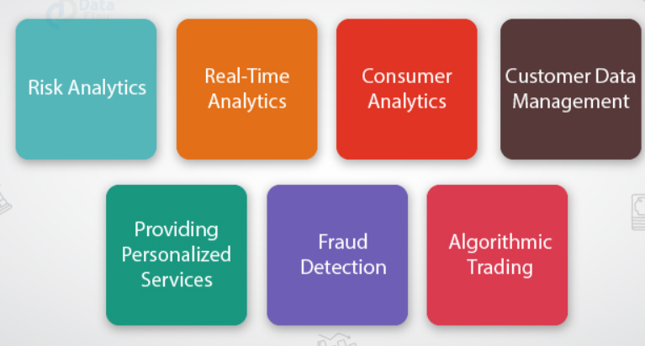
Applications in Finance

Slide 20
Career opportunities
Business Intelligence Analyst
Data Analyst
Data Scientist
Data Engineer
Quantitative Analyst
Data Analytics Consultant
Operations Analyst
Marketing Analyst
Transportation Logistics Specialist
Big data Engineer
Artificial Intelligence researcher
Machine Learning Engineer
Research Scientist
AI Data Analyst
AI Engineer
Robotics Scientist

Slide 21
Questions ????

Slide 22
Day 2:
AI -> Unstructured format-> video, image, audio, unstructured text
ML-> Structured-> csv,excel
Numpy,Pandas,seaborn,matplotlib,sklearn
ML:
import numpy as np
import pandas as pd
import matplotlib.pyplot as plt
%matplotlib inline
import seaborn as sns

Slide 23
# Load the dataset
df=pd.read_excel(“name”)
Age,gender,occu -> pd.read_csv(‘name’)
Age-gender-occu -> How do u load? -> pd.read_csv(‘name’,sep=‘-’)
Age/gender/occu-> pd.read_csv(‘name’,sep=‘/’)
How to rename columns with pandas?-> Find out
df.sample(25)
No.rows and columns-> df.shape
Only the column names-> df.columns

Slide 24
df.dtypes df.describe() df.describe(include=‘all’) df.describe(include=‘object’)
df.info() -> complete information
Ex: 891 observations -> info-> Embarked 889 non-null object
df.isnull().sum()
## Data Visualization
Categorical(Obj) -> univariate-> sns.countplot(x=“columnname”),data=df,palette=“Paired”)
Numerical(int/float)-> univariate->df.hist() ->shape/distribution/min/max
Numerical(univariate)-> sns.boxplot(x=“Age”,data=df) -> Five number summary(min,Q1,Q2,Q3,max),outliers
Two categorical ->bivariate -> sns.countplot(x=“columnname_1”,hue=“columnname_2”,data=df,palette=“Paired”)
One Categorical and one numerical->bivariate ->boxplot,catplot(box,violin,swarm)->sns.boxplot(x=“Product”,y=“Age”,data=df)

Slide 25
sns.violinplot(x=“Product”,y=“Age”,data=df)
sns.swarmplot(x=“Product”,y=“Age”,data=df)
Two numerical->relplot,scatterplot and pairplot-> Correlation
sns.pairplot(df) ->9 columns->81 plots
sns.pairplot(df,hue=“dependent variable”)
### Model implementation
from sklearn.model_selection import train_test_split
from sklearn.tree import DecisionTreeClassifier
Split into X and Y Xtrain,xtest,ytrain,ytest dtc=DecisionTreeClassifier()
dtc.fit(X_train,y_train) dtc.score(X_train,y_train) dtc.score(X_test,y_test)

Slide 26
Generalized Model
ML -> Supervised ML Unsupervised ML
Supervised ML-> Regression(DV-numerical) and classification (DV-categorical)
Linear Regression -> Regression
Logistic Regression-> Classification
KNN -> regression and Classification
Naïve Bayes -> Classification
SVM → R and c
DT -> R and C
Bagging -> R and C
Ada Boosting-> R and C
Gradient boosting-> R and C
Random Forest-> R and C
Xgboost-> R and C

Slide 27
Ensemble->
Singing competition -> one judge
Three Judges
Linear,Log reg,knn,nb,svm,dt-> Individual
Decision tree->hyperparameter(max_depth)
Bagging,Boosting,RF-> ensemble -> cost(time) -> hyperparameters
3 ->

Slide 28


































Slide 29



















Slide 30

















