Slide 1
AI in Finance
Premalatha T

Slide 2

WHO AM I?
LinkedIn: https://www.linkedin.com/in/latha-t-k-b21018128/
Data Science ,AIML
Data Analysis ,SQL,Pyspark
Data Visualization ,PowerBI,Tableau
Natural Language Processing (NLP)
Computer Vision
Generative AI,Prompt Engineering
BigData and Data Engineering

Slide 3
Agenda
What is ML,DL and AI
Steps in a ML Project
ML Techniques and Tools
ML in Finance

Slide 4
What is Artificial Intelligence?
Artificial Intelligence (AI) refers to the ability of machines or computer systems to perform tasks that normally require human intelligence.

Slide 5
Tasks
Learning from data
Understanding language
Recognizing images and speech
Making decisions
Solving problems
Generating content
Reasoning and planning

Slide 6
AI Around Us
Google Search
Maps Navigation
Netflix Recommendations
Amazon Product Suggestions
Face Unlock
Voice Assistants
Spam Detection
Grammar Correction
Banking Fraud Detection
Healthcare Diagnosis Support

Slide 7
How many AI applications have you already used before reaching office today

Slide 8
AI is Like a Student
Human Student
Learns from books
Makes mistakes
Improves through practice

Slide 9
AI is Like a Student
AI Model
Learns from data
Makes predictions
Improves with better training
Important Message
AI does not "think."
It predicts the most probable answer.

Slide 10
Activity
Create a realistic image of a software engineer working in an office.

Slide 11
Create an image of a man writing with Left hand

Slide 12
Image Generation
Create an image of a doctor treating a patient.
Then ask participants:
Now modify the prompt.
Examples
Female doctor
Rural hospital
Pediatrician
Wearing PPE
Elderly patient
Wheelchair user

Slide 13
According to our communication sofar,
Which hindi movie character do you relate me with? Justify.

Slide 14


Slide 15


Slide 16


Slide 17


Slide 18


Slide 19


Slide 20
Why AI Sometimes Fails
Bias
Hallucination
Outdated knowledge (depending on the model)
Lack of common sense
Ambiguous prompts
No emotions
Cannot verify every answer
Golden Rule
AI should assist human decision-making—not replace it.

Slide 21
Why AI Sometimes Fails
Explain Artificial Intelligence like I am a 10-year-old.
Explain Artificial Intelligence for a CEO in one paragraph.
Explain Artificial Intelligence for a doctor.

Slide 22
Narrow AI (Weak AI)
Narrow AI is designed to perform one specific task extremely well.
Characteristics
Specialized
Task-specific
No understanding beyond its domain
Needs human instructions
Cannot transfer knowledge

Slide 23
Narrow AI (Weak AI)
Examples
Face Unlock
Spam Detection
Google Translate
Netflix Recommendation
Medical Image Detection

Slide 24
Artificial General Intelligence (AGI)
What is General AI?
General AI (AGI) refers to an AI system capable of performing any intellectual task that a human can perform.
It would be able to
Learn new skills independently
Apply knowledge across domains
Reason
Plan
Solve unfamiliar problems
Adapt to new environments

Slide 25
Artificial General Intelligence (AGI)
Can ChatGPT repair your car?
Can it cook dinner?
It is powerful but still Narrow AI.

Slide 26
Agentic AI
Agentic AI goes beyond generating answers.
It can
Understand a goal
Create a plan
Use tools
Make decisions
Execute tasks
Monitor progress
Adjust when something changes

Slide 27
Activity: Travel Agent Example
Plan a 3-day vacation to Goa with a budget of ₹25,000.
ChatGPT only generated a plan.
An Agentic AI would also
Search flights
Compare hotels
Book tickets
Add calendar events
Monitor flight delays
Notify changes
This is the difference between answer generation and task execution.

Slide 28
Agentic AI in Business
Employee says "Prepare next week's customer meeting."
An AI Agent could
✔ Search CRM
✔ Read previous emails
✔ Create PowerPoint
✔ Schedule meeting
✔ Invite attendees
✔ Summarize customer issues
✔ Generate meeting notes afterward
Discussion
AI is becoming a digital teammate rather than just a chatbot.

Slide 29
Evolution of AI Systems
How AI Has Evolved
Artificial Intelligence has evolved from rule-based systems to autonomous AI agents capable of reasoning and taking actions.
AI Evolution Journey
Rule-Based Systems → Machine Learning → Deep Learning → Generative AI → Agentic AI
Key Message
AI has evolved from following instructions to learning, creating, and now acting autonomously.

Slide 30
Stage 1: Rule-Based AI (1950s–1990s)
AI Based on Rules
Early AI systems relied on predefined rules written by humans.
How It Works
Input → Rules → Output
Example:
If balance < ₹500 → Low balance alert

Slide 31
Stage 1: Rule-Based AI (1950s–1990s)
No learning
Deterministic
Easy to explain
Limited flexibility
Examples
Tax calculators
Early expert systems
Rule-based chatbots

Slide 32
Stage 2: Machine Learning
Example
Rather than coding every fraud rule:
Train a model on millions of transactions.
The model identifies suspicious patterns.
Applications
Spam detection
Credit scoring
Product recommendations
Customer churn prediction

Slide 33
Stage 3: Deep Learning
Learning Complex Patterns
Deep Learning uses artificial neural networks inspired by the human brain.
What Changed?
AI became much better at:
Image recognition
Speech recognition
Language understanding
Video analysis

Slide 34
Stage 3: Deep Learning
Examples
Face recognition
Self-driving perception
Medical image analysis
Voice assistants
Activity
Show an image and ask participants:
"Can AI identify whether this is a cat or a dog?"
Discuss how deep learning learns visual patterns instead of handcrafted rules.

Slide 35
Stage 4: Generative AI
AI That Creates
Generative AI doesn't just analyze data—it creates new content.
It Can Generate
Text
Images
Code
Audio
Video
Presentations

Slide 36
Stage 4: Generative AI
Examples
ChatGPT
Image generation tools
AI coding assistants
AI presentation tools

Slide 37
Stage 4: Generative AI
Prompt:
"Create a professional email requesting leave.“
Change the prompt:
"Make it formal."

Slide 38
Stage 5: Agentic AI
AI That Acts
Agentic AI moves beyond generating answers.
It can:
Plan
Reason
Use tools
Make decisions
Complete multi-step tasks
Monitor progress

Slide 39
Stage 5: Agentic AI
Organize next week's customer meeting."
The AI agent can:
Read emails
Find available meeting slots
Create an agenda
Generate presentation slides
Send calendar invitations

Slide 40
Hands-On Demonstration
Challenge: Observe the Evolution in Action
Use the same business scenario across different AI stages:
Scenario: "A customer complains about a delayed product."
Rule-Based AI: Sends a predefined apology message.
Machine Learning: Predicts whether the customer is likely to churn.
Deep Learning: Analyzes the sentiment of the complaint.
Generative AI: Drafts a personalized response email.
Agentic AI: Drafts the email, checks order status, initiates a refund if eligible, updates the CRM, and schedules a follow-up task.

Slide 41
What is Data?

Slide 42
What is DATA?
Data is a collection of facts, figures, observations, or measurements that can be analyzed to gain insights.
It can be structured (like tables in a database) or unstructured (like text, images, or videos).
Data is crucial for decision-making in businesses, research, and technology.

Slide 43
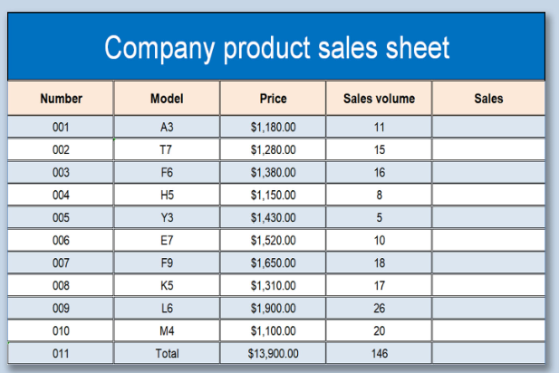
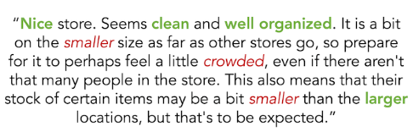

Slide 44

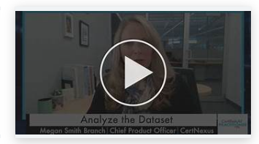
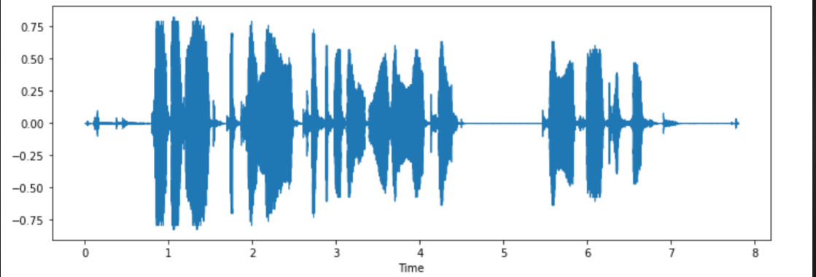

Slide 45
Structured or Unstructured?
Customer purchase history in a database
Video recordings of stock market news
Excel sheet with employee salary data
WhatsApp chat messages
Weather sensor readings

Slide 46
When to Use ML, CV, NLP, and DL?
Each technique—Machine Learning (ML), Computer Vision (CV), Natural Language Processing (NLP), and Deep Learning (DL)—is used based on the type of data and the problem being solved.

Slide 47
Machine Learning (ML)
Use ML when:
You have structured/tabular data (e.g., sales records, customer transactions).
You need to make predictions, classifications, or clustering.
Examples:
Predicting loan approvals (Classification)
Customer churn prediction
Fraud detection in banking
Recommender systems (Netflix, Amazon)

Slide 48
Computer Vision (CV)
Use CV when:
You are working with images or videos.
You need to analyze, classify, or generate images.
Examples:
Face recognition in security systems
Object detection in self-driving cars
Medical image analysis (e.g., detecting tumors in MRI scans)
Defect detection in manufacturing

Slide 49
Natural Language Processing (NLP)
Use NLP when:
You are working with text or speech data.
You need to understand, generate, or translate language.
Examples:
Chatbots and virtual assistants (Siri, Alexa)
Sentiment analysis of customer reviews
Machine translation (e.g., Google Translate)
Email spam detection

Slide 50
Deep Learning (DL)
Use DL when:
Your dataset is large and complex (images, speech, unstructured text).
Traditional ML models do not perform well.
You need high accuracy and have computational power (GPUs/TPUs).
Examples:
Autonomous driving (Self-driving cars)
Image generation (Deepfake technology)
Speech recognition (Google Assistant, Alexa)
Large Language Models (ChatGPT, Gemini,COPILOT)

Slide 51
Problem Statements
A bank wants to predict whether a customer will default on a loan based on transaction history and demographics.
A company wants to classify customer support emails as complaints, inquiries, or feedback.
A factory needs an AI system to detect defects in manufactured products by analyzing images.

Slide 52
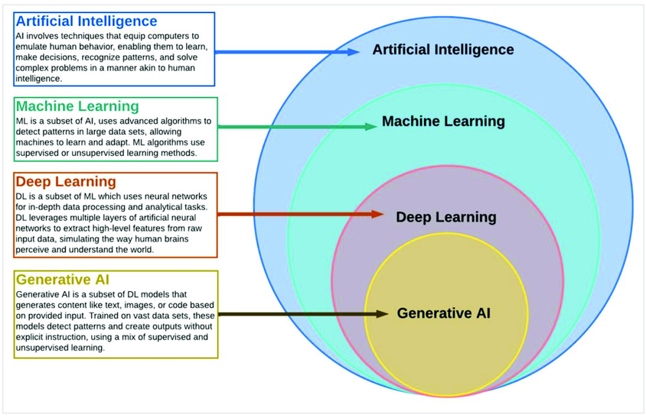

Slide 53
AI vs ML vs DL vs Generative AI
AI, Machine Learning, Deep Learning, and Generative AI are not competing technologies—they are nested technologies, where each builds upon the previous one.
Artificial Intelligence (AI)
│
├── Machine Learning (ML)
│ │
│ └── Deep Learning (DL)
│ │
│ └── Generative AI (GenAI)
Key Message
Every Generative AI model uses Deep Learning, every Deep Learning model is a Machine Learning model, and every Machine Learning model is part of Artificial Intelligence.

Slide 54
Types of Analytics
In today's data-driven world, information is king. But raw data itself isn't enough.
We need to analyze it to extract insights and make informed decisions

Slide 55






Slide 56
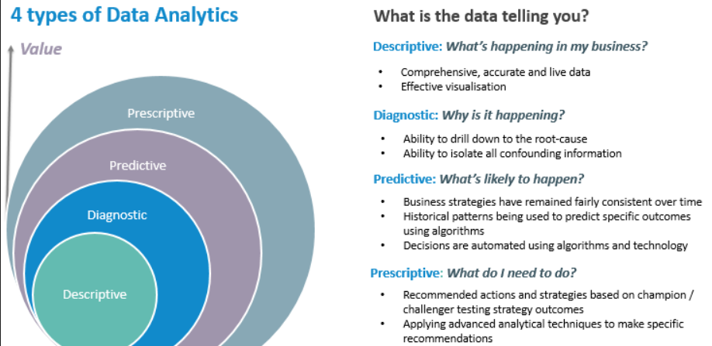

Slide 57
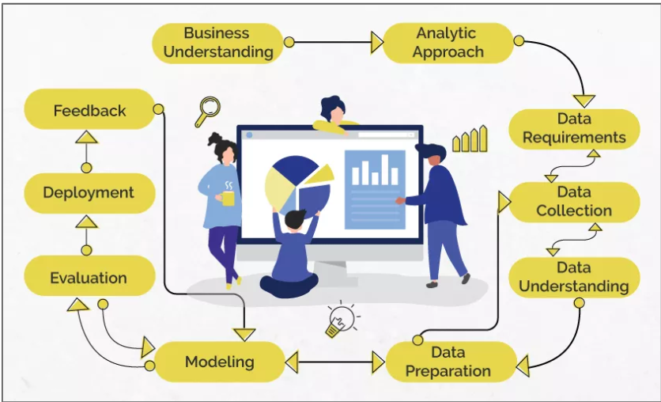
Data Science/Machine Learning

Slide 58
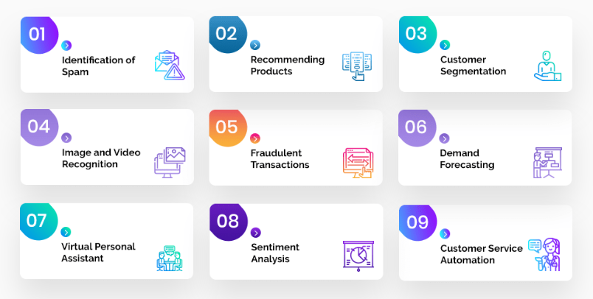
Problem Statement

Slide 59
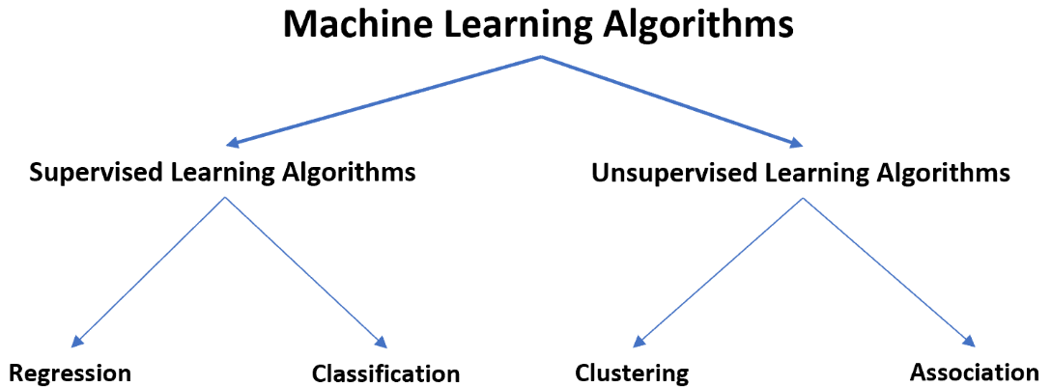

Slide 60
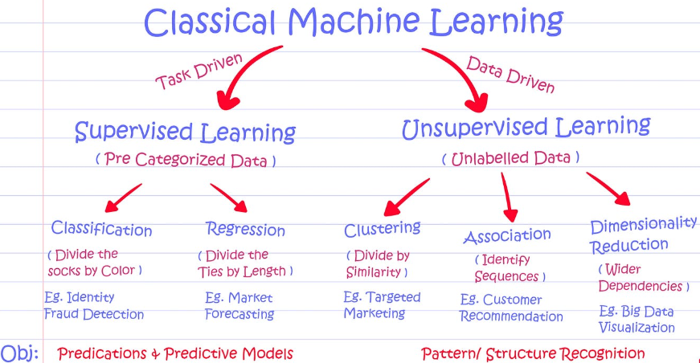

Slide 61
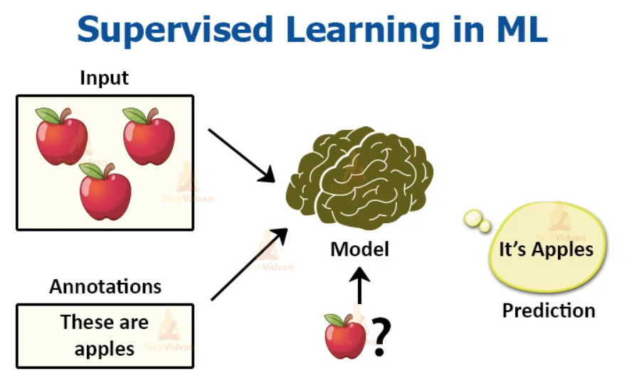

Slide 62
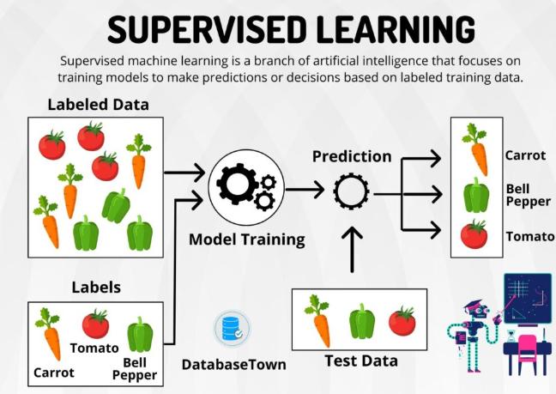

Slide 63
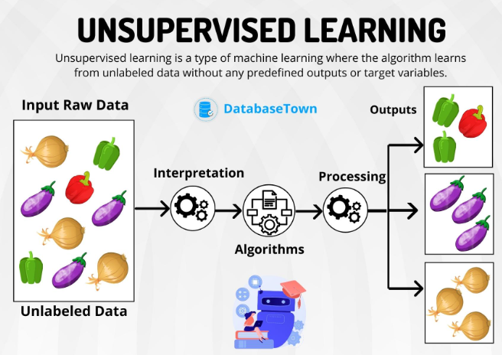

Slide 64
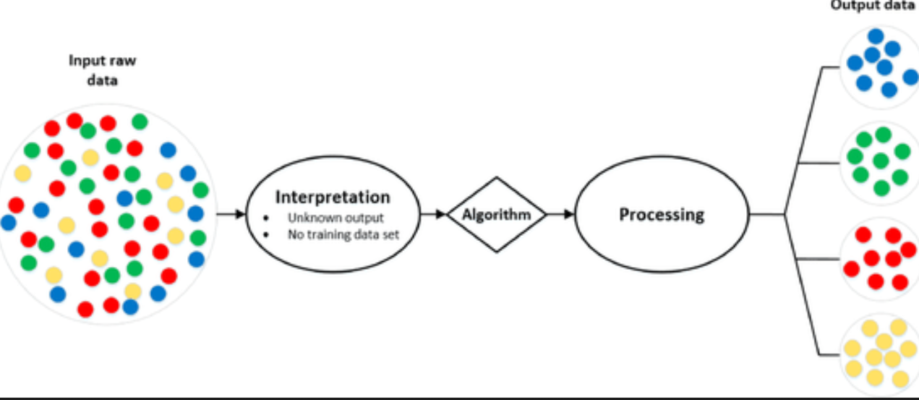
Analytic Approach

Slide 65
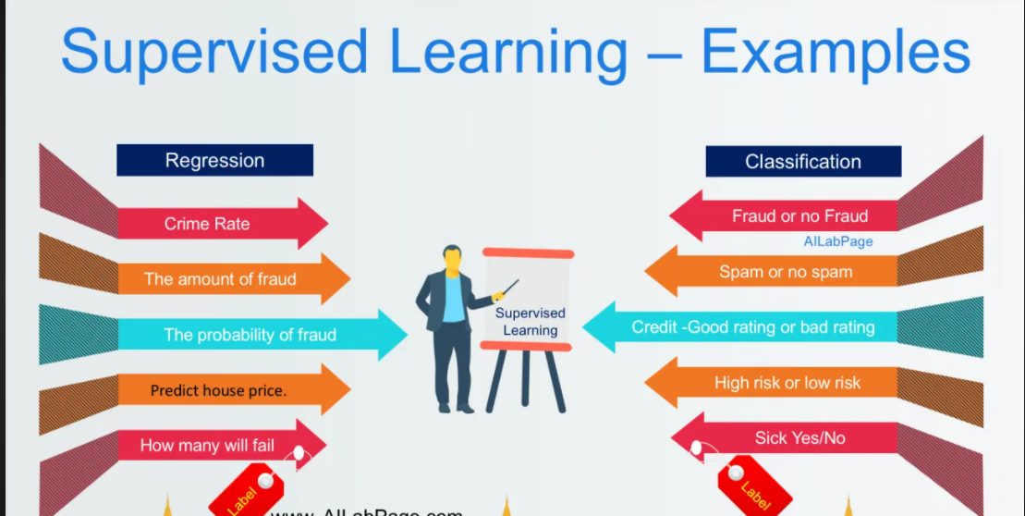
Supervised Learning

Slide 67
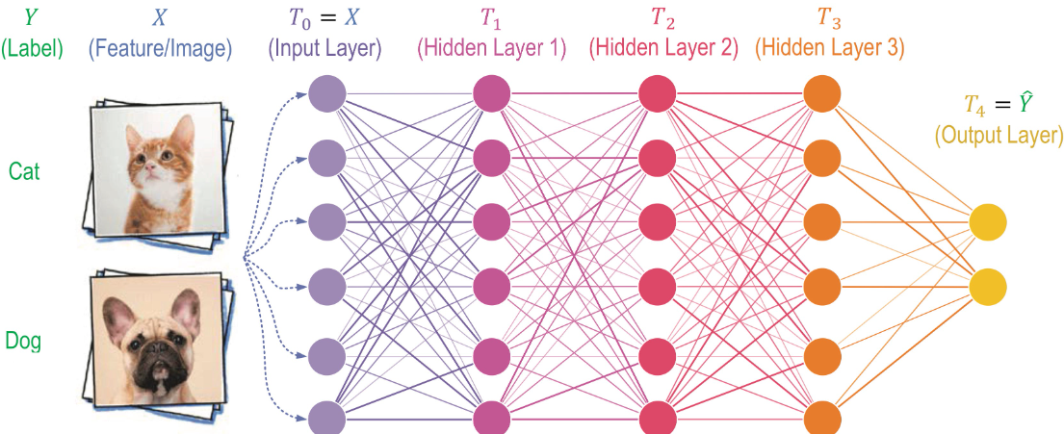

Slide 68
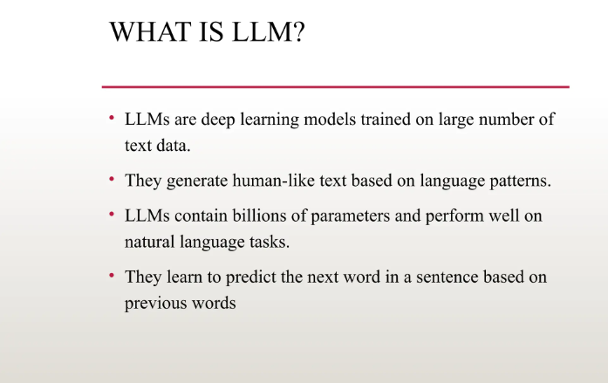

Slide 69
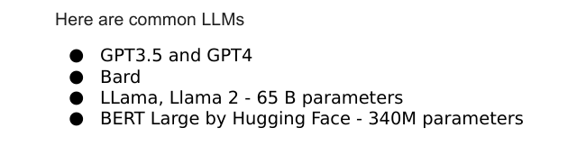

Slide 70
Data?
Information and Noise(Insignificant information)
ML ,DS,AI-> Extract information(Exclude noise)

Slide 71
Types of Analytics
In today's data-driven world, information is king. But raw data itself isn't enough.
We need to analyze it to extract insights and make informed decisions

Slide 74
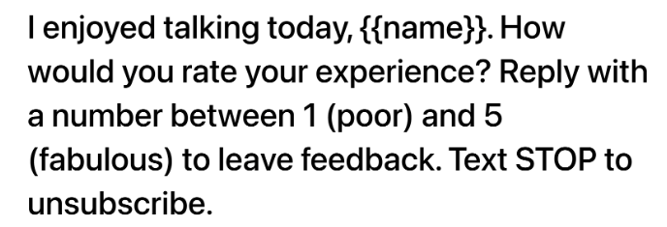

Slide 76
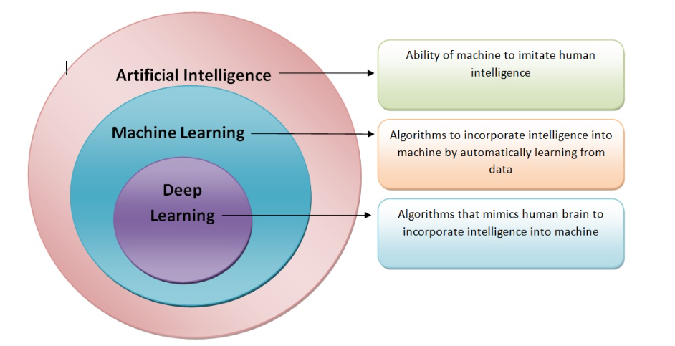

Slide 77
Data Science/Machine Learning

Slide 78
Problem Statement

Slide 79
Analytic Approach

Slide 80
Analytic Approach

Slide 81
Supervised Learning

Slide 82


Slide 83
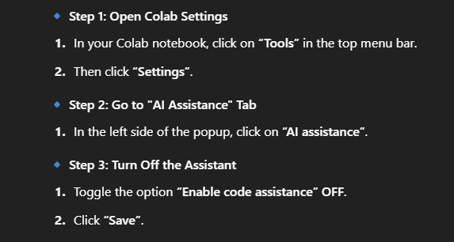

Slide 84
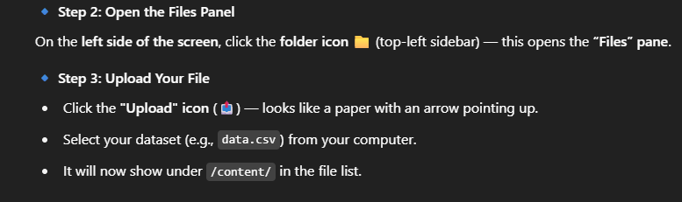

Slide 85
Questions ????

Slide 86
What is AI in Finance?
Artificial Intelligence (AI) in finance means using machines and algorithms to analyze financial data, identify patterns, make predictions, and automate decisions that traditionally required human judgment.
Instead of manually analyzing spreadsheets or reports, AI systems can process millions of transactions, detect anomalies, predict risks, and support financial decision-making in real time.

Slide 87
Simple Example
A finance analyst may review thousands of transactions to detect fraud.
AI can:
Scan millions of transactions
Identify unusual patterns
Flag potential fraud within seconds

Slide 88
Pattern Recognition
AI finds hidden patterns in large datasets.
Examples:
Fraud detection
Spending behavior analysis
Market trends
Supplier payment patterns

Slide 89
Automation
AI automates repetitive financial tasks.
Examples:
Invoice processing
Expense categorization
Bank reconciliation
Customer support

Slide 90
Decision Support
AI supports financial decision-making.
Examples:
Should a loan be approved?
What credit limit should be offered?
Which customer is high risk?
AI does not replace humans, but augments decision-making.

Slide 91
AI-based systems evaluate many variables simultaneously, such as:
spending behavior
transaction history
employment pattern
repayment behavior
location patterns

Slide 92
Key Changes in Financial Products
Personalized Financial Services
AI enables hyper-personalized financial experiences.
Examples:
Personalized credit limits
Customized loan offers
Smart investment recommendations
Tailored insurance plans

Slide 93
Example:
A banking app suggests:
“You can save ₹8,000 this month”
“You may qualify for a home loan”

Slide 94
Real-Time Decision Making
Earlier processes took days or weeks.
AI enables instant financial decisions.
Examples:
Instant loan approval
Real-time fraud detection
Instant payment risk scoring
Example:
A credit card transaction is approved in milliseconds using AI risk scoring.

Slide 95
Smarter Risk Management
AI evaluates risk more accurately than traditional methods.
Examples:
Predicting loan default
Detecting suspicious transactions
Monitoring portfolio risk

Slide 96
AI considers:
transaction patterns
behavioural signals
macroeconomic indicators

Slide 97
Intelligent Automation
Many finance operations are now AI-assisted or automated.
Examples:
Automated invoice processing
Smart reconciliation
Contract analysis
Expense validation

Slide 98
This reduces:
manual effort
errors
processing time

Slide 99
Proactive Financial Insights
AI systems provide alerts and recommendations.
Examples:
“Cash flow may drop next month”
“Supplier payments are delayed”
“Customer payment risk increasing”
Finance teams move from reactive reporting to proactive decision-making.

Slide 100
Role of an AI-Aware Finance Product Manager
Finance Product Managers are responsible for building financial products that deliver business value.
With AI, their role expands.
They must understand:
where AI adds value
what problems AI should solve
risks of AI decisions
governance and compliance

Slide 101
Key Responsibilities
Identify AI Opportunities
Example questions a PM should ask:
Can AI detect fraud earlier?
Can we automate reconciliation?
Can we predict payment delays?

Slide 102
Key Responsibilities
Define the Right Problem
Not every problem needs AI.
Example:
Bad problem:
“Use AI for accounts payable”
Good problem:
“Use AI to predict late supplier payments”

Slide 103
Key Responsibilities
3. Work with Data Teams
PMs collaborate with:
data scientists
engineers
compliance teams
They translate business needs into data-driven features.
Example:
Business Need → Reduce loan defaults
AI Feature → Loan risk prediction model

Slide 104
Key Responsibilities
Evaluate AI Performance
PMs must track:
accuracy
fairness
reliability
business impact

Slide 105
Key Responsibilities
Example metrics:
fraud detection rate
reduction in manual review
improvement in approval time

Slide 106
Key Responsibilities
Ensure Responsible AI
Finance is highly regulated.
PMs must ensure:
fairness
transparency
explainability
compliance
Example:
A bank must explain why a loan was rejected.

Slide 107
How AI Impacts Key Finance Functions
AI affects multiple financial areas.
Credit & Lending
AI helps evaluate borrower risk more accurately.
Applications:
credit scoring
loan approval
default prediction
credit limit optimization
Example:
AI predicts which borrowers are likely to miss payments.

Slide 108
Payments
AI improves payment processing and fraud detection.
Applications:
transaction monitoring
payment authentication
anomaly detection
Example:
AI detects suspicious card transactions instantly.

Slide 109
Risk Management
AI helps identify financial risks earlier.
Applications:
portfolio risk analysis
liquidity risk prediction
market volatility detection
Example:
AI predicts risk exposure in loan portfolios.

Slide 110
Compliance
Financial institutions must follow strict regulations.
AI helps monitor compliance.
Applications:
AML (Anti-Money Laundering)
transaction monitoring
regulatory reporting
Example:
AI flags suspicious transactions linked to money laundering.

Slide 111
Finance Operations
AI automates operational processes.
Applications:
invoice processing
reconciliation
expense auditing
document processing
Example:
AI reads invoices and automatically extracts:
vendor name
amount
due date

Slide 112
As an AIPM
AI is transforming finance from:
Manual → Automated
Reactive → Predictive
Rule-based → Intelligent
For finance professionals and product managers, the goal is not to build AI models but to:
✔ Identify valuable problems
✔ Understand data opportunities
✔ Design AI-enabled financial products
✔ Ensure governance and trust

Slide 113
Understanding AI Product Management
AI Product Management is about designing products that use AI to improve decisions, automate processes, and create better financial experiences for customers.
Unlike traditional software products, AI products learn from data and evolve over time.
Because of this, Product Managers must understand how AI behaves, what it can do well, and where it may fail.

Slide 114
Why Product Managers Need to Understand AI Behaviour
Traditional software behaves predictably.
Example:
If payment amount > ₹1,00,000 → send approval request
The output is always the same.
AI systems behave differently.
AI learns patterns from historical data and then makes predictions or classifications.
Because of this, the output may change as the model learns new patterns.

Slide 115
Example in finance:
Traditional rule:
Reject loan if credit score < 650
AI-based evaluation considers many factors:
spending behavior
repayment patterns
income consistency
transaction patterns
previous defaults
AI may approve a borrower even if their credit score is slightly lower, because other signals suggest low risk.

Slide 116
Why PMs Must Understand AI Behaviour
Product Managers are responsible for product decisions, not technical model building.
But You must understand:

Slide 117
AI is not always 100% accurate
Example:
A fraud model may detect 92% of fraud cases, but 8% may still slip through.
PMs must decide:
Is this accuracy acceptable?
Should we add human review?

Slide 118
AI depends heavily on data quality
If data is incomplete or biased, AI decisions will also be biased.
Example:
If historical loan data excludes certain customer groups, the model may unfairly reject them.

Slide 119
AI models degrade over time
Customer behavior changes.
Example:
Spending patterns during festivals or economic downturns change dramatically.
AI models must be monitored and retrained regularly.

Slide 120
AI decisions must be explainable in finance
Financial institutions must justify decisions.
Example:
If a loan is rejected, the system must explain:
insufficient income
high credit utilization
past late payments
PMs must ensure the product supports explainable AI.

Slide 121
How AI Improves Understanding of Customers and Decisions
AI enables financial institutions to analyze customer behavior at scale.
Instead of relying on limited information, AI analyzes:
transaction data
spending patterns
payment history
digital interactions
financial habits
This helps organizations understand customers better and make smarter decisions.

Slide 122
Example 1: Customer Behavior Analysis
AI can analyze:
where customers spend
how frequently they transact
when they typically pay bills
Insights may include:
high-value customers
customers likely to churn
customers likely to upgrade products

Slide 123
Example:
A bank identifies that a customer:
frequently books flights
spends on hotels
travels internationally
AI may suggest:
premium travel credit cards
forex cards
travel insurance

Slide 124
Example 2: Risk Understanding
AI helps identify risk signals earlier.
Example:
A lending platform may notice:
declining account balance
increasing credit card usage
missed payments
AI predicts that this customer may default in the next 3 months.

Slide 125
The bank can:
reduce credit exposure
offer restructuring
notify risk teams

Slide 126
Example 3: Operational Decision Support
AI supports internal decision-making.
Example:
Finance operations may use AI to:
prioritize invoices
detect duplicate payments
identify suspicious vendor activity
This improves:
efficiency
cost control
operational accuracy

Slide 127
Evaluating Which Financial Problems
Require AI
One of the most important responsibilities of an AI Product Manager is deciding when AI is actually needed.
Not every financial problem requires AI.
Sometimes simple rules are better.

Slide 128
Step 1: Check If the Problem Involves Patterns
AI is useful when there are complex patterns in data.
Examples:
Good AI use cases:
fraud detection
credit risk prediction
transaction anomaly detection
customer segmentation

Slide 129
Poor AI use cases:
applying fixed tax rules
validating invoice format
applying regulatory limits
These tasks work better with simple rules.

Slide 130
Step 2: Check If Historical Data Exists
AI learns from past data.
If there is no historical data, AI cannot learn patterns.
Example:
AI can predict loan default because banks have decades of repayment data.
But AI cannot predict something with no historical data available.

Slide 131
Step 3: Check If the Problem Requires Prediction
AI works well when the goal is to predict something.
Examples:
Which customer may default?
Which transaction may be fraud?
Which customers may respond to an offer?
Prediction-based problems are ideal for AI.

Slide 132
Step 4: Check If the Problem Involves Large Data
AI is useful when there are large volumes of data.
Example:
A bank processes millions of transactions daily.
Manual analysis is impossible.
AI can analyze patterns instantly.

Slide 133
Simple Decision Framework for PMs
Before choosing AI, a Product Manager should ask:
Is the problem pattern-based?
Do we have enough historical data?
Does the problem require prediction?
Is the data volume large?
If the answer is yes to most of these, AI is likely useful.

Slide 134
AI Product Management is about making the right decisions about where and how to use AI.
Product Managers must:
✔ Understand how AI behaves
✔ Use AI to better understand customers and risks
✔ Identify financial problems where AI adds real value
✔ Avoid using AI when simple rules are sufficient

Slide 135
Machine Learning Thinking for Finance (Business Perspective)
Machine Learning (ML) is a branch of Artificial Intelligence that learns patterns from historical data and uses them to make predictions or decisions.

Slide 136
Instead of writing thousands of rules manually, ML systems learn from past financial data such as:
transaction history
loan repayments
payment behavior
spending patterns
customer interactions
Using this data, ML can identify patterns, predict outcomes, and classify customers or transactions.

Slide 137
How AI Identifies Patterns (Fraud, Defaults)
One of the most powerful capabilities of AI is detecting patterns that humans cannot easily see.
Financial systems generate massive amounts of data:
millions of transactions
thousands of customers
complex payment behaviors
AI analyzes this data and identifies unusual or risky patterns.

Slide 138
Example: Fraud Detection
Fraudulent transactions often follow hidden patterns.
Example signals AI may detect:
sudden large purchases in another country
many transactions within seconds
unusual merchant categories
transactions at unusual times

Slide 139
Example pattern
Normal behaviour:
Customer spends ₹2000–₹5000 in local stores.
Suspicious behaviour:
₹85,000 transaction in another country at midnight.

Slide 140
AI learns these patterns from past fraud cases and flags suspicious transactions instantly.
This allows banks to:
block suspicious transactions
send alerts to customers
prevent financial losses

Slide 141
Example: Loan Default Pattern
AI can analyze past loan data and identify patterns such as:
Customers who:
frequently miss credit card payments
have unstable income
have high credit utilization
may have higher probability of defaulting on loans.
These patterns help financial institutions manage lending risk better.

Slide 142
How AI Predicts Outcomes (Risk, Cash Flow)
Another important capability of AI is prediction.
Prediction means estimating what is likely to happen in the future based on past data.
This is extremely valuable in finance because organizations constantly need to predict:
risk
revenue
cash flow
repayment behavior

Slide 143
Example: Credit Risk Prediction
AI analyzes historical loan data including:
income levels
repayment history
outstanding debts
employment stability
Using this information, AI predicts:
“What is the probability that this borrower may default?”

Slide 144
Banks can use this prediction to:
approve or reject loans
adjust interest rates
reduce exposure to risky borrowers

Slide 145
Example: Cash Flow Forecasting
Finance teams need to estimate future cash inflows and outflows.
AI can analyze:
historical revenue
seasonal patterns
supplier payments
customer payment delays

Slide 146
Example insight
AI prediction:
Cash inflow next month may drop by 18%
due to delayed customer payments.
This allows companies to plan working capital more effectively.

Slide 147
How AI Classifies Customers
(Priority, Risk Levels)
Classification means grouping items into categories.
In finance, AI can classify:
customers
transactions
loans
vendors
based on risk, value, or behavior.

Slide 148
Banks can use this classification to:
monitor high-risk customers
limit credit exposure
trigger additional verification

Slide 149
Example: Customer Priority Segmentation
Financial institutions often classify customers into segments:
Premium customers
High-value customers
Standard customers
Low engagement customers

Slide 150
AI analyzes:
account balance
transaction frequency
product usage
spending behavior
Example result:
Customer Segment:
High-value frequent traveler

Slide 151
The bank may offer:
premium travel cards
airport lounge benefits
higher credit limits

Slide 152
Examples from Finance Functions
Lending
AI helps improve lending decisions.
Applications:
credit risk prediction
loan approval scoring
default probability estimation
Example:
AI predicts which borrowers are most likely to repay loans.

Slide 153
Benefits:
fewer bad loans
faster loan approvals
better risk management

Slide 154
Payments
Payment systems process millions of transactions daily.
AI helps in:
fraud detection
transaction anomaly detection
payment risk scoring
Example:
AI identifies unusual spending patterns and flags fraudulent transactions in real time

Slide 155
Reconciliation
Finance teams spend significant time reconciling:
bank statements
invoices
payments
AI can automatically match transactions using pattern recognition.

Slide 156
Example:
AI matches:
Invoice amount: ₹48,950
Bank transfer: ₹48,948
Even if amounts are slightly different, AI identifies likely matches.
This reduces manual reconciliation work.

Slide 157
Risk Management
AI helps organizations monitor financial risks continuously.
Applications:
portfolio risk analysis
liquidity risk prediction
market volatility detection
Example:
AI predicts that certain loans in a portfolio have rising risk levels, allowing risk teams to intervene early.

Slide 158
As an AIPM
For finance professionals, the key is not learning algorithms, but understanding:
✔ What problem AI is solving
✔ What data is required
✔ What decision the prediction supports

Slide 159
Working with Data as a Product Manager
AI systems are only as good as the data they learn from.
For Product Managers, understanding whether the available data is useful and reliable is extremely important before building AI-powered financial features.
A common mistake in AI projects is:
Building models first and checking data later.
Successful AI products start with good data evaluation.

Slide 160
What “Useful Data” Means in Finance
Not all financial data is useful for AI.
Useful data has three important characteristics:
Relevant
Accurate
Sufficient in quantity
Let’s understand each one.

Slide 161
Relevant Data
Relevant data means the data actually helps answer the business problem.
Example:
If the goal is predicting loan default, useful data may include:
repayment history
credit utilization
income stability
outstanding debts
previous defaults

Slide 162
Relevant Data
But data like:
customer favorite shopping category
preferred language
may not be useful for loan risk prediction.
So a Product Manager must ask:
Does this data help the model understand the financial behaviour related to the problem?

Slide 163
Accurate Data
Financial AI systems require high-quality and accurate data.
Examples of bad data:
missing repayment records
incorrect transaction amounts
duplicate customer profiles
If the data is incorrect, AI will learn incorrect patterns.

Slide 164
Example:
If many borrowers are incorrectly marked as “defaulted”, the model may start rejecting good customers.
This leads to:
lost revenue
poor customer experience
unfair decisions

Slide 165
Sufficient Data
AI systems learn patterns from large datasets.
Example:
If a bank has only 50 fraud cases, it is difficult for AI to learn fraud patterns.
But if there are 50,000 fraud cases, the model can detect patterns more accurately.
Product Managers must evaluate:
how many records exist
how many examples of the target outcome exist

Slide 166
Evaluating if Data is Good Enough for an AI Feature
Is Historical Data Available?
AI learns from past patterns.
Example:
To predict loan default, the system must know:
which loans were repaid
which loans defaulted
Without historical outcomes, the model cannot learn.

Slide 167
Is the Data Structured or Unstructured?
Finance data may exist in multiple formats.
Structured Data
Highly organized data stored in tables.
Examples:
transaction records
loan applications
customer profiles
payment history
Structured data is easier to use for AI.

Slide 168
Unstructured Data
Data that is not organized in tables.
Examples:
invoices
contracts
emails
customer complaints
AI techniques like document processing or NLP may be required to extract information.

Slide 169
Is the Data Complete?
Missing data creates unreliable models.
Example:
Loan dataset missing:
income information
repayment history
employment data

Slide 170
Such incomplete data may reduce prediction accuracy.
PMs must check:
missing values
incomplete records
inconsistent fields

Slide 171
Is the Data Biased?
Bias occurs when the data does not represent all customer groups fairly.
Example:
If past loan approvals favored only certain income groups, the AI model may learn the same bias.
This creates:
unfair lending decisions
compliance risks
Finance organizations must ensure fair and responsible AI decisions.

Slide 172
Aligning Business Outcomes with
Prediction or Automation
AI features should always be designed to achieve clear business outcomes.
Product Managers must connect:
Business Goal → AI Capability → Product Feature

Slide 173
Example 1: Lending
Business Goal:
Reduce loan defaults.
AI Capability:
Predict default probability.
Product Feature:
Risk scoring system during loan approval.
Result:
better lending decisions
reduced financial losses

Slide 174
Example 2: Payments
Business Goal:
Reduce payment fraud.
AI Capability:
Detect abnormal transaction patterns.
Product Feature:
Real-time fraud detection system.
Result:
fewer fraudulent transactions
increased customer trust

Slide 175
Example 3: Finance Operations
Business Goal:
Reduce manual reconciliation effort.
AI Capability:
Pattern matching in financial records.
Product Feature:
Automated reconciliation engine.
Result:
faster financial closing
lower operational cost

Slide 176
Key Idea for Product Managers
Before building an AI feature, ask:
Do we have the right data?
Is the data reliable and complete?
What decision will the AI support?
What business outcome will improve?
If these questions are answered clearly, the AI feature has strong product potential.

Slide 177
Machine Learning (ML) & Deep Learning
Core Function: Pattern recognition and prediction from vast datasets.
Finance Application: This is the backbone for credit scoring, algorithmic trading, and fraud detection.
Deep learning networks, in particular, can analyze complex, non-linear relationships in market data that are invisible to traditional models.

Slide 178
Robotic Process Automation (RPA)
Enhanced with AI
Core Function: Automating repetitive, rule-based tasks.
Finance Application: While RPA alone is not AI, when infused with AI (often called “Intelligent Process Automation” or IPA), it can handle exceptions and make judgments. Think of it automating invoice processing, but also learning to handle discrepancies without human intervention.

Slide 179
Natural Language Processing (NLP)
Core Function: Understanding and generating human language.
Finance Application: Powers sentiment analysis of news and social media for trading signals, automates customer service via advanced chatbots, and extracts critical information from unstructured documents like legal contracts and earnings reports.

Slide 180
Generative AI
Core Function: Creating new content, scenarios, and data.
Finance Application: Beyond chatbots, Generative AI is used for synthetic data generation to train models without compromising real customer data, stress-testing portfolios by simulating thousands of unique economic scenarios, and generating personalized financial reports.

Slide 181
Computer Vision
Core Function: Deriving information from images and documents.
Finance Application: Automates the verification of identity documents (e.g., passports, driver’s licenses) for KYC/AML processes and analyzes damage assessments in insurance claims from submitted photos.

Slide 182
AI-Driven Portfolio Management & Algo-Trading
Beyond Automation: Platforms like BlackRock’s Aladdin are now table stakes. The next frontier is Reinforcement Learning, where AI agents learn optimal trading strategies through trial and error in simulated market environments, adapting to new market regimes far quicker than human-defined algorithms.

Slide 183
Hyper-Personalized Banking & Wealth Management
Beyond Product Recommendations: AI will power true contextual and behavioral banking. For example, your banking app might analyze your calendar, location, and spending habits to automatically suggest saving for an upcoming trip or offer a short-term loan if it detects an unexpected large expense.

Slide 184
3. Predictive Risk Management & Underwriting
Beyond Traditional Metrics: Insurers and lenders are moving from historical data to predictive behavioral data. For instance, auto insurers might use telematics (via smartphone apps) to assess driving behavior in real-time, while lenders might analyze cash flow patterns with much greater granularity than a simple credit score.

Slide 185
4. Next-Generation Fraud Detection and AML
Beyond Pattern Matching: Instead of just flagging transactions that break rules, AI will build a “behavioral biometrics” profile for each user. It understands your typical transaction patterns, device usage, and even typing speed. Any deviation from this baseline raises a flag, catching sophisticated, novel fraud attempts that rule-based systems miss.

Slide 186
Autonomous Finance Operations
Beyond RPA: Corporate finance departments will leverage AI for continuous accounting and forecasting. AI systems will automatically reconcile transactions, identify anomalies in real-time, and generate financial forecasts that update dynamically as new market or operational data comes in, moving the finance team’s role from reporter to strategic advisor.

Slide 187
Data Quality and Accessibility
The Problem: AI models are only as good as the data they’re trained on. Most financial institutions suffer from siloed, inconsistent, and poor-quality data.

Slide 188
Algorithmic Bias and Fairness
The Problem: AI can perpetuate and even amplify existing biases in historical data, leading to discriminatory lending, hiring, or insurance practices.

Slide 189
The Talent Gap
The Problem: There is a fierce competition for data scientists and ML engineers who also understand finance.

Slide 190
Cybersecurity and Model Risk
The Problem: AI systems themselves become attack vectors. Adversarial attacks can subtly manipulate input data to trick a model into making a wrong decision (e.g., approving a fraudulent loan).

Slide 191
Language Intelligence for Product Managers
Premalatha T

Slide 192
How AI Understands Language
What Financial Product Managers Need to Know
Financial products process large amounts of language-based information, such as:
policies and compliance documents
loan applications and forms
customer messages and complaints
contracts and invoices
Modern AI systems use Large Language Models (LLMs) to understand this information.

Slide 193
For Product Managers, the real question is:
Where can language understanding create product value without introducing regulatory risk?
Language AI typically performs four types of tasks:
Reading documents
Extracting structured information
Understanding customer intent
Generating responses or explanations

Slide 194
How AI Interprets Policies and Rules
Financial organizations rely heavily on written policies and regulatory guidelines.
Examples include:
credit approval rules
expense reimbursement policies
compliance procedures
anti-money laundering (AML) guidelines

Slide 195
Real Product Example
An internal employee assistant may receive a question like:
"What documents are required for approving a corporate loan above ₹50 lakhs?"
The AI system:
searches policy documents
identifies relevant sections
summarizes the requirement

Slide 196
Example response:
"Corporate loans above ₹50 lakhs require financial statements, credit history verification, and approval from the regional credit committee."
PM Design Consideration
Policy interpretation must be restricted to verified knowledge sources, because incorrect responses may lead to regulatory violations.

Slide 197
How AI Reads Forms and Financial Documents
Many financial workflows depend on documents that contain both text and structured information, such as:
loan applications
invoices
KYC documents
insurance claims
AI systems can read these documents and extract key information.

Slide 198
Real Product Example
In a loan processing system, AI may read an uploaded loan application and extract:
applicant name
monthly income
requested loan amount
employment type

Slide 199
Example output:
Applicant Income: ₹75,000/month
Requested Loan: ₹8,00,000
Employment Type: Salaried
This allows the system to automatically populate fields and reduce manual entry.
PM Design Consideration
AI extraction should be combined with validation rules, because incorrect data extraction may affect financial decisions.

Slide 200
How AI Understands Customer Intent
When customers interact with financial products, their messages usually represent specific intents.
Intent refers to what the user is trying to achieve.
Example Customer Messages
"I want to dispute a transaction."
"Why was my payment declined?"
"How can I increase my credit limit?"

Slide 201
AI systems classify these queries into intents such as:
transaction dispute
payment failure
credit limit request

Slide 202
Customer Message | Detected Intent | System Action
"My payment failed" | Payment issue | Open payment troubleshooting flow
"I don't recognize this charge" | Fraud concern | Trigger fraud review

Slide 203
Intent detection improves automation and routing, but complex issues should still allow human escalation.

Slide 204
How AI Detects Tone and Sentiment
Customer messages often contain emotional signals that indicate urgency or dissatisfaction.
Examples of emotional signals:
frustration
urgency
confusion
satisfaction
AI systems can analyze these signals and adjust responses accordingly.

Slide 205
Real Product Example
Customer message:
"I have contacted support three times and my refund is still not processed."
AI interpretation:
Intent: Refund inquiry
Sentiment: Frustration

Slide 206
System action:
prioritize ticket
generate empathetic response
escalate to support team
PM Design Consideration
Sentiment detection helps prioritize customer issues, improving service quality and retention.

Slide 207
How AI Uses Context to Understand Meaning
Understanding language requires context, not just text.
Example message:
"Why was this charge applied?"
Without context, the system cannot determine the cause.
However, if the system accesses transaction history, it may identify:
subscription renewal
service charge
late payment fee

Slide 208
Real Product Example
Customer question:
"Why was ₹499 deducted?"
AI system checks account history and responds:
"The ₹499 charge corresponds to your monthly subscription for the premium account service."
PM Design Consideration
Language AI works best when combined with product data and transaction history.

Slide 209
Strengths of Language AI in Financial Products
Language AI is particularly useful for tasks involving large volumes of text and communication.
Key strengths include:
Document processing
Extracting information from contracts, invoices, and forms.
Knowledge retrieval
Answering questions from policy or compliance documentation.
Customer support automation
Handling common service queries automatically.

Slide 210
Financial explanation
Helping users understand transactions, fees, or statements.
Example Product Features
AI policy assistant for employees
automated invoice processing
AI-powered customer helpdesk
financial explanation assistants

Slide 211
Limitations Financial PMs Must Understand
Despite its capabilities, language AI has several limitations.
Hallucination Risk
AI may generate responses that sound correct but are factually wrong.
Example risk:
AI incorrectly explaining a loan eligibility rule.

Slide 212
Regulatory Risk
Incorrect financial explanations may violate compliance guidelines.
Example risk:
AI giving incorrect advice about investment eligibility.

Slide 213
Ambiguity in Language
Human instructions are often unclear.
Example:
"Approve high-value customers quickly."
AI cannot interpret such rules without clear definitions.

Slide 214
Practical Design Guidelines for Financial PMs
When building language AI features, PMs should follow several principles.
Use Verified Knowledge Sources
Restrict AI responses to trusted policy documents.
Combine AI with Rules
Critical financial decisions should rely on both AI insights and deterministic rules.
Design Human Escalation Paths
High-risk queries should be routed to human experts.

Slide 215
Monitor AI Performance
Track metrics such as:
response accuracy
incorrect explanations
escalation frequency

Slide 216
Key Takeaway for Product Managers
Language AI enables financial products to:
interpret documents
understand customer requests
automate communication
provide explanations

Slide 217
However, successful implementation requires careful attention to:
regulatory compliance
reliable knowledge sources
human oversight
product context integration
The role of a Product Manager is to ensure that AI systems enhance decision-making while maintaining safety and trust in financial products.

Slide 218
Where LLMs Can Be Used in Financial Products
Policy & Compliance Knowledge Assistants
Document Reading and Information Extraction
Customer Support and Query Handling
Financial Explanation Assistants
Customer Complaint and Feedback Analysis
Internal Employee Helpdesk Assistants
Contract and Agreement Summarization
Intelligent Knowledge Search Across Documents
Customer Communication Generation
Workflow Assistance and Process Guidance

Slide 219
Where LLMs Should Not Be Used in Financial Products
Final Loan Approval or Credit Decisions
Exact Financial Calculations
Regulatory Interpretation Without Guardrails
Investment or Financial Advice Generation
Fraud Confirmation Decisions
Compliance Enforcement Decisions
High-Risk Transaction Authorization
Risk Scoring Without Validation Models
Decisions Based on Incomplete Context
Any Fully Autonomous Financial Decision Making

Slide 220
Language Intelligence for Product Managers
Premalatha T

Slide 221
How AI Understands Language
What Financial Product Managers Need to Know
Financial products process large amounts of language-based information, such as:
policies and compliance documents
loan applications and forms
customer messages and complaints
contracts and invoices
Modern AI systems use Large Language Models (LLMs) to understand this information.

Slide 222
For Product Managers, the real question is:
Where can language understanding create product value without introducing regulatory risk?
Language AI typically performs four types of tasks:
Reading documents
Extracting structured information
Understanding customer intent
Generating responses or explanations

Slide 223
How AI Interprets Policies and Rules
Financial organizations rely heavily on written policies and regulatory guidelines.
Examples include:
credit approval rules
expense reimbursement policies
compliance procedures
anti-money laundering (AML) guidelines

Slide 224
Real Product Example
An internal employee assistant may receive a question like:
"What documents are required for approving a corporate loan above ₹50 lakhs?"
The AI system:
searches policy documents
identifies relevant sections
summarizes the requirement

Slide 225
Example response:
"Corporate loans above ₹50 lakhs require financial statements, credit history verification, and approval from the regional credit committee."
PM Design Consideration
Policy interpretation must be restricted to verified knowledge sources, because incorrect responses may lead to regulatory violations.

Slide 226
How AI Reads Forms and Financial Documents
Many financial workflows depend on documents that contain both text and structured information, such as:
loan applications
invoices
KYC documents
insurance claims
AI systems can read these documents and extract key information.

Slide 227
Real Product Example
In a loan processing system, AI may read an uploaded loan application and extract:
applicant name
monthly income
requested loan amount
employment type

Slide 228
Example output:
Applicant Income: ₹75,000/month
Requested Loan: ₹8,00,000
Employment Type: Salaried
This allows the system to automatically populate fields and reduce manual entry.
PM Design Consideration
AI extraction should be combined with validation rules, because incorrect data extraction may affect financial decisions.

Slide 229
How AI Understands Customer Intent
When customers interact with financial products, their messages usually represent specific intents.
Intent refers to what the user is trying to achieve.
Example Customer Messages
"I want to dispute a transaction."
"Why was my payment declined?"
"How can I increase my credit limit?"

Slide 230
AI systems classify these queries into intents such as:
transaction dispute
payment failure
credit limit request

Slide 231
Step-by-Step Process
1. User Sends a Message
Example:
“My card was charged twice. Please help.”
Text Processing
The system cleans and processes the text:
remove punctuation
tokenize words
normalize language
Example processed text:

Slide 232
Step-by-Step Process
Feature Extraction
The system converts text into numerical representations.
Common methods:
TF-IDF
word embeddings
sentence embeddings
Example representation:
[0.12, 0.87, 0.34, 0.56 ...]

Slide 233
Step-by-Step Process
Classification Model
A machine learning model predicts the intent category.
Common models:
Logistic Regression
Naive Bayes
BERT-based models
Example prediction:
Intent = transaction dispute

Slide 234
Step-by-Step Process
System Triggers Workflow
Once the intent is identified, the system performs the next action.

Slide 235
Step-by-Step Process
Intent detection improves automation and routing, but complex issues should still allow human escalation.

Slide 236
Step-by-Step Process
Using LLM-Based Systems (Modern Approach)
With modern systems using LLMs like:
GPT-4
LLaMA
Mistral

Slide 237
Step-by-Step Process
Intent detection can be done via prompting instead of training a model.
Example prompt:
Classify the user query into one of the intents:
1. payment failure
2. transaction dispute
3. credit limit request
User query: "My payment failed yesterday"

Slide 238
How AI Detects Tone and Sentiment
Customer messages often contain emotional signals that indicate urgency or dissatisfaction.
Examples of emotional signals:
frustration
urgency
confusion
satisfaction
AI systems can analyze these signals and adjust responses accordingly.

Slide 239
How AI Detects Tone and Sentiment
Real Product Example
Customer message:
"I have contacted support three times and my refund is still not processed."
AI interpretation:
Intent: Refund inquiry
Sentiment: Frustration

Slide 240
How AI Detects Tone and Sentiment
System action:
prioritize ticket
generate empathetic response
escalate to support team
PM Design Consideration
Sentiment detection helps prioritize customer issues, improving service quality and retention.

Slide 241
How AI Uses Context to Understand Meaning
Understanding language requires context, not just text.
Example message:
"Why was this charge applied?"
Without context, the system cannot determine the cause.
However, if the system accesses transaction history, it may identify:
subscription renewal
service charge
late payment fee

Slide 242
How AI Detects Tone and Sentiment
Real Product Example
Customer question:
"Why was ₹499 deducted?"
AI system checks account history and responds:
"The ₹499 charge corresponds to your monthly subscription for the premium account service."
PM Design Consideration
Language AI works best when combined with product data and transaction history.

Slide 243
Strengths of Language AI in Financial Products
Language AI is particularly useful for tasks involving large volumes of text and communication.
Key strengths include:
Document processing
Extracting information from contracts, invoices, and forms.
Knowledge retrieval
Answering questions from policy or compliance documentation.
Customer support automation
Handling common service queries automatically.

Slide 244
How AI Detects Tone and Sentiment
Financial explanation
Helping users understand transactions, fees, or statements.
Example Product Features
AI policy assistant for employees
automated invoice processing
AI-powered customer helpdesk
financial explanation assistants

Slide 245
Limitations Financial PMs Must Understand
Despite its capabilities, language AI has several limitations.
Hallucination Risk
AI may generate responses that sound correct but are factually wrong.
Example risk:
AI incorrectly explaining a loan eligibility rule.

Slide 246
Regulatory Risk
Incorrect financial explanations may violate compliance guidelines.
Example risk:
AI giving incorrect advice about investment eligibility.

Slide 247
Ambiguity in Language
Human instructions are often unclear.
Example:
"Approve high-value customers quickly."
AI cannot interpret such rules without clear definitions.

Slide 248
Practical Design Guidelines for Financial PMs
When building language AI features, PMs should follow several principles.
Use Verified Knowledge Sources
Restrict AI responses to trusted policy documents.
Combine AI with Rules
Critical financial decisions should rely on both AI insights and deterministic rules.
Design Human Escalation Paths
High-risk queries should be routed to human experts.

Slide 249
Monitor AI Performance
Track metrics such as:
response accuracy
incorrect explanations
escalation frequency

Slide 250
Key Takeaway for Product Managers
Language AI enables financial products to:
interpret documents
understand customer requests
automate communication
provide explanations

Slide 251
However, successful implementation requires careful attention to:
regulatory compliance
reliable knowledge sources
human oversight
product context integration
The role of a Product Manager is to ensure that AI systems enhance decision-making while maintaining safety and trust in financial products.

Slide 252
Where LLMs Can Be Used in Financial Products
Policy & Compliance Knowledge Assistants
Document Reading and Information Extraction
Customer Support and Query Handling
Financial Explanation Assistants
Customer Complaint and Feedback Analysis
Internal Employee Helpdesk Assistants
Contract and Agreement Summarization
Intelligent Knowledge Search Across Documents
Customer Communication Generation
Workflow Assistance and Process Guidance

Slide 253
Where LLMs Should Not Be Used in Financial Products
Final Loan Approval or Credit Decisions
Exact Financial Calculations
Regulatory Interpretation Without Guardrails
Investment or Financial Advice Generation
Fraud Confirmation Decisions
Compliance Enforcement Decisions
High-Risk Transaction Authorization
Risk Scoring Without Validation Models
Decisions Based on Incomplete Context
Any Fully Autonomous Financial Decision Making

Slide 254
Ethical and Responsible AI in Finance
Artificial Intelligence has transformed financial services. From credit scoring and fraud detection to portfolio optimization and customer segmentation, AI systems increasingly influence high-stakes decisions.
However, a fundamental question arises:
If an AI system denies someone a mortgage, who is accountable?

Slide 255
Is it:
The algorithm?
The data scientist?
The bank?
The regulator?

Slide 256
In finance, AI ethics is not speculative. It directly affects:
Access to credit
Financial inclusion
Consumer protection
Institutional trust
Ethical AI in finance is therefore not only a technological challenge — it is a governance, regulatory, and strategic imperative.

Slide 257
Why Ethical AI Is Different in Finance
AI applications in social media or entertainment may tolerate minor errors. Financial AI cannot.
Finance is:
Highly regulated
Trust-dependent
Data-intensive
Socially impactful

Slide 258
Why Ethical AI Is Different in Finance
An AI error in finance can lead to:
Regulatory fines
Lawsuits
Reputational damage
Financial exclusion
Systemic risk

Slide 259
Why Ethical AI Is Different in Finance
Unlike other industries, financial AI decisions affect credit access, wealth distribution, and economic opportunity. Therefore, ethical standards must be stronger and more structured.

Slide 260
Core Ethical Risk Areas in Financial AI
Ethical risks in finance typically fall into four major categories:
Bias and Fairness
Privacy and Data Governance
Explainability and Transparency
Model Security and Emerging Risks
Each risk area carries both legal and strategic implications.

Slide 261
How Bias Enters AI Systems
AI models learn from historical data. If historical decisions contain bias, the model may inherit or amplify it.
Bias can enter through:
Historical discrimination
Proxy variables (e.g., ZIP code, education)
Imbalanced datasets
Biased labels

Slide 262
Equal Opportunity and False Positive Gaps
Another fairness metric evaluates True Positive Rate (TPR) differences:
If TPR differs significantly across groups, one group may be unfairly denied credit despite being qualified.
Similarly, False Positive Rate (FPR) gaps measure whether one group is incorrectly classified at higher rates.
Fairness evaluation therefore requires multi-dimensional assessment beyond aggregate performance.

Slide 263
Strategic Question
From a purely predictive perspective, the model performs well. From an ethical and regulatory perspective, it may expose the institution to risk.
Ethical AI requires balancing predictive performance with fairness compliance.

Slide 264
Privacy and Data Governance
Privacy and Data Governance refers to the policies, controls, and safeguards ensuring that financial data is:
Collected lawfully
Stored securely
Accessed appropriately
Used responsibly
Retained for legitimate purposes

Slide 265
Privacy and Data Governance
What data is collected?
Who can access it?
How it is used in models?
How long it is retained?

Slide 266
Privacy and Data Governance
Why It Matters in AI Systems
AI models often aggregate:
Transaction histories
Behavioral data
Geolocation patterns
Alternative credit data

Slide 267
Improper handling can lead to:
Privacy violations
Regulatory penalties
Loss of customer trust
Financial data is not just information — it represents economic identity.

Slide 268
Privacy Mitigation Strategies
Mitigation mechanisms include:
Data minimization
Encryption
Access control systems
Anonymization and pseudonymization
Differential privacy techniques

Slide 269
Explainability and Transparency
Definitions
Explainability is the ability to describe how an AI model generates predictions.
Transparency refers to openness about:
Data sources
Model logic
Assumptions
Governance processes

Slide 270
Why Explainability Is Critical in Finance
If a loan application is denied, the applicant has the right to understand why.
Explainability supports:
Regulatory compliance
Customer trust
Appeals processes
Internal risk oversight

Slide 271
Global vs Local Explainability
Global Explainability
Explains overall model behavior.
Example questions:
Which variables matter most?
How does income affect approval probability?
Local Explainability
Explains a single prediction.
Example: Why was this individual denied?

Slide 272
Governance and Accountability
Who Is Responsible?
Corporates are accountable.
Responsibility cannot be delegated to algorithms.
AI is a tool. Institutions own its consequences.

Slide 273
AI Governance Framework
Effective governance includes:
AI Ethics Review Board
Model validation committees
Fairness testing protocols
Documentation standards

Slide 274
Human-in-the-Loop
Mandatory review for:
Loan denials
Large credit exposures
Fraud edge cases
Automation does not eliminate accountability.

Slide 275
Documentation and Audit
Institutions must document:
Training data sources
Data lineage
Model assumptions
Performance metrics
Fairness results
Version history
Transparency protects both customers and institutions.

Slide 276
Ethical AI as Strategic Advantage
Ethical AI is not merely risk avoidance.
It can become competitive advantage through:
Increased customer trust
Reduced regulatory exposure
Stronger brand reputation
Sustainable AI deployment
In finance, trust is currency. Ethical AI strengthens institutional capital.

Slide 277
What are AI Guardrails?
AI guardrails are safety barriers designed to keep AI systems on track and ensuring they behave responsibly and safely.
Think of them as a set of policies, controls and technical measures that sit between AI model and the user interface.
Their primary function is to intercept, block and mitigate risks in real time.
It protects organizations from issues like:

Slide 278
What are AI Guardrails?
It protects organizations from issues like:
Hallucinations (incorrect or nonsensical outputs)
Data leakage
Prompt injections

Slide 279
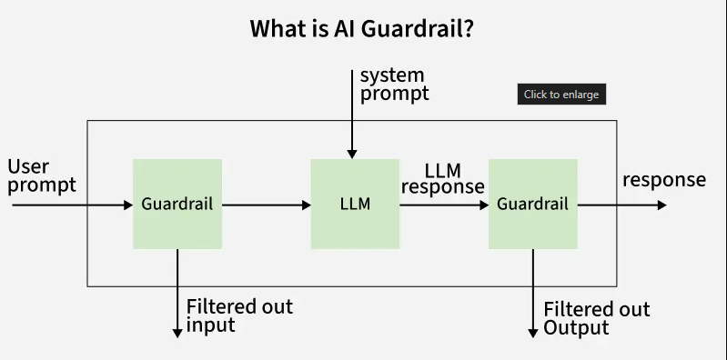

Slide 280
Is Prompt Engineering Enough?
Prompt engineering, carefully designing inputs to steer AI outputs, can influence AI behavior but isn’t a full solution. It’s like giving a driver verbal directions but no road signs. Guardrails outperform prompt engineering by:
Applying consistent rules across all inputs, not just specific prompts.
Addressing systemic issues, like model biases, that prompts can’t resolve.
Enforcing ethical and safety standards universally.
While prompt engineering is a useful tool, guardrails provide the robust, scalable control AI systems need.

Slide 281
How Do AI Guardrails Work?
AI guardrails constantly monitors both the input and output of AI systems.
They rely on predefined rules and algorithms such as finetuned models or pipelines to detect potentially problematic content or behavior.
This real time monitoring allows for immediate intervention when necessary, ensuring that the AI system operates within acceptable boundaries.

Slide 282
AI guardrails can be implemented through a combination of:
Rule-Based Filters: Simple checks that block or flag specific words, phrases or patterns.
Algorithmic Monitoring: Machine learning models that detect anomalies or risky behavior in real time.
Policy Integration: Embedding organizational or regulatory guidelines into the AI’s operational logic.
Human Oversight: Involving human reviewers for edge cases or high-risk scenarios.

Slide 283
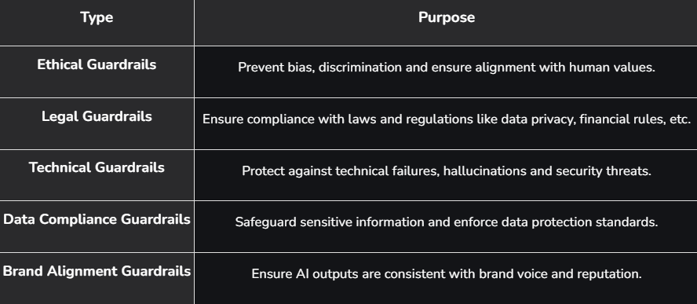
Types of AI Guardrails

Slide 284
Banking Industry
An American banking chatbot might be asked for investment advice. In this case:
Ethical and legal guardrails ensure the bot does not provide unauthorized financial advice.
The system complies with financial regulations like FINRA preventing regulatory breaches.

Slide 285
Types of AI Risks Protected by Guardrails
Guardrails address a spectrum of risks:
Bias and Discrimination: Prevent unfair outcomes, like rejecting loan applications based on gender or race.
Misinformation: Stop AI from generating or spreading false information.
Safety Hazards: Avoid dangerous recommendations, such as incorrect medical advice.
Privacy Violations: Protect user data from unauthorized access or leaks.
Ethical Missteps: Ensure AI doesn’t promote harmful ideologies or actions.

Slide 286
Why Do AI Guardrails Matter for Businesses?
Implementing AI guardrails is crucial for several reasons:
Risk Mitigation: Prevents AI from generating harmful, biased or non-compliant outputs.
Regulatory Compliance: Ensures adherence to industry-specific regulations and reducing legal risks.
Data Protection: Safeguards sensitive and personal information from unauthorized exposure.
Brand Protection: Maintains consistency with company values and public image.
Operational Efficiency: Enables safe, reliable and scalable AI deployment leading to better business outcomes

