Slide 1

Driver Drowsiness Detector Using Quantum Computing
by
C.PREMALATHA
Roll No. 224G1A0577
E.MANJULA
Roll No. 234G5A0506
M.RANJITH KUMAR
Roll No. 234G5A0512
Under the guidance of
Mr. G. Chinna Pullaiah , M. Tech., Ph.D.
Assistant Professor
Department of Computer Science and Engineering
Srinivasa Ramanujan Institute of Technology
Autonomous
Rotarypuram Village, B K Samudram Mandal, Ananthapuramu – 515701.
2024-2025
B-20
1

Slide 2
Contents
Driver Drowsiness Detector Using Quantum Computing
Title Justification
Abstract
Problem statement
Objectives of Project
Literature survey for objectives
Proposed Work -(Methods to be followed for proposed system)
References
GitHub Link
Queries
Srinivasa Ramanujan Institute of Technology

Slide 3
Title Justification
Driver Drowsiness Detector Using Quantum Computing
The title “Driver Drowsiness Detection System” is appropriate because it clearly represents the main aim of the project, which is to identify when a driver becomes sleepy while driving. Drowsiness is one of the major causes of road accidents, and detecting it early can help prevent serious incidents. This system continuously monitors the driver’s eye movements and facial patterns in real time. By using computer vision and machine learning techniques, it accurately identifies signs of fatigue. The title reflects both the purpose and the technology used in the project. It highlights the focus on improving road safety and reducing human errors. The system provides timely alerts to the driver, helping them stay awake and aware. Overall, the title is short, meaningful, and directly communicates the project’s main function and significance.
Srinivasa Ramanujan Institute of Technology

Slide 4
Abstract
Driver Drowsiness Detector Using Quantum Computing
Driver drowsiness is a major cause of road accidents, creating a need for effective real-time monitoring systems. This project presents a non-intrusive, vision-based approach that uses facial landmarks, CNN-based feature extraction, and a Variational Quantum Circuit (VQC) classifier to detect early signs of fatigue. Live video from a webcam is analyzed to classify the driver as awake or drowsy, and automatic alerts—such as audio alarms and email notifications—are triggered when drowsiness is detected. Although detailed numerical results are not included, the system successfully demonstrates real-time detection and highlights the potential of hybrid quantum–classical models for improving safety in driver-assistance applications.
Keywords:Driver Drowsiness Detection, Computer Vision, Facial Landmark Detection, Hybrid Quantum–Classical Model, Convolutional Neural Network (CNN), Real-Time Alert System.
Srinivasa Ramanujan Institute of Technology

Slide 5
Problem Statement
Driver Drowsiness Detector Using Quantum Computing
Driver drowsiness is a major cause of road accidents, leading to reduced alertness, slower reaction time, and increased risk of fatal collisions.
Traditional monitoring systems fail to provide accurate and real-time detection, especially in low-light conditions, varying facial features, and dynamic driving environments.
There is a growing need for an intelligent, non-intrusive, and reliable drowsiness detection system that can analyze facial cues and alert drivers instantly.
Real-time alert mechanisms such as audio alarms and automated email notifications are essential to prevent accidents by warning both the driver and external contacts
Srinivasa Ramanujan Institute of Technology

Slide 6
Objectives of Project
Driver Drowsiness Detector Using Quantum Computing
Objective 1:
To develop an intelligent real-time driver drowsiness detection system using a hybrid quantum–classical deep learning model, based on facial expressions and eye-based feature analysis to accurately identify fatigue conditions.
Objective 2:
To design and implement an automated alert mechanism that immediately warns the driver through audio alarms and notifies external contacts via SMTP-based email notifications, thereby preventing potential road accidents.
Srinivasa Ramanujan Institute of Technology

Slide 7
Driver Drowsiness Detector Using Quantum Computing
Literature survey for objectives
◻
Authors | Year | Objective Linked | Main Contribution | Research Gap
Dhasarathan | 2025 | Objective 1 | Optimized deep-learning models using TensorRT for real-time detection on edge devices. | Focused on speed, but accuracy under low-light conditions not addressed.
Hassan | 2025 | Objective 1 | Proposed transformer-based models for highly accurate real-time drowsiness detection. | High computational cost; not suitable for low-power onboard vehicle systems without optimization.
Archita Bhanja | 2025 | Objective 1 | Developed a MobileNet-based real-time system that classifies open/closed eyes with high accuracy and integrates it into a live camera application for detecting driver drowsiness. | Does not use additional physiological signals and needs more advanced models for better accuracy in varied lighting and driver positions.
Mohammad Abu Alsheikh | 2025 | Objective 1 | Proposed a privacy-preserving federated learning framework with Spatial Self-Attention and LSTM for accurate drowsiness detection on decentralized facial data, achieving 89.9% accuracy. | Does not include physiological signals; future work could explore multimodal fusion and improved real-time deployment under diverse conditions.
Anupam Yadav | 2025 | Objective 1 | Optimized CNNs for EEG-based drowsiness detection using human-inspired algorithms (TLBO and SPBO), achieving high predictive performance with efficient training. | Limited to EEG signals; multimodal integration and real-time deployment remain unexplored.
Srinivasa Ramanujan Institute of Technology

Slide 8
Proposed System
Driver Drowsiness Detector Using Quantum Computing
To overcome the limitations of traditional drowsiness detection methods, the proposed system integrates computer vision with a hybrid quantum–classical deep learning model to accurately identify early signs of driver fatigue in real time.
The system captures live video using a webcam, extracts facial and eye features using CNN-based processing, and performs final classification through a Variational Quantum Circuit for improved decision accuracy.
When drowsiness is detected, the system automatically triggers an audio alert for immediate driver awareness and sends an SMTP email notification to registered contacts as an external safety measure.
The proposed system is fully automated, non-intrusive, and capable of continuous monitoring, ensuring enhanced reliability and faster response during fatigue-related incidents.
Srinivasa Ramanujan Institute of Technology

Slide 9
References
Driver Drowsiness Detector Using Quantum Computing
Dhasarathan, C., Gnanasekaran, S., Pattanayak, A., Kumar, G., Vig, K., Narain, V., ... & Garg, S. (2025). TensorRT optimized driver drowsiness detection system using edge device. Ain Shams Engineering Journal, 16(10), 103620.
Hassan, O. F., Ibrahim, A. F., Gomaa, A., Makhlouf, M. A., & Hafiz, B. (2025). Real-time driver drowsiness detection using transformer architectures: a novel deep learning approach. Scientific Reports, 15(1), 17493
Archita Bhanja, D., Parhi, D., Gajendra, D., Sinha, K., & Sahoo, A. K. (2025). Driver Drowsiness Shield (DDSH): Real-time eye-state classification for drowsiness detection. Scientific Reports, 15(1), 11234..
Mohammad Abu Alsheikh, T. V. Khoa, D. H. Son, Y. F. Alem, & D. T. Hoang. (2025). Privacy-preserving driver drowsiness detection with spatial self-attention and federated learning. IEEE Transactions on Intelligent Transportation Systems. (Submitted)s
Yadav, A., Kumar, R., Singh, P., & Sharma, V. (2025). Enhancing convolutional neural networks in electroencephalogram driver drowsiness detection using human-inspired optimizers. Scientific Reports, 15(1), 14567.
Srinivasa Ramanujan Institute of Technology

Slide 10
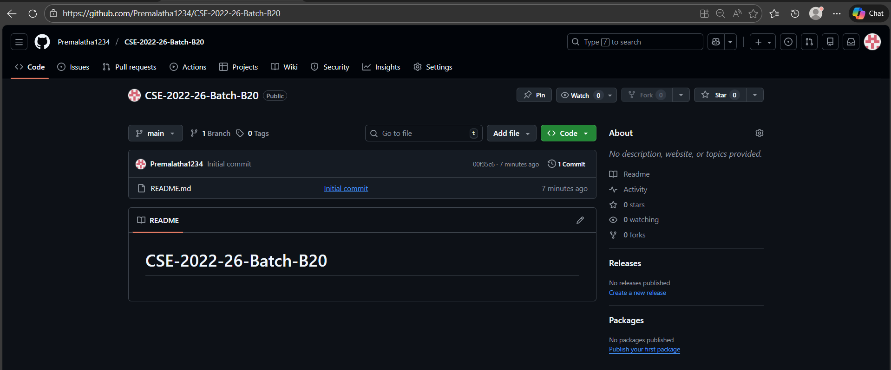
Git Hub Dashboard
Driver Drowsiness Detector Using Quantum Computing
link of the Github: Premalatha1234/CSE-2022-26-Batch-B20
Srinivasa Ramanujan Institute of Technology

Slide 11
Any Queries?
Driver Drowsiness Detector Using Quantum Computing
Srinivasa Ramanujan Institute of Technology

