Slide 1
EMAIL SPAM CLASSIFICATION USING MACHINE LEARNING
PRESENTED BY:PREMA.M
REGISTER NO:613521104029
DEPARTMENT:COMPUTER SCIENCE AND ENGINEERING

Slide 2
PROJECT TITLE
EMAIL SPAM CLASSIFICATION

Slide 3
AGENDA
Introduction
Problem definition
Dataset Overview
Data Preprocessing & Vectorization
Machine Learning Algorithms
Proposed System
Conclusion

Slide 4
INTRODUCTION
Spam emails also referred to as spam are junk emails. They are sent in bulk for commercial purposes. Spam emails can also be dangerous. It can include malicious links that can infect your computer with malware or phishing attacks.

Slide 5
PROBLEM DEFINITION
Each email provider has their own filtering system or technique, but most of them don't work to their full capacity.
The cyberpunks use emails to obtain valuable credentials.
There is no integrated approach for classifying and filtering a mail as a spam or a legitimate.
Data intergration is a preprocessing technique that involves combining data.

Slide 6
Data Oveview
spam ham dataset.csv' dataset used in the code.
Contains labeled examples of spam and ham emails.

Slide 7
DATA PREPROCESSING & VECTORIZATION
Data Splitting:
Dataset split into 80% training and 20% testing sets.
Random state 42 for reproducibility.
Vectorization:
Count Vectorizer converts text data. into numerical feature vectors.
Training and testing data transformed using CountVectorizer.

Slide 8
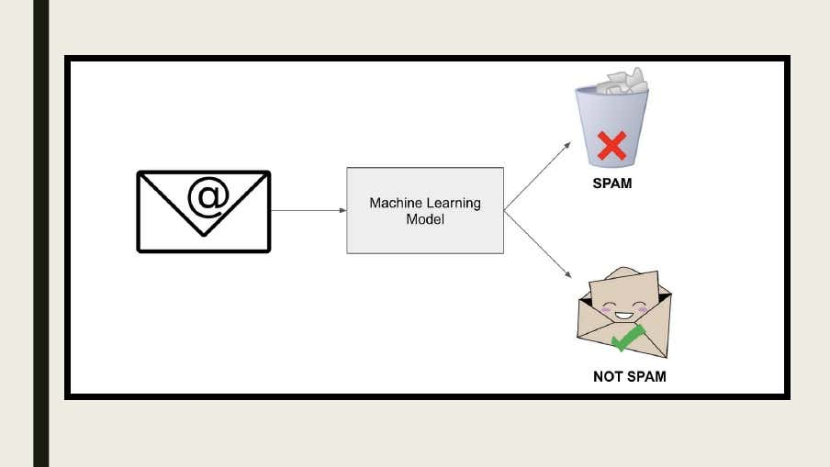

Slide 9
MACHINE LEARNING ALGORITHMS
Explore the power of machine learning in identifying email spam. Understand the role of algorithms in automated classification and their impact on efficiency.

Slide 10
PROPOSED SYSTEM
Spam Classification system can distinguish spam from non-spam emails based on a self-leurning algorithm.

Slide 11
NAIVE BAYES CLASSIFIER
Training: MultinomialNB classifier trained with vectorized training data.
Prediction: Naive Bayes predicts labels for the test data
Accuracy Calculation: accuracy score metric used to evaluate Naive Bayes accuracy.

Slide 12
LOGISTIC REGRESSION CLASSIFIER
Training: Logistic Regression classifier trained with vectorized training data.
Prediction: Logistic Regression prodiets labels for the test data.
Accuracy Calculation: accuracy score metric used to evaluate Logistic Regression accuracy.

Slide 13
K NEAREST NEIGHBORS
K Nearest Neighbors algorithm is a non-parametric method used for pattern classification. It is an instance-based learning algorithm.
We directly calculate the k nearest neighbors for each data point in the testing dataser. Then among these k valves, we calculate whether the email is mostly classified as ham or spam.
If majority of the k neighbors are classified as spam, the data point or the instance is classified as spam. Otherwise it is classified as harn.
Then we move on to calculate the accuracy by cheeking the value of the ham/spam to the original class value.

Slide 14
EMAIL PREDICTION
Sample test spam and ham ensails used for prediction.
Display predicted labels for the test spam and ham emails.

Slide 15
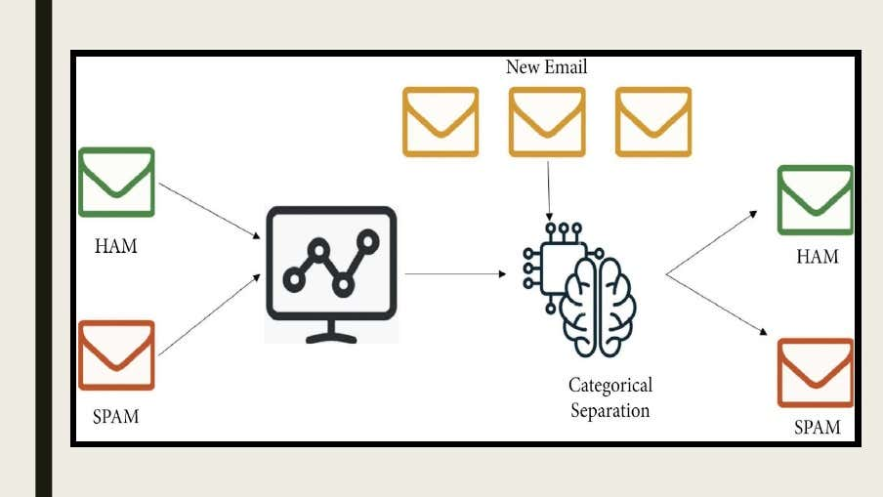

Slide 16
CONCLUSION
In conclusion, effective spam classification is pivotal for optimizing email efficiency and security. By leveraging advanced techniques and technologies, organizations can achieve significant improvements in productivity and protection.

Slide 17
Thanks!

