Slide 1


SMART INDIA HACKATHON 2024
Geeks Learning Platforn(GLP)
Problem Statement ID – 1586
Problem Statement Title- Student Innovation
Theme- Smart Education
PS Category- Software
Team ID-
Team Name (Registered on portal)

Slide 2






SMART EDUCATION SYSTEM
Green Greeks
Smart Education, a Concept that Describes learning in digital age.it enables learner to learn more effectively,efficently,flexibly and comfortably.
Provides personalized, adaptive, and engaging learning experiences for students
Offers advanced tools for teachers to optimize instructional methods
Gives administrators data-driven insights to inform decision-making
Personalizing Learning: Tailored learning pathways for each student
Making Learning Accessible: Learn anywhere, anytime, on any device
Fostering Collaboration: Real-time interaction with peers and teachers
Developing 21st-Century Skills: Critical thinking, problem-solving, and creativity
Improving Efficiency: Reducing administrative burdens on teachers
AI-Powered Adaptive Learning: Tailored education for each student
Immersive Virtual Learning: Engaging and interactive learning experiences
Real-Time Analytics: Instant feedback and optimization for teachers
Personalized Learning Paths: Unique learning paths for each student
Gamification and Incentives: Motivating students to learn

Slide 3
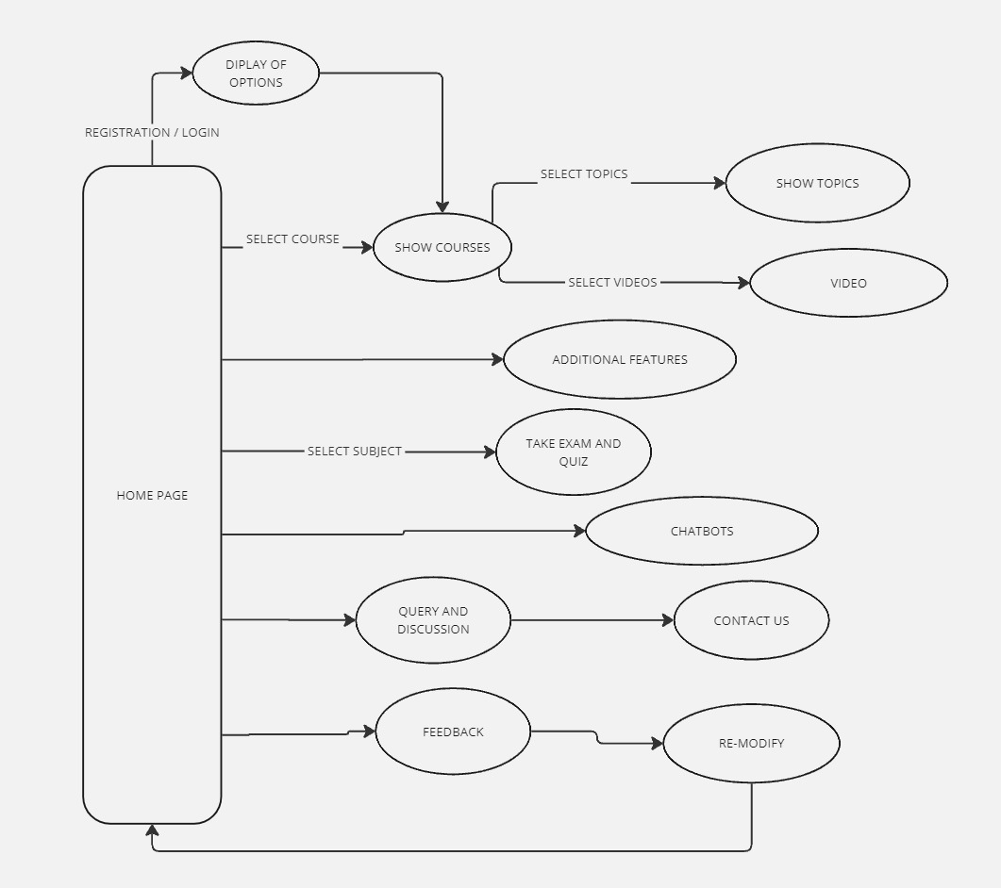



TECHNICAL APPROACH
Green Greeks
PROGRAMING LANGUAGE:
CSS3
HTML5
JAVASCRIPT
FRAMEWORKS:
BOOTSTRAP or MATERIAL-UI
BACKEND TECHNOLOGIES:
PHP
DATA BASE
MySQL
Methodology and process for implementation (Flow Charts/Images/ working prototype)

Slide 4














FEASIBILITY AND VIABILITY
Green Greeks
Technical: AI and virtual reality technologies are available to support ILP.
Financial: Initial investment required, but scalable and financially viable.
Operational: Can be implemented with minimal disruption, with training and support provided.
Market: Growing demand for smart education solutions, with ILP's unique features providing a competitive advantage.
Overall: ILP is a feasible idea with potential benefits in smart education.
Potential challenges and risks
Technical Challenges:
AI Bias: Ensuring AI algorithms are free from bias and provide fair assessments.
Data Security: Protecting sensitive student data and ensuring platform security.
Implementation Challenges:
Teacher Buy-In: Gaining teacher acceptance and buy-in for the new platform.
Infrastructure: Ensuring adequate infrastructure and internet connectivity in schools.
Financial Risks:
Initial Investment: High upfront costs for development and implementation.
Subscription Model: Ensuring a sustainable subscription model that appeals to schools and students.
Strategies for overcoming these challenges
Technical:
Diverse Data Sets: Use diverse data sets to train AI algorithms and minimize bias.
Encryption and Access Controls: Implement robust encryption and access controls to ensure data security.
Implementation:
Teacher Training: Provide comprehensive training and support for teachers to ensure successful adoption.
Pilot Programs: Launch pilot programs to test and refine the platform before scaling up.
Financial:
Phased Rollout: Implement a phased rollout to manage costs and ensure a sustainable business model.
Partnerships: Form partnerships with educational institutions and organizations to share costs and resources.

Slide 5








IMPACT AND BENEFITS
Green Greeks
Potential impact on the target audience
Students:
Personalized learning
Improved engagement
Better outcomes
Teachers:
Efficient instruction
Data-driven instruction
Professional development
Parents:
Increased involvement
Better communication
Improved outcomes
Education System:
Increased efficiency
Improved quality
Scalability
Benefits of the solution (social, economic, environmental, etc.)
Social: Increases accessibility to quality education globally.
Economic: Reduces costs for physical infrastructure and expands learning opportunities.
Environmental: Lowers paper usage and reduces the need for transportation, cutting emissions.
Flexibility: Enables learning anytime, anywhere, supporting diverse learning needs.

Slide 6
RESEARCH AND REFERENCES
Green Greeks
Details / Links of the reference and research work:
https://slejournal.springeropen.com/articles/10.1186/s40561-016-0026-2
https://www.sciencedirect.com/science/article/pii/S1877050918308275
https://unesdoc.unesco.org/ark:/48223/pf0000383678
https://link.springer.com/book/10.1007/978-3-319-19875-0
https://www.researchgate.net/publication/338886125_Smart_Education_Literature_A_theoretical_analysis
https://india.theiet.org/media/1245/smart-education.pdf

