Slide 1

SECURING PATIENT INFORMATION THROUGH WAVELET BASED STEGANOGRAPY
Project Guide:Mr . A. ARAVINDAN@
SIVAKUMAR.
Project Members :
BOOSHAN.M (10T06308)
PREMARASSAN.M(10T06348)
VENUGOBAL.M (10T06375)

Slide 2
OVERVIEW
Objective
Introduction
Block diagram
Full description
Phase I output
Conclusion for Phase I
Working Plan For Phase II
References

Slide 3
OBJECTIVE
To increase the protection for transmitting the patient report and decrease the distortion of the data to less than 1%.

Slide 4
INTRODUCTION
In present environment ,patients are suffering from an unsecured confidential medical information.
The patients information is transmitted in a secured way through ECG based wavelet steganography.
The effectiveness of this technique on ECG signal has two distortion measurement metrics have been used ,the percentage residual difference (PRD) & the Wavelet weighted PRD.

Slide 5
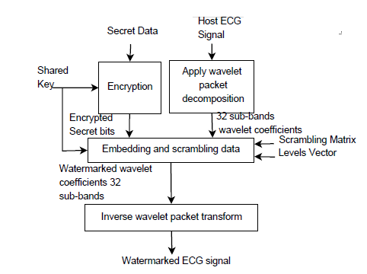
BLOCK DIAGRAM FOR PHASE -I

Slide 6
DESCRIPTION
The secret data consists of patient report such as Iris scanning, Ecg signal, patient details is transmitted.
The patient information is encrypted
And the encrypted message can be decrypted by using a same secret key.

Slide 7
Cntd
By using Wavelet Decomposition Method the ECG signal is decomposed to 32 sub bands.
A shared key will be known for the sender and receiver in order to protect the data with high security.
The information data of the patient can be encrypted by using a permutation cipher

Slide 8
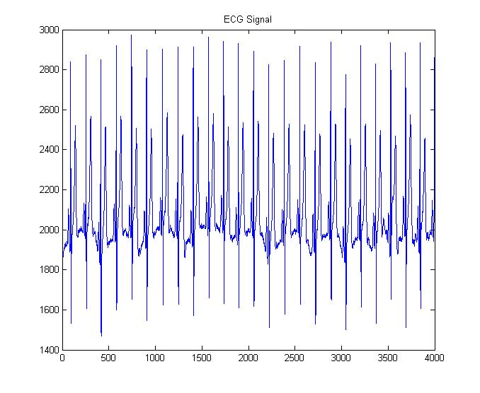
WAVELET DECOMPOSTION OF ECG
PHASE I -OUTUPUT

Slide 9
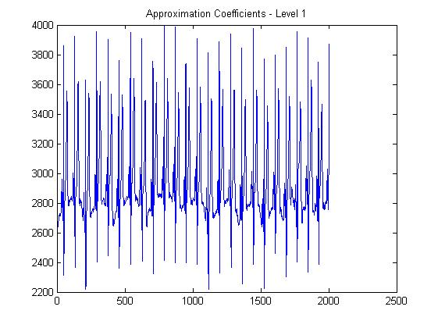
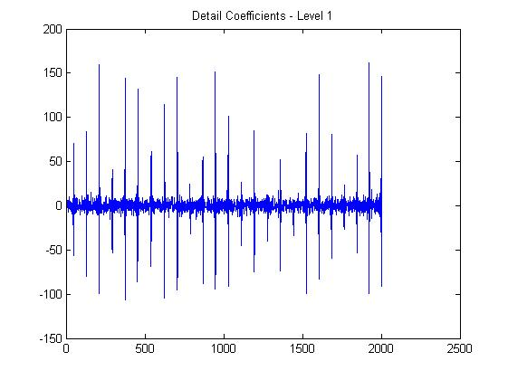
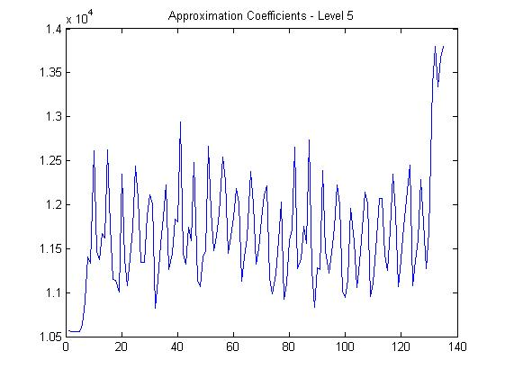
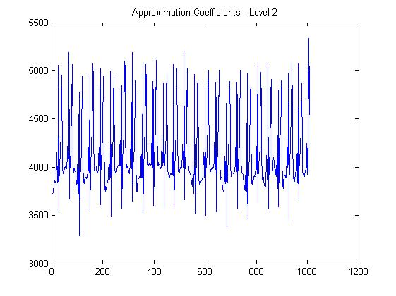
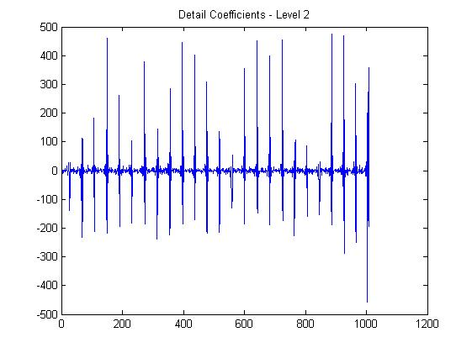
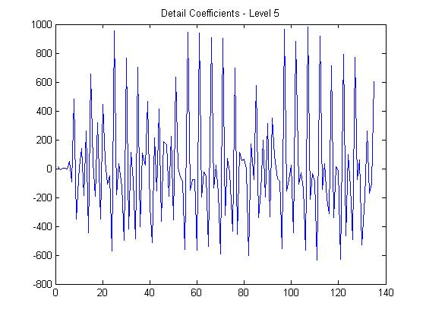
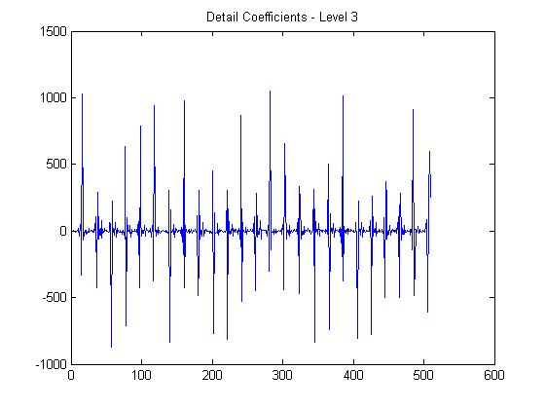
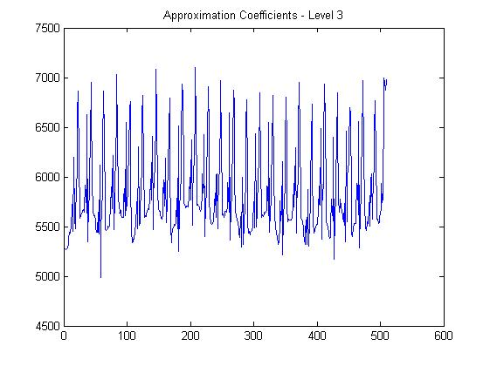

Slide 10
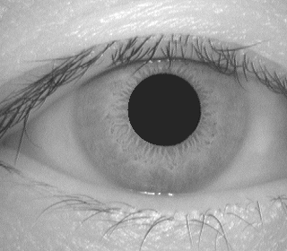

Encrypted image

Slide 11
ENCRYPTION PROCESS
bosch
Key=(0-1023):29
@ðÌã
PLAIN TEXT→
CIPHER TEXT →

Slide 12
CONLUSION FOR PHASE I
Thus the ECG signal and other patient information is collected and the data is converted into cipher text and it is ready to transmit over public network .

Slide 13
WORK PLAN OF PHASE II
The transmitted patient information is embedded inside the ECG host signal and it can be decrypted with high security protection through steganography.

Slide 14
REFERENCES
[1] Ayman Ibaida, Ibrahim Khalil,” Wavelet Based ECG Steganography for Protecting Patient Confidential Information in Point-of-Care Systems,”IEEE Transacions on biomed eng . may 21,2013.
[2] Y. Lin, I. Jan, P. Ko, Y. Chen, J. Wong, and G. Jan, “A wireless PDA-based physiological monitoring system for patient transport,” IEEE Transactions on information technology in biomedicine, vol. 8, no. 4,pp. 439–447, 2004.
[3] F. Hu, M. Jiang, M. Wagner, and D. Dong, “Privacy-preserving telecardiology sensor networks: toward a low-cost portable wireless hardware/ software codesign,” IEEE Transactions on Information Technology in Biomedicine,, vol. 11, no. 6, pp. 619–627, 2007.
[4] A. Ibaida, I. Khalil, and F. Sufi, “Cardiac abnormalities detection from compressed ECG in wireless telemonitoring using principal components analysis (PCA),” in 5th International Conference on Intelligent Sensors,Sensor Networks and Information Processing (ISSNIP), 2009. IEEE,2010, pp. 207–212.

Slide 15
THANK YOU

