Slide 1


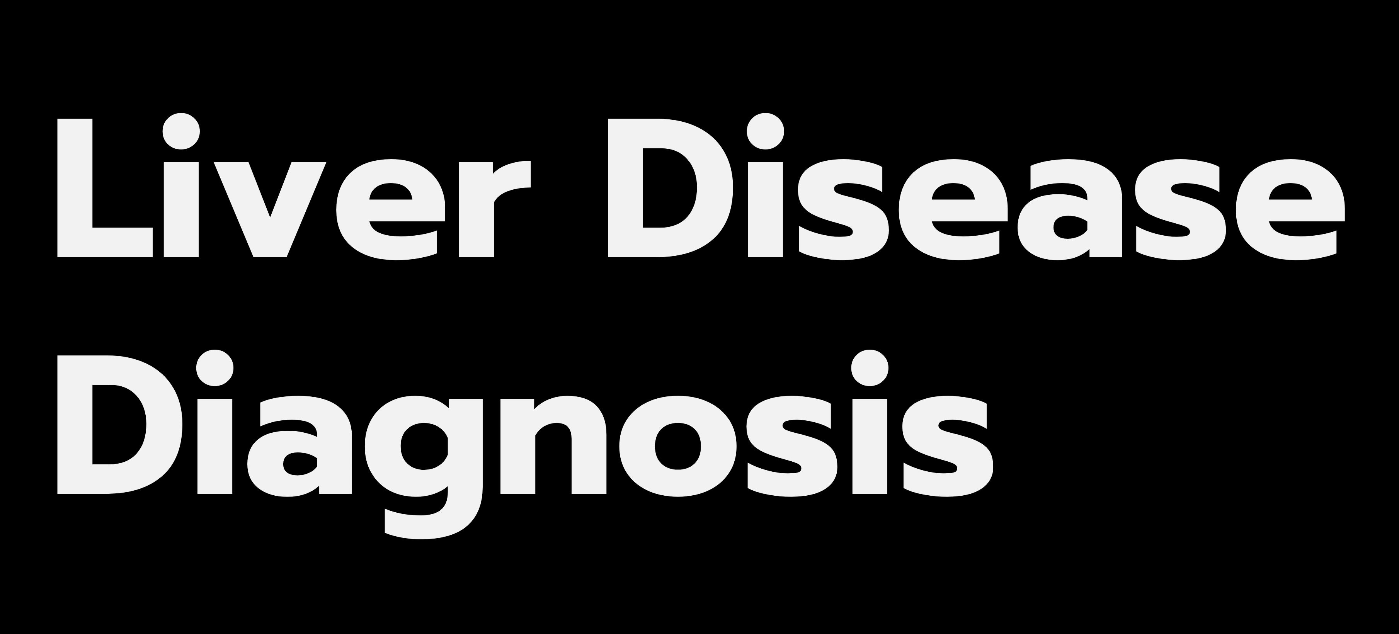

CSCI-6660-02
TEAM STAKK:
Prem Deep Lankam Setty
Kuladeep Sai Nallani
Sai Ganesh Takkellapati
University of New Haven West Haven, CT

Slide 2

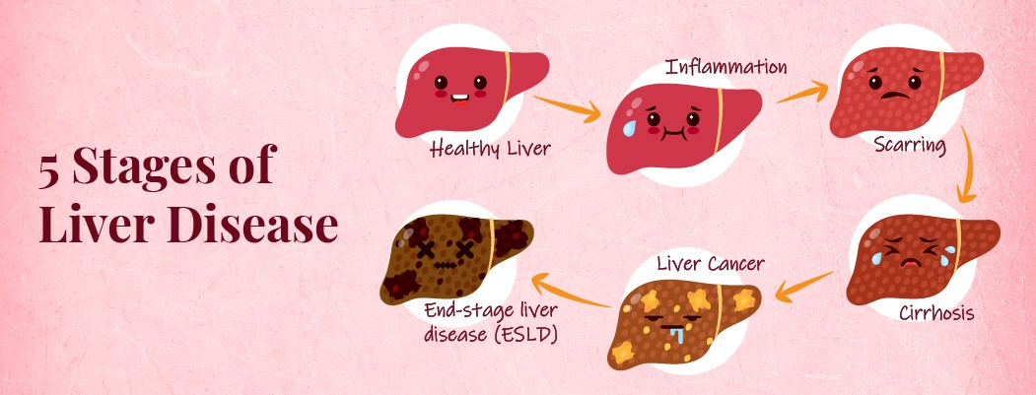
Source: https://www.relainstitute.com/blog/liver-disease-5-stages-of-progression
3

Slide 3
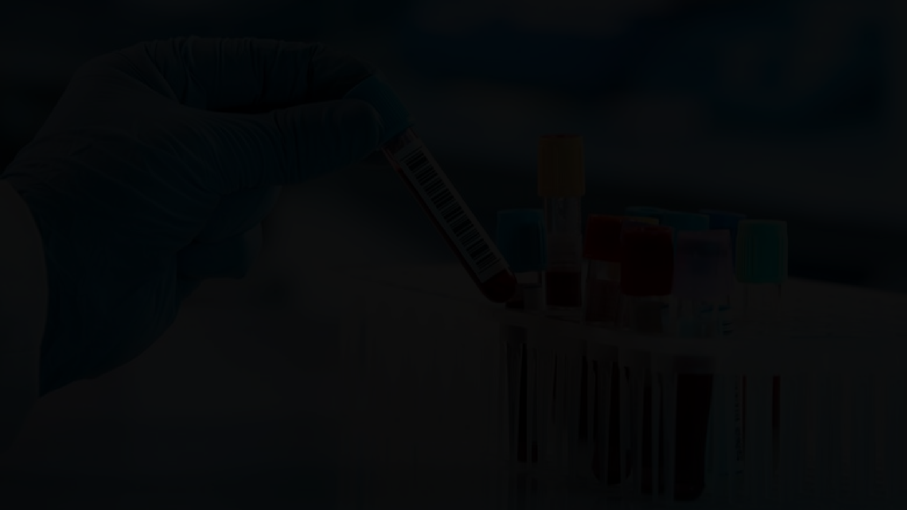

Objective
Use blood test results paired with historical patient data and demographics to predict the presence of liver disease.
4

Slide 4

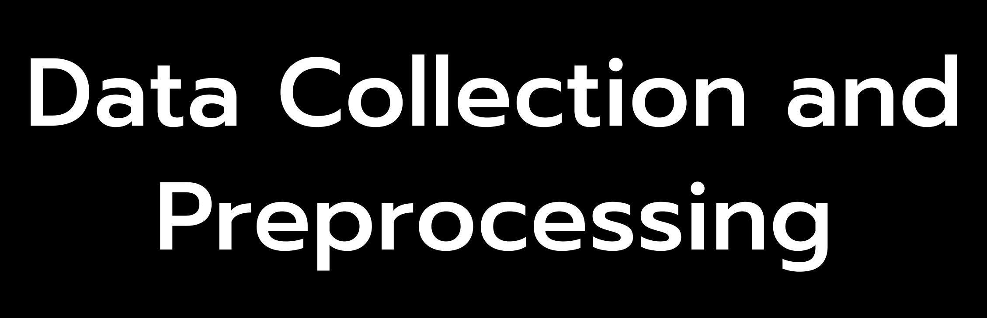


Project Plan
Build a liver disease classification model
5

Slide 5

Dataset - Liver Patients
583 patients record (416 liver patient, 167 non liver patient)
Age Gender
Total Bilirubin Direct Bilirubin
Alkaline Phosphotase Alamine Aminotransferase Aspartate Aminotransferase Total Proteins
Albumin
A/G Ratio Albumin and Globulin Ratio Diagnosis
Source: UCI- ILPD (Indian Liver Patient Dataset)
6

Slide 6
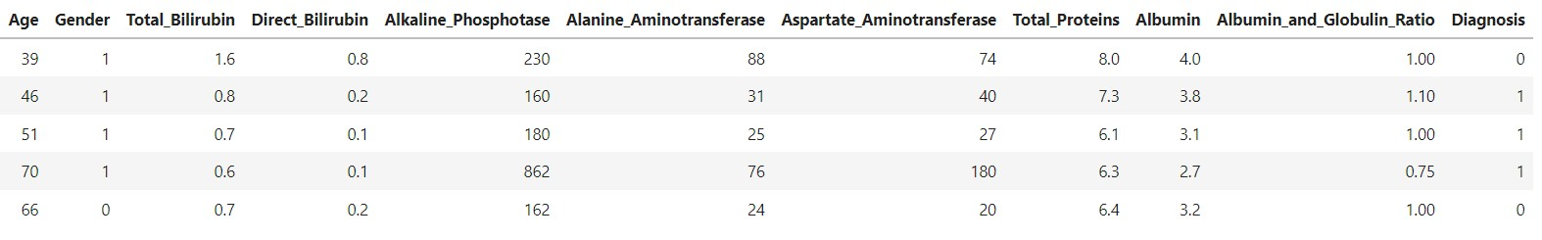
Dataset sample

Slide 7









Training a classification model
Liver Disease (1)
Classification model
Train data
No Liver Disease (0)
.csv data (Age, gender, blood tests)
Test data
Preprocessing
Diagnosis

Slide 8
The most used machine learning algorithms for diagnosing and predicting liver disease are 1. K-Nearest Neighbors (KNN) 2. Random Forest 3. Support Vector Machines (SVM)
EVALUTION METHODOLOGY

Slide 9
Screening and Diagnosis
Look for symptoms such as fatigue, gastrointestinal bleeding, jaundice, abdominal pain.
Imaging techniques such as Ultrasound and CT scans.
Series of blood tests such as cellular enzymes, albumin, bilirubin and proteins.
4

Slide 10
Problem
Most patients are asymptomatic.
Doctors have limited findings suggestive of the presence of the liver disease.
4

Slide 11


Data Preprocessing
Filled null values with mean of the column Label-encoded feature variables
Feature Selection using Pearson Coefficient Feature Scaling Oversampling for imbalanced dataset
CSV Dataset
Train
Test
80% Data
20% Data

Slide 12




Trained and evaluated classification models
Liver Disease Classifier
Deployed the model with highest accuracy

Slide 13


Classification Model
Model
Logistic Regression Support Vector Classifier Random Forest Classifier
K-Nearest Neighbours Classifier
Accuracy
76.57%
77.71%
76.57%
70.28%

Slide 14






Deployment
Deployed the application using Streamlit
Open-source app framework for Machine Learning and Data Science
Automatically gets deployed as the GitHub repository is updated.
Application code
+ =
Deployed Application
Cloud
12

Slide 15
Future Improvements
Collaborate with healthcare professionals for feedback Collect more data such as previous medications, alcohol consumption, and family history of liver disease.
Engineer new features
Tune hyperparameters for the modeling algorithm
12

Slide 16
THANK YOU !

