Slide 1
Particle Fluids for Blender Tutorial
Premium Graphics

Slide 2
画面構成

Slide 3
Simulation Workflow
CreateSource
ParticleSystem

Slide 4
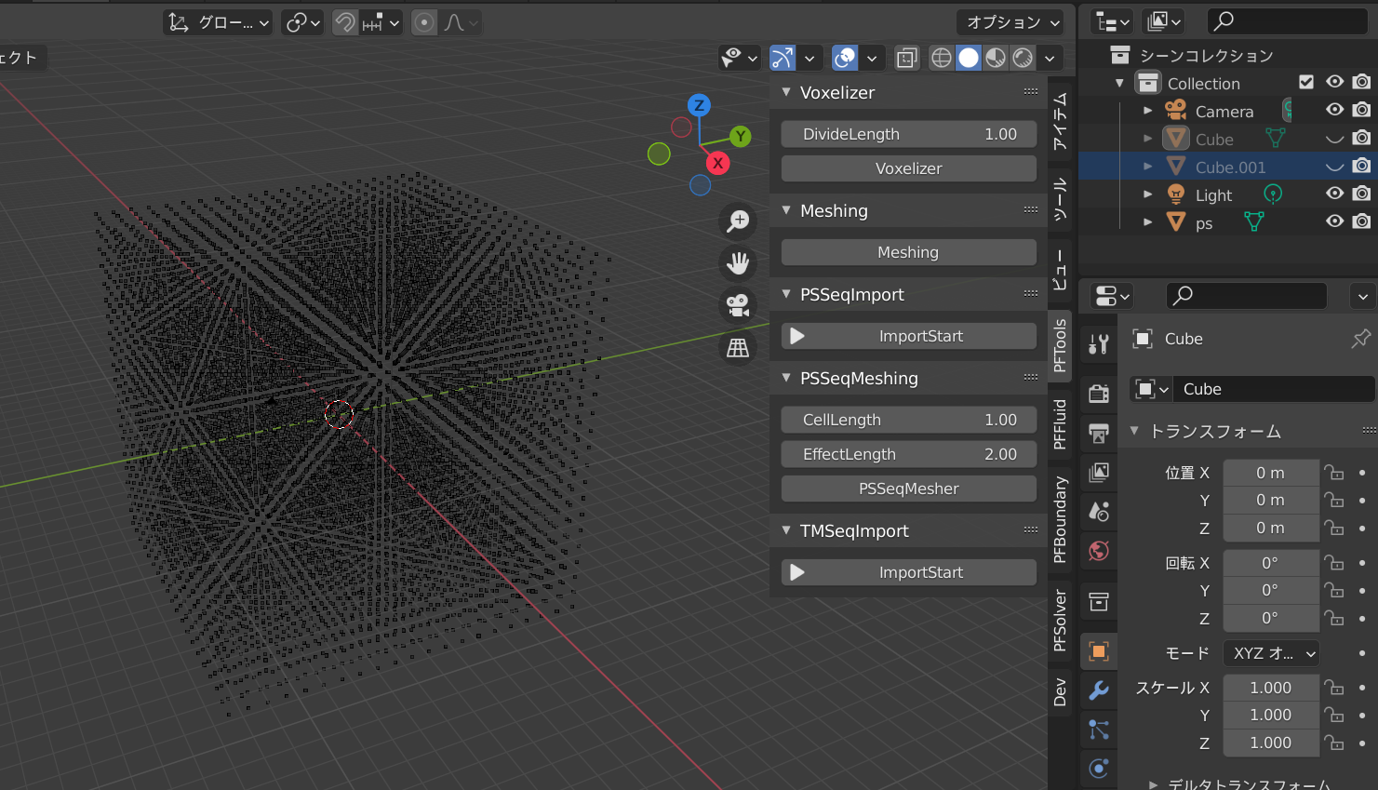
Create Mesh

Slide 5
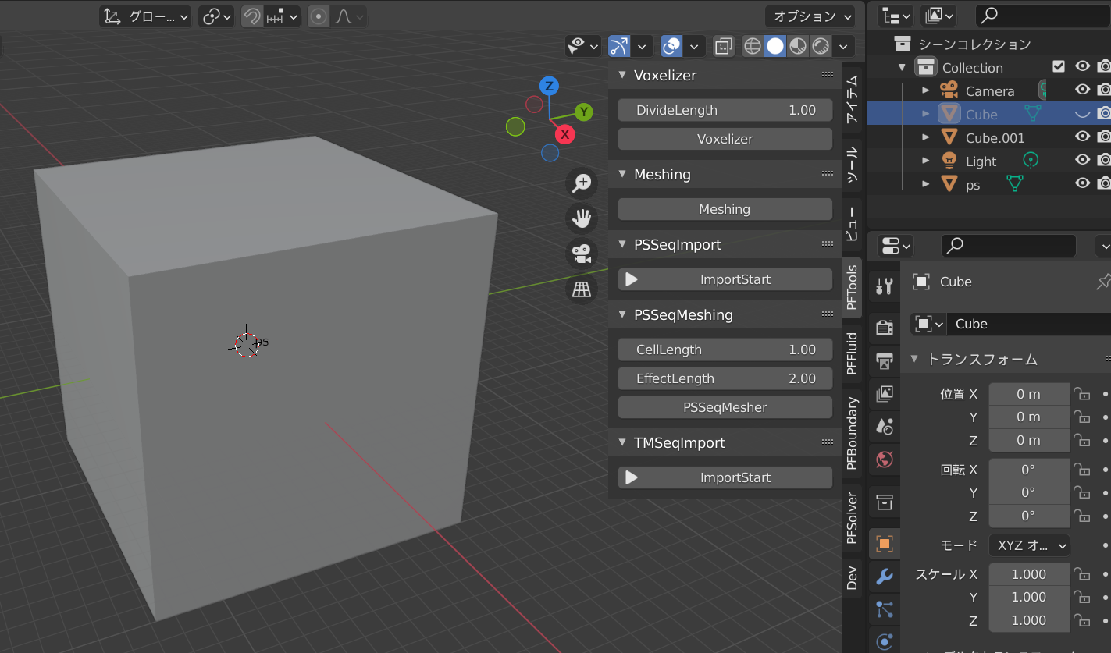
Voxelizer
A simple tool to convert mesh to particle system

