Slide 1
SCHOOL MANAGEMENT SYSTEM
Presented by: S.PREM KUMAR
Enrollment No: EBEON03251076652
Batch : 2024-14789

Slide 2
Objective
• To implement (OOP) object-oriented programming concepts like classes, inheritance, encapsulation and use Java Collections (like ArrayList) for managing real-world data in a simple and organized manner.
• To stimulate a School Management System that
Efficiently handles student records, teacher details and financial transactions (including student fees payments and teacher salary expenses) using core java techniques.

Slide 3
System Architecture
Main.java : Handles user input and application flow.
School.java : Tracks money earned and spent.
Student.java : Manages student details and fee payments.
Teacher.java : Manages teacher details and salary payments.

Slide 4
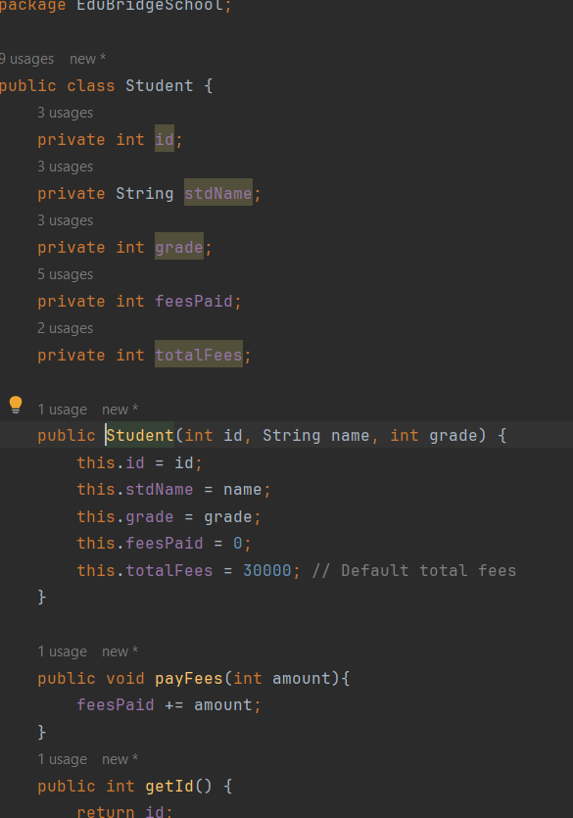
Class - Student.java
Attributes: stdName, id, grade, feesPaid, totalFees
Methods: enroll(), payFees(),

Slide 5
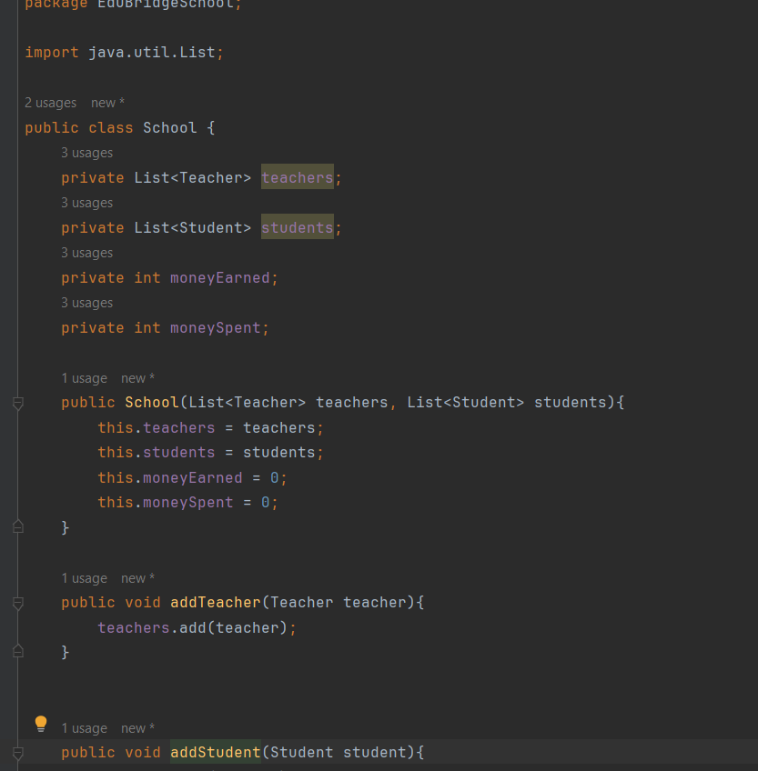
Class - School.java
Maintains lists and IDs for teachers and students, and calculates total money earned and spent

Slide 6
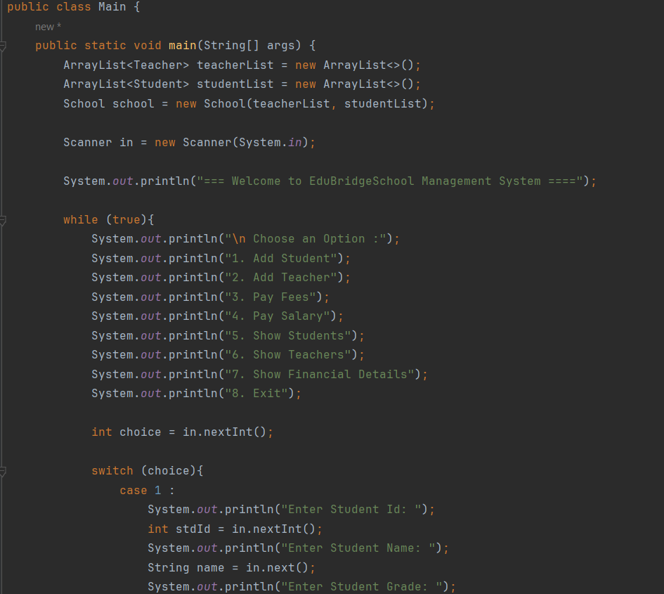
Main.java – User Interaction
Displays a menu using switch-case, handles user input, and directs actions accordingly

Slide 7
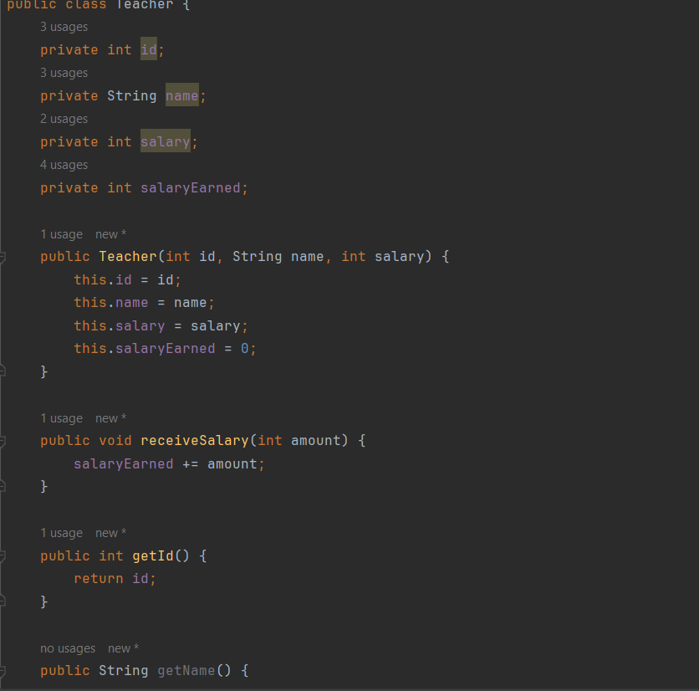
Class – Teacher.java
Encapsulates teacher details (ID, name, salary) and manages salary transactions, updating school expenses

Slide 8
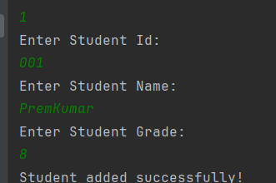
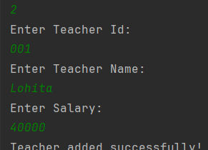
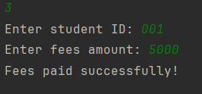
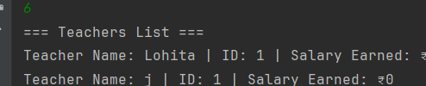

Output

Slide 9
Features
Student Fee Processing
Teacher Salary Management
Financial Tracking of School
Object-Oriented Design Approach
Basic Report Generation

Slide 10
OOP Concepts Used
Encapsulation: uses private fields with public getters/setters for data protection.
Objects: Represents real world entities like School, Student and Teacher.
Reusability: Seperates logic into modular, reusable components.
ArrayList: Manages dynamic collections of data.

Slide 11
Conclusion
• Built a working console-based school Management system
• Applied Java fundamentals effectively

